Slide 1

IBM Capstone Project
Analysis of Cities in Taiwan

Slide 2
Business Problems
Which city in Taiwan is the most comfortable for living?
Visualizing the landmark for visiter.

Slide 3
Data and Methodology
Collect the List of cities in Taiwan from Wiki
Find the size of the poplation and area
Locate these cities with latitude and longitude
Using Foresquare to locate the landmarks(restaurant, shop, night club, school, transportation)

Slide 4
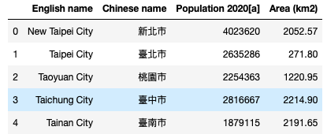
Data from Wiki

Slide 5
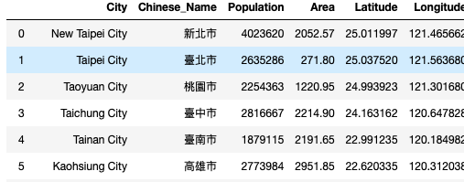
Add the Location Information

Slide 6
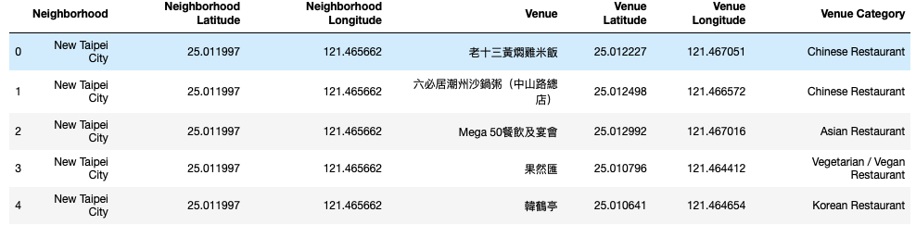
List of the landmarks in Cities

Slide 7
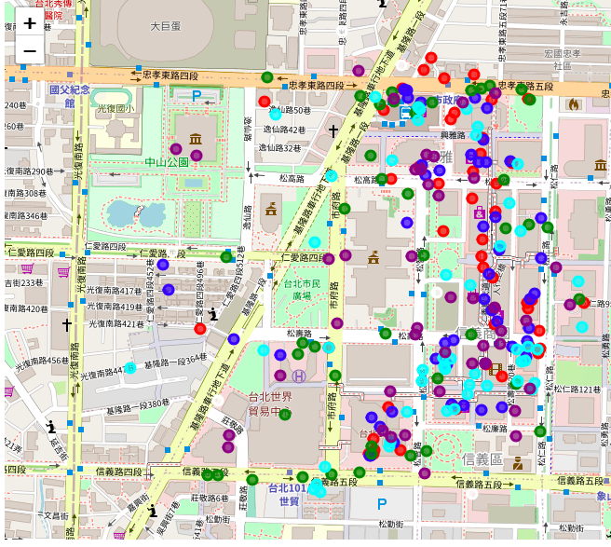
Visulization the Landmarks

