Slide 1

Microprocessor Systems
Lab3 - I²C Introduction & SSD1305 OLED & MPU6050
Prof. Ren-Shuo Liu
NTHU EE

Slide 2
Outline
I²C
  I²C Introduction
  Data Transfer Method
SSD1305 OLED
  SSD1305 Block Diagram
  GDDRAM
  Data Format
MPU6050
  MPU6050 Introduction
  Application
  Gyroscope & Accelerometer

Slide 3
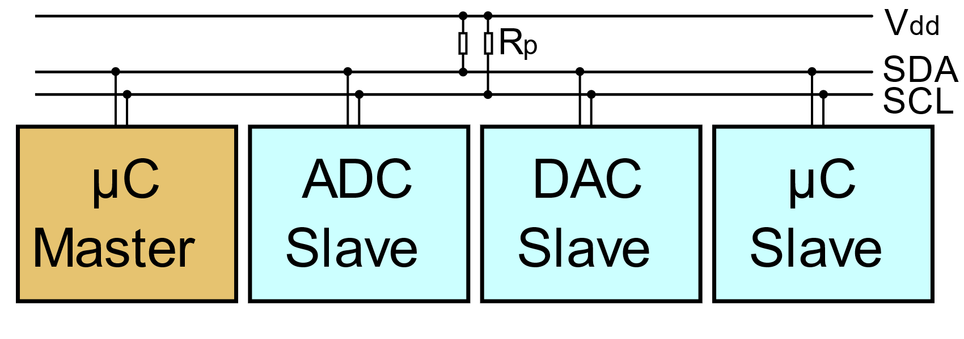
I²C
The name I²C stands for Inter-Integrated Circuit bus.
I²C only uses two physical wires, called serial data(SDA) and serial clock(SCL).
Rp(pull up resistor) is used to ensure a known state for a signal.

Slide 4
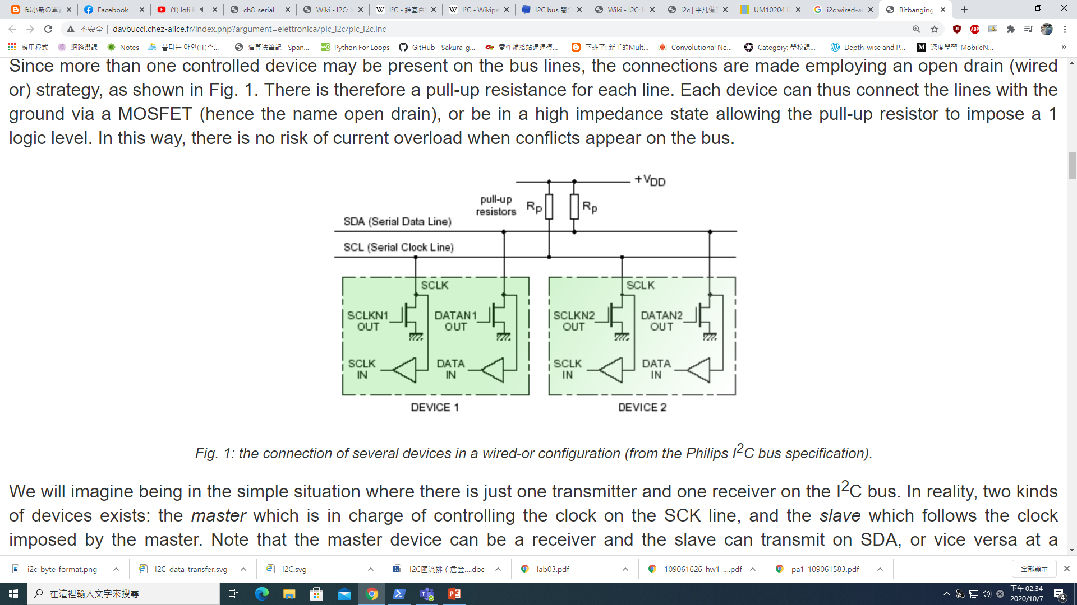
Wire-And Configuration
Any node can only pull down the SCL or SDA line to Logic 0; it cannot force the line up to Logic 1.
This role is played by a single pull-up resistor connected to each line.

Slide 5
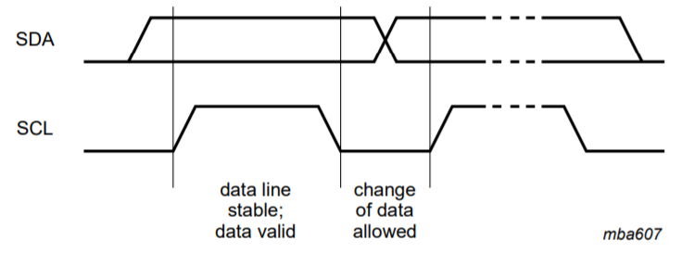
Serial Data Transfer
For each clock pulse one bit of data is transferred.
The SDA signal can only change when the SCL signal is low – when the clock is high the data should be stable.

Slide 6
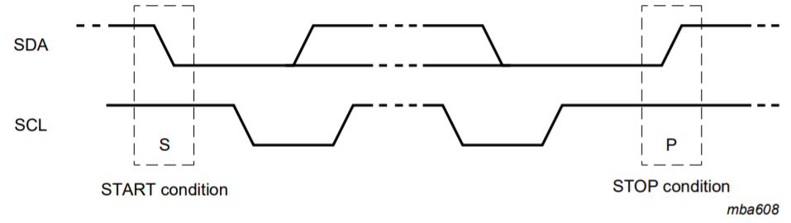
Start and Stop Condition
Start and Stop is a special case.
Start bit is sent when SDA is low and SCL stays high.
Stop bit is sent when SDA is high and SCL stays high.

Slide 7
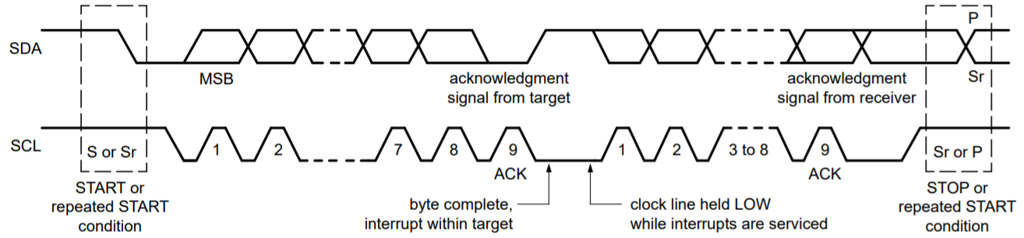
I²C Data Transfer
Data on the I2C bus is transferred in 8-bit packets
Each byte must be followed by an Acknowledge bit to guarantee the receiver getting the data
All the bytes are transferred with the MSB bit shifted first.

Slide 8
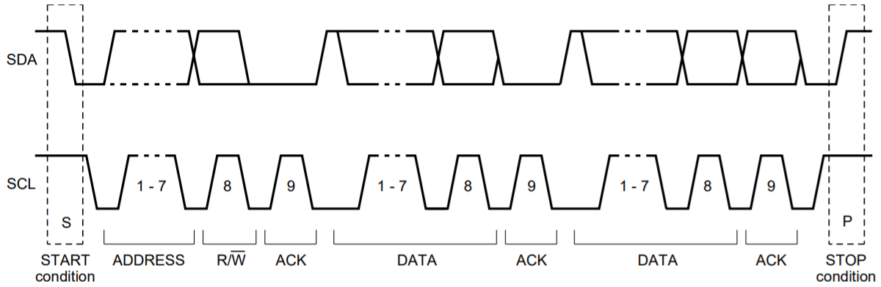
7 Bit I²C Address
Start bit: Start to sent data
Slave address: 7 bit slave address is sent.
R/W: 0 represents write; 1 represents read.
ACK: Slave sent a ACK bit after receiving the data.

Slide 9
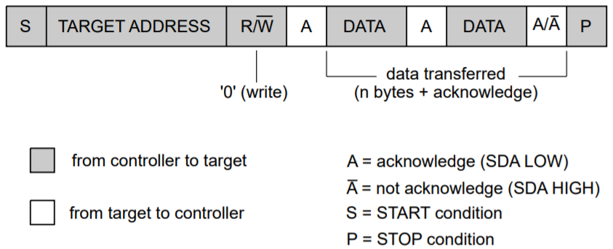
I²C Write Mode
ACK: Slave sent a ACK bit to after receiving the data.
Data: Master keep sending data.

Slide 10
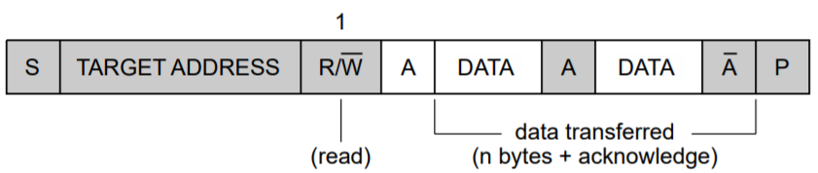
I²C Read Mode
ACK: Master sent a ACK bit to after receiving the data.
Data: Slave keep sending data.

Slide 11
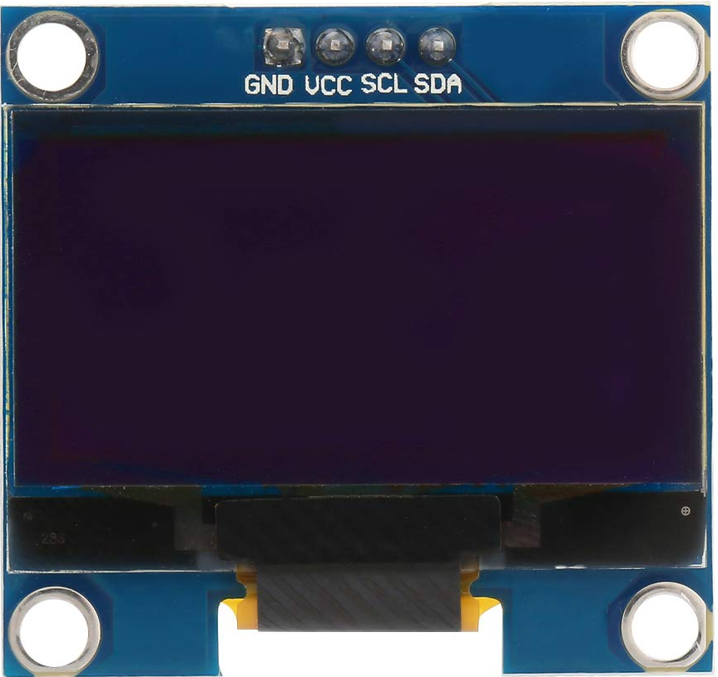
OLED (Appearance)

Slide 12
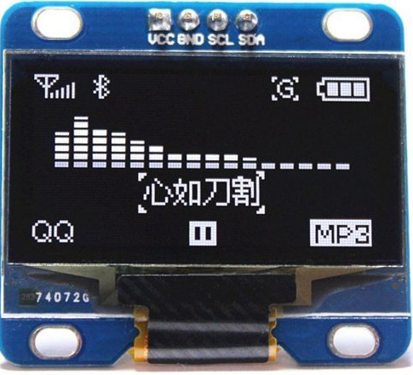
OLED

Slide 13
SSD1305
SSD1305 is a CMOS OLED/PLED driver with controller for OLED dot matrix graphic display system.
It consists of 132 segments and 64 commons that can support a maximum display resolution of 132x64.

Slide 14
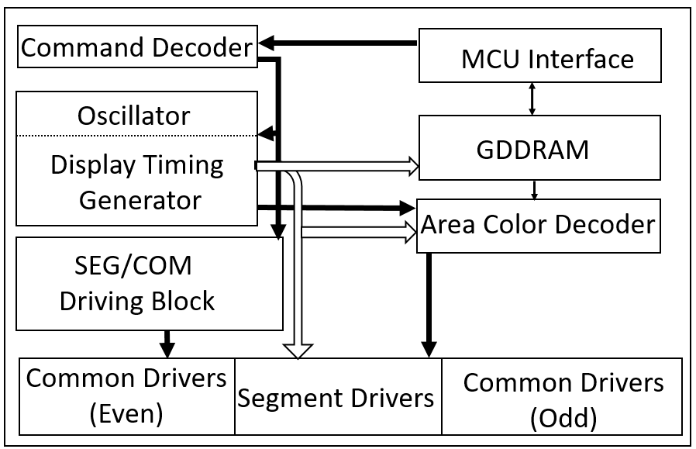
SSD1305 Block Diagram

Slide 15
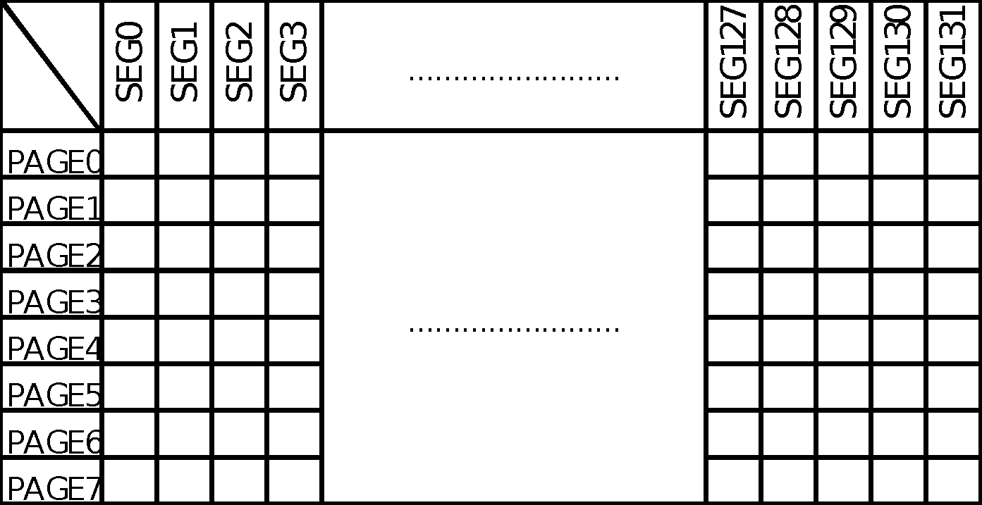
Graphic Display Data RAM (GDDRAM)
128
8
64
Only display from column2 to column129

Slide 16
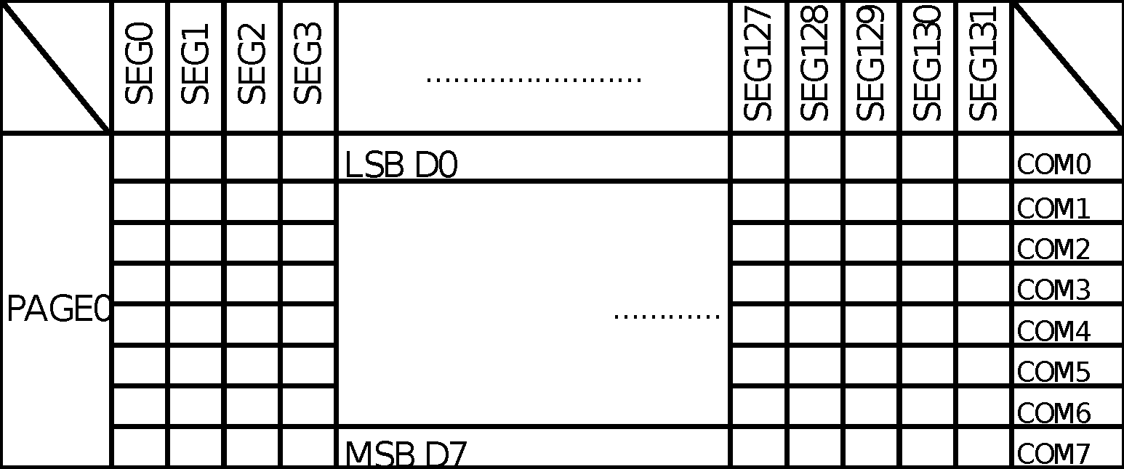
Graphic Display Data RAM (GDDRAM)
Each lattice represents one bit of image data

Slide 17
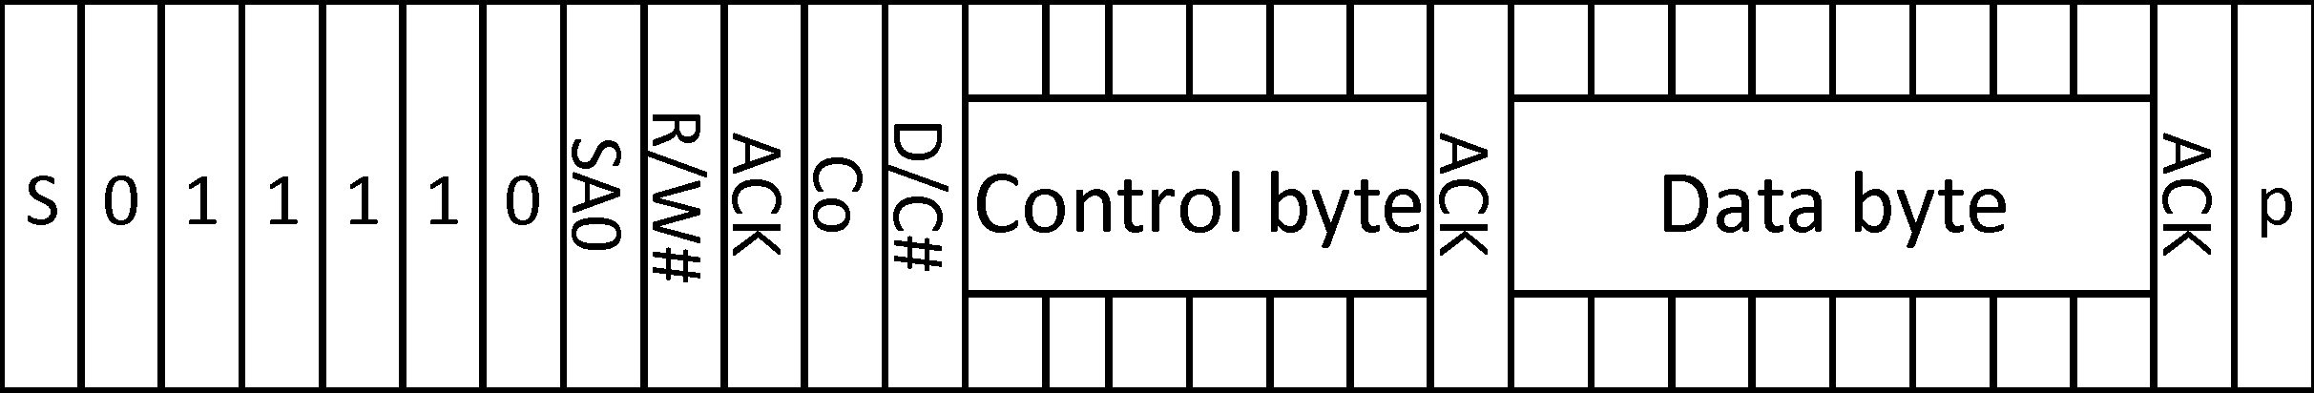
OLED Data Format
Slave address
1 byte
1 byte
S – Start condition / P – Stop Condition
SA0 – Slave address bit (preset to 0)
R/W# – Write / Read mode selection bit
0 represents write mode; 1 represents read mode
Co – Continuation bit (preset to 0)
D/C# – Data / Command selection bit
0 represents command mode; 1 represents data mode

Slide 18
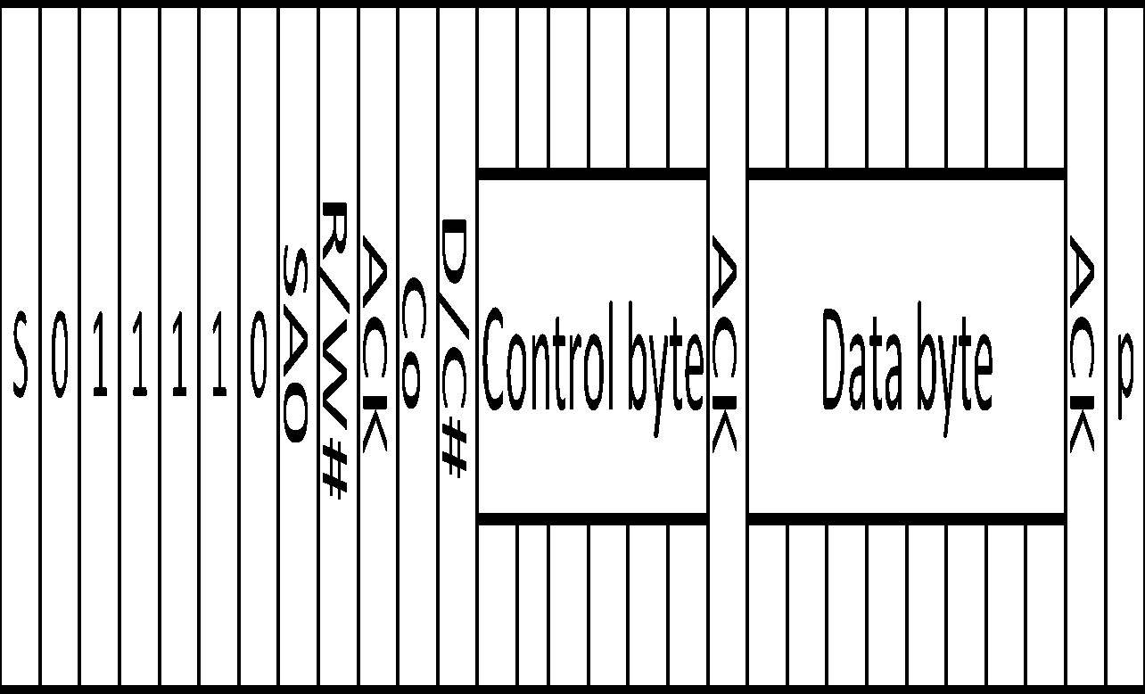
OLED Data Format (Slave Address)
SSD1305 slave address:
3Ch (when SA0 = 0), SA0 presets to 0
3Dh (when SA0 = 1)
R/W# bit:
0 means write mode
1 means read mode

Slide 19
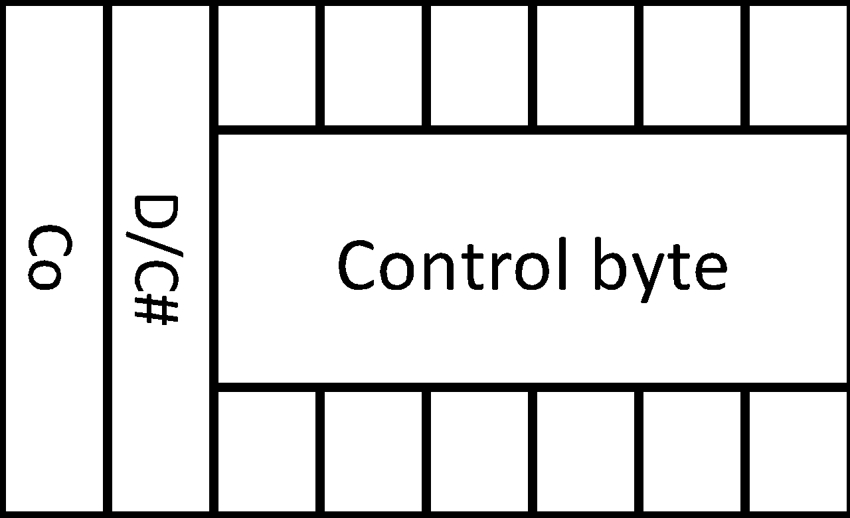
OLED Data Format (Data/Command)
Co: Always 0 when data byte is behind
D/C# bit:
0 means data byte behind is command
1 means data byte behind is pixel
Control byte: 00_0000

Slide 20
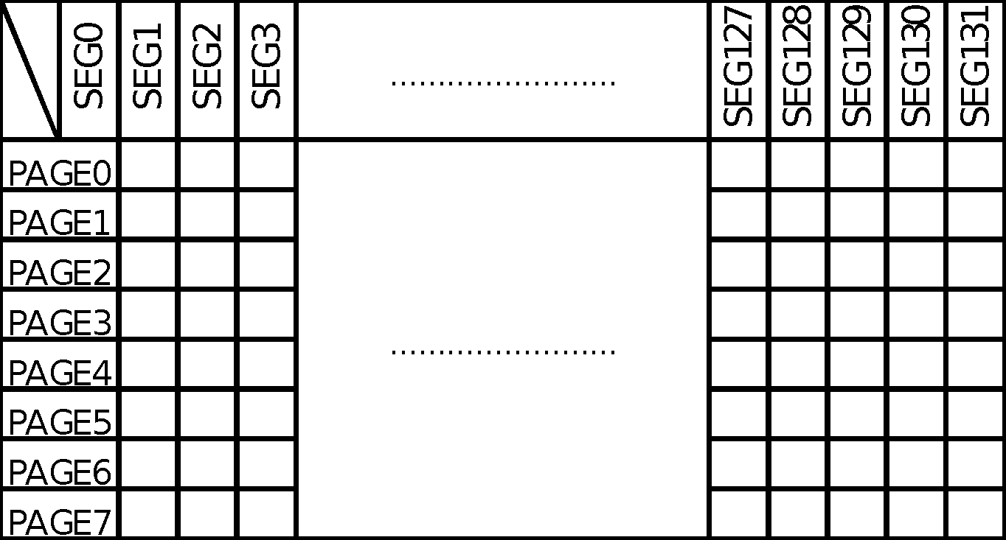
Example (Write Data in PAGE0, SEG127)
Select PAGE0~7 to write by command B0h to B7h.
In this example, command is B0h to select PAGE0.

Slide 21
Example (Write Data in PAGE0, SEG127)
SA0 = 0, R/W# = 0, Co = 0, D/C# = 0, Control = 00_0000
Data byte = B0h

Slide 22
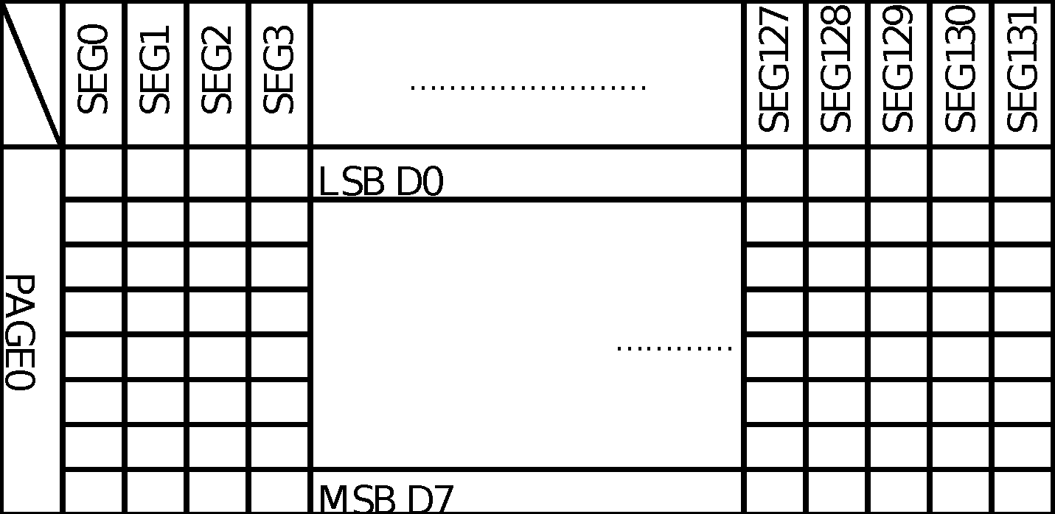
Example (Write Data in PAGE0, SEG127)
Select SEG0~127 to write by command 10h to 1Fh and command 00h to 0Fh.
(SEG higer 4 bits and SEG lower 4 bits)

Slide 23
Example (Write Data in PAGE0, SEG127)
In this example, SEG127 is 7F.
First commands is 17h.(0001 X7X6X5X4, higher 4bits)
Second command is 0Fh.(0000 X3X2X1X0, lower 4bits)

Slide 24
Example (Write Data in PAGE0, SEG127)
First command to select SEG127
SA0 = 0, R/W# = 0, Co = 0, D/C# = 0, Control = 00_0000
Data byte = 17h

Slide 25
Example (Write Data in PAGE0, SEG127)
Second command to select SEG127
SA0 = 0, R/W# = 0, Co = 0, D/C# = 0, Control = 00_0000
Data byte = 0fh

Slide 26
Example (Write Data in PAGE0, SEG127)
RAM access pointer
The RAM access pointer is PAGE0 and SEG127.

Slide 27
Example (Write Data in PAGE0, SEG127)
RAM access pointer
SA0 = 0, R/W# = 0, Co = 0, D/C# = 1, Control = 00_0000
Data byte = Pixel

Slide 28
Example
RAM access pointer
The RAM access pointer will increase automatically after writing one data. The pointer is PAGE0 and SEG128 now.

Slide 29
Example
RAM access pointer
The RAM access pointer will reload automatically SEG0 when it points to the end of the SEG in preset mode.
.

Slide 30
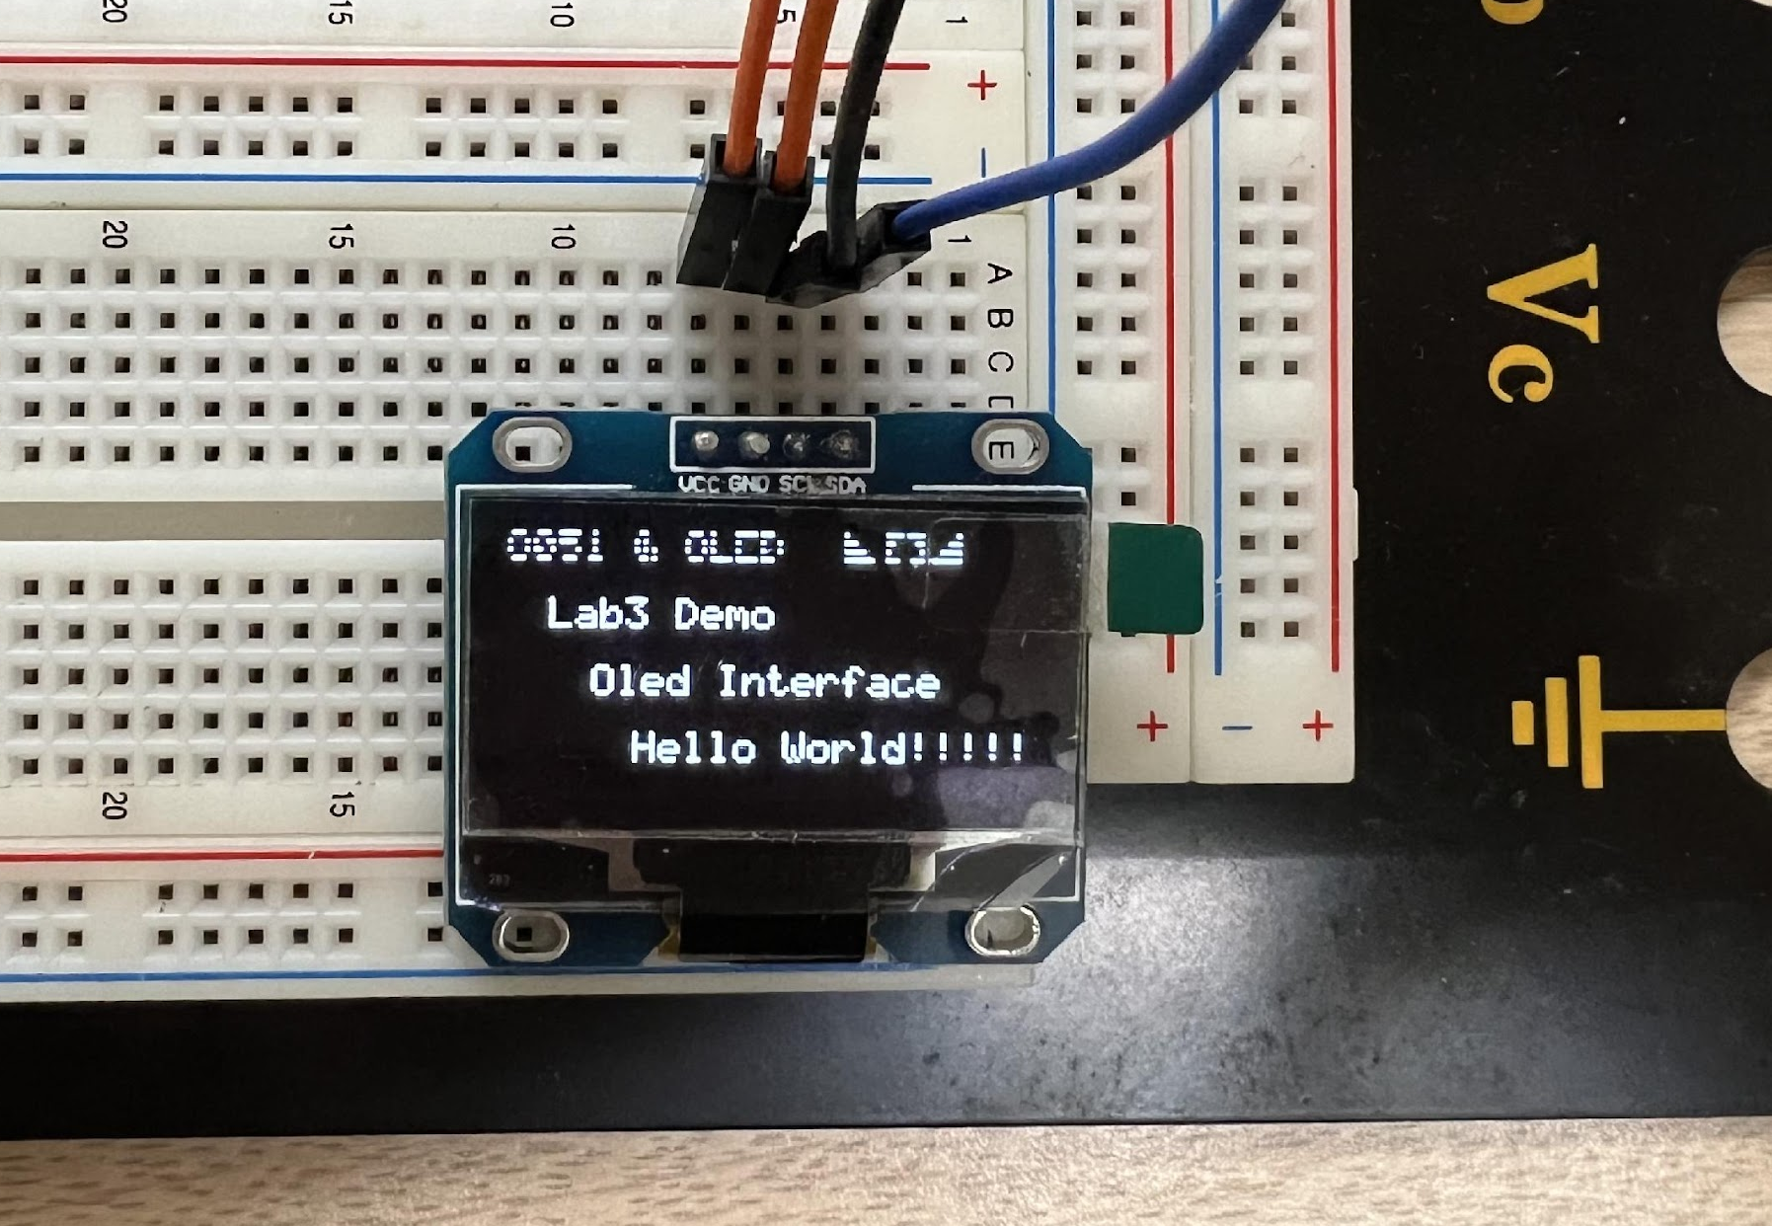
Example 1 – OLED Demo

Slide 31
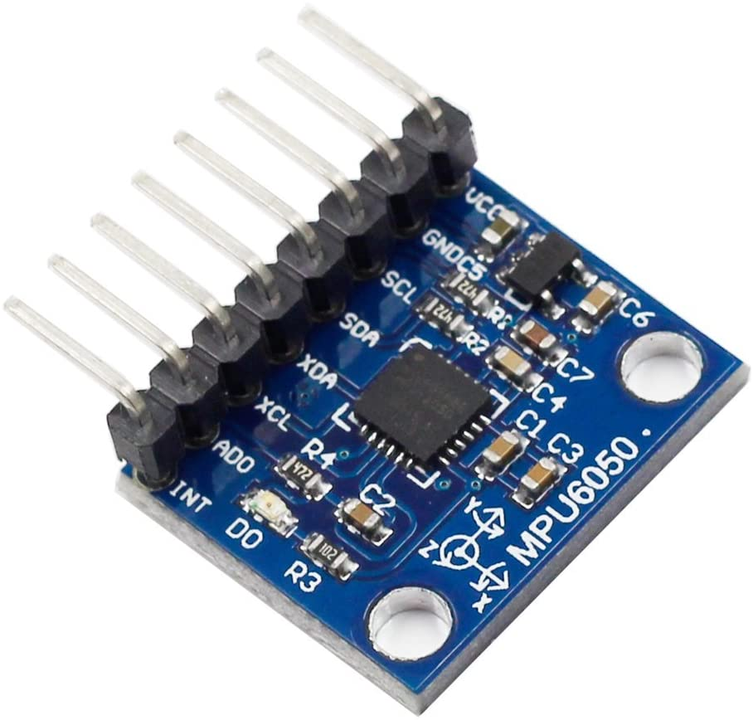
MPU6050 (Appearance)

Slide 32
MPU6050 Introduction
6-axis MotionTracking device that combines a 3-axis gyroscope, 3-axis accelerometer, and a Digital Motion Processor
Communication with all registers of the device is performed using I2C at 400kHz

Slide 33
MPU6050 Application
Video/Still Image Stabilization
Handset and portable gaming
Motion-based game controllers
Wearable sensors for health, fitness and sports
3D remote controls for Internet connected DTVs and set top boxes, 3D mice

Slide 34
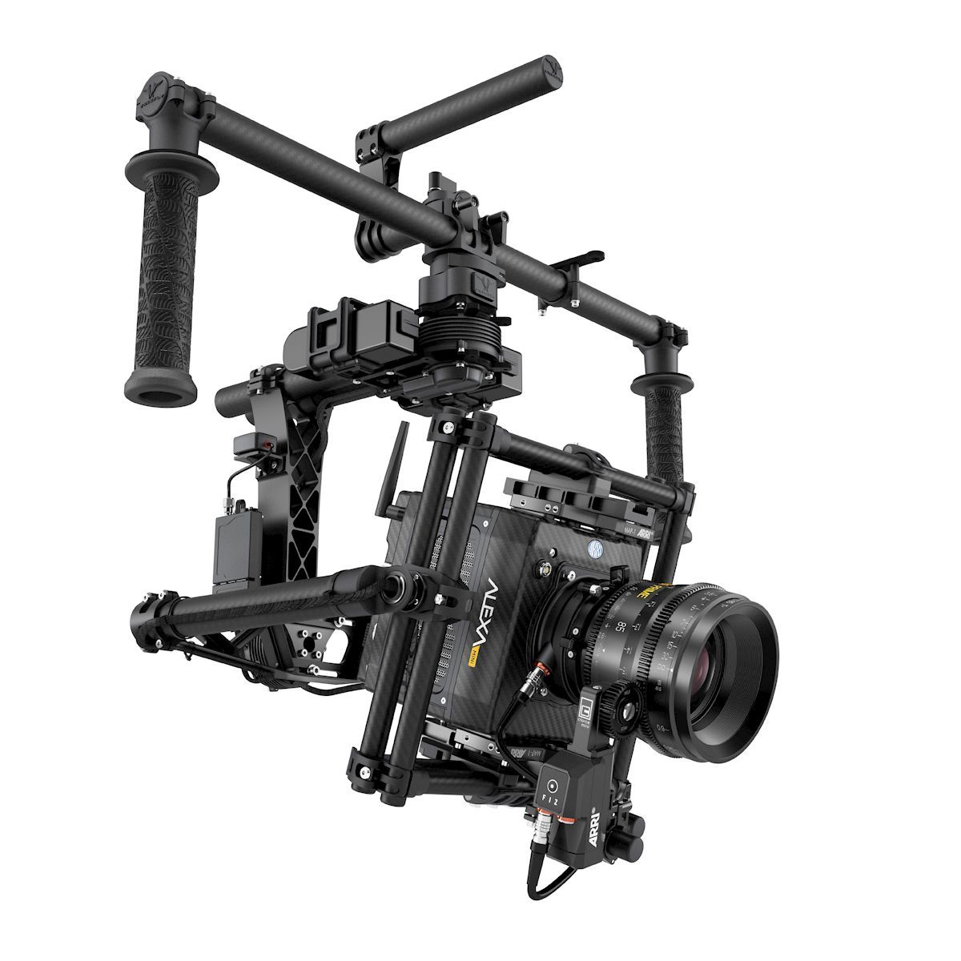
MPU6050 Application

Slide 35

MPU6050 Application

Slide 36
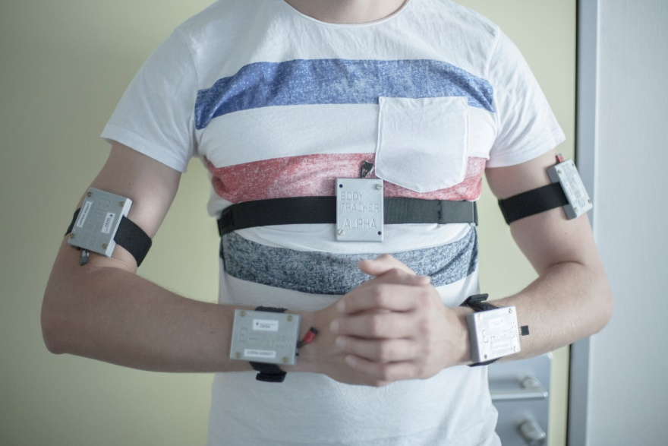
MPU6050 Application

Slide 37
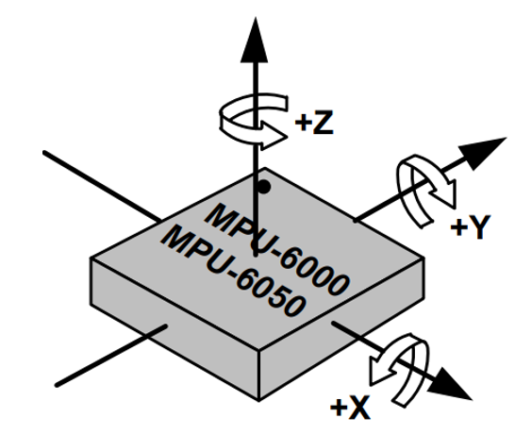
Gyroscope Features
Digital-output X-, Y-, and Z-Axis angular rate sensors (gyroscopes) with a user-programmable full-scale range of ±250, ±500, ±1000, and ±2000°/sec

Slide 38
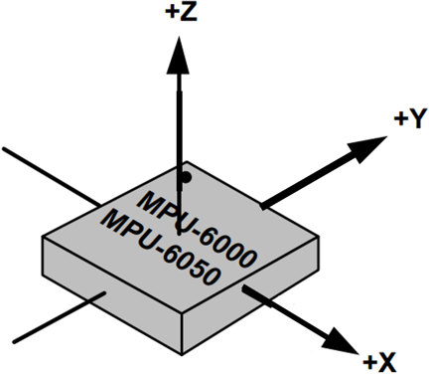
Accelerometer Features
Digital-output triple-axis accelerometer with a programmable full scale range of ±2g, ±4g, ±8g and ±16g
Orientation detection and signaling

Slide 39
MPU6050 Other Features
External sync signal connected to the FSYNC pin supports image, video and GPS synchronization
Enhanced bias and sensitivity temperature stability reduces the need for user calibration
Improved low-frequency noise performance
User-programmable interrupts

Slide 40
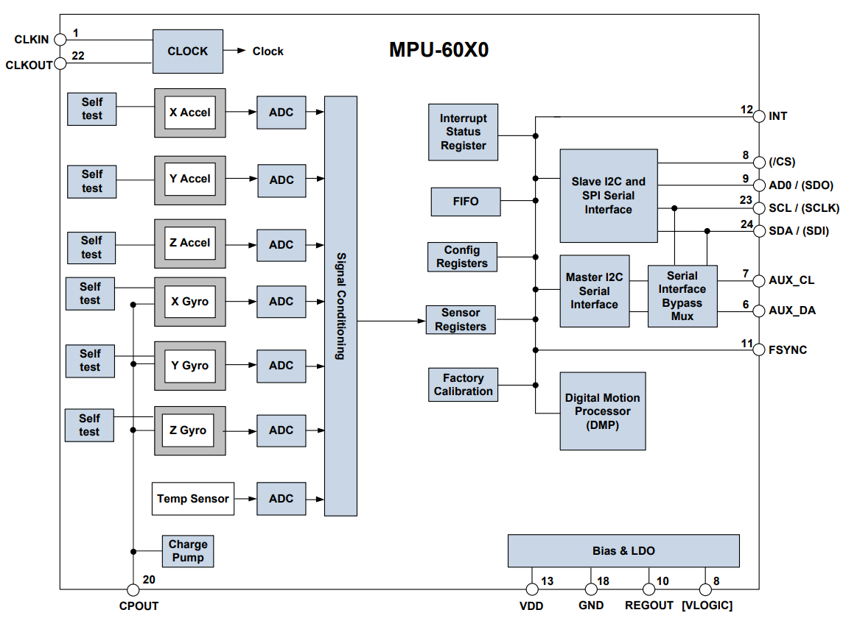

MPU6050 Block Diagram

Slide 41

MPU6050 Basic Principle
By measuring the capacitance, we can get the change of spring on different direction to get the acceleration.
d

Slide 42
Accelerometer Theory
m
Physics of a Spring and Mass System

Slide 43

Accelerometer Theory
X
a
K
m

Slide 44
Accelerometer Theory
Movable capacitance plate
X
a
K
m
By measuring the capacitance, we can calculate the value of X which helps to infer the acceleration

Slide 45
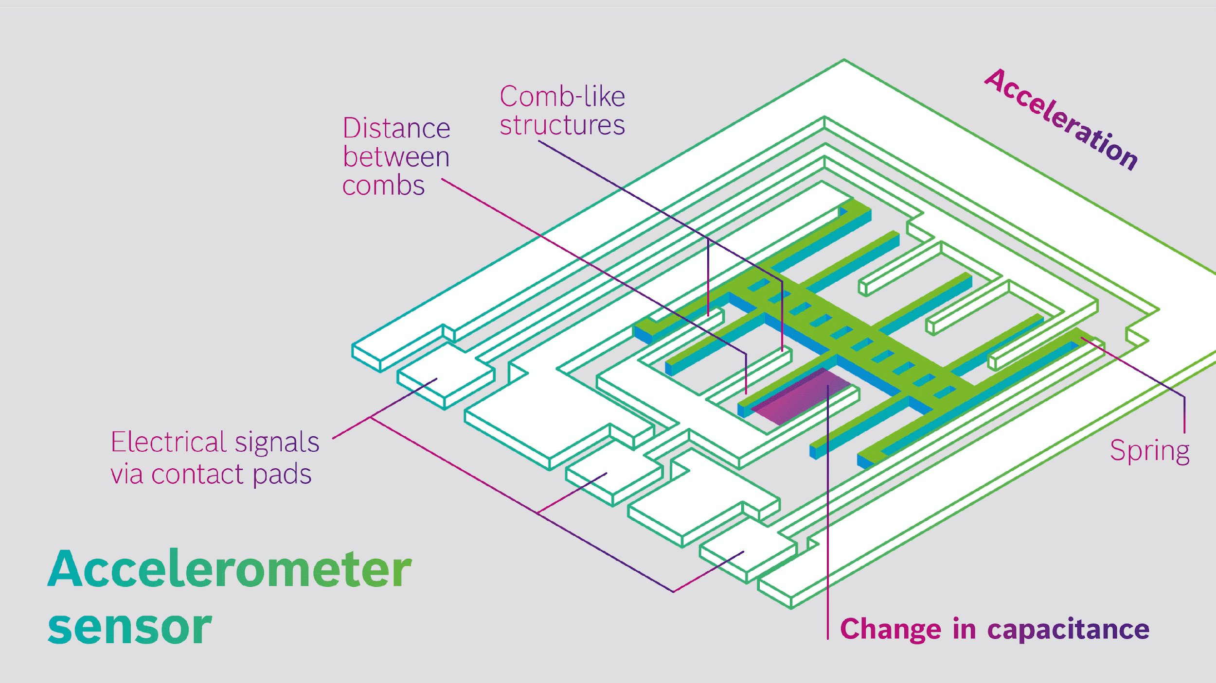
Accelerometer Structure

Slide 46
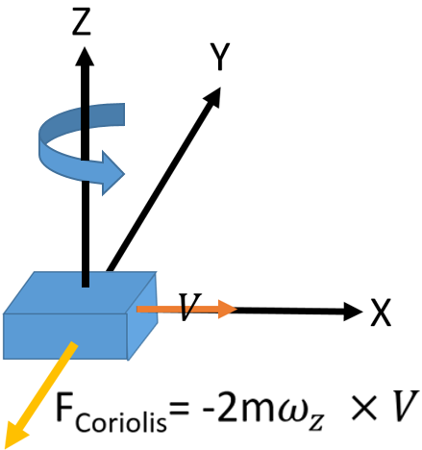
Gyroscope Theory
Gyroscopes use the Coriolis effect to infer the rotate angle

Slide 47
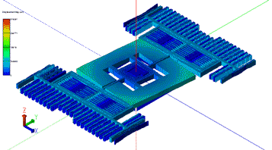
Gyroscope Structure
In a gyroscope, the resulting physical displacement is then read using a capacitive sensing interface

Slide 48
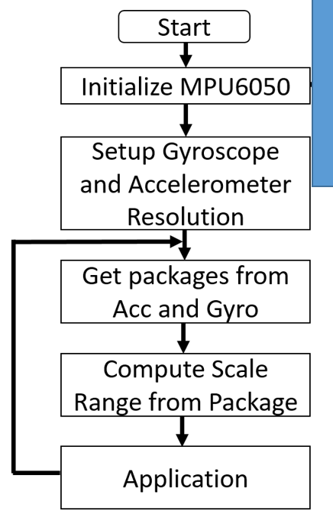
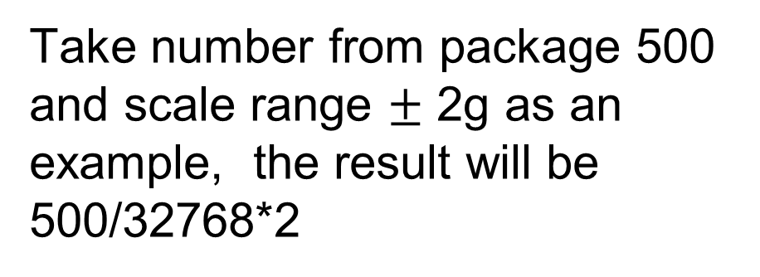
MPU6050 Flow Chart
Power Manager
Sample Rate
Programmable Interrupt
Number from -32768 to 32767

Slide 49
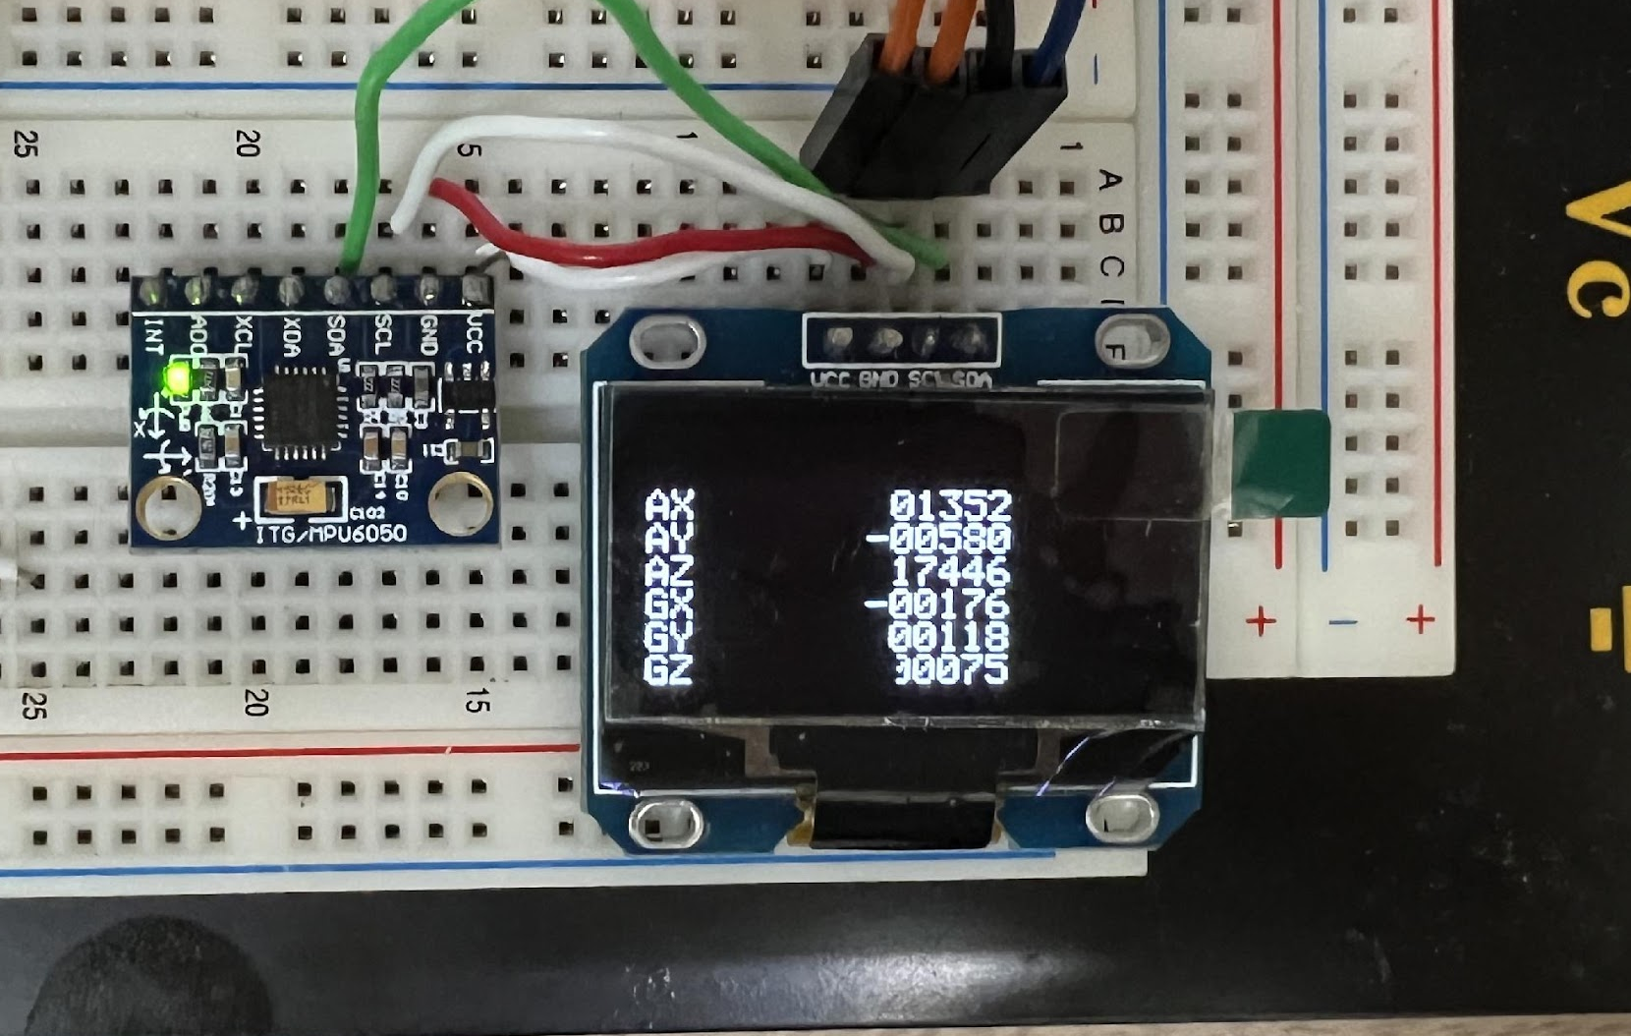
Example2 - OLED&MPU6050 Demo

Slide 50
Reference
https://en.wikipedia.org/wiki/I%C2%B2C
https://www.nxp.com/docs/en/user-guide/UM10204.pdf
https://i2c.info/i2c-bus-specification
https://exploreembedded.com/wiki/OLED_Interface_With_8051
https://cdn-shop.adafruit.com/datasheets/SSD1305.pdf
https://www.analog.com/en/technical-articles/mems-gyroscope-provides-precision-inertial-sensing.html
https://www.researchgate.net/figure/Principle-of-operation-for-MEMS-vibrating-gyroscope-125_fig11_299465820
https://www.youtube.com/watch?v=T_iXLNkkjFo
https://invensense.tdk.com/wp-content/uploads/2015/02/MPU-6000-Datasheet1.pdf
https://www.slideshare.net/ankushwawoo/mems-gyroscope-working

