Slide 1

Microprocessor Systems
Lab5 - Universal Asynchronous Receiver Transmitter (UART)
Prof. Ren-Shuo Liu
NTHU EE

Slide 2
Introduction
Universal asynchronous receiver-transmitter (UART) is an asynchronous serial communication.
The data format and transmission speeds are configurable.
Asynchronous communication doesn’t require the clock to be connected between nodes.
An UART has one connection for transmitted data, called TX, and another for received data, called RX.

Slide 3
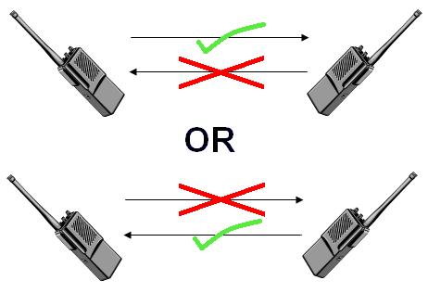
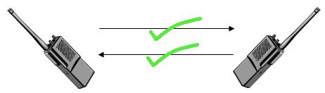
Communication
Communication may be simplex , full duplex or half duplex .
Simplex
Half duplex
Full duplex

Slide 4
Common Configurations
Data rate (or baud rate) are predetermined.
  Both transmitter and receiver are pre-set to the same data rate.
Standard baud rates include 110, 300, 600, 1200, 2400, 4800, 9600, 14400, 19200, 38400, 57600, 115200, 128000 and 256000 bits per second (bps).
Data length are also predetermined to tell how many bits would transfer/receive (5 to 9 bits, typically).

Slide 5
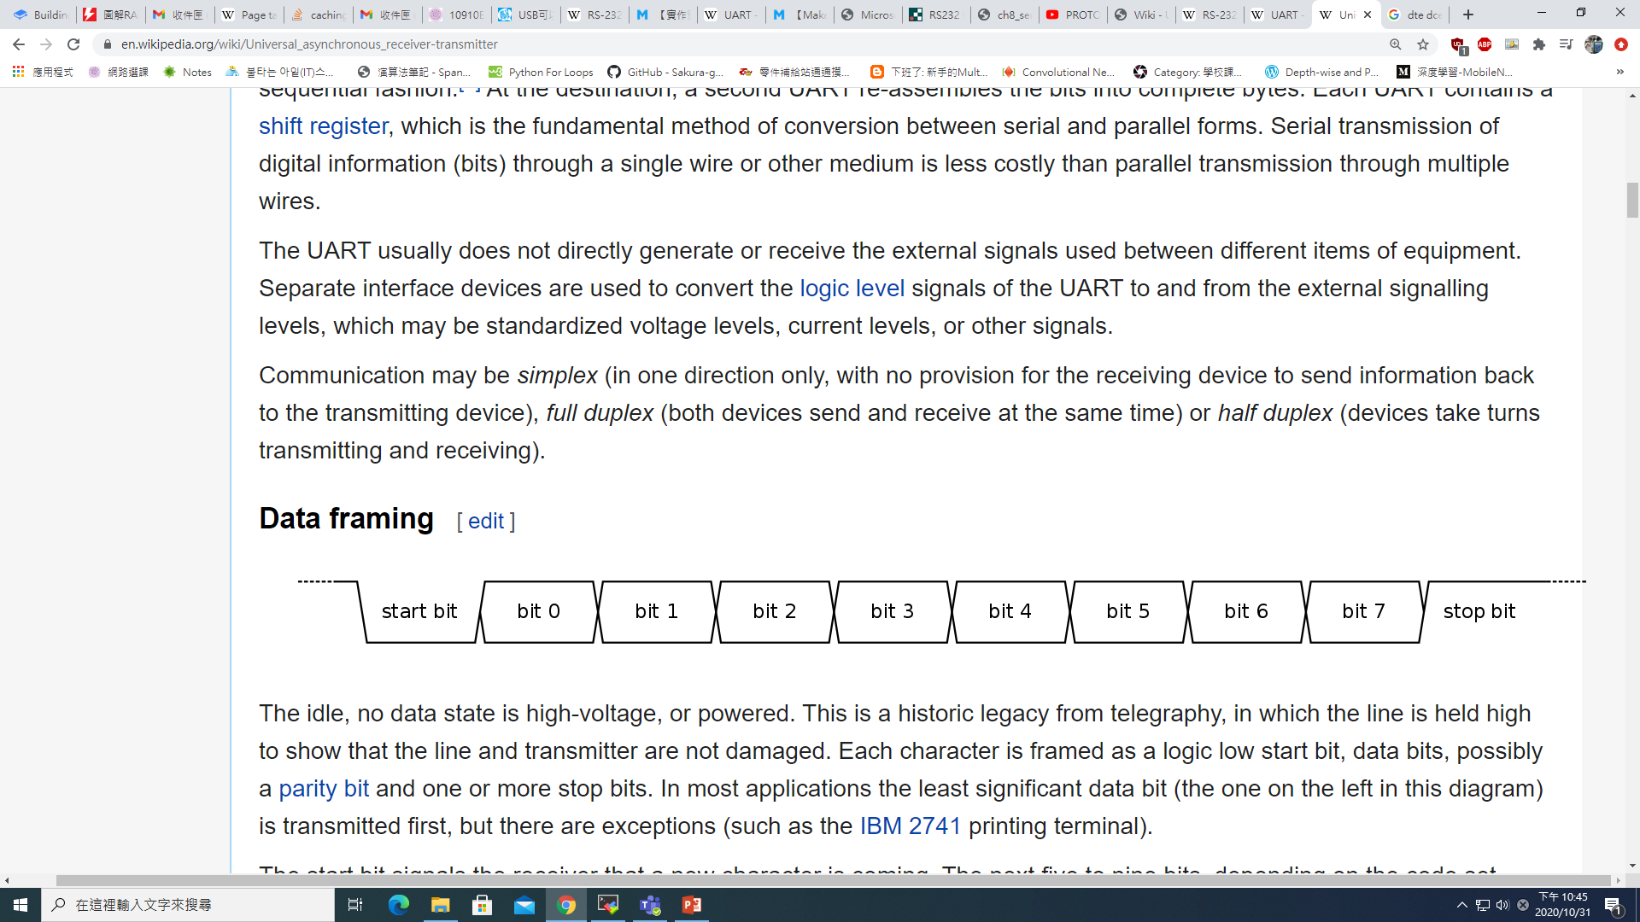
Data Frame
Idle: keep logic high.
The start bit (logic low) signals receiver that a data character is coming.
If parity bit is used, it would be placed after the data bits to keep the package odd or even logic high.
The final bit is the stop bit (logic high).
idle
LSB
MSB
parity
bit

Slide 6
Receiver
After the receiver getting the start bit, it starts to sample bit0 after 1.5 bit time in order to ensure that the data is stable, and then sample succeeding data every 1 bit time.
After the required number of bit periods for the character length (5 to 9 bits) have elapsed, the contents of the shift register are made available.
1.5 bit time
1 bit time
Receive data in the middle of bit

Slide 7
Transmitter
As soon as the sending system deposits a character in the shift register, the UART generates a start bit.
Shifts the required number of data bits out to the line, generates and sends the parity bit (if used), and sends the stop bits.
1 bit time
All transmit data is the same bit time

Slide 8
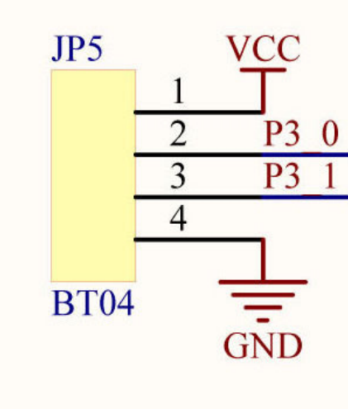
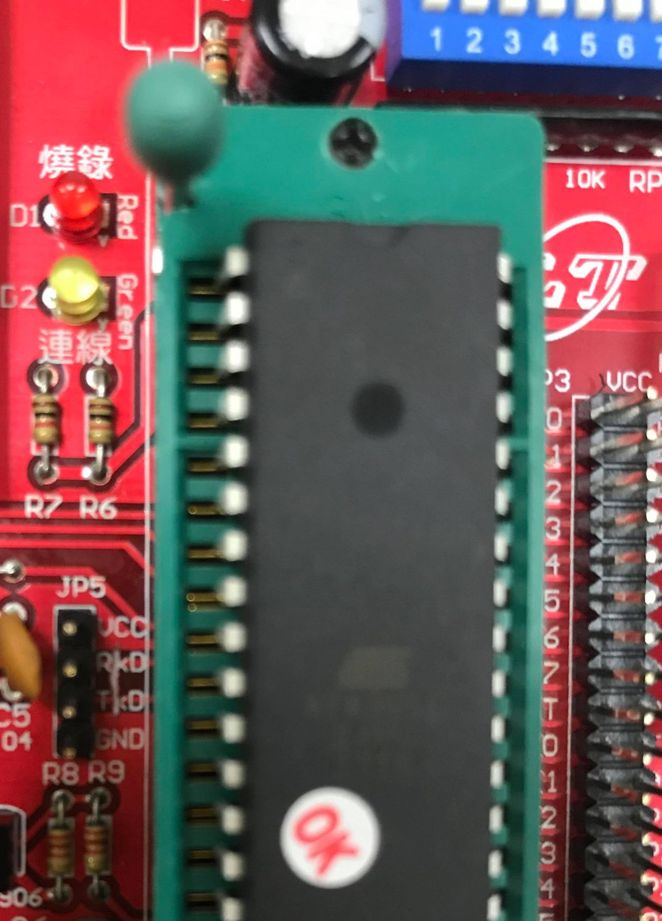
8051-UART Position
P3_0: Rx
P3_1: Tx

Slide 9
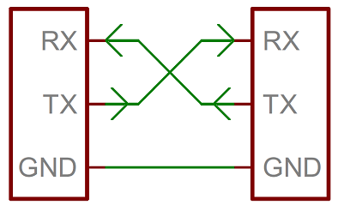
UART Communication
UART
UART
Device 1
Device 2

Slide 10
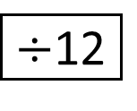
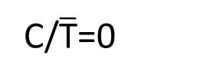
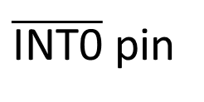
Timer1 Mode2
(8bit Operation with Auto Reload)
OSC
TL0
(8 bits)
Overflow
TF0
T0 pin
Control
Interrupt
TR1
Reload
TH0
(8 bits)
Gate1=0

Slide 11
8051 Serial Port Settings
Set special function registers in 8051
Set timer1 work mode
TMOD, TCON
Set serial port work mode
SCON
Set baud rate
TH1, SMOD
Set interrupt enable
IE

Slide 12
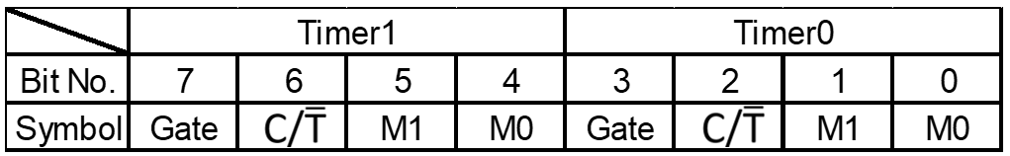
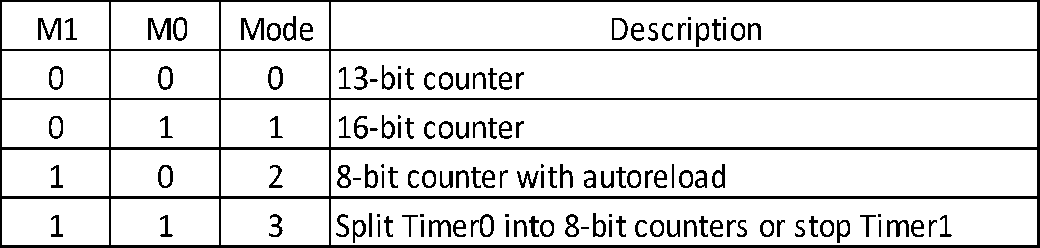
Time Mode Control Register (TMOD)
Gate1 (bit7): 1 for interrupt to drive timer.
0 for TR1 in TCON to drive Timer1.
C/T: 1 for timer working as counter.
0 for timer working as timer.

Slide 13
Timer Control Register (TCON)
TMOD
TCON
Bit No. | 7 | 6 | 5 | 4 | 3 | 2 | 1 | 0
Symbol | TF1 | TR1 | TF0 | TR0 | IE1 | IT1 | IE0 | IT0
Set Gate1=0 (TMOD bit7) and TR1=1 to open timer 1

Slide 14
Serial Port Control Register (SCON)
Bit No. | 7 | 6 | 5 | 4 | 3 | 2 | 1 | 0
Symbol | SM0 | SM1 | SM2 | REN | TB8 | RB8 | TI | RI
SM0 | SM1 | Mode | Description
0 | 0 | 0 | Shift register
0 | 1 | 1 | 8 Bit UART with configurable baud rate
1 | 0 | 2 | 9 Bit UART with identical baud rate
1 | 1 | 3 | 9 Bit UART with configurable baud rate
Set to mode 1.
Ren: set/cleared to enable/disable reception.
TI: Transmitter interrupt flag.
RI: Receiver interrupt flag.

Slide 15
IE (Interrupt Enable) Register
Bit No. | 7 | 6 | 5 | 4 | 3 | 2 | 1 | 0
Symbol | EA | RSV | RSV | ES | ET1 | EX1 | ET0 | EX0
EA | Enables interrupt
- | Reserved for future use
- | Reserved for future use
ES | Enables/disables serial port interrupt
ET1 | Enables/disables timer1 overflow interrupt
EX1 | Enables/disables external interrupt1
ET0 | Enables/disables timer0 overflow interrupt
EX0 | Enables/disables external interrupt0
Set EA and ES =1 (Enable serial port interrupt)

Slide 16
Timer1 Mode2
(8bit Operation with Auto Reload)
OSC
TL0
(8 bits)
Overflow
TF0
T0 pin
Control
Interrupt
TR1
Reload
TH0
(8 bits)
Gate1=0

Slide 17
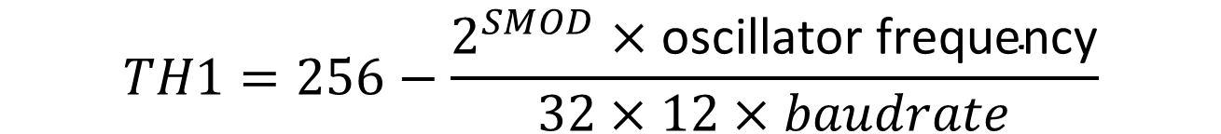
UART Clock Source (Case 1)
Freq_T1 = Freq_osc / (12*(256 - TH1)) (C/T = 0)
Freq_Uart = Baudrate = Freq_T1 / 32 (SMOD = 0)
Freq_Uart = Baudrate = Freq_T1 / 16 (SMOD = 1)
For Example:
Freq_osc = 12Mhz, Baudrate = 9600bps, SMOD = 1
Freq_T1 = 9600*16 = 153,600
(256 - TH1) = 12M / 12 / 153.6k = 6.51
TH1 = 249 or 250
The actual Baudrate = 8928 or 10416 bps
error = -7.5% or +7.8% (> +- 6%) can’t use

Slide 18
UART Clock Source (Case 2)
Freq_T1 = Freq_osc / (12*(256 - TH1)) (C/T = 0)
Freq_Uart = Baudrate = Freq_T1 / 32 (SMOD = 0)
Freq_Uart = Baudrate = Freq_T1 / 16 (SMOD = 1)
For Example:
Freq_osc = 11.0592Mhz, Baudrate = 9600bps, SMOD = 1
Freq_T1 = 9600*16 = 153,600
(256 - TH1) = 11.0592M / 12 / 153.6k = 6
TH1 = 250
The actual Baudrate = 9600 bps
error = 0%

Slide 19
UART Clock Source (Case 3)
User define buadrate
Freq_T1 = Freq_osc / (12*(256 - TH1)) (C/T = 0)
Freq_Uart = Baudrate = Freq_T1 / 32 (SMOD = 0)
Freq_Uart = Baudrate = Freq_T1 / 16 (SMOD = 1)
For Example:
Freq_osc = 12Mhz, Baudrate = 8928bps, SMOD = 1
Freq_T1 = 8928*16 = 142,848
(256 - TH1) = 12M / 12 / 142.848k = 7
TH1 = 249
The actual Baudrate = 8928
error = 0%

Slide 20
Serial Buffer SBUF
After setting, the data would transmit/receive through SBUF.
RI | D7 | D6 | D5 | D4 | D3 | D2 | D1 | D0
Receive SBUF value
START | D0 | D1 | D2 | D3 | D4 | D5 | D6 | D7 | STOP
Rx
STOP | D7 | D6 | D5 | D4 | D3 | D2 | D1 | D0 | START
Tx
Sent SBUF value
TI | D7 | D6 | D5 | D4 | D3 | D2 | D1 | D0

Slide 21
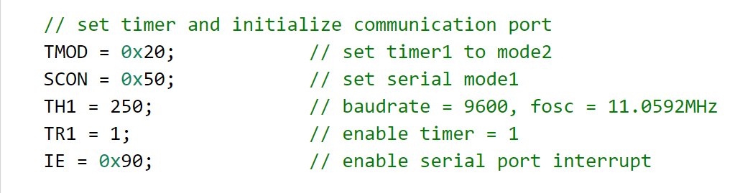
Example code : Initial Setting

Slide 22
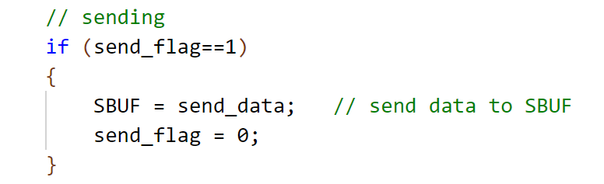
Example code : Tx sends data

Slide 23
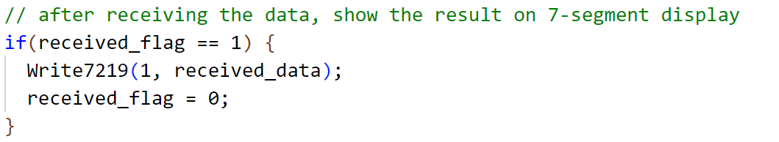
Example code : Rx receives data

Slide 24
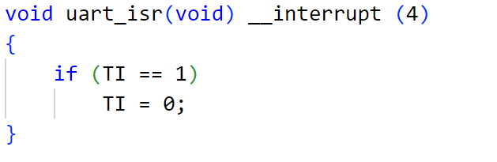
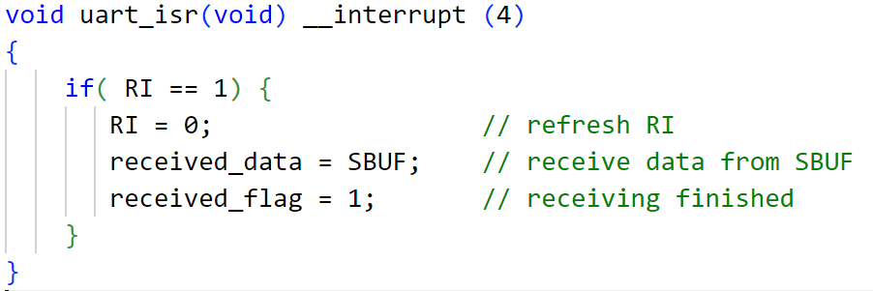
Example Code : Interrupt
Transmitter
Receiver

Slide 25
Reference
http://www.formosaos.url.tw/my8051/8051_mcu.html
http://www.finetech.idv.tw/techdoc/8051serial/8051serial.htm

