Slide 1

Microprocessor Systems
Lab2 – SPI and 7-Segment Display with MAX7219
Prof. Ren-Shuo Liu
NTHU EE

Slide 2
Outline
Beginning
Example Project
Practice
To Do List

Slide 3
Outline
Beginning
Example Project
Practice
To Do List

Slide 4
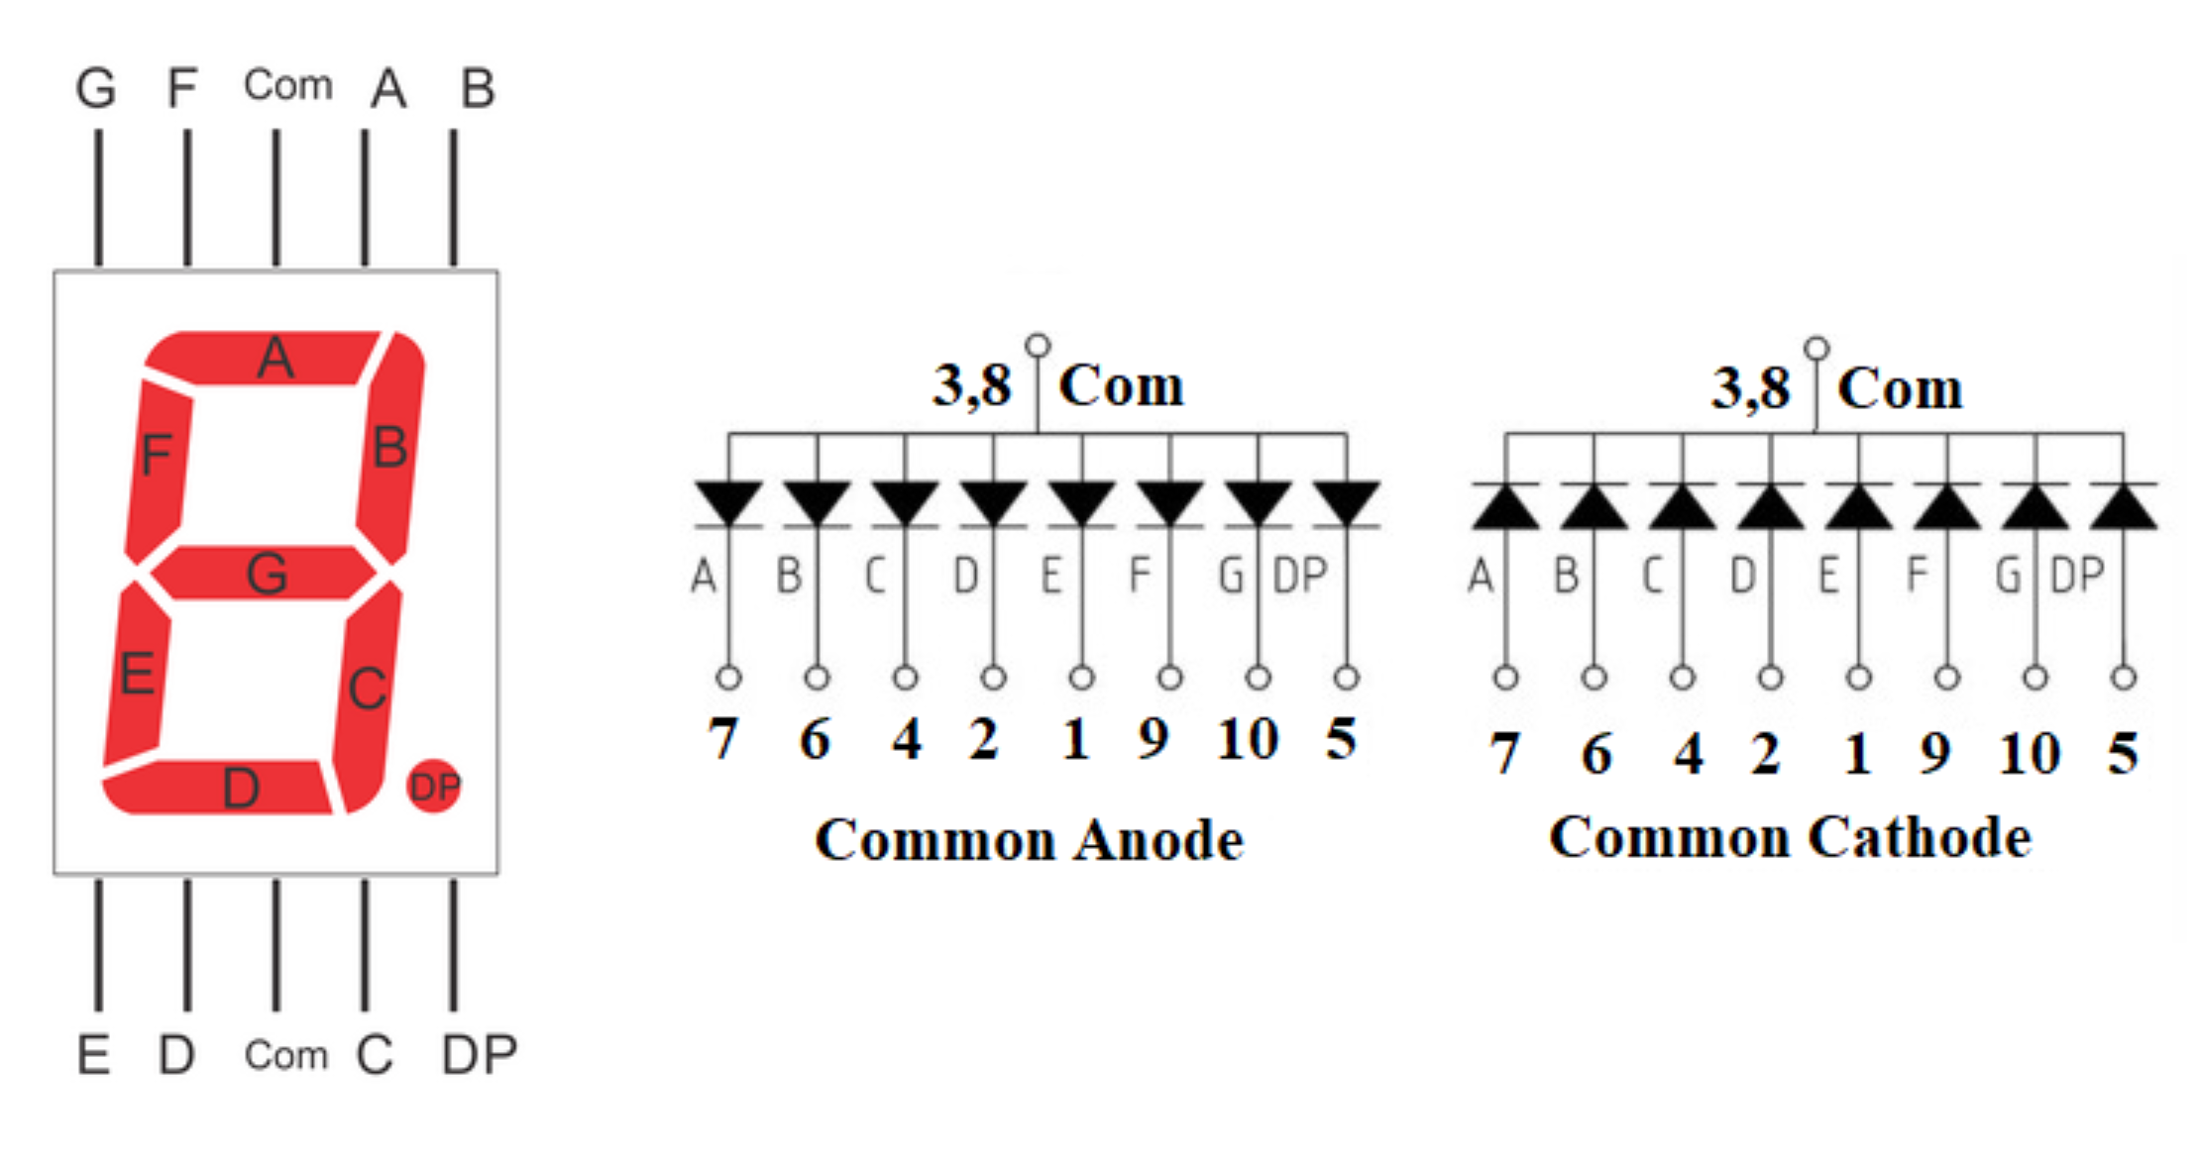
7-Segment Display

Slide 5
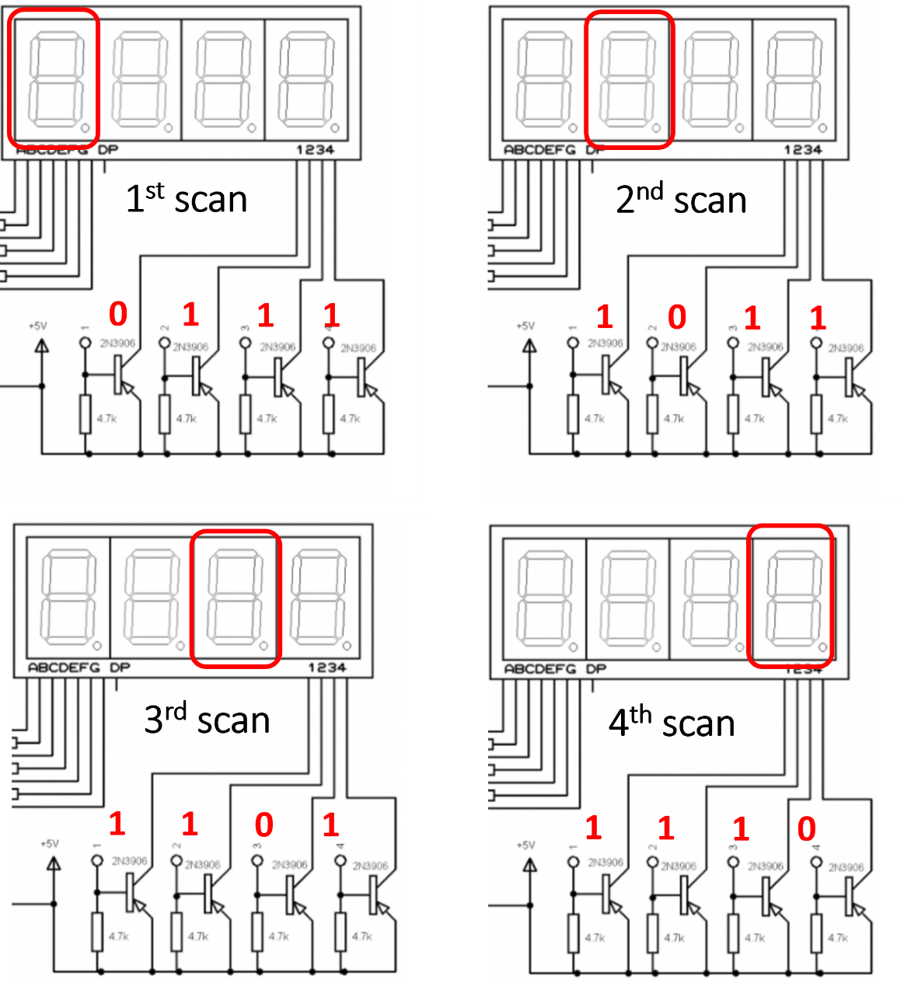
Multiplexed 7-Segment

Slide 6
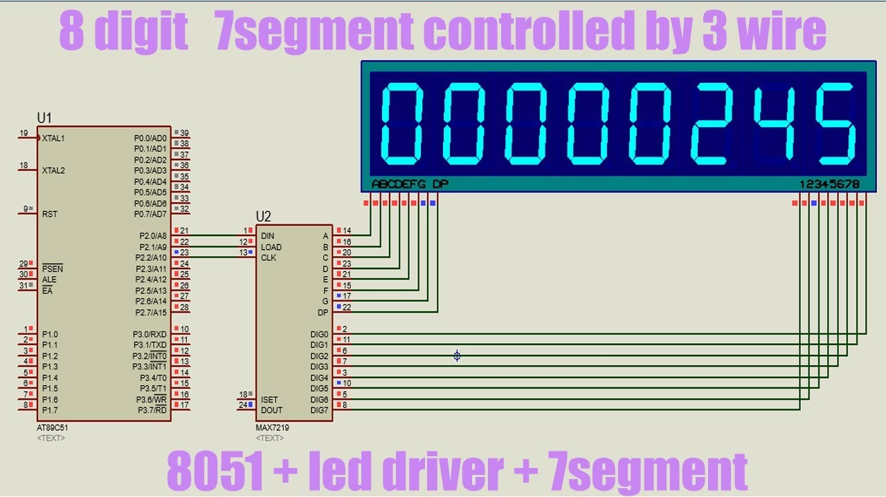
MAX7219

Slide 7
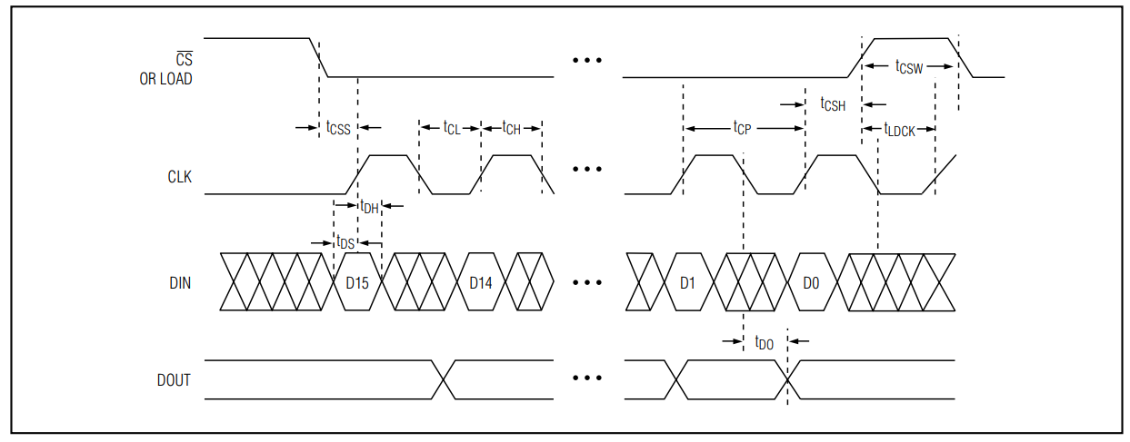
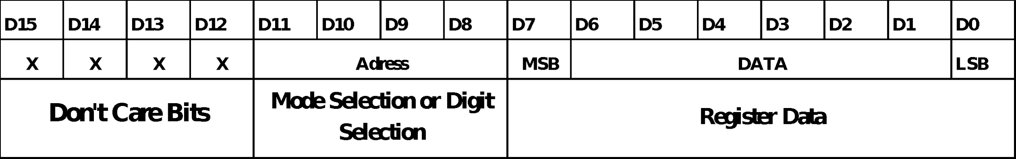
SPI

Slide 8
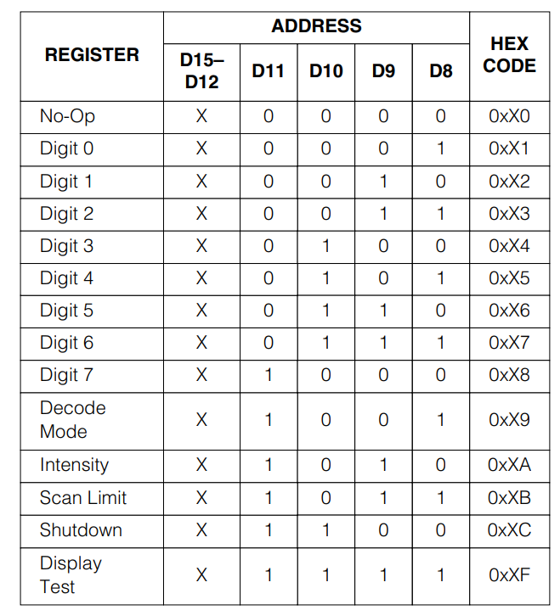
Register Address Map
No-Op : 整個顯示器維持現狀
Digit 0~7 : (Mode or Digit selection)
Decode Mode : BCD模式或原始
資料模式
Intensity: 亮度調整
Scan Limit: 欲亮燈數控制
Shutdown:開啟 / 關閉顯示器模組
Display Test: 測試模式
(顯示器全亮)

Slide 9
Outline
Beginning
Example Project
Practice
To Do List

Slide 10
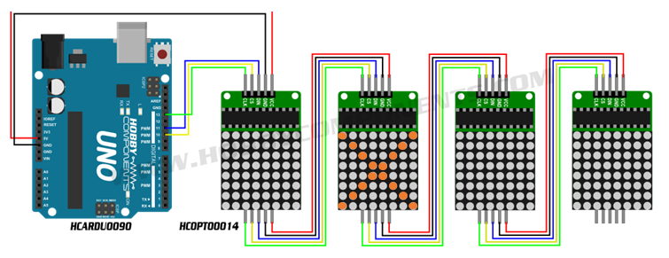
Write Data in Order
4. Write 0x00 to no-op.
2. Write 0x00 to no-op.
3. Write 0x00 to no-op.
1. Write data to digit0-7 reg to show picture X.

Slide 11
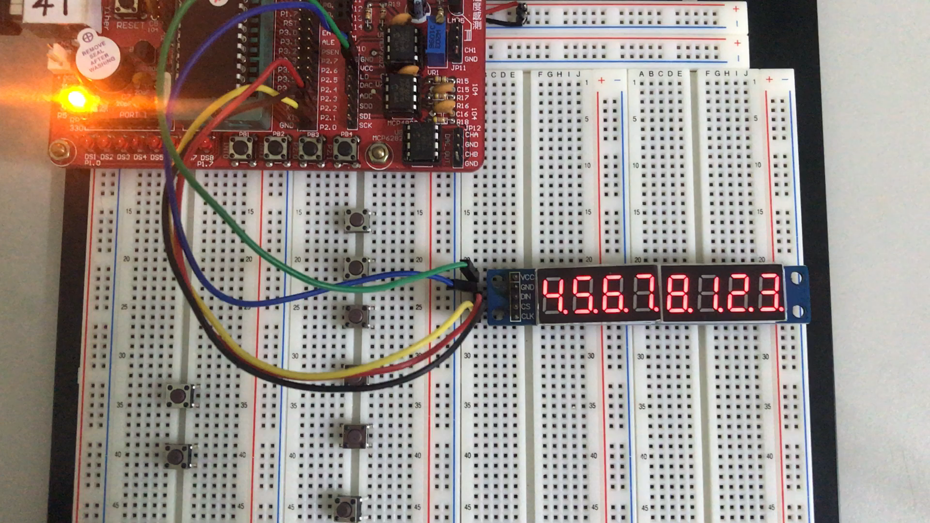
Example 1:

Slide 12
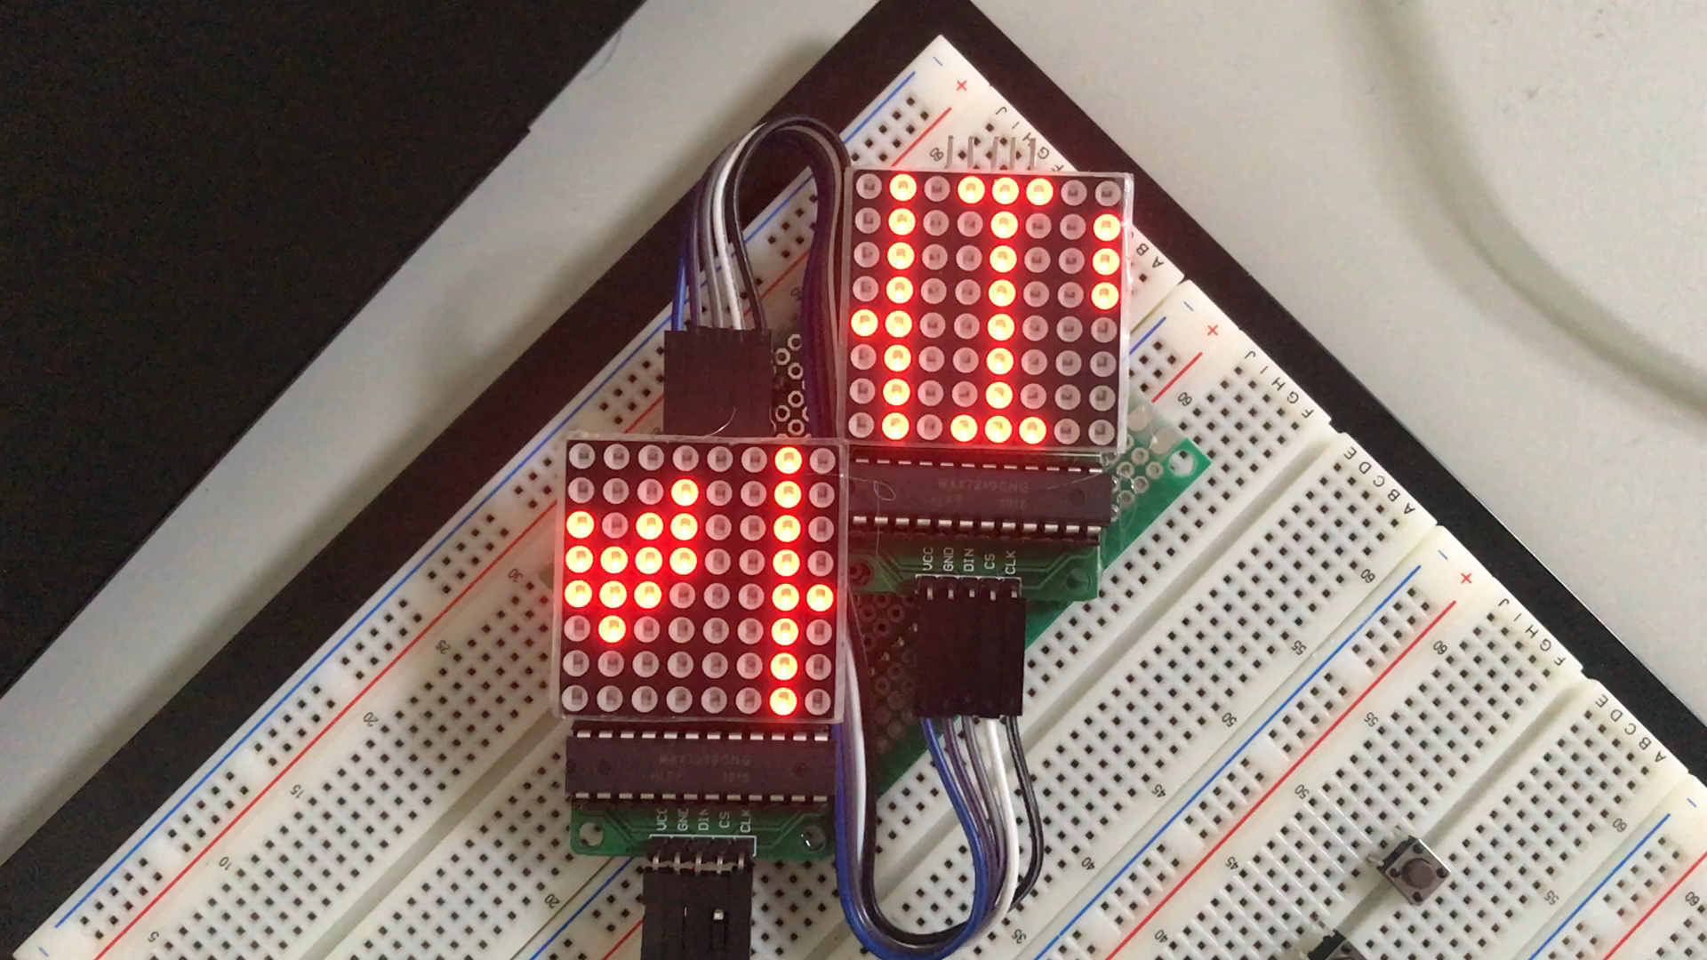
Example 2

Slide 13
Outline
Beginning
Example Project
Practice
To Do List

Slide 14
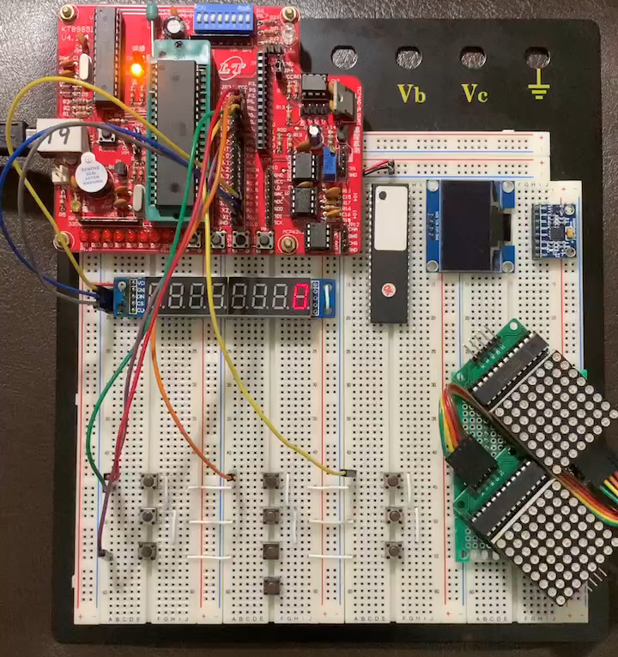
Practice 1

Slide 15
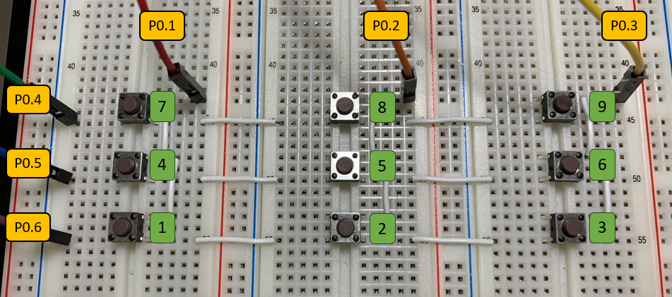
Practice 1

Slide 16
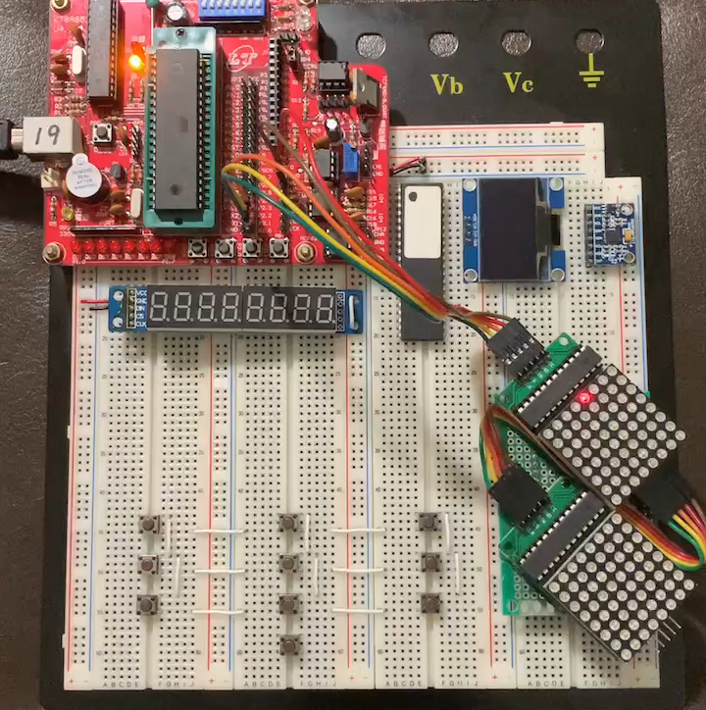
Practice 2

Slide 17
Outline
Beginning
Example Project
Practice
To Do List

Slide 18
To Do List
問問題(環境架設/Lab1/Lab2)
拿線(公母*11、母母*5)
Demo Lab1
完成Lab2

