Slide 1
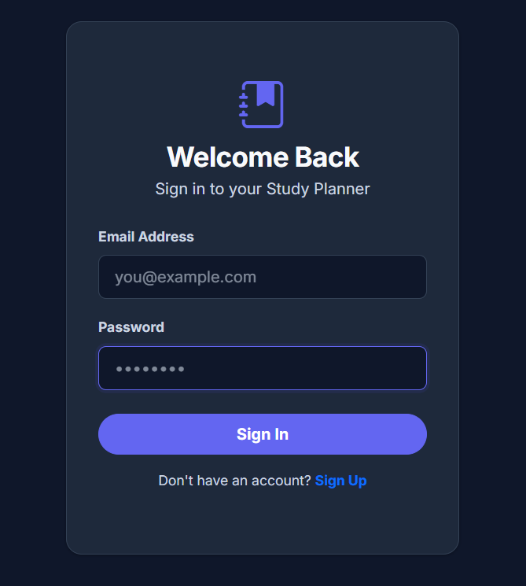
Smart Study Planner
A Web-Based Academic Task Management System
Mani Rithik CS-2341323
Department of Computer Science
April 2026

Slide 2
Problem Statement & Objectives
The Challenge
Project Goals
Students today juggle multiple courses, assignments, and deadlines across different subjects. Without a centralized system, it's easy to lose track of what's due when. Traditional paper planners can't adapt to changing priorities, and students lack tools to measure their productivity or maintain focus during study sessions.
Build an intelligent web application for academic task scheduling and priority management
Implement a Pomodoro focus timer to boost productivity through timed study sessions
Provide visual analytics dashboards to track study performance and completion rates
Enable calendar integration for seamless task synchronization across platforms
Support persistent note-taking and flashcard creation for comprehensive learning
Deploy the application as a publicly accessible web service
The absence of integrated tracking makes it difficult to assess study patterns, identify time sinks, or optimize learning strategies. Students need a comprehensive solution that combines task management with focus aids and performance analytics.

Slide 3



Technology Stack
The application follows a robust 3-tier MVC architecture, combining modern frontend frameworks with reliable backend technologies and cloud infrastructure.
Layer
Technology
Frontend
HTML5, CSS3, Vanilla JavaScript
Styling
Bootstrap 5, Custom CSS with Dark/Light Mode Toggle
Backend
Node.js + Express.js (RESTful API)
Database
MongoDB Atlas (Cloud-hosted NoSQL)
Charts
Chart.js for Interactive Visualizations
Hosting
Render Cloud + GitHub Integration
Browser Interface
Node.js Server
MongoDB Atlas
User interacts with responsive UI built with Bootstrap components
Express handles API requests, authentication, and business logic
Data persistence in AWS Mumbai region with automatic backups

Slide 4
Core Features
User Authentication
1
Secure sign-up, login, and logout functionality with session management. Passwords are hashed using bcrypt for security. Users can recover accounts and update profile information.
Smart Task Scheduler
2
Add, edit, and delete academic tasks with custom fields including priority levels, deadlines, subject categories, and estimated study hours. Tasks are automatically sorted by urgency.
Pomodoro Focus Timer
3
25-minute study sessions with 5-minute breaks, featuring streak-based gamification. Track consecutive completed sessions and maintain productivity momentum with visual streak counters.
Calendar Integration
4
Export tasks as .ics files compatible with Google Calendar and Apple Calendar. Sync deadlines across devices and receive native calendar notifications for upcoming due dates.
Performance Analytics
5
Interactive bar charts display completion statistics while doughnut charts visualize time distribution across subjects. Charts update in real-time as tasks are added or marked complete.
Notes & Flashcards
6
Full-page auto-saving notes system with rich text formatting. Create Q&A flashcards for active recall studying, exportable as study materials for exam preparation.

Slide 5
Intelligent Priority Algorithm
The application automatically sorts tasks using a dynamic Urgency Score calculation that considers both priority level and deadline proximity.
Urgency Score Formula
Priority Weights
Automatic Recalculation
Score = Priority Weight × (1 / Days Until Deadline)
High Priority: 3 pointsMedium Priority: 2 pointsLow Priority: 1 point
Tasks re-sort dynamically whenever a new task is added, completed, or modified. The system accounts for time decay as deadlines approach.
Higher scores appear at the top of the task list, ensuring critical work is prioritized.
Example Calculation
Task
Priority
Days Left
Score
Order
Math Assignment
High (3)
2 days
3 × 0.5 = 1.5
1st
History Essay
Low (1)
1 day
1 × 1.0 = 1.0
2nd
Science Lab
Medium (2)
5 days
2 × 0.2 = 0.4
3rd

Slide 6
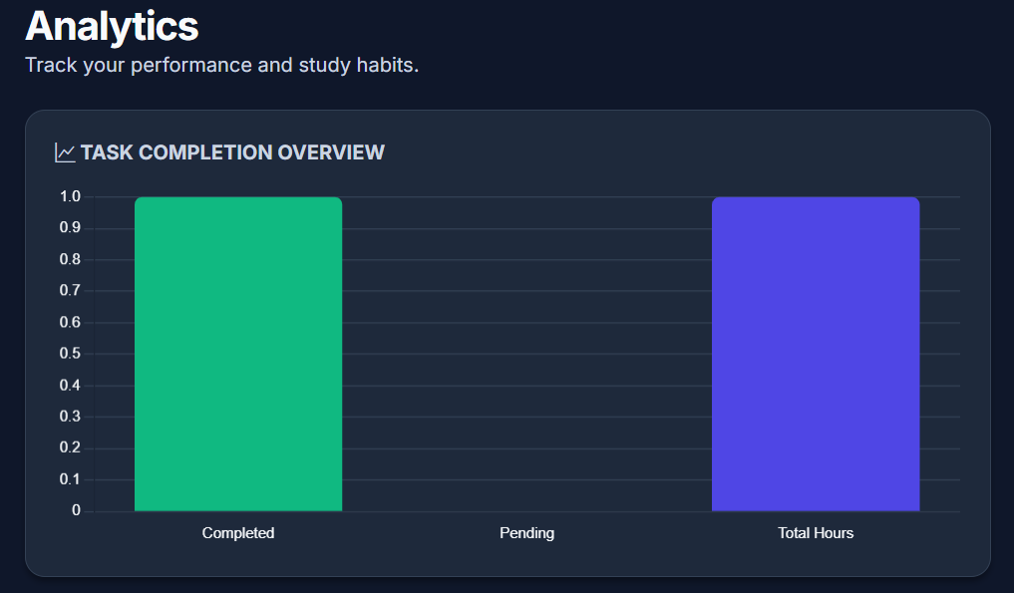
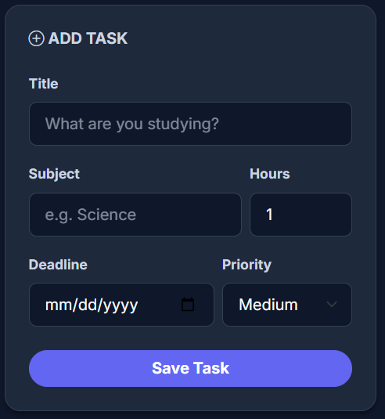
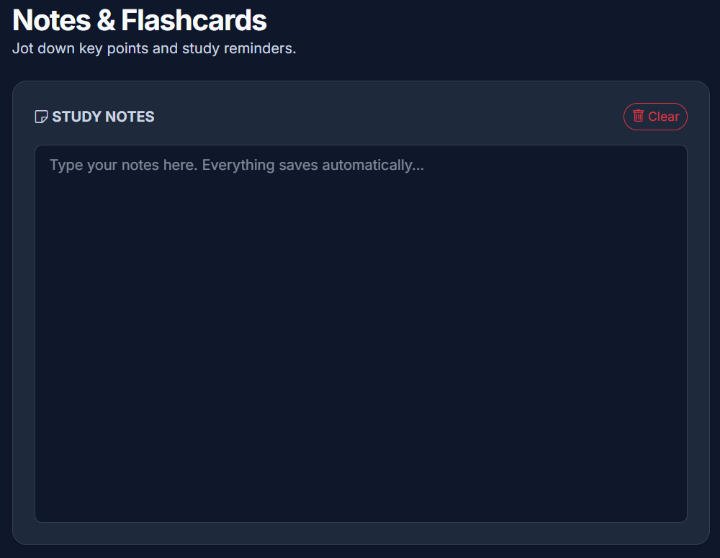
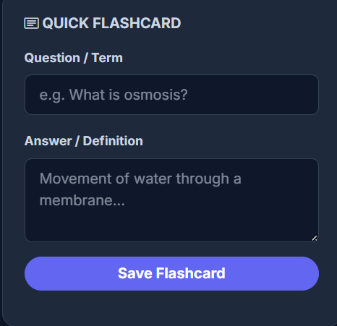
Application User Interface
The application features six dedicated views, each designed for a specific aspect of academic management. The dark mode interface reduces eye strain during late-night study sessions.
Login & Registration
Dashboard Overview
Clean centered card design with email and password fields. Supports both sign-up and login with dark mode toggle.
Personalized greeting displays total tasks, completed count, and logged study hours. Pomodoro timer runs in sidebar.
Schedule View
Add tasks with priority, deadline, subject, and hours. Full task list shows color-coded borders: Red (High), Yellow (Medium), Green (Low).
Notes System
Flashcard Creator
Full-page auto-saving notes with rich text formatting toolbar. Changes save instantly without manual save button clicks.
Q&A flashcard system for active recall studying. Create card decks by subject and export for mobile study.

Slide 7
Deployment Architecture
The application is hosted on Render's free tier, with code managed through GitHub and data stored in MongoDB Atlas cloud infrastructure.
Render Hosting Platform
Source Code Management
Free tier Node.js web service automatically deploys on every git push. Serves the application at smart-study-planner-4zb5.onrender.com
Code hosted on GitHub repository: rickyriffs16/smart-study-planner. Version control tracks all changes and enables collaboration.
Public Access
MongoDB Atlas
Application accessible worldwide at dedicated URL. HTTPS encryption secures all data transmission between clients and servers.
M0 Free Cluster hosted on AWS Mumbai region. Stores user accounts, tasks, notes, and analytics data with automatic backups.
Live Deployment
The application is publicly accessible at smart-study-planner-4zb5.onrender.com. Render automatically rebuilds and deploys the application whenever new code is pushed to the main branch of the GitHub repository.

Slide 8
Results & Conclusion
Project Outcomes
Future Enhancements
The Smart Study Planner successfully addresses the core challenges of academic task management. The deployed application combines intelligent scheduling, time management, analytics, and note-taking into a single accessible platform.
AI-Powered Study Paths
Integrate OpenAI API to generate personalized study recommendations based on course syllabi and performance data.
Fully functional web application accessible at smart-study-planner-4zb5.onrender.com
Smart urgency algorithm automatically sorts tasks by priority and deadline proximity
Four dedicated views: Dashboard, Schedule, Analytics, and Notes with seamless navigation
Real-time charts update automatically on every task addition or completion
Persistent data storage in MongoDB Atlas cloud database with automatic backups
Responsive design adapts to desktop, tablet, and mobile screen sizes
Browser Notifications
Implement push notifications for upcoming deadlines and Pomodoro session reminders, even when the app is not actively open.
Mobile Application
Develop React Native mobile app version for iOS and Android, syncing data with the web platform through the same API.
Collaboration Features
Add group study modes where students can share task lists, coordinate study sessions, and track team project progress.
Conclusion: The Smart Study Planner provides a comprehensive solution for academic task management by integrating scheduling, focus techniques, performance tracking, and note-taking into a unified web application. The intelligent priority system ensures students focus on what matters most, while analytics help identify productivity patterns and areas for improvement.

