Slide 1

Stayzey.com Accommodation Management System 141-T2/2016-AKL Edcorp International IT7x01 Project Final Presentation
Ricky Sun (21503099)
Feng Zhu (21503621)
Ridihima Anil Sareen (21502811)
Yu Xia (21503101)

Slide 2
Stay
Easy
Stayzey

Slide 3

Agenda
Background
Project Objectives
Scope
Deliverables
Requirements
Demonstration
Tools, Technologies & Platforms
Methodology
Issues & Challenges
Lessons Learnt
Future Work

Slide 4

Background - Client
Edcorp International
Provides IT solutions for connecting Indian students who study in New Zealand, located in 300 Queen Street
Knowledge about NZ & Indian Business Culture
Technical Expertise
EDCORP
Agent Management System (CRM)
Student Focussed Mobile Apps
Multi Platform Mobile Technology Solutions
Application Management Engines

Slide 5

Background - Project
Currently, there is no efficient communication channel between Indian students and Kiwi landlords before they arrived
The potential accommodation market became larger as the growing number of international students
A brand new web platform should be introduced for connecting Indian students and Kiwi landlords ASAP
Lack of development resources
A good opportunity for IT students in Whitireia

Slide 6

Background - Stakeholders
Client: Edwin Paul
Project Coordinator: Justin Joseph
Project Supervisor: Rohini Gaur
Project Manager & Developer: Ricky Sun
Developer: Yu Xia
Testers: Feng Zhu, Ridihima Anil Sareen

Slide 7





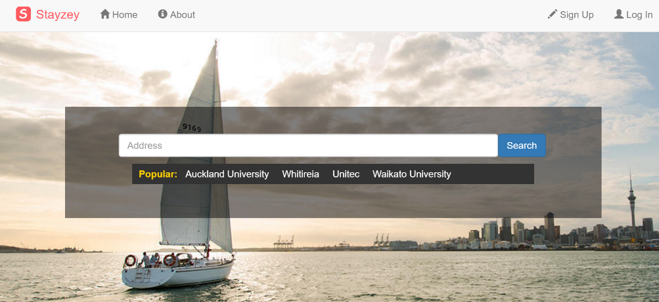
Project Objective

Slide 8

Scope
Stayzey.com Website
Product Scope
Landlords can list their accommodations
Project Scope
Stayzey Admin Panel
Documents
Landlords can manage received bookings
Students can query accommodations
Students can do accommodation bookings
…

Slide 9

Deliverables
Admin Panel
Documents
Website

Slide 10

Deliverables (cont.)
Website (stayzey.azurewebsites.net)
Source code: aspx, c#, js, css, html
Application resources: images, fonts
SQL script for initializing database
Admin Panel (stayzey-admin.azurewebsites.net)
Source code: aspx, c#, js, css, html
Documents
Proposal
Design (architecture, ER diagram)
Testing (cases, reports)
Handover book

Slide 11

Requirements
Landlords
List Accommodations
Manage Bookings
Students
Book Accommodations
Query Accommodations
Admins
Review Accommodations
Manage Users
Manage Listings
Manage Bookings
Data Reporting
System
Responsive Design
PayPal
Google Map
ASP.Net MVC

Slide 12

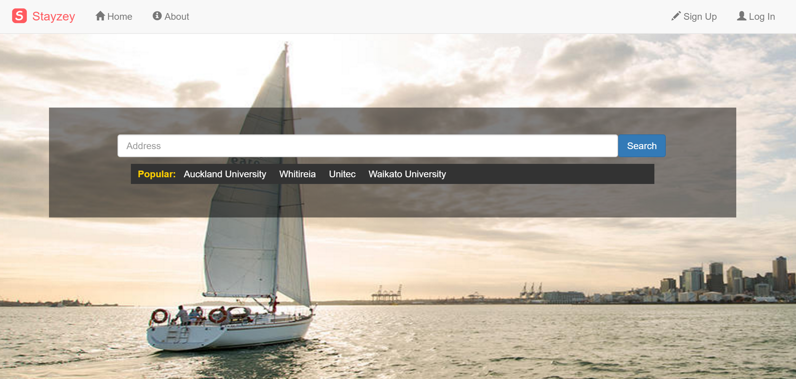
Demonstration

Slide 13



Demonstration - Workflow
List a new room
Request to book
Accept the request
Pay
Review

Slide 14






Tools
IDE
Database
Collaboration
Code Repository
Design

Slide 15








Technologies
ASP.NET MVC, ADO.NET, Entity Framework, LINQ
HTML5, CSS3, Media Query, Responsive Design
jQuery, Selectors, Events, jQuery Calendar, jQuery Ajax, JSON
Bootstrap, Grid Layout, Font Icons, Form Controllers, Modal Dialog
Easy UI, Grid, Text Field, Dialog, Buttons, Splitter
SQL Server, User-defined Function, Joined Query, Sub Query
Google Map API, PayPal API

Slide 16



Platforms

Slide 17

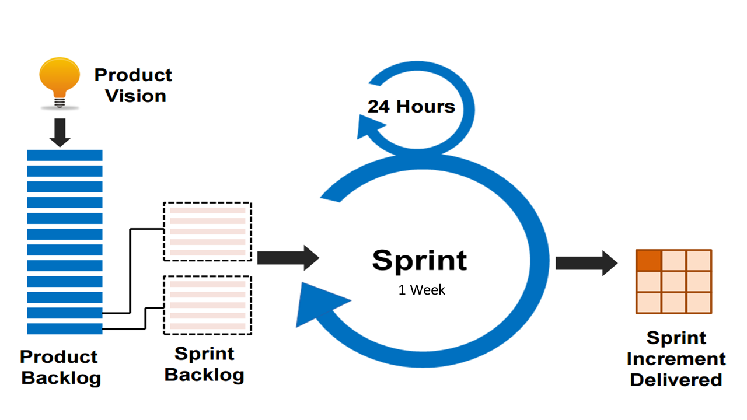
Methodology
Agile Scrum

Slide 18

Issues & Challenges
A green-field project built from scratch without any commercial engines
Build a totally working commercial website within 8 weeks with only two developers
Lack of commercial experience in ASP.NET MVC
Good looking design without professional web designer
Responsive design website which should be compatible with multiple browsers both on PCs and mobile devices
Security should be considered for protecting personal sensitive data

Slide 19

Lessons Learnt
Development life-cycle of a commercial website
Process of building websites by ASP.NET MVC
Usages of ADO.NET, Entity Framework and LINQ
Concepts and principles of building responsive design websites
Experience of developing geography-based information system
Experience of connecting website to payment gateway, such as PayPal
Experience of using Microsoft Azure
Full-stack development

Slide 20

Future Work
More pages need to be done, such as landlords’ home page, students’ home page
More functions should be added into the system
Operation history
Review students
More configurations on room listing
High availability and server clusters should be involved as the business grows

Slide 21

Questions

