Slide 1

Analysis of models
A Reprot of Assignment 1 of COMP472

Slide 2
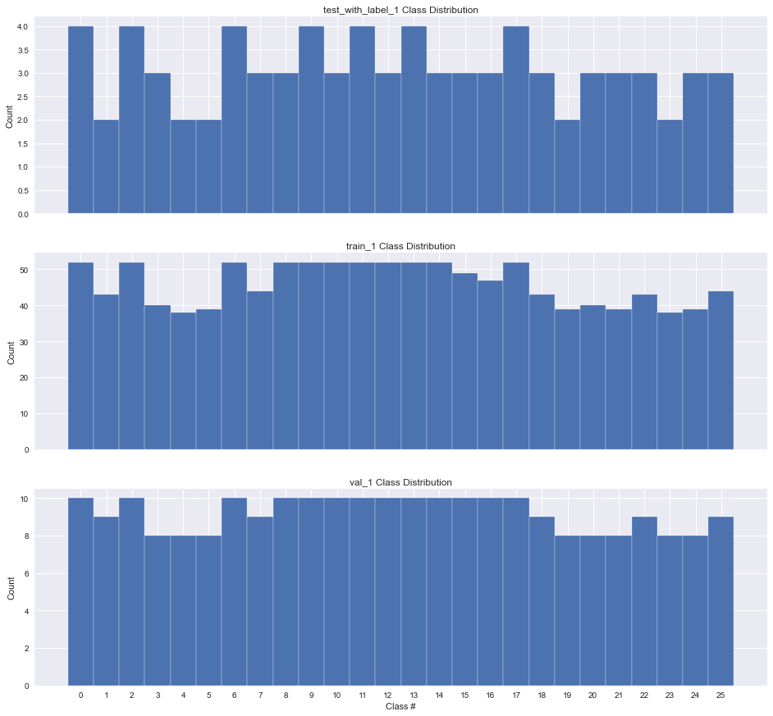
Comparation between training set and test/Val set 1

Slide 3
For data set 1, The validation set and test has similar distribution so the validation set “inspire” the training set for classification. However, some categories in training set have less representation than in the other two sets, which may lead to errors since they are relatively “under-trained”

Slide 4
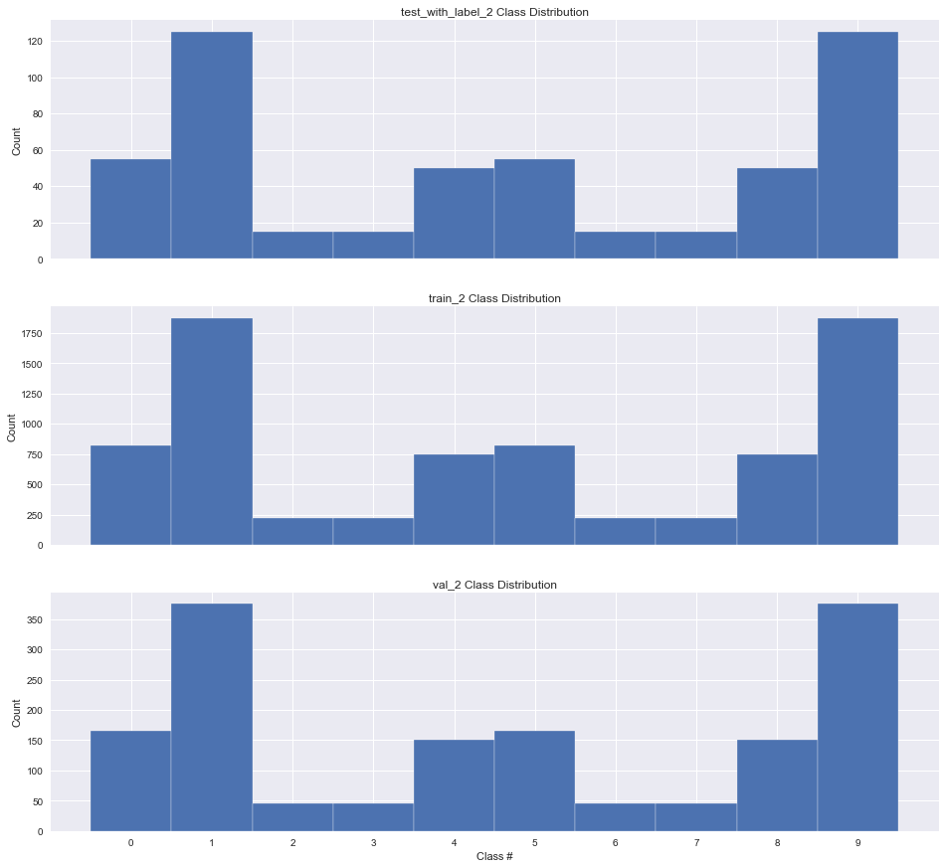
Comparation between training set and test/Val set 2

Slide 5
There are no visible difference between the training set and the val/test set. We can, in this case claim without experiments that DS2 will outperform DS1 in models we build since the ”experiences” a model learned from training set can be applied to test set without much tuning.

Slide 6
Metrics
In this classification problem, misclassifying a true character “A” as “B”(Recall cares) or a character classified as “B” turn out to be “A”(Precision cares) are both unpleasing. In this case we assignment both metrics with same importance, which justify the introduce of F1 measure.

Slide 7
Metrics
Since the test set data 1 have a close-to-uniform distribution, Macro F1 and Weighted F1 tend to show similarly, which is indeed the case for the experiments. The test set data 2 has varied distribution, so we expect Macro F1 and Weighted F1 have significant difference and make Weighted F1 the desire metric.

Slide 8
Model contracts Data set 1
Weighted-Average F1for | Gaussin Naive Bayes | Base Decision Tree | Best Decision Tree | Percept-ron | Base Multi-Layered Perceptron | Best Multi-Layered Perceptron | Tatal data cases for training | Total class for training | Case/-Class training
DS1 | 0.69 | 0.47 | 0.56 | 0.77 | 0.85 | 0.87 | 1197 | 26 | 46
DS2 | 0.68 | 0.79 | 0.77 | 0.83 | 0.88 | 0.90 | 7800 | 10 | 780

Slide 9
Data set 1 Vs data set 2
The previous table show that Data set 2 has generally better result than Data set 1, because the distribution of test set is similar to that of training set, in contrast the data set 1 is not the case. Also, the training case/class ratio of data set 2 is much more than its counterpart which means the model of data set 2 has better training for each class.

Slide 10
GNB vs Decision Tree
GNB often has better performance than Decision Tree in image classification. Since GNB is a generative model and the pattern of images also boost the concept of probability, the GNB has a good score in image categorization. Decision Tree works best for a small number of classes, more branches on a tree may lead to more of a chance of over-fitting, which reduces F1 mesure.

Slide 11
Data sufficiency for Decision tree
When sufficient data is available, Decision Tree can improve its performance significantly(0.79 and 0.77), better that GNB(0.68) which even slightly reduces it performance(But can also be improved if smooth is considered).

Slide 12
Performance drop of Best-DT for Data set 2
For data set 2 we noticed a performance drop(0.79 to 0.77) when we switch from base Decision Tree to Best Decision Tree. This is counter intuition. The reason is that Best DT strategy use a separate validation set to adjust hyper-parameter which can lead to over-fitting thus reducing the performance of our “Best” classifier.

Slide 13
Discussion of Best-DT model for Data set 1
The best Parameters found by grid search is {'class_weight': None, 'criterion': 'gini', 'max_depth': None, 'min_impurity_decrease': 0, 'min_samples_split': 4}
Setting min_samples_split and min_mipurity_decrease toto as small as possible, make max_depth to None can lead to more leafs thus may improve performance.
Gini is more appropriate here since Gini is intended for continuous attributes, and Entropy for attributes that occur in classes.
Since the distribution in validation set is nearly in uniform distribution, the difference of class_weight between balanced and None may be pretty small, its importance is reduced compared with the other factors.

Slide 14
Discussion of Best-DT model for Data set 2
The best Parameters found by grid search is {'class_weight': None, 'criterion': 'entropy', 'max_depth': None, 'min_impurity_decrease': 0.001, 'min_samples_split': 5}.
Generaly speaking, making min_impurity_decrease and min_samples_split as small as possible and making max_depth None can have bettern performance. But the grid search slightly increase them to avoid over-fitting. Same rease for class_weight and criterion.

Slide 15
Base MLP vs perception
For both data set, Base Multi-Layer Perception out performance the single layer perception(eg. 0.85 vs 0.77 for data set 1 and 0.88 vs 0.83 for data set 2). This simply show the power of one more layer in terms of performance improve, although the total nodes(30+50) is less than 100 of its counterpart.

Slide 16
Discussion of Best-MLP model for Data set 1
Best Parameters: {'activation': 'tanh', 'hidden_layer_sizes': (30, 50), 'solver': 'adam’}
For activation, tanh is similar to sigmoid, they both introducte non-linear but tanh is zero-centered and has bigger value scope([-1, 1]). The ReLu is Computationally efficient.
The default solver ‘adam’ works pretty well on relatively large datasets (with thousands of training samples or more) in terms of both training time and validation score. For small datasets, however, ‘lbfgs’ can converge faster and perform better.

Slide 17
Discussion of Best-MLP model for Data set 2
Best Parameters: {'activation': 'relu', 'hidden_layer_sizes': (30, 50), 'solver': 'adam'}

