Slide 1

Slide 1
Recruiter AI Tool
Smart and convenient way to connect with recruiters
Juan Leon
Nestor Mendoza

Slide 2


Slide 7
1.)
2.)
3.)
Why AI for Recruiters?

Slide 3
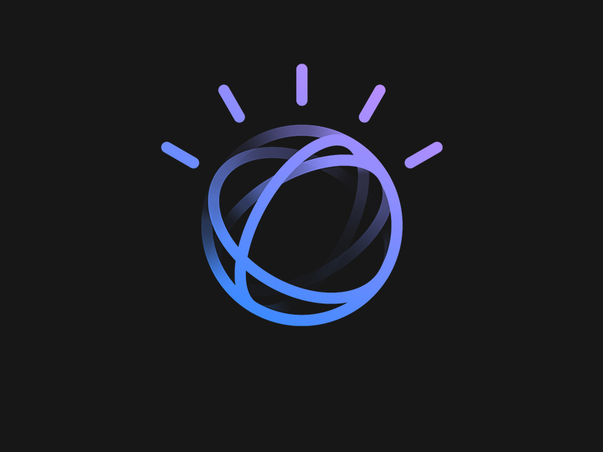



Technology

Slide 4

Demo Time
To the Batmobile...

Slide 5
Questions?

