Slide 1

FSWD80 CodeReview 09: Rent-a-Car company
Ricarda Nadler
Vienna, 08. November 2019

Slide 2


Rent-a-Car company: Step 1 – Requirement Analysis
Return location
Reservation
Agency
Customer
Invoice
Pick-up Location
Additional Charges

Slide 3
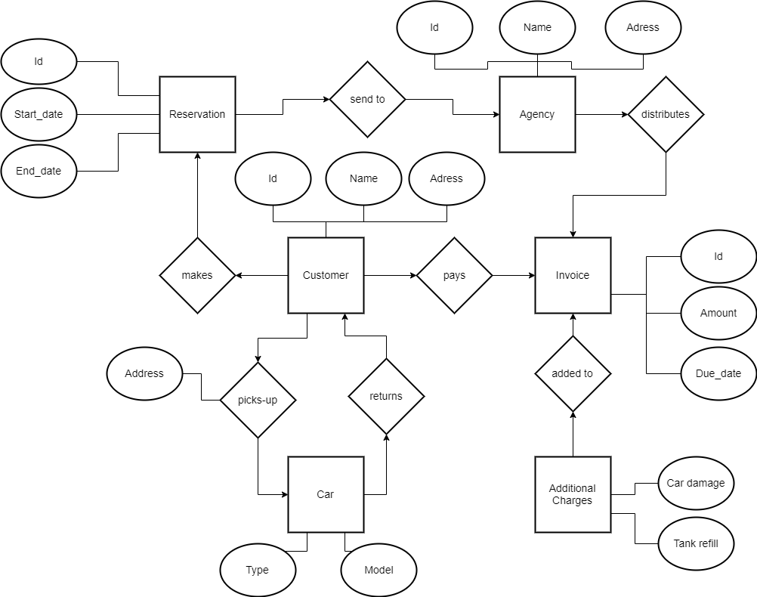
Rent-a-Car company : Step 2 – Entity Relationship Model

Slide 4
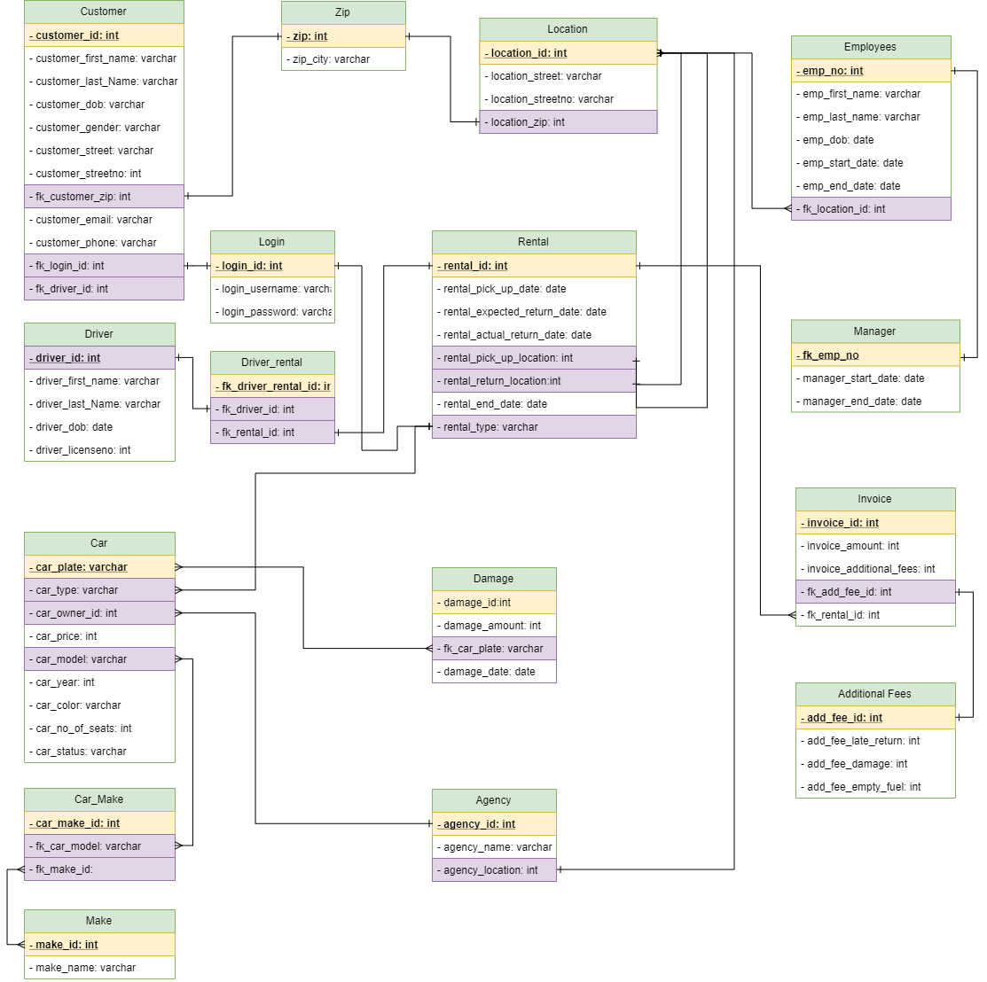
Rent-a-Car company : Step 3 – Unified Modeling Language (UML)

Slide 5
Rent-a-Car company : Step 4 – Refine & Normalize the Design
First normal form (1NF) sets the very basic rules for an organized database:
Define the data items required, because they become the columns in a table. Place related data items in a table.
Ensure that there are no repeating groups of data.
Ensure that there is a primary key.
Second Normal Form (2NF)
A table is 2NF, if it is 1NF and every non-key column is fully dependent on the primary key. Furthermore, if the primary key is made up of several columns, every non-key column shall depend on the entire set and not part of it.
Third Normal Form (3NF)
A table is in 3NF, if it is 2NF and the non-key columns are independent of each others. In other words, the non-key columns are dependent on the primary key- only on the primary key and nothing else.

