Slide 1
Renewable Energy Networks (REN)
R. Fernandes – 2023/NOV/14

Slide 2
Today’s Goal
To get familiar with the (software) tools needed to solve REN’s assignments. These tools are:
Python (high-level programming language that is becoming increasingly popular in the scientific/engineering realm)
Pandas (package for data manipulation and analysis in Python)
Matplotlib (package for creating static and interactive visualizations in Python)
Scikit-learn (package for machine learning in Python, which includes a PCA library)
Jupyter (web-based interactive computing platform where one can run Python code)
To achieve the goal, we will during this course:
Go through a brief introduction of some of the tools, namely: Python, Pandas and Matplotlib
Solve a basic exercise using these tools in your own computer
Walkthrough an (already solved) exercise to see the tools in action, as well as perform an analysis of the principal components (PCA) that govern a given time-series (we will attempt to run/replicate this exercise in your own computer)

Slide 3
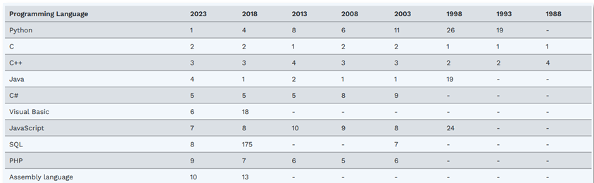
Python (Some Info)
High-level programming language created in 1995 by Guido van Rossum
Free and open-source (no licensing fees)
Simple and intuitive syntax (i.e. easy to learn)
Supports several programming paradigms (namely: procedural, object-oriented and functional)
Has thousands of packages that greatly extends its functionality (we will use some of these in the course)
Increasingly used in science/engineering
Official website: https://www.python.org
Programming languages popularity (source: TIOBE)

Slide 4
Python (Some Data Types)
Number (which can be an integer or a float). Examples:
x = 10
pi = 3.14
String (contiguous set of characters in between quotation mark). Example:
city = "New York"
List (collection of (heterogenous) values, which can have one or more dimensions). Examples:
colors = ["red", "green", "blue"] # colors[0] == "red", colors[1] == "green", colors[2] == "blue"
image_2d = [[2, 4, 5], [4, 8, 6]] # image_2d[0] = [2, 4, 5], image_2d[0][2] == 5
Dictionary (collection of key-value pairs). Example:
capitals = {"Norway": "Oslo", "Germany": "Berlin"} # capitals["Norway"] == "Oslo", capitals["Germany"] == "Berlin"

Slide 5
Python (Conditions)
The if-elif-else statement evaluates an expression, and if the expression is True, it then executes the indented code. Examples:
if x == 10:
print("x is equal to 10")
else:
print("x is not equal to 10")
if y < -10 or y > 10:
print("y is outside normal range")
if animal == "dog":
print("animal is a dog")
elif animal == "cat":
print("animal is a cat")
else:
print("unknown animal")

Slide 6
Python (Loops)
The for statement is used to iterate over sequences such as lists, dictionaries, strings, etc. Examples:
for i in range(10): # loop 10 times (from i = 0 to i = 9)
print(i)
for i in range(2):
for j in range(3):
print(image_2d[i][j])
for key in capitals:
print("The capital of %s is %s" % (key, capitals[key]))
The while statement is used for repeated execution as long as an expression is True. Example:
i = 0
while i < 10: # loop 10 times (from i = 0 to i = 9)
print(i)
i = i + 1

Slide 7
Python (Functions)
The def statement is used to define a function which is a block of organized code that is used to perform a single task, which enables better modularity and reuse-ability of code. It may receive zero or more arguments and optionally return zero or more values. Examples:
def hello():
print("Hello world!")
hello() # call function “hello” and print “Hello world!”
def multiply(a, b):
result = a * b
return result
print("2 * 3 is equal to %d" % multiply(2, 3)) # call function “multiply” and print “2 * 3 is equal to 6”

Slide 8
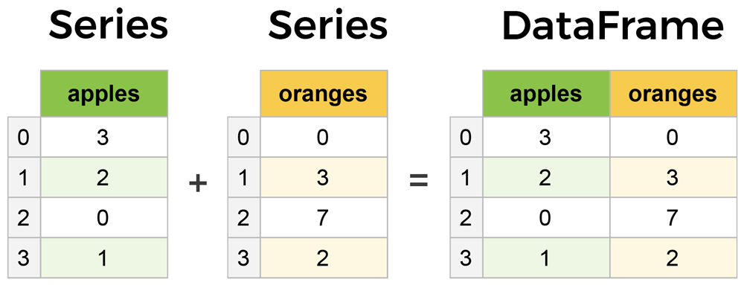
Pandas (Some Info)
The de facto package for data manipulation and analysis in Python
It revolves around two data structures, namely: Series (1D data) and DataFrame (2D data – a.k.a. tabular data)
Typical operations performed on these data structure are (to name a few):
loc (accesses a group of rows and columns by label(s))
min, max and mean (returns the minimum, maximum and mean value over the requested axis, respectively)
groupby (involves some combination of splitting the object, applying a function and combining the results)
drop (removes rows or columns from the data structure)
Official website: https://pandas.pydata.org
Pandas Series and DataFrame (source: https://www.learndatasci.com)

Slide 9
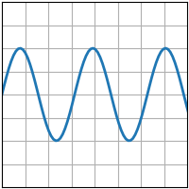
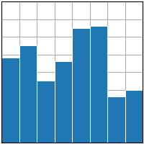
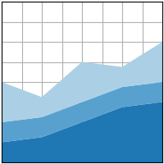
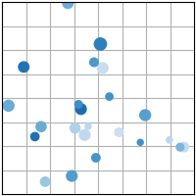
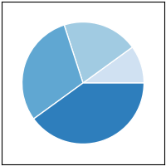
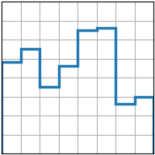
Matplotlib (Some Info)
The de facto package for data plotting and visualization in Python
It can either plot data stored in Python data types (to some extend) or Pandas data structures
Some of the most popular Matplotlib plots are:
plot
bar
stackplot
scatter
pie
stairs
Official website: https://matplotlib.org
Matplotlib plots (source: https://matplotlib.org/stable/plot_types)

Slide 10
How to Get/Install the Tools
First, install miniconda (which includes Python) to help installing all the tools needed by doing the following:
Open the web-page https://docs.conda.io/projects/miniconda
Scroll down to the “Quick command line install” section
Execute the instructions found in the section depending on the platform you are using (i.e. Windows, Linux or macOS) to install miniconda, as well as to open an Anaconda terminal once the installation is finished
Install Pandas by executing the following in the terminal: conda install pandas
Install Matplotlib by executing the following in the terminal: conda install matplotlib
Install Plotly by executing the following in the terminal: conda install plotly
Install Scikit-learn by executing the following in the terminal: conda install -c anaconda scikit-learn
Install Jupyter by executing the following in the terminal: conda install jupyter

Slide 11
Exercise (Preparation)
For the sake of synchronization in the classroom, create a new folder named “REN_workspace” – this is the folder from where we will launch Jupyter and save both the exercises and time-series related to this course
Open an Anaconda terminal (if not already opened) – see instructions on how to do this at the end of the web-page https://docs.conda.io/projects/miniconda
Go in folder “REN_workspace” by executing the following in the terminal: cd /path/to/REN_workspace
Run Jupyter from that folder by executing the following in the terminal: jupyter lab
After few seconds, a web-browser should open showing Jupyter – all set for the warm-up exercise!

Slide 12
Exercise (Description)
Within Jupyter, create a short Python script that:
Populates a 2D array implemented as a list (3x3), where row #0 stores 2, 4, 1; row #1 stores 3, -1, 5; and row #2 stores 2, 3, 1
Prints the sum of all values stored in the list
Prints the maximum value stored in each of row
Generates a plot displaying the maximum value stored in each row using Matplotlib

Slide 13
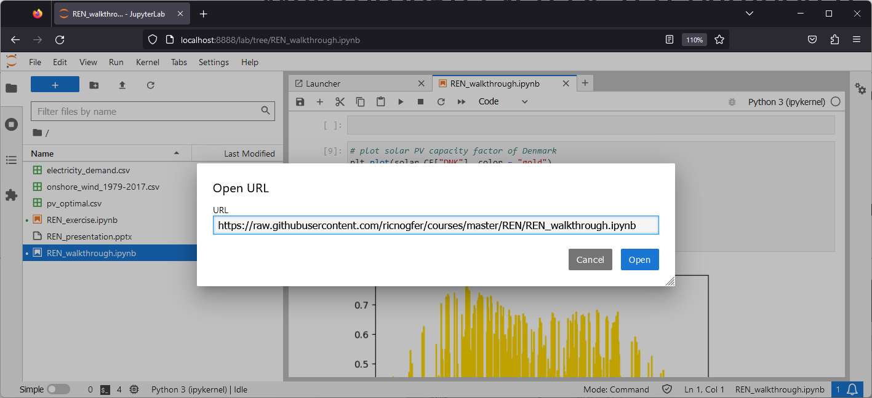
Walkthrough Exercise (Preparation I)
Within Jupyter, click on menu “File” and select option “Open from URL…”. Then, in the input text field, type the following and click button “Open” when finished:
https://raw.githubusercontent.com/ricnogfer/courses/master/REN/REN_walkthrough.ipynb
This will download a Jupyter notebook that has been prepared with an illustration of the tools previously mentioned in action, including the analysis of the principal components (PCA) that govern a given time-series in Python

Slide 14
Walkthrough Exercise (Preparation II)
Download wind capacity factor time-series of European countries (between the year 1979 and 2017) from https://zenodo.org/records/3253876/files/onshore_wind_1979-2017.csv and save the file in folder “REN_workspace”
Download solar PV capacity factor time-series of European countries (between the year 1979 and 2017) from https://zenodo.org/records/2613651/files/pv_optimal.csv and save the file in folder “REN_workspace”
Download electricity demand time-series of European countries (for the year 2015) from https://raw.githubusercontent.com/martavp/MESM_project/master/data/electricity_demand.csv and save the file in folder “REN_workspace”

