Slide 1
Lariat Fleet Analysis

Slide 2
Agenda
Financial Overview
Fleet Analysis
Fleet Recommendations
Financial Impact

Slide 3

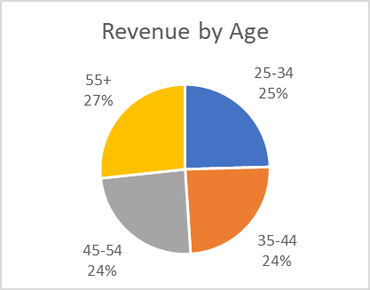
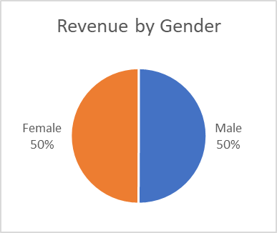
Financial Overview
Lariat 2018 Financial Overview
Number of Vehicles | 4000
Total Revenue | $ 64,866,040.00
Total Cost | $ 30,320,297.92
Total Profit | $ 34,545,742.08
Proft Margin | 53.26%
Profit per Vehicle | $ 8,636.44
Age Range | Revenue | Days Rented
25-34 | $15,928,240 | 98,366
35-44 | $15,823,890 | 97,388
45-54 | $15,806,448 | 97,551
55+ | $17,307,462 | 106,642
Gender | Revenue | Days Rented
Male | $32,461,144 | 200,197
Female | $32,404,896 | 199,750
*excludes December and partial November data

Slide 4

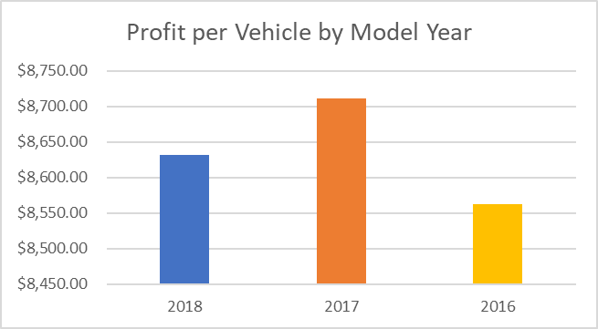
Fleet Analysis
2018 Fleet Data
Total Vehicles | 4000
Avg. Per Vehicle Revenue | $16,216.51
Avg. Per Vehicle Cost | $ 7,580.07
Avg. Per Vehicle Profit | $ 8,636.44
Avg. Days Rented per Vehicle | 100
Accident Rate | 1.24%
Model Year | # of Vehicles | Profit | Profit per Vehicle
2018 | 1355 | $ 11,696,122.28 | $ 8,631.82
2017 | 1361 | $ 11,855,534.32 | $ 8,710.90
2016 | 1284 | $ 10,994,085.48 | $ 8,562.37
*excludes December and partial November data

Slide 5
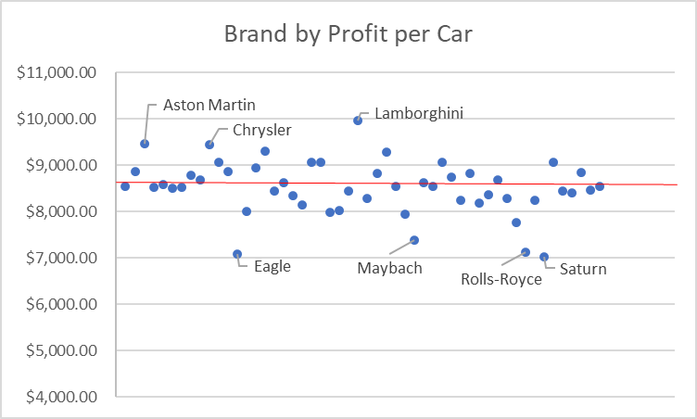
Fleet Analysis
Car Brand | # of Vehicles | Profit per Car
Aston Martin | 28 | $ 9,470.81
Chrysler | 70 | $ 9,445.03
Lamborghini | 26 | $ 9,963.48
Eagle | 14 | $ 7,080.58
Maybach | 10 | $ 7,374.30
Rolls-Royce | 6 | $ 7,129.49
Saturn | 22 | $ 7,024.06
*excludes Car Brands with less than 5 vehicles

Slide 6



Recommendation 1 - Model Year Transition
 | Model Year Transition
 |  | 2018 | 2019
 | Number of Vehicles | 4000 | 4000
 | Total Revenue | $ 64,866,040.00 | $ 65,766,040.79
 | Total Cost | $ 30,320,297.92 | $ 30,210,905.43
 | Total Profit | $ 34,545,742.08 | $ 35,555,135.36
 | Profit per Vehicle | $ 8,636.44 | $ 8,888.78
 | Profit Increase |  | $ 1,009,393.28
Sell 100 worst performing 2016 vehicles
Buy 5 of the top 20 best performing 2018 vehicles*
*excludes 2018 vehicles with less than 3 in fleet

Slide 7
Recommendation 2 - Brand Consolidation
Sell underperforming luxury and budget brands
 | Brand Consolidation
 |  | 2018 | 2019
 | Number of Vehicles | 4000 | 4000
 | Total Revenue | $ 64,866,040.00 | $ 64,985,331.65
 | Total Cost | $ 30,320,297.92 | $ 30,314,271.60
 | Total Profit | $ 34,545,742.08 | $ 34,671,060.05
 | Profit per Vehicle | $ 8,636.44 | $ 8,667.77
 | Profit Increase |  | $ 125,317.97
Purchase overperforming budget and luxury brands

Slide 8

Updated Financials
 | Updated Financials
 |  | 2018 | 2019
 | Number of Vehicles | 4000 | 4000
 | Total Revenue | $ 64,866,040.00 | $ 65,885,332.44
 | Total Cost | $ 30,320,297.92 | $ 30,204,879.11
 | Total Profit | $ 34,545,742.08 | $ 35,680,453.33
 | Profit per Vehicle | $ 8,636.44 | $ 8,920.11
 | Profit Increase |  | $ 1,134,711.25

