Slide 1
Housing Data Analysis
Factors Driving Home Prices for Mortgage Backed Security Research

Slide 2
Agenda
Housing Data Overview
Neighborhood Statistical Analysis
Lot Configuration Statistical Analysis
Square Footage Statistical Analysis
Recommendations

Slide 3

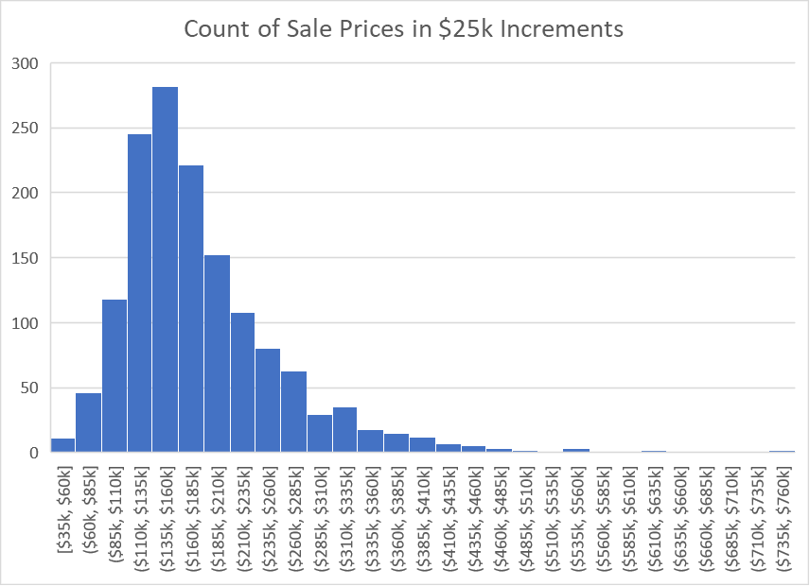
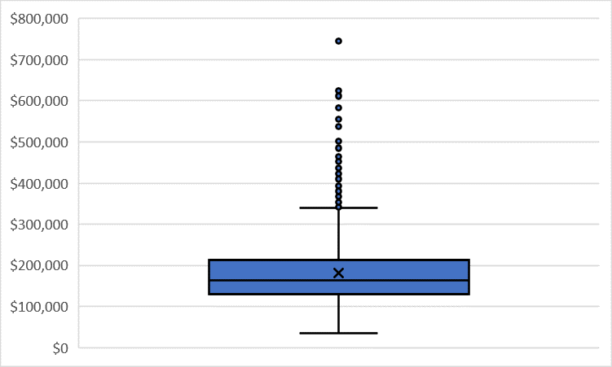
Housing Data Overview

Slide 4
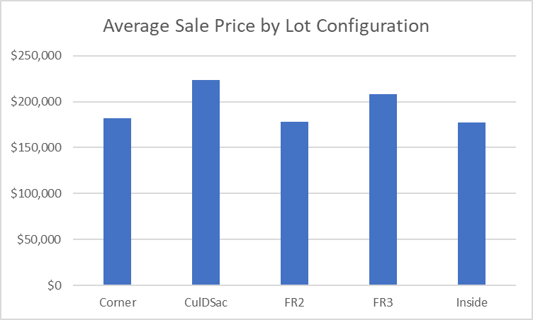
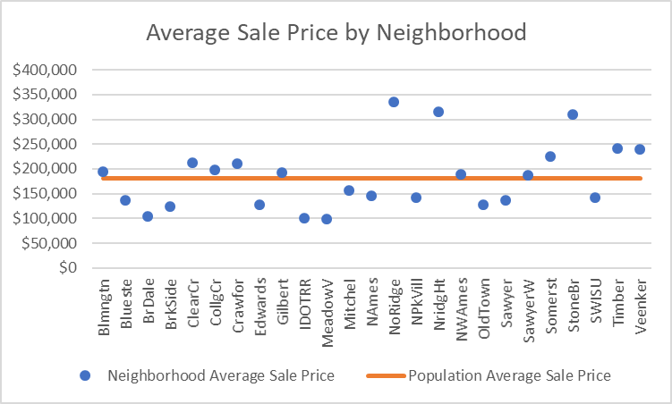
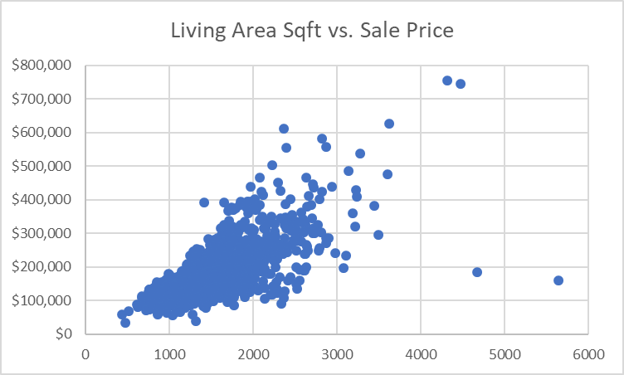
Housing Data Overview

Slide 5

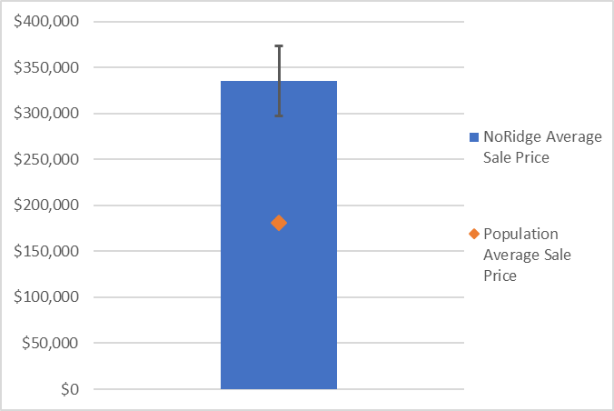
Neighborhood Statistical Analysis
On average, are homes located in North Ridge sold at a different price than all homes in Ames, IA?

Slide 6
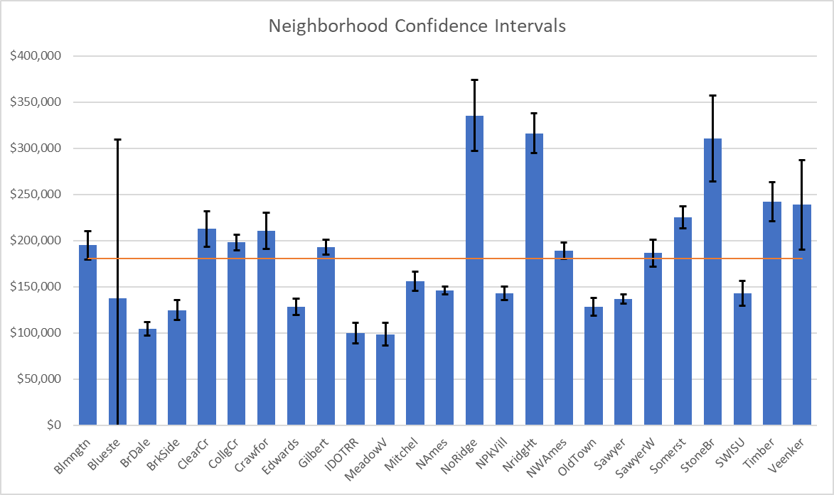
Neighborhood Statistical Analysis
*large confidence interval for Blueste due to small sample size (2)

Slide 7

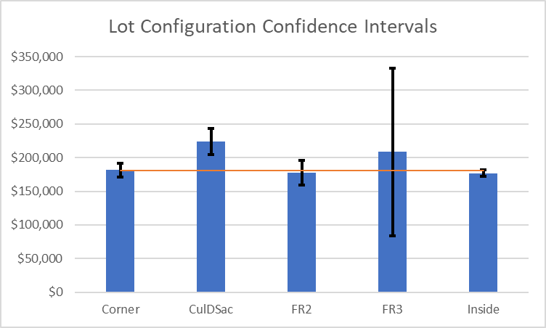
Lot Configuration Statistical Analysis
On average, are homes with a specific lot configuration sold at a different price than all homes in Ames, IA?
*large confidence interval for FR3 due to small sample size (4)

Slide 8

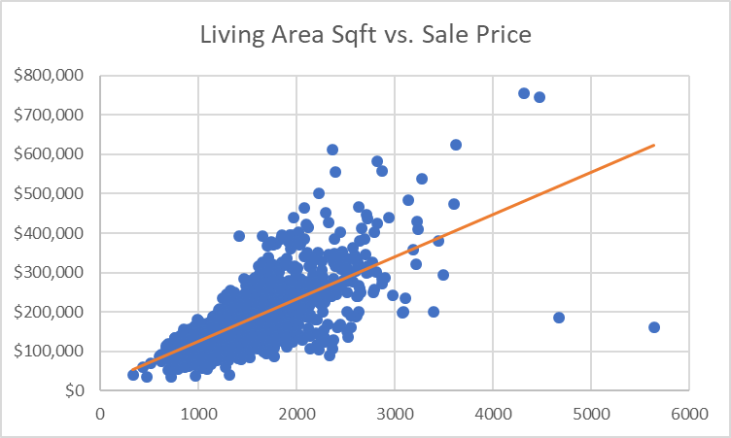
Square Footage Statistical Analysis
Does above grade living area size affect the price of homes?
$$SalePrice=\$18,569.03+\left(\$107.12 ×GrLivArea\right)$$

Slide 9

Recommendations
When purchasing mortgage backed securities…
Lot configuration (excl. cul-de-sac)
Consider:
Ignore:
Neighborhood location
Above grade living area

