Slide 1
NFL Play Analysis
Calculating Offensive Play Tendencies on 3rd Down

Slide 2
Agenda
NFL Rules Overview
Data Overview
3rd Down Play Analysis
Results
Recommendations

Slide 3

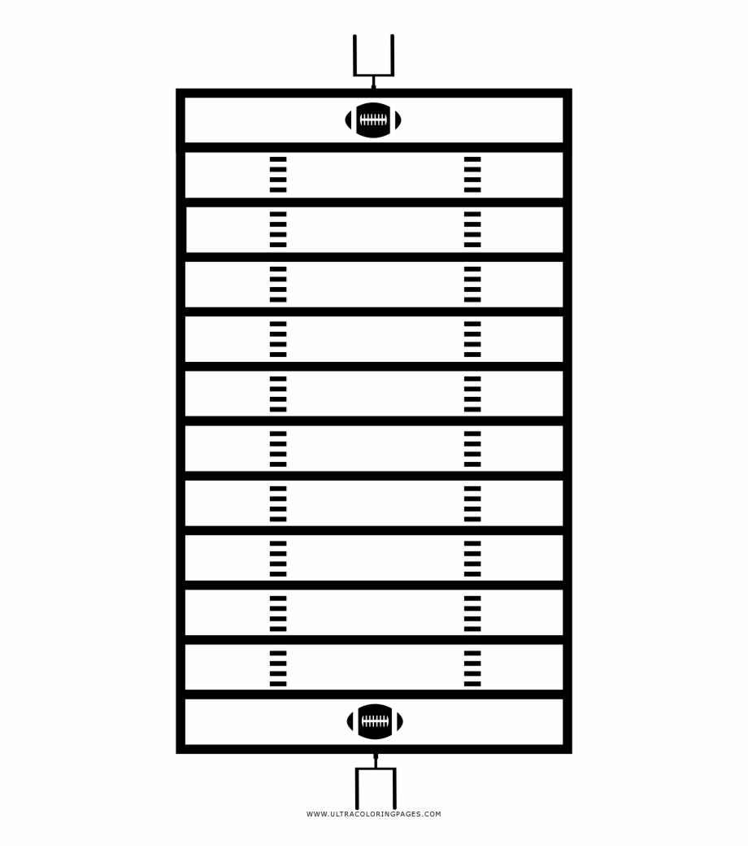
NFL Rules Overview
Offense has 4 tries (downs) to advance ball 10 yards
Offense can run two types of plays:
Rush play (handing the ball off to a player who runs forward)
Pass play (throwing the ball to a player who is already forward)
Defense attempts to stop offense from advancing ball
Most teams will punt ball down field on 4th down (their final try)
Stopping offense on 3rd down allows defense to receive ball
10
20
30
40
50
40
30
20
10

Slide 4

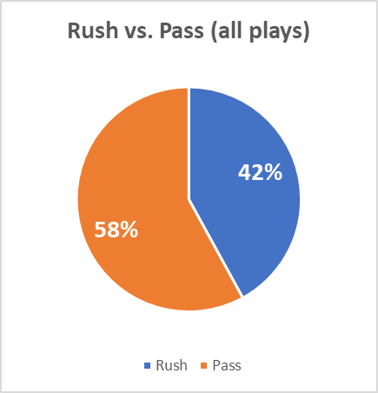
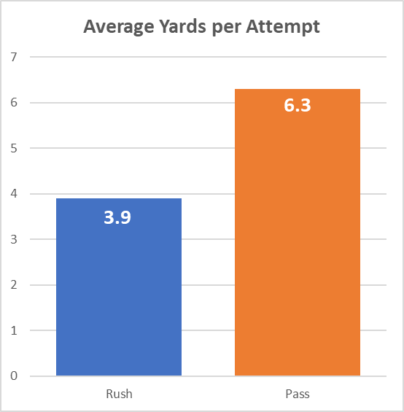
NFL Play Data Overview
450,000 plays from 2009-2018
250 columns of data for each play:
Down
Distance to Go
Rush Attempt
Pass Attempt
Source: https://www.kaggle.com/maxhorowitz/nflplaybyplay2009to2016/download

Slide 5

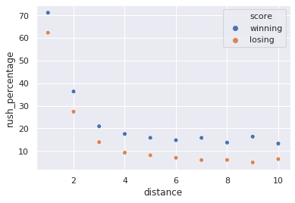
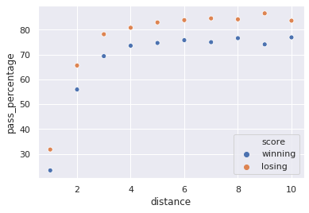
3rd Down Play Analysis
Are teams more likely to rush or pass on varying 3rd Down distances?
Are these percentages affected by whether the offensive team is winning or losing?
Rush Percentage
Pass Percentage

Slide 6

Results
A team is more likely to rush on 3rd Down & 1
A team is more likely to pass on 3rd Down & 2-10
A team that is losing increases chance of passing by about 10 percentage points for all 3rd Down attempts

Slide 7

Recommendations
When playing defense and it is 3rd Down &…
1 yard:
2-10 yards:
Call a run defense play
Call a pass defense play
Future Considerations:
Tendencies by Team
Game situations
Win Probability

