Slide 1
Access Control
Nov 2015
Richard Andersen
Notes:
Das Ziel dieser Präsentation ist, die aktuellen PIA Frameworks aufzulisten und eine Diskussions-Grundlage für künftige Entwicklungen zu schaffen.

Slide 2
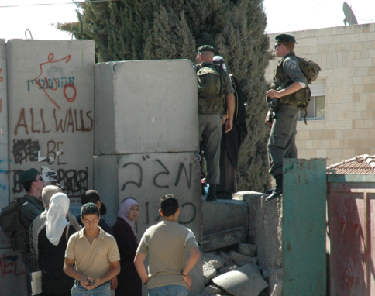
Access Control
Check Point
Login Screen
Acquire ID
Show ID
Verify ID
Look up Rights
Approve
Disapprove
Access Resource
Motivation
Desire to be safe
Distinguish between Insider and Outsider
Secure Border by Building Wall
Identify Individuals
Grant Access at Check Points
Access
Granted
Access
Denied

Slide 3
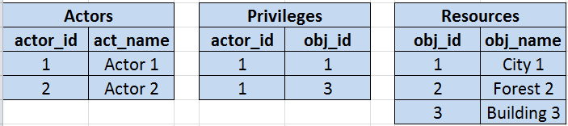

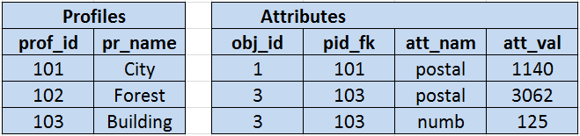
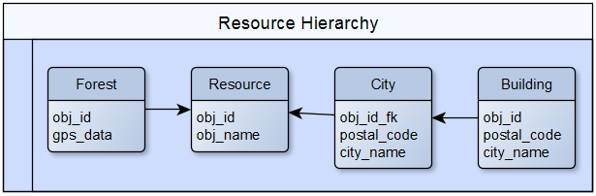
Resources & Attributes & Profiles
Resources
Grouped by
(1) Common Attributes
(2) Common Ancestry

Slide 4
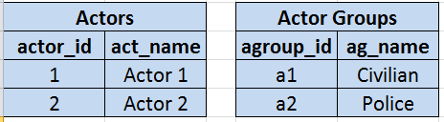
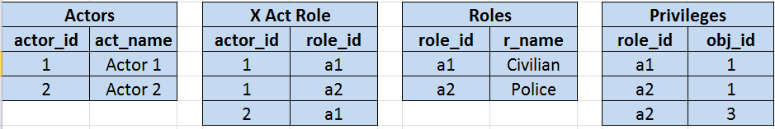
Actors & Groups & Roles
Actors assigned
(1) Single Group
(2) Multiple Roles

Slide 5
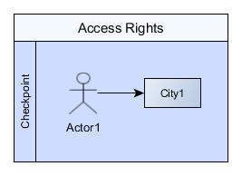
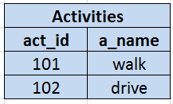
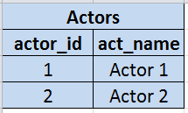
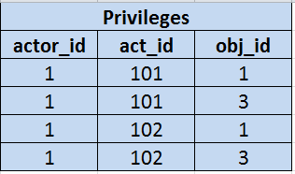
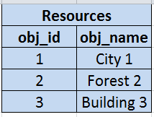
Activities
Privilege1 -> Actor1 Access City1
Privilege -> [Subject] [Predicate] [Object]
-> right to execute -> particular action -> on specific object

Slide 6
Access Control 2
Check Point
Login Screen
Acquire ID
Credentials
I.D.
-> attestation by authority
-> issued by a third party
e.g:
-> I.D.
-> username & password
-> identity document
-> stating personal identity
identification
-> act of presenting I.D.
Show ID
Identification
Verify ID
Authentication
2FA
-> confirming an attribute
e.g:
-> due to seal on passport
-> system validates password
-> two-factor authentication
thing you know & thing you own
knowledge factors
ownership factors
inherence factors
-> (biometric, DNA, signature)
-> Anhaften, Innewohnen
Look up Rights
Audit
session -> begin - end
login -> failed attempts

Slide 7
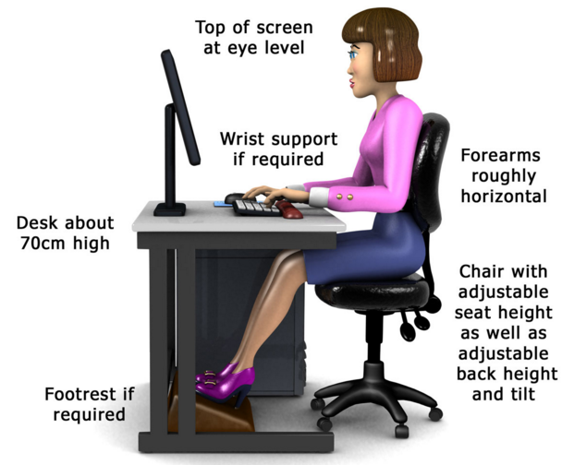
Safety -> Being safe Security -> Becoming safe
Safety
-> being protected against non-desirable events
-> "something bad will never happen"
Computer Safety
-> "the computer is safe"
-> IT security can help
-> fail-over hardware can help
Safety
Security
-> protection against danger, damage, loss, and crime
-> level of safety
Computer Security (cybersecurity) -> Protection
-> of system hardware from theft or damage
-> of software and information
-> from disruption or misdirection of service
-> from malpractice by operators
-> intentional or accidental deviation from secure procedures
Stages
vulnerable | no safety
reactive | after
compliant | rules based
proactive | anticipating
resilient | adaptive

Slide 8
Links
https://lostechies.com/derickbailey/2011/05/24/dont-do-role-based-authorization-checks-do-activity-based-checks/
Oracle
https://docs.oracle.com/cd/B14117_01/network.101/b10773/authoriz.htm#1009619

Slide 9
This Concludes Today’s Presentation. Thank you.

