Slide 1
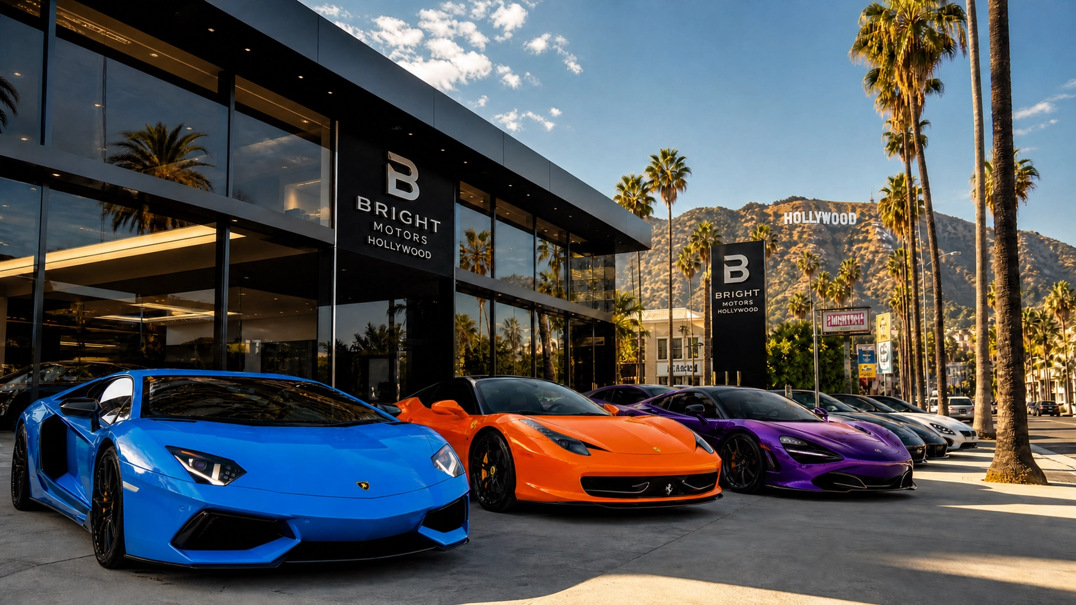
BRIGHT MOTOR
Sales Analysis
Comprehensive Business Intelligence Report
Strategic Insights from 540K+ Vehicle Transactions • 1984 – 2015
Prepared by Pascal Mmamogopodi
Date
April 2026

Slide 2
Executive Summary
Headline metrics from 31 years of operations
TOTAL SALES
TOTAL REVENUE
AVG SELLING PRICE
DATA PERIOD
540,008
$7.39B
$13,686
1984–2015
vehicles sold
gross revenue
per vehicle
31 years coverage
Performance Overview
Bright Motor processed over half a million vehicle transactions across three decades, generating $7.39 billion in revenue. The economy segment drives volume while luxury commands premium pricing, with peak performance observed in 2012–2013. Profitability remains a key challenge, requiring focused pricing strategy refinement.
Bright Motor | Sales Analysis Report
2 / 12

Slide 3
Market Segment Performance
Volume vs. revenue distribution across three segments
Economy
415K sales
77% of volume
$5.23B revenue
Luxury
94K sales
17% of volume
$1.91B revenue
Mid-Range
31K sales
6% of volume
$251M revenue
Key Insight
Economy dominates volume; Luxury commands premium pricing per unit.
Bright Motor | Sales Analysis Report
3 / 12

Slide 4
Sales Trend Over Time
Annual transaction volume, 1984 – 2015
PEAK YEARS
GROWTH TRAJECTORY
2012–2013: 96K+ transactions per year (all-time high)
Steady expansion 1984–2011, sharp acceleration through 2013
Bright Motor | Sales Analysis Report
4 / 12

Slide 5
Top Performing Brands
Top 5 manufacturers by total vehicle sales
Rankings
#1
Ford
92,074
92,074 sales
#2
Chevrolet
59,219
59,219 sales
#3
Nissan
53,279
53,279 sales
#4
Toyota
39,340
39,340 sales
#5
Dodge
30,233
30,233 sales
Bright Motor | Sales Analysis Report
5 / 12

Slide 6
Geographic Distribution
Revenue concentration by US state
Top 5 States
# | State | Revenue
1 | California | $1.31B
2 | Pennsylvania | $1.12B
3 | Florida | $1.05B
4 | Texas | $0.98B
5 | New York | $0.92B
Key Markets
California, Pennsylvania, and Florida each generate $1B+ in revenue, representing the company's strongest geographic markets.
Bright Motor | Sales Analysis Report
6 / 12

Slide 7
Revenue Analysis
Total revenue and average selling price evolution
PRICE EVOLUTION
REVENUE PEAK
PEAK YEAR
$5K → $27K
$2.5B+
2012
Bright Motor | Sales Analysis Report
7 / 12

Slide 8
Body Type & Transmission Preferences
Customer preferences across vehicle attributes
Revenue by Body Type
Transmission Preference
Bright Motor | Sales Analysis Report
8 / 12

Slide 9
Profitability Analysis
Net wholesale loss with negative margin across segments
NET WHOLESALE LOSS
-$84.3M
-12.2% margin
Root Cause
Vehicles consistently sold below MMR (Manheim Market Report wholesale value), eroding unit economics across all segments. Pricing strategy and acquisition cost discipline require immediate review.
Bright Motor | Sales Analysis Report
9 / 12

Slide 10
Seasonal Patterns
Monthly sales activity across the calendar year
PEAK MONTHS
PLANNING IMPLICATION
May–June: highest activity of the year
Align inventory and marketing spend to spring/summer demand
Bright Motor | Sales Analysis Report
10 / 12

Slide 11
Key Insights & Recommendations
Strategic priorities for the next planning cycle
1
Segment Strategy
Economy drives volume; Luxury offers superior unit economics. Rebalance the portfolio mix.
2
Brand Concentration
Ford and Chevrolet dominate market share — deepen these supplier relationships.
3
Geographic Expansion
CA, PA, and FL anchor revenue. Build a focused expansion playbook for adjacent states.
4
Seasonal Marketing
Spring and summer drive peak demand — concentrate marketing investment there.
5
Margin Recovery
Vehicles selling below MMR. Overhaul acquisition pricing to reverse the -12.2% margin.
Bright Motor | Sales Analysis Report
11 / 12

Slide 12
Appendix & Data Sources
Methodology, sources, and contact
Methodology
Data Sources
Contact & Notes
Aggregated 540,008 vehicle transaction records
Period: January 1984 – December 2015
Revenue measured at gross selling price
Profitability benchmarked against MMR wholesale values
Internal Bright Motor sales ledger
Manheim Market Report (MMR) wholesale benchmarks
US state registration filings
Manufacturer brand classification
Business Intelligence Team
analytics@brightmotor.example
Refresh cadence: quarterly
Figures rounded for presentation clarity
Bright Motor | Sales Analysis Report
12 / 12

