Slide 1
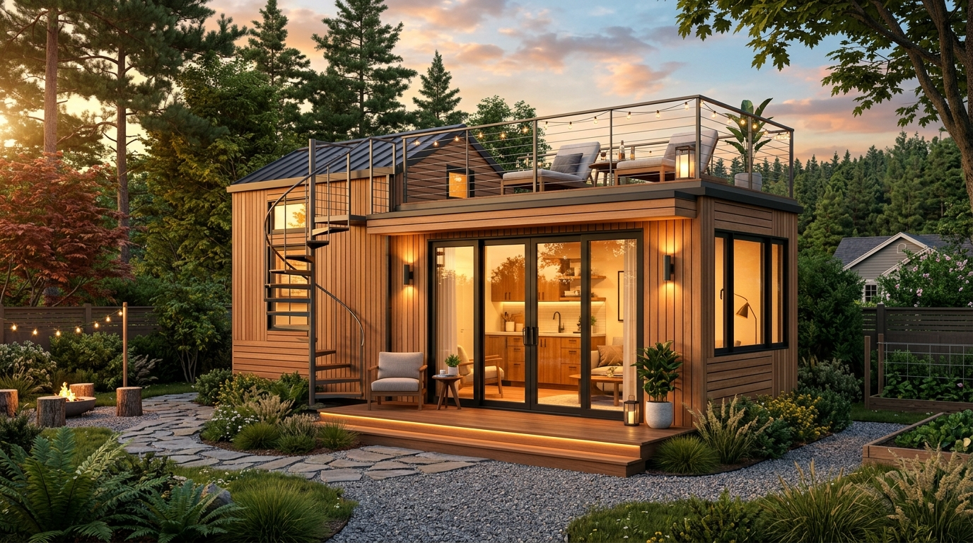
S2A MODULAR • HAAS PORTFOLIO
Next-Gen Modular ADU & Tiny Home Collection
Complete Architectural CAD Floorplans & Turnkey Housing-as-a-Service (HaaS) Revenue Suite.
Zero Upfront Capital • Passive Homeowner Revenue • Turnkey Operator Delivery

Slide 2
HOUSING-AS-A-SERVICE (HAAS) ECONOMICS
The Zero-CapEx Turnkey Backyard Revenue Model
1. Homeowner Benefit
$500 – $1,000 / Mo Net
Homeowners license unused backyard space for zero upfront cost. Operator funds permitting, foundation, unit fabrication, crane installation, and tenant management.
2. Operator Economics
$1,500 – $2,200 / Mo Net Yield
High-ADR mid-term corporate executive, traveling medical, and high-quality long-term tenant placement yields 18–24 month capital payback per installation.
3. Precision Modular Speed
30-Day Delivery Timeline
S2A factory-built offsite construction eliminates 90% of neighborhood disruption. Site utility trenching and crane set takes under 48 hours.

Slide 3
MODEL 01 • MODERN LUXURY ADU
The Haven (14' × 29' • 350 Sq. Ft.)
DIMENSIONS: 14' × 29'-0" | LIVING AREA: 350 Sq. Ft.
Est. Monthly Rent: $2,200 – $2,950 / mo
Homeowner Passive Net: $650 – $950 / mo
Architectural & Blueprint Highlights:
• Full rooftop sky lounge deck with spiral staircase access
• 4'-0" integrated covered front porch
• Open kitchenette & living room with roof skylight access
• Private bedroom with double wardrobe closet & full bathroom
• Large sliding glass patio doors for indoor-outdoor flow
Ideal Placement: Upscale suburban backyards, premium view lots, executive retreats.

Slide 4
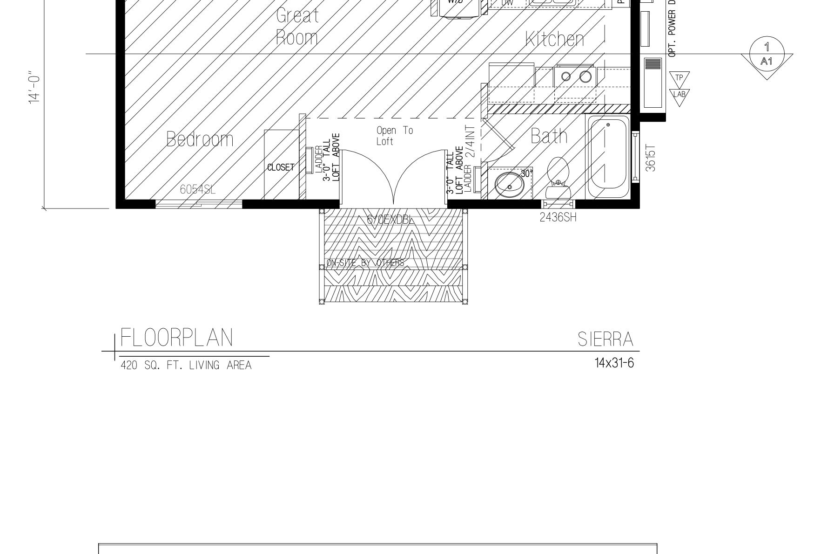
MODEL 01 • ARCHITECTURAL PLAN
The Haven Floorplan (14' × 29' • 350 Sq. Ft.)
OFFICIAL CAD BLUEPRINT SPECIFICATIONS
Factory Framed & State Approved
• Covered Porch: 4'-0" integrated covered front entry porch with recessed downlights.
• Great Room & Kitchen: Open 14' wide living space with roof skylight access hatch.
• Private Bedroom: Ground floor bedroom with dual 2442SH egress windows & double closet.
• Full Bathroom: 3-3060 shower, vanity, toilet, and dedicated stack washer/dryer.
• Rooftop Deck: Optional rooftop terrace accessed via site-installed spiral stairs.
✓ Sealed Architectural Drawing Number A1

Slide 5
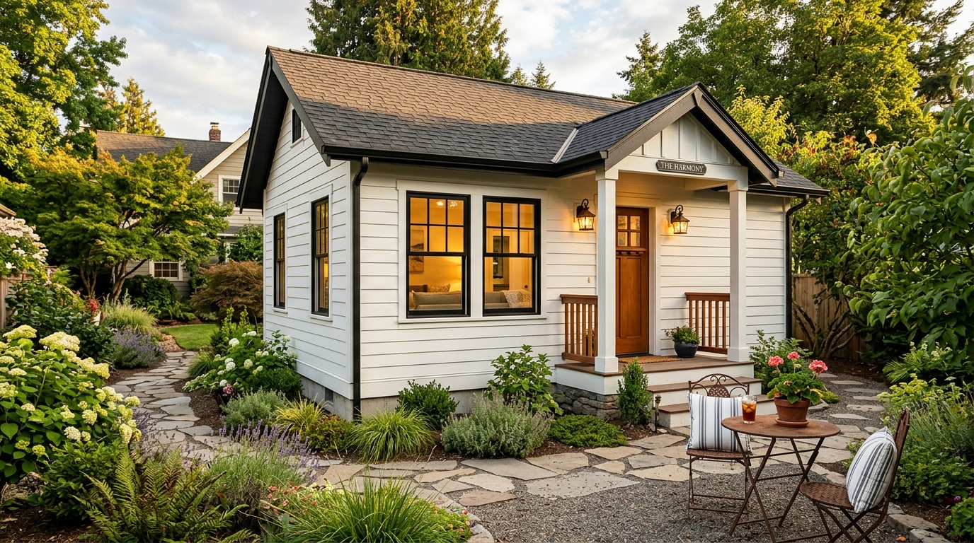
MODEL 02 • MODERN CRAFTSMAN COTTAGE
The Harmony (14' × 24' • 348 Sq. Ft.)
DIMENSIONS: 14' × 24'-0" | LIVING AREA: 348 Sq. Ft.
Est. Monthly Rent: $1,850 – $2,350 / mo
Homeowner Passive Net: $550 – $800 / mo
Architectural & Blueprint Highlights:
• Classic pitched gabled roofline with architectural shingles
• Welcoming covered front portico with artisan coach lights
• Smart-lap horizontal white siding with black frame windows
• Spacious Bed/Living open studio layout with full kitchen
• Complete bathroom with 3-3060 shower and stack W/D
Ideal Placement: Traditional HOA neighborhoods, in-law suites, historic districts.

Slide 6
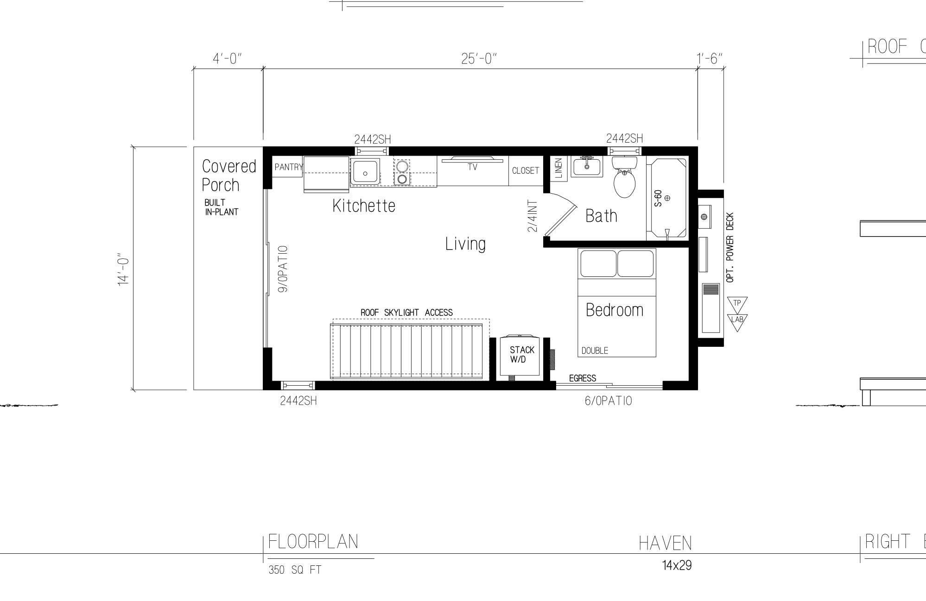
MODEL 02 • ARCHITECTURAL PLAN
The Harmony Floorplan (14' × 24' • 348 Sq. Ft.)
OFFICIAL CAD BLUEPRINT SPECIFICATIONS
Factory Framed & State Approved
• Bed/Living Suite: Large 14' × 12' open living/bedroom area with 3060SH windows.
• Full Kitchen: Complete cooktop, sink, refrigerator, and pantry cabinet.
• Full Bathroom: Enclosed private bath with 3-3060 fiberglass shower stall.
• Laundry & Storage: Built-in stackable W/D closet with 2/4 INT door.
• Front Portico: Covered stoop with classic artisan architectural trim.
✓ Sealed Architectural Drawing Number A1

Slide 7
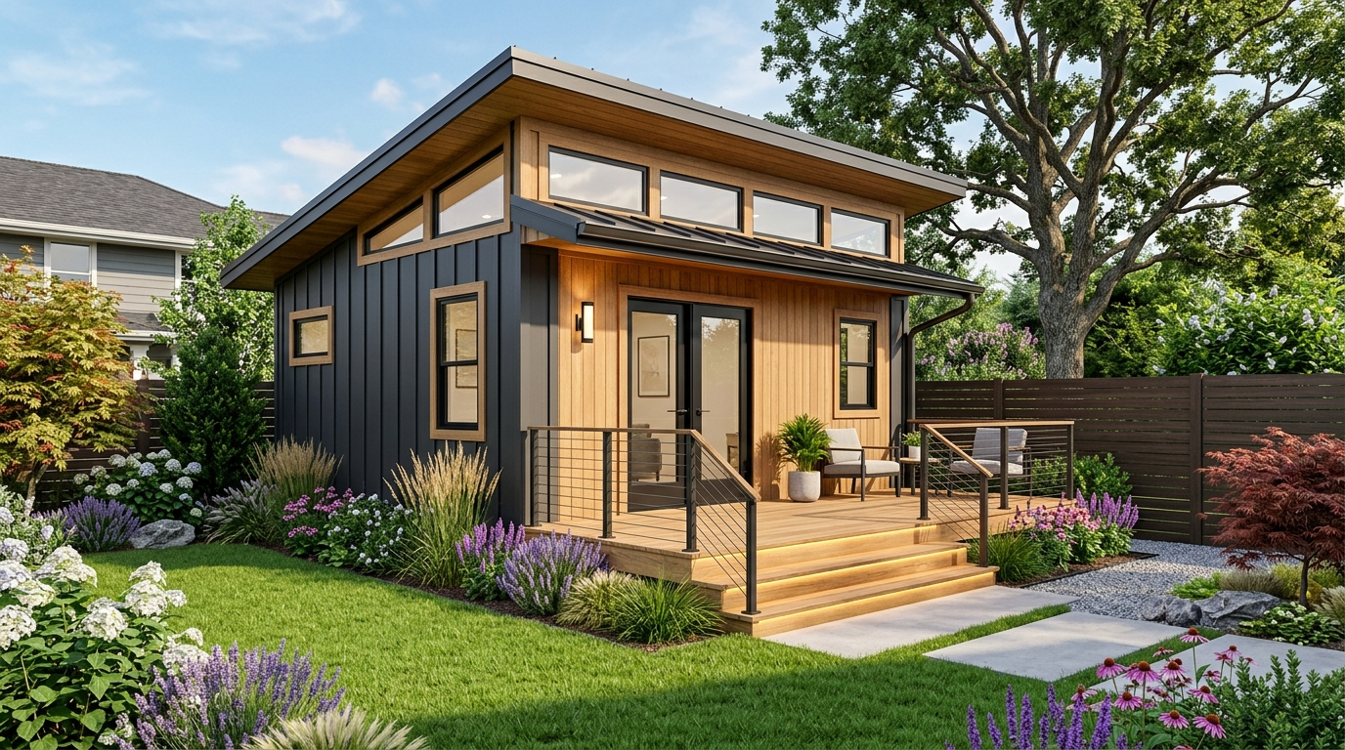
MODEL 03 • MONO-PITCH SHED LOFT
The Sierra (14' × 31'-6" • 420 Sq. Ft.)
DIMENSIONS: 14' × 31'-6" | LIVING AREA: 420 Sq. Ft.
Est. Monthly Rent: $2,400 – $3,100 / mo
Homeowner Passive Net: $600 – $900 / mo
Architectural & Blueprint Highlights:
• Modern mono-pitch shed roofline with clerestory transoms
• Vaulted Great Room with mezzanine sleeping loft above
• Ground floor private bedroom with large closet & egress
• Board-and-batten dark charcoal siding with natural oak inlays
• Front and rear entry decks with step lighting
Ideal Placement: Medium-to-large residential lots, remote tech professionals.

Slide 8
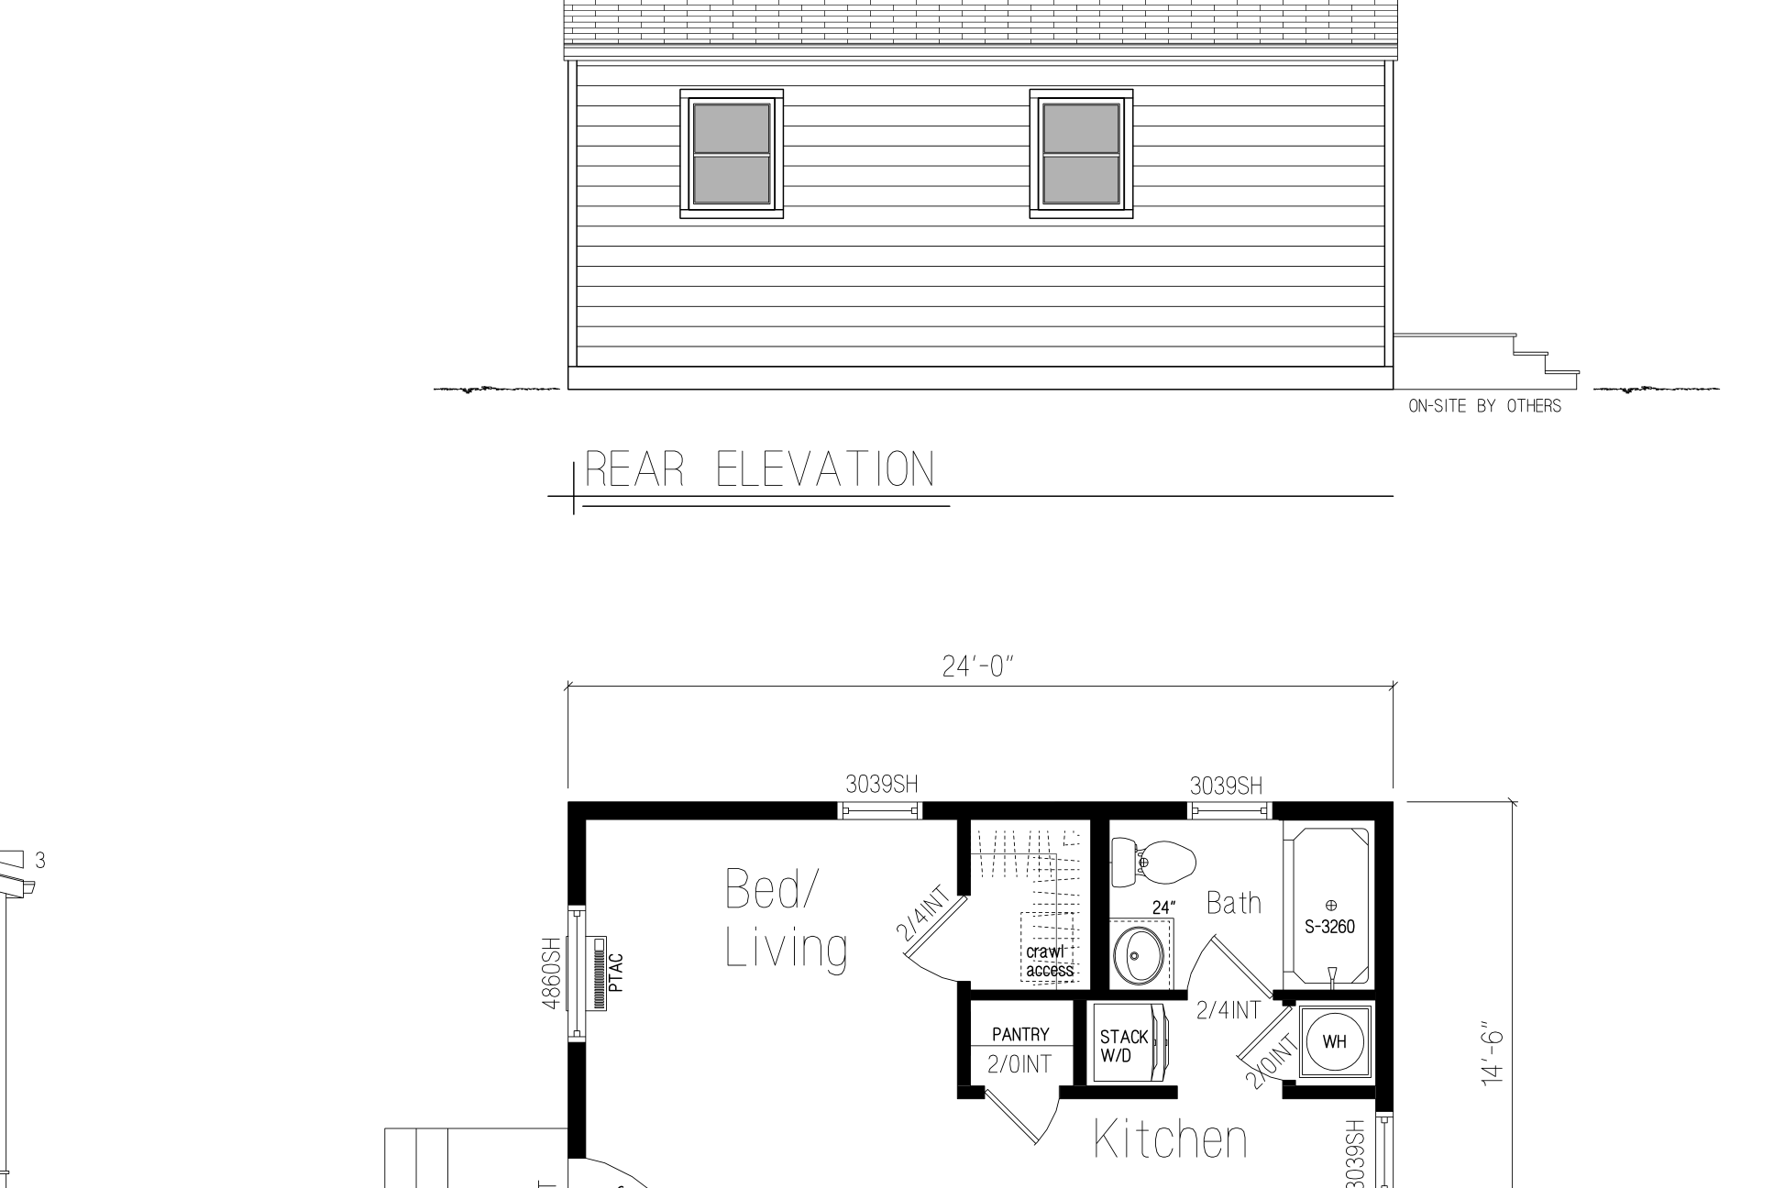
MODEL 03 • ARCHITECTURAL PLAN
The Sierra Floorplan (14' × 31'-6" • 420 Sq. Ft.)
OFFICIAL CAD BLUEPRINT SPECIFICATIONS
Factory Framed & State Approved
• Vaulted Great Room: Expansive 30'-0" span with double front sliding glass doors.
• Mezzanine Loft: Upper sleeping/storage loft open to below with access ladder.
• Private Bedroom: Ground floor rear bedroom with full closet and egress windows.
• Full Kitchen & Dining: Cooktop, prep island, sink, and high clerestory windows.
• Outdoor Stoops: Dual front and rear site-built wooden entry stoops.
✓ Sealed Architectural Drawing Number A1

Slide 9
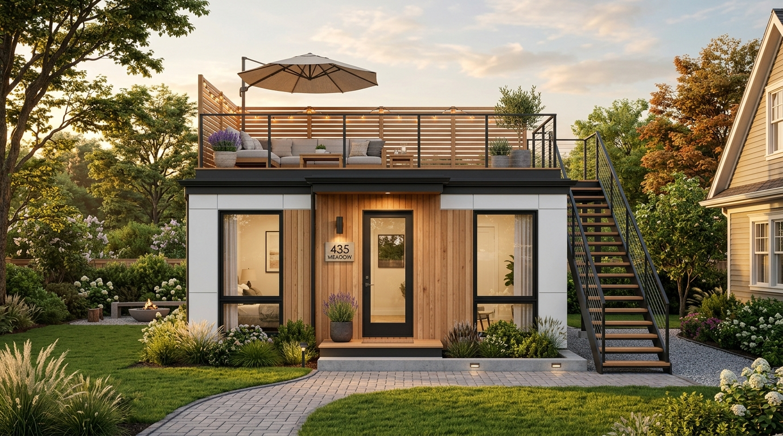
MODEL 04 • FLAGSHIP ROOFTOP TERRACE
The Meadow (15' × 31'-9" • 435 Sq. Ft.)
DIMENSIONS: 15' × 31'-9" | LIVING AREA: 435 Sq. Ft.
Est. Monthly Rent: $2,600 – $3,400 / mo
Homeowner Passive Net: $700 – $1,000 / mo
Architectural & Blueprint Highlights:
• Full-footprint rooftop sun terrace with slatted privacy railings
• Exterior open staircase connecting yard directly to rooftop
• Symmetrical front facade with flanked oversized black windows
• Dual lofts (sleeping + storage/lounge) and plant ledge top
• Full gourmet kitchen with dining peninsula and rear patio door
Ideal Placement: Wide suburban parcels (50'+ width), high-ADR luxury travel rentals.

Slide 10
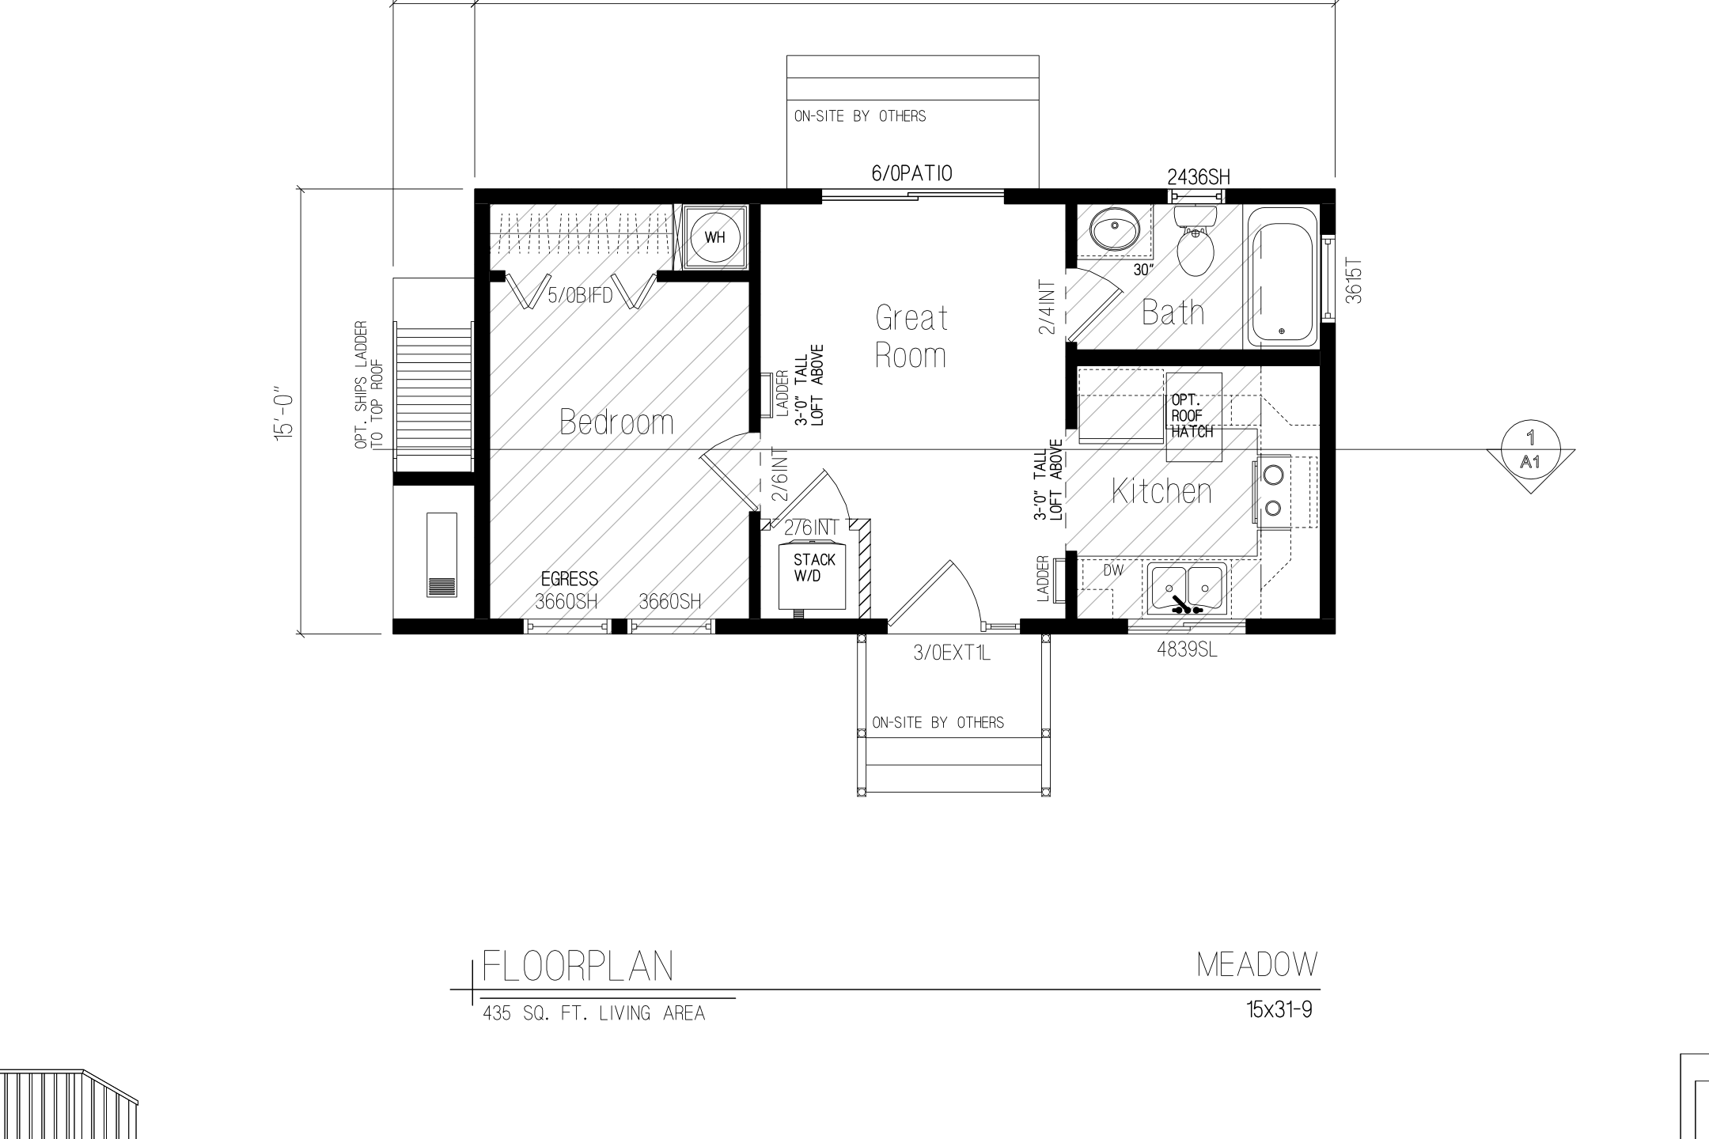
MODEL 04 • ARCHITECTURAL PLAN
The Meadow Floorplan (15' × 31'-9" • 435 Sq. Ft.)
OFFICIAL CAD BLUEPRINT SPECIFICATIONS
Factory Framed & State Approved
• Dual Lofts: Dual mezzanine lofts (Loft 1 + Loft 2) with plant ledge top.
• Exterior Staircase: 2'-9" exterior open stair ascending to full rooftop terrace.
• Gourmet Kitchen: Central kitchen with peninsula dining & 4836SL windows.
• Private Suite: Private master bedroom with closet and stack W/D closet.
• Rear Patio Egress: 6/0 Patio sliding door opening directly onto garden deck.
✓ Sealed Architectural Drawing Number A1

Slide 11
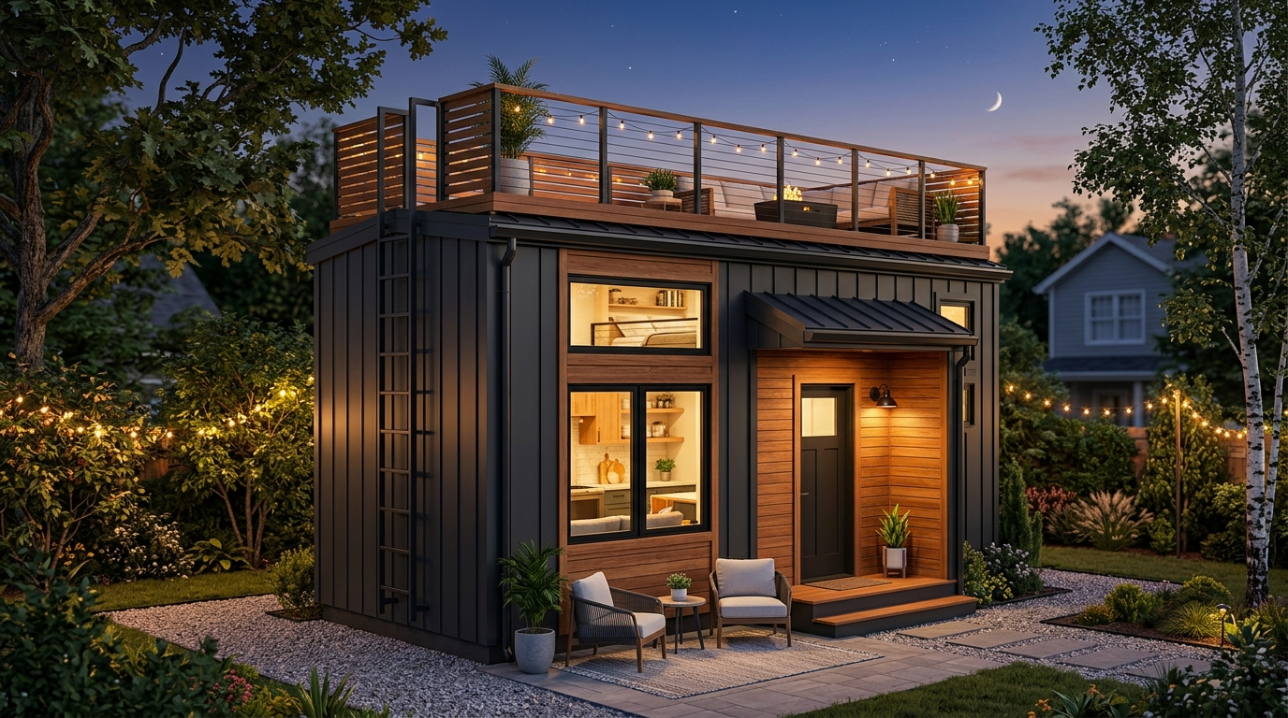
MODEL 05 • ULTRA-COMPACT HIGH-YIELD INFILL
The Cascade (12' × 27'-9" • 300 Sq. Ft.)
DIMENSIONS: 12' × 27'-9" | LIVING AREA: 300 Sq. Ft.
Est. Monthly Rent: $1,650 – $2,100 / mo
Homeowner Passive Net: $500 – $750 / mo
Architectural & Blueprint Highlights:
• Slimline 12-foot exterior profile engineered for narrow lots
• Industrial steel ship's ladder ascending to observation deck
• Efficient open Living/Dining, Kitchenette, and Bath
• Ground floor bedroom with upper loft overhead
• Fits 95% of standard residential parcels without setback variance
Ideal Placement: Narrow side yards, urban infill parcels, maximum ROI density.

Slide 12
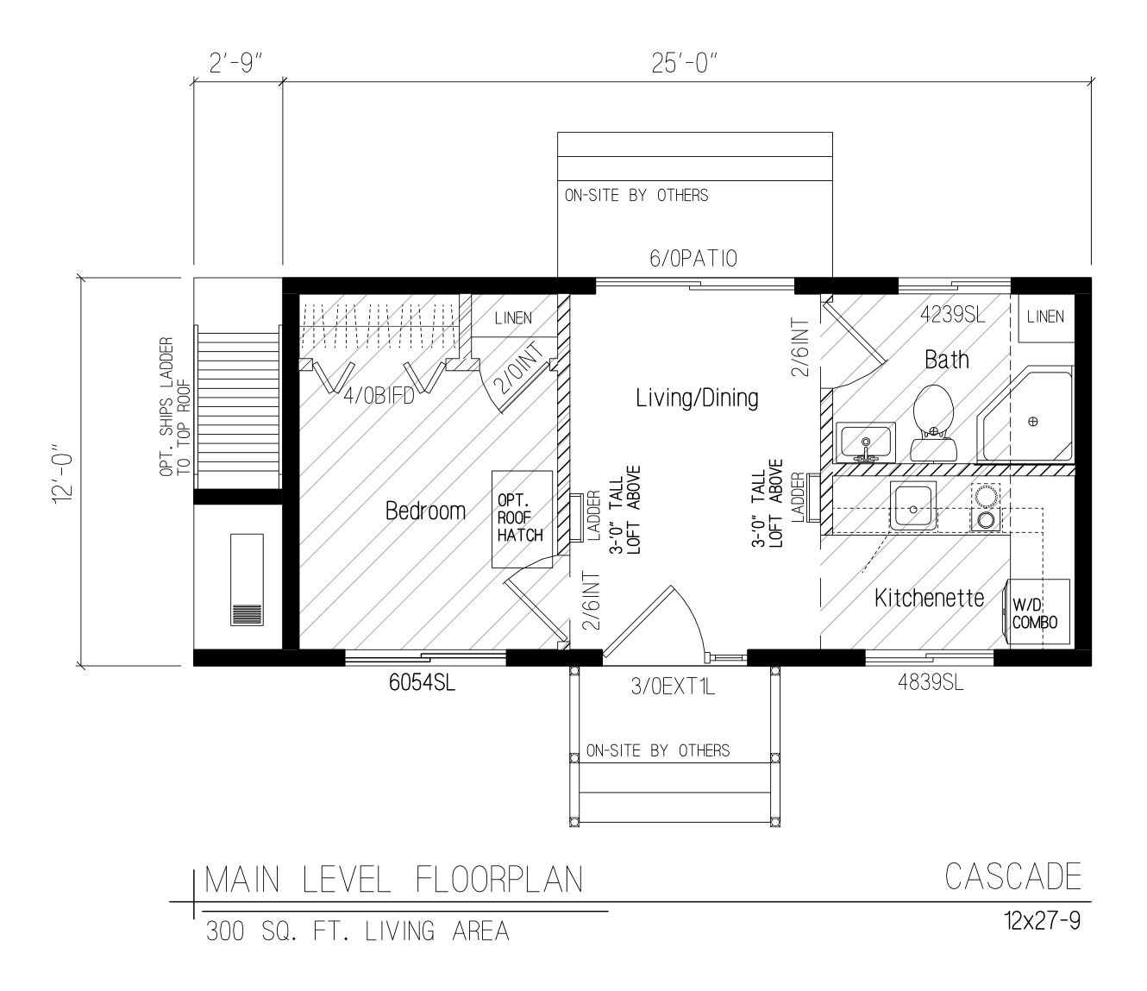
MODEL 05 • ARCHITECTURAL PLAN
The Cascade Floorplan (12' × 27'-9" • 300 Sq. Ft.)
OFFICIAL CAD BLUEPRINT SPECIFICATIONS
Factory Framed & State Approved
• 12' Slimline Footprint: 26'-0" main box length engineered for tight setbacks.
• Ship's Ladder Access: 2'-9" side ship's ladder leading to rooftop observation deck.
• Living/Dining & Kitchenette: Efficient open plan with 4836SL window and linen storage.
• Bedroom & Loft: Private sleeping quarters with bonus overhead storage loft.
• Rear Patio Door: 6/0 Patio sliding door for indoor-outdoor access.
✓ Sealed Architectural Drawing Number A1

Slide 13
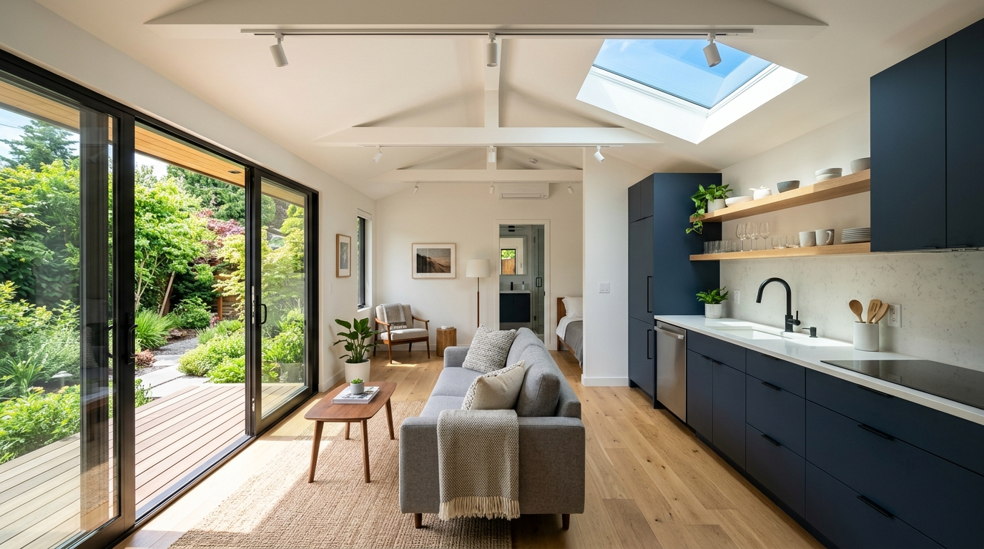
INTERIOR ARCHITECTURE & FINISH STANDARDS
Scandinavian Modern Luxury & Space Optimization
PREMIUM FACTORY-FINISHED INTERIORS
• Vaulted Timber Ceilings: Exposed natural wood trusses create expansive spatial volume.
• Mezzanine Sleeping Lofts: Adds 100+ sq ft of functional bonus space for sleeping or storage.
• Quartz Waterfall Kitchens: Durable quartz countertops, custom oak flat-panel cabinetry.
• European Oak Hardwood: Waterproof luxury engineered plank flooring throughout.
• Designer Bathrooms: Walk-in glass showers, floating vanities, matte black hardware.
• Energy Efficiency: All-electric mini-split HVAC, smart thermostats, tankless hot water.

Slide 14
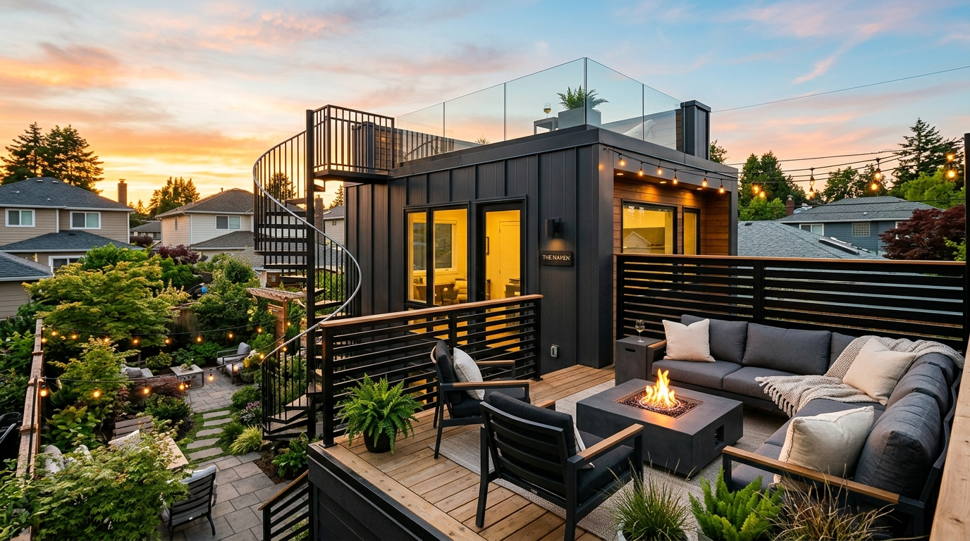
SEAMLESS INDOOR-OUTDOOR LIVING
Private Backyard Entertaining Patios & Sun Decks
ELEVATING THE BACKYARD EXPERIENCE
• Floor-to-Ceiling Sliders: Seamless transition between interior living room and private garden deck.
• Dedicated Outdoor Dining: Space for outdoor tables, lounge chairs, and BBQ entertaining.
• Integrated Step Lighting: Warm low-voltage LED pathway lighting for evening safety and ambiance.
• Privacy Screening: Architectural slat walls protect homeowner and tenant privacy.
• Minimal Yard Footprint: Leaves 60-70% of standard backyards open for landscaping and lawns.

Slide 15
PORTFOLIO COMPARISON
Comprehensive S2A Modular ADU Lineup
Model | Dimensions | Living Area | Key Blueprint Feature | Est. Rent | Homeowner Split
Cascade | 12' × 27'-9" | 300 sq. ft. | 12' Slim Infill • Rooftop Ladder | $1,650 – $2,100 | $500 – $750 / mo
Harmony | 14' × 24'-0" | 348 sq. ft. | Pitched Roof • Covered Portico | $1,850 – $2,350 | $550 – $800 / mo
Haven | 14' × 29'-0" | 350 sq. ft. | 4' Porch • Rooftop Sky Lounge | $2,200 – $2,950 | $650 – $950 / mo
Sierra | 14' × 31'-6" | 420 sq. ft. | Mono-Pitch Shed • Clerestory Loft | $2,400 – $3,100 | $600 – $900 / mo
Meadow | 15' × 31'-9" | 435 sq. ft. | Dual Lofts • Full Rooftop Terrace | $2,600 – $3,400 | $700 – $1,000 / mo

Slide 16
TURNKEY DELIVERY TIMELINE
From Site Audit to Monthly Cash Flow in 30–45 Days
Day 1–5: Site Feasibility & Digital Permit
GIS setback validation, utility hookup mapping, pre-approved architectural plan submission.
Day 6–20: Offsite Factory Modular Build
Precision factory framing, plumbing, electrical, quartz counters, and paint under climate-controlled conditions.
Day 21–25: Foundation & Trenching
Helical pile / concrete pad foundation and underground sewer/power/water utility trenching in yard.
Day 26–30: Crane Delivery & Installation
Single-day crane lift over main house roofline, utility tie-in, and final city inspection sign-off.
Day 31+: Tenant Placement & Revenue
Furnishing, professional photography, tenant onboarding, and automated monthly revenue-share payouts.

Slide 17
UNLOCK YOUR BACKYARD'S PASSIVE INCOME
Get Your Free 48-Hour Site Feasibility & Revenue-Share Audit
We assess your parcel geometry, local ADU zoning, utility trenching distances, and provide a guaranteed monthly passive income estimate.
S2A Modular • Housing-as-a-Service (HaaS) Solutions

