Slide 1
EE 123: Bioelectricity
Fall 2020
Tufts University
Instructor: Joel Grodstein
joel.grodstein@tufts.edu
Bioelectricity I – intro

Slide 2
Big picture of the course
Where does bioelectricity come from?
Neurons and working with the nervous system
Cardiac bioelectricity
Worms

Slide 3
Do we care about this?
Argument for no
Some people think biological physics is the best; others go into sleep mode ☺
Wide range of backgrounds
Can design things without understanding the physics
Argument for yes
People who understand details in multiple aspects are valuable
bioelectricity and electroceuticals are a newly-growing field; it’s hard to predict where it will be in 10 years
The fundamentals of bioelectricity won’t change
Resolution
Backgrounder + quiz for people without background
Distill it down to a few equations & models → you can get by

Slide 4
In the news…
https://spectrum.ieee.org/the-human-os/biomedical/devices/using-weak-electric-fields-to-make-viruskilling-face-masks
How do N95 masks use electrets?
You can:
Do a very brief read, and then chat about it with me during office hours
Do a more detailed read, and then talk about it for the quiz on this unit

Slide 5
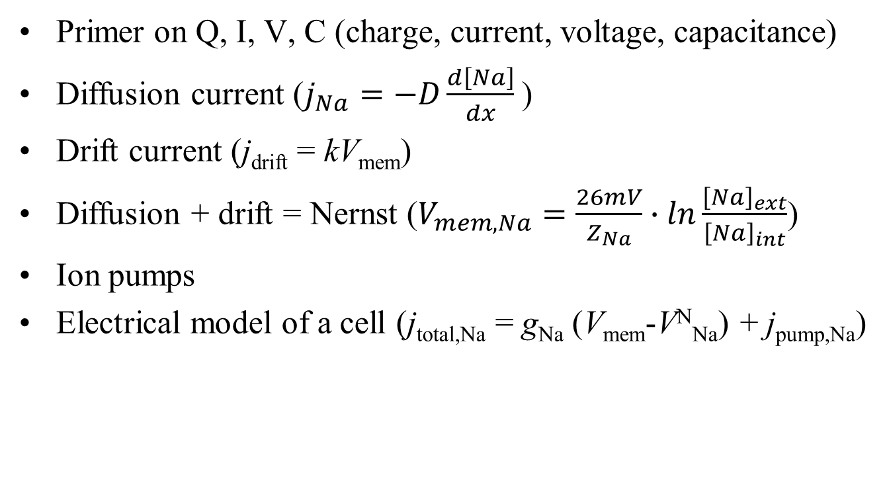
Outline for this section
Primer on Q, I, V, C (charge, current, voltage, capacitance)
Diffusion current ($j_{Na}=−D\frac{d\left[Na\right]}{dx}$)
Drift current (j_{drift} = kV_{mem})
Diffusion + drift = Nernst ($V_{mem,Na}=\frac{26mV}{Z_{Na}}∙ln\frac{{\left[Na\right]}_{ext}}{{\left[Na\right]}_{int}}$)
Ion pumps
Electrical model of a cell (j_{total,Na} = g_{Na} (V_{mem}-V^{N}_{Na}) + j_{pump,Na})

Slide 6
Electric charge
So what is electricity, anyway?
Start with the basics: charge.
Atoms have electrons (negative charge) and protons (positive charge)
Same number of each → net zero charge
An atom can give away an electron to another atom
The “giver” then has one more proton than electron → net charge of +1
The receiver has net charge of -1
Both are now called ions
Example: NaCl → Na⁺ and Cl⁻
Na
Na⁺
Cl
Cl⁻
11 protons
17 protons
10 e-
11 e⁻
17 e⁻
18 e-

Slide 7
Electric force
+ and - ions attract each other
Like there’s a big invisible rubber band between them
You pull them apart & they go back together!
Two positive ions (or two negative) repel each other
Push them together & they run away
That’s pretty much what charge is
“Coulomb’s Law” says how hard they push and pull
We’ll get quantitative soon enough
The unit of charge is a “Coulomb” (named after Charles-Augustin de Coulomb)

Slide 8

Na⁺
Cl⁻
Opposite charges attracting

Slide 9

Na⁺
K⁺
Two positive charges repel
Two negative charges do too

Slide 10

Work can overcome this
Na⁺
Na⁺
Two positive charges repel

Slide 11
Fixed and movable charges
these charges are stuck in place
Na⁺
K⁺
Cl⁻
Why are the Na⁺ and Cl⁻ stuck?
who knows, it’s just an example
maybe there’s a cell membrane between them, with an ion channel that’s permeable to K⁺ but not to Na⁺ or Cl⁻
What will happen?
The movable K⁺ will travel to the right
cell interior
this charge is movable
Notes:
Give a two-sentence description of what’s a cell & an ion channel.

Slide 12
Fixed and movable charges
these charges are stuck in place
Na⁺
K⁺
Cl⁻
cell interior
Again, we can move it back with enough work
this charge is movable

Slide 13
Voltage
We could work with Coulomb’s Law to compute forces, accelerations and velocities
But it’s usually easier to use a higher-level concept – voltage
In fact, we won’t learn Coulomb’s Law
but it was still useful to learn about positive & negative ions!

Slide 14
Voltage
this charge is movable
these charges are stuck in place
Na⁺
Cl⁻
K⁺
K⁺
Na⁺
Cl⁻
What if we had twice as many fixed-in-place ions?
There would be twice as much electric force on the K⁺
it would move twice as fast
it would require twice as much work to move it back
Any time you separate charges, you get a voltage
Separating charges across a cell membrane is the basis of bio-electricity
Voltage is the amount of energy (or work) needed to push 1C of charge across from point A to point B
The unit is Volts
1C of charge, moving across 1V, takes 1J of work
2C of charge, moving across 3V, takes 6J of work

Slide 15

Voltage
this charge is movable
these charges are stuck in place
Na⁺
Cl⁻
K⁺
K⁺
Na⁺
Cl⁻
Separating charges across a cell membrane is the basis of bio-electricity
The fixed separated charges (Na⁺ and Cl⁻) create, e.g., 3V
A Volt is a Joule/Coulomb
moving (e.g.,) 2C of K⁺ across 3V takes how much work?
Next question: why did the Na⁺ and Cl⁻ create 3V and not 4V?
How much voltage gets made by how much separated charge?
Q=CV
$\frac{3 Joules}{C}∙\frac{2C}{1}$=6 Joules
Capacitance of the cell membrane (mostly, how thick it is). In this case, .33 Farads
how much charge: e.g., 1 Coulomb
how much voltage: like, 3 Volts

Slide 16

Current
Na⁺
K⁺
Cl⁻
Say we have an observer (that’s the eye!) sitting in the middle and counting how many ions pass by
the number of ions that pass by every second is called current
the current per m² of cross-sectional area is called flux
the unit of current is an Ampere (from André-Marie Ampere)
1 A ≡ 1 C/s
What are the units of flux?
A/m²

Slide 17
End of electricity primer
That’s electricity in a nutshell.
It’s very useful for everything from washing machines to cell phones.
And…most cells in our body create voltage
The big takeaways:
Intuitively, what is charge, voltage, current and flux
Opposite charges attract, like charges repel
Q=CV

Slide 18
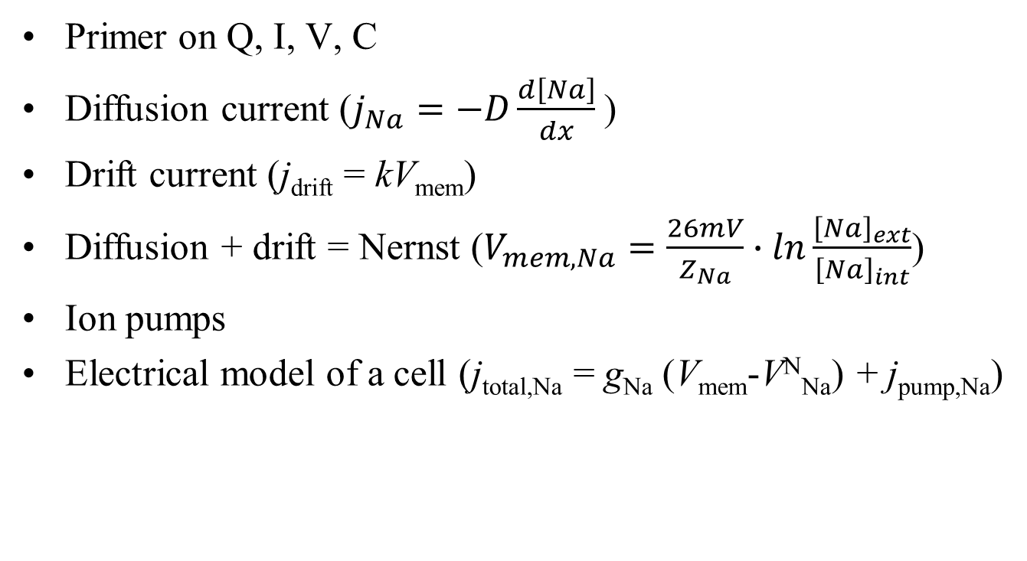
Outline for this section
Primer on Q, I, V, C
Diffusion current ($j_{Na}=−D\frac{d\left[Na\right]}{dx}$)
Drift current (j_{drift} = kV_{mem})
Diffusion + drift = Nernst ($V_{mem,Na}=\frac{26mV}{Z_{Na}}∙ln\frac{{\left[Na\right]}_{ext}}{{\left[Na\right]}_{int}}$)
Ion pumps
Electrical model of a cell (j_{total,Na} = g_{Na} (V_{mem}-V^{N}_{Na}) + j_{pump,Na})

Slide 19
Diffusion
“(In the nanoworld), everything is dancing,” Philip Nelson, Biological Physics
Particles move randomly; on average, they move from high concentration to low concentration

Slide 20
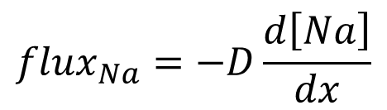
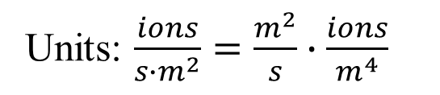
Diffusion
Cell
ECF
cell membrane
Intuition:
Assume particles move in random directions
On average more particles cross the membrane right→left than left→right
It is probabilistic, but deterministic if there are enough particles
The magic of statistical mechanics!
how big the gradient is
how fast ions cross the membrane
$${flux}_{Na}=−D\frac{d\left[Na\right]}{dx}$$
Note the sign: diffusion evens out concentrations
magic constant
Units: $\frac{ions}{{s∙m}^{2}}=\frac{m^{2}}{s}∙\frac{ions}{m^{4}}$
Notes:
The diffusion story: Richard Brown, Brownian motion, saw pollen move around in a vial with a microscope (1827). Assumed the pollen was alive. Stuck the vial in a dark room for a year – still moved around! Several similar experiments, including: Took flecks of stone from the Giant Sphynx and dropped them in water – they moved too! Einstein finally explained it in 1905.

Slide 21
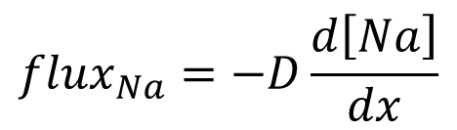
What is D, really?
$${flux}_{Na}=−D\frac{d\left[Na\right]}{dx}$$
We have a simple equation
We (hopefully) know what it means
D is how fast an ion moves, for a given gradient pushing it
What affects D, our magic proportionality constant?
High-volume ion:
In a vacuum:
In a liquid
will bump into lots of things and slow down, so D will be small
D will be quite large (not relevant for us!)
Not nearly so large

Slide 22
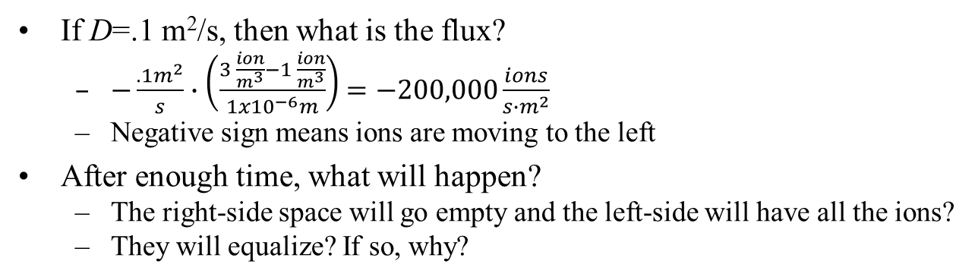
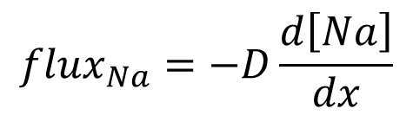
Example
Cell
1 ion/m³
ECF
3 ions/m³
$${flux}_{Na}=−D\frac{d\left[Na\right]}{dx}$$
If D=.1 m²/s, then what is the flux?
$−\frac{.1m^{2}}{s}∙\left(\frac{3 \frac{ion}{m^{3}}−1 \frac{ion}{m^{3}}}{1x{10}^{−6}m}\right)$ $=−200,000\frac{ions}{{s∙m}^{2}}$
Negative sign means ions are moving to the left
After enough time, what will happen?
The right-side space will go empty and the left-side will have all the ions?
They will equalize? If so, why?
dx = 1μ
Will they always eventually equalize to 2 moles/m³
No. E.g., if the ECF is really big then they will equalize to just under 3
Thought question: is the ECF usually really big?
3
1
concentration
time
Notes:
Note that diffusion is really a partial differential equation; the “flux” part is really d[Na]/dt. We’ve simplified the d/dx by assuming d[Na]/dx is 0 in the cells and constant in the membrane

Slide 23
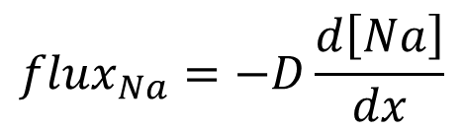
Example
dx = 1μ
Cell
2.99 ions/m³
Cell
1 ion/m³
$${flux}_{Na}=−D\frac{d\left[Na\right]}{dx}$$
ECF
3 ions/m³
ECF
2.99 ions/m³
Assume the ECF is big, the cell is really little
After diffusion is done…
Why? At any time,
# of ions leaving the ECF = # entering the cell
So [ion] changes faster in the cell than in the ECF
An analogy:
It’s 20° outside, your house is 70°, and you open the door
After a few hours your house is also 20°, and you’ve not appreciably warmed up the earth
3
1
concentration
time

Slide 24
Outline for this section
Primer on Q, I, V, C
Diffusion current ($j_{Na}=−D\frac{d\left[Na\right]}{dx}$)
Drift current (j_{drift} = kV_{mem})
Diffusion + drift = Nernst ($V_{mem,Na}=\frac{26mV}{Z_{Na}}∙ln\frac{{\left[Na\right]}_{ext}}{{\left[Na\right]}_{int}}$)
Ion pumps
Electrical model of a cell (j_{total,Na} = g_{Na} (V_{mem}-V^{N}_{Na}) + j_{pump,Na})

Slide 25
Drift
We saw diffusion
random thermal motion + concentration gradient = net ion currents
Drift:
charged ion + voltage pushing it around = ion current

Slide 26
Drift current
this charge is movable
these charges are stuck in place
Na⁺
Cl⁻
K⁺
Na⁺
Cl⁻
We said similar charges repel, opposite charges attract
That causes charges to move
We call this drift current
Problem: real systems have too many charges to deal with ☹
More common formulation:
The separated charges (Na⁺ and Cl⁻) create a voltage
The voltage creates a K⁺ drift current (or flux)

Slide 27
Separated charges create a voltage
this charge is movable
these charges are stuck in place
+ 3V -
Na⁺
Cl⁻
K⁺
Na⁺
Cl⁻
Separating charges across a cell membrane is the basis of bio-electricity
The fixed separated charges (Na⁺ and Cl⁻) create, e.g., 3V
Why did the Na⁺ and Cl⁻ create 3V and not 4V?
How much voltage gets made by how much separated charge?
Q=CV
Capacitance of the cell membrane (mostly, how thick it is). In this case, .33 Farads
how much charge: e.g., 1 Coulomb
how much voltage: like, 3 Volts

Slide 28
Cool tricks to do with voltage
+ 3V -
Na⁺
Cl⁻
K⁺
K⁺
Na⁺
Cl⁻
Separating charges across a cell membrane is the basis of bio-electricity
The fixed separated charges (Na⁺ and Cl⁻) create, e.g., 3V
A Volt is a Joule/Coulomb
moving (e.g.,) 2C of K⁺ across 3V takes how much work?
Voltage tells you how much work it takes to move an ion from one place to another
$\frac{3 Joules}{C}∙\frac{2C}{1}$=6 Joules
Warning – we won’t use this fact in this course (but it’s what voltage really is)

Slide 29
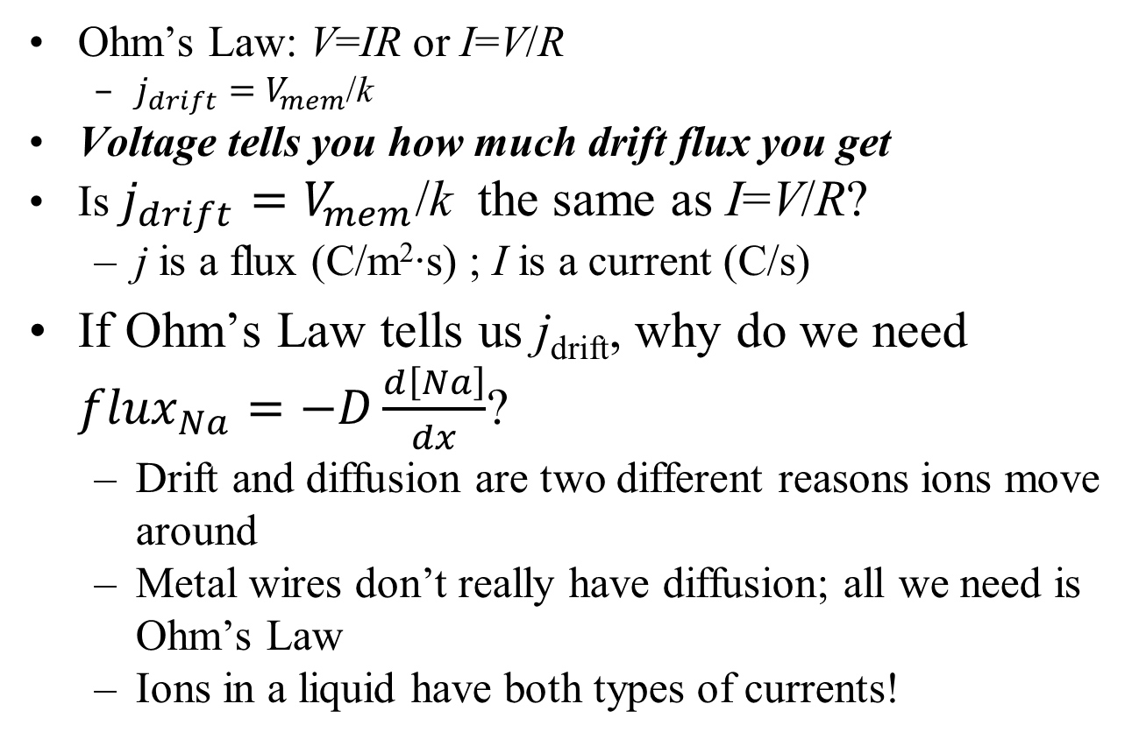
Cool tricks to do with voltage
Ohm’s Law: V=IR or I=V/R
$j_{drift}=V_{mem}$/k
Voltage tells you how much drift flux you get
Is $j_{drift}=V_{mem}$/k the same as I=V/R?
j is a flux (C/m²∙s) ; I is a current (C/s)
If Ohm’s Law tells us j_{drift}, why do we need ${flux}_{Na}=−D\frac{d\left[Na\right]}{dx}$?
Drift and diffusion are two different reasons ions move around
Metal wires don’t really have diffusion; all we need is Ohm’s Law
Ions in a liquid have both types of currents!

Slide 30
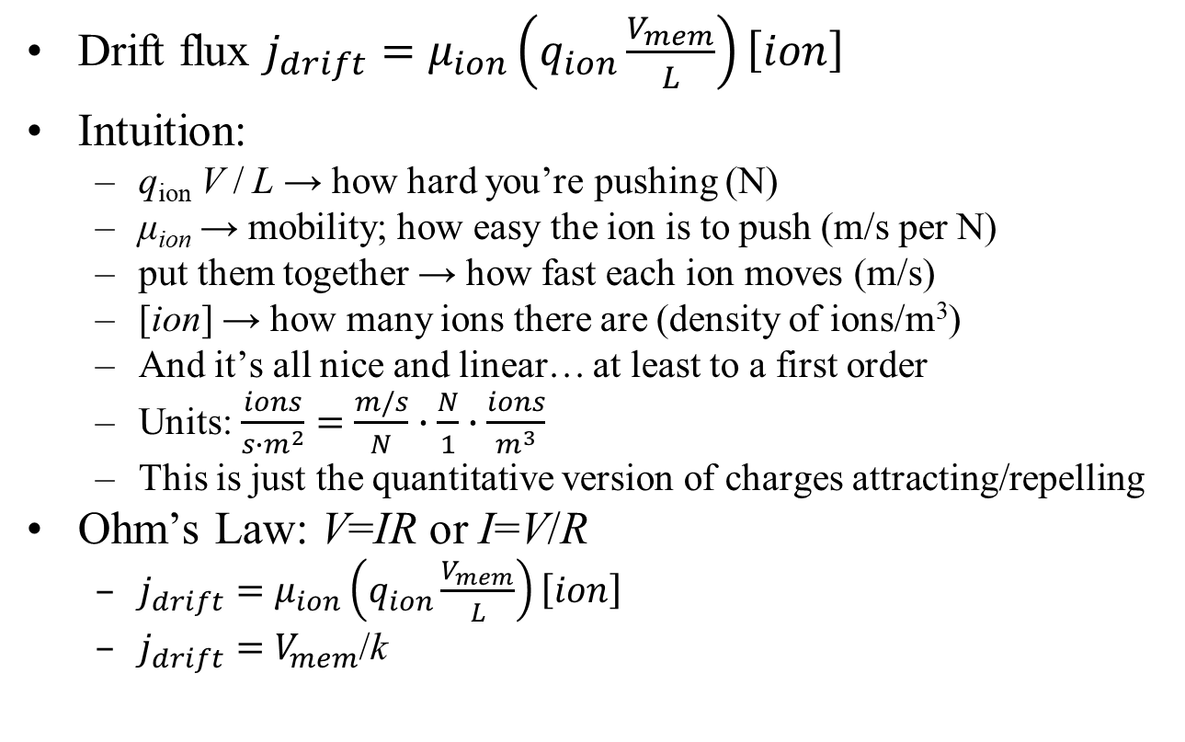
Why does Ohm’s Law work?
ion density
Drift flux $j_{drift}=μ_{ion}\left(q_{ion}\frac{V_{mem}}{L}\right)\left[ion\right]$
Intuition:
q_{ion} V / L → how hard you’re pushing (N)
μ_{ion} → mobility; how easy the ion is to push (m/s per N)
put them together → how fast each ion moves (m/s)
[ion] → how many ions there are (density of ions/m³)
And it’s all nice and linear… at least to a first order
Units: $\frac{ions}{{s∙m}^{2}}=\frac{m/s}{N}∙\frac{N}{1}∙\frac{ions}{m^{3}}$
This is just the quantitative version of charges attracting/repelling
Ohm’s Law: V=IR or I=V/R
$j_{drift}=μ_{ion}\left(q_{ion}\frac{V_{mem}}{L}\right)\left[ion\right]$
$j_{drift}=V_{mem}$/k
mobility
pushing force (attract/repel)
Backup

Slide 31
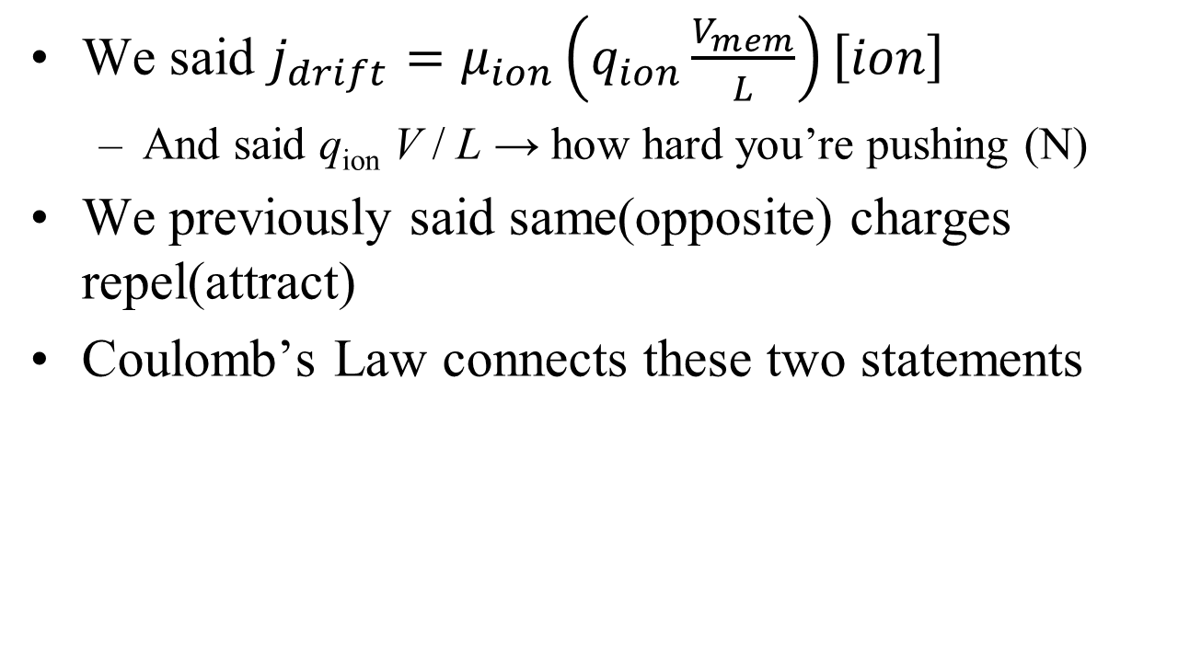
q_{ion}V/L → force: why?
We said $j_{drift}=μ_{ion}\left(q_{ion}\frac{V_{mem}}{L}\right)\left[ion\right]$
And said q_{ion} V / L → how hard you’re pushing (N)
We previously said same(opposite) charges repel(attract)
Coulomb’s Law connects these two statements
Backup

Slide 32
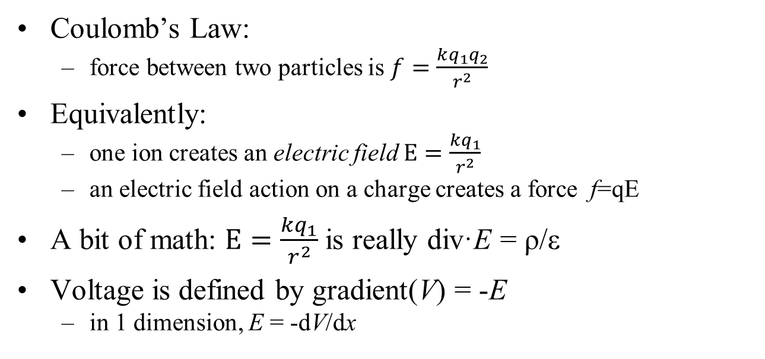
q_{ion}V/L → force: why?
Coulomb’s Law:
force between two particles is $f=\frac{kq_{1}q_{2}}{r^{2}}$
Equivalently:
one ion creates an electric field $E=\frac{kq_{1}}{r^{2}}$
an electric field action on a charge creates a force f=qE
A bit of math: $E=\frac{kq_{1}}{r^{2}}$is really div·E = ρ/ε
Voltage is defined by gradient(V) = -E
in 1 dimension, E = -dV/dx
Maxwell’s 1st eqn
+++++
- - - - -
The above two equations can derive that E=V/L, and Q=CV, and even the value of C
Backup

Slide 33
q_{ion}V/L → force: why?
A basic statement of electric charges
f=qE
A charge q
feels a force f
in the presence of a field E
Newton’s first Law
acceleration a = f / m = q_{ion}E/m_{ion}
Constant E field implies constant acceleration
Will the ion travel faster and faster until it goes infinitely fast?
Not really
First, nothing ever goes infinitely fast ☺
Einstein said relativity gets in the way
Backup

Slide 34
Mobility*force = velocity – why?
Car with your foot on the gas (providing a constant force)
What stops your car from hitting 10K mph?
Air drag.
The faster you go, the more drag, until it all balances out
Ions see the same drag forces
Car bumps into random air molecules
An ion bumps into other ions & molecules
End result: v = μ_{ion} f = μ_{ion} q_{ion} E
Intuition:
More charge or field → more force → more speed
More V → more E
And it’s all nice and linear… at least in our simple model
And then J_{drift} = v[ion]
mobility
velocity
Backup

Slide 35
Mobility*force = velocity – why?
We have a simple equation
We (hopefully) know what it means
What affects μ, our magic proportionality constant?
High-volume ion:
In a vacuum:
In a liquid:
The units work
f=qE: E is N/C, q is C and so E q is N
v= μf: μ is m/s per N, so μ f is a velocity
will bump into lots of things and slow down, so μ will be small
μ will be quite large (not relevant for us!)
Not nearly so large.
Backup

Slide 36
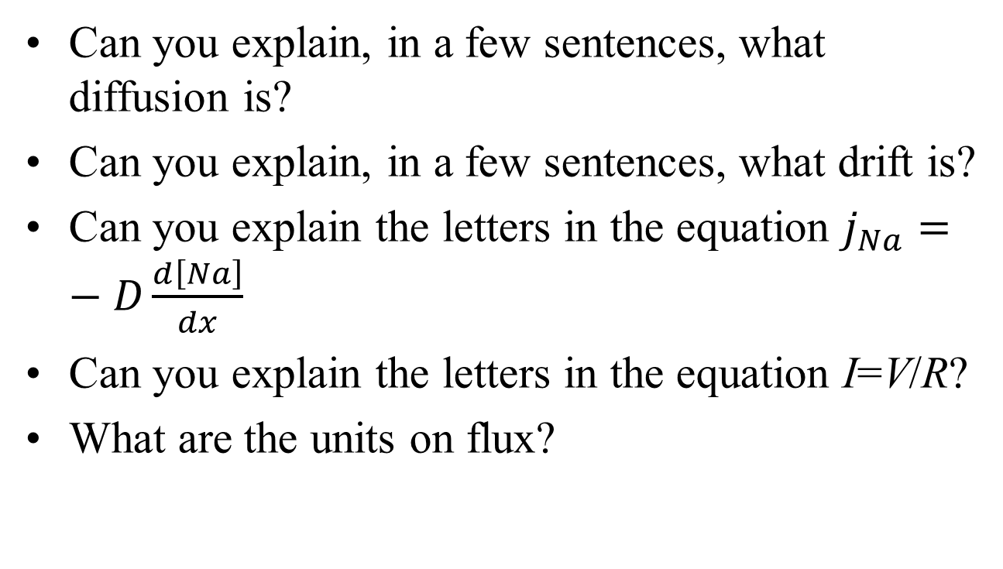
Mini quiz
Can you explain, in a few sentences, what diffusion is?
Can you explain, in a few sentences, what drift is?
Can you explain the letters in the equation $j_{Na}=−D\frac{d\left[Na\right]}{dx}$
Can you explain the letters in the equation I=V/R?
What are the units on flux?

Slide 37
Outline for this section
Primer on Q, I, V, C
Diffusion current ($j_{Na}=−D\frac{d\left[Na\right]}{dx}$)
Drift current (j_{drift} = kV_{mem})
Diffusion + drift = Nernst ($V_{mem,Na}=\frac{26mV}{Z_{Na}}∙ln\frac{{\left[Na\right]}_{ext}}{{\left[Na\right]}_{int}}$)
Ion pumps
Electrical model of a cell (j_{total,Na} = g_{Na} (V_{mem}-V^{N}_{Na}) + j_{pump,Na})

Slide 38
Dilemma
Diffusion – particles move from high concentration to low
End result: uniform concentrations everywhere
Same amount of Na⁺ on inside & outside of cell
Drift is caused by voltage
Voltage is caused by separated charges
E.g., lots of Na⁺ inside and lots of Cl⁻ outside
But…
If all particles are uniformly distributed, how can we have separated charges?

Slide 39
Drift + diffusion = voltage
extra-cellular fluid
Cell
P⁻
Cells make lots of proteins
Protein → big negative piece + small positive piece
Protein
P⁺
Cell membrane
intra-cellular fluid

Slide 40
Drift + diffusion = voltage
Cell interior is charge neutral
So is the ECF
P⁺
P⁻
P⁻
P⁺
P⁻
P⁺
P⁺
P⁻
Any voltage?
Any diffusion across the cell membrane?
Assume P⁺ can get through the membrane, but P⁻ is too big
Notes:
No separated charge, so no voltage
But there is diffusion of P+

Slide 41
Drift + diffusion = voltage
P⁺
P⁺ diffuses out of the cell
Is there any voltage?
ICF is negative, ECF is positive
P⁻
P⁻
P⁺
P⁻
P⁺
P⁺
P⁻
Which direction does P⁺ diffuse?
Which direction does it drift?
With only one P⁺ outside, V is small: diffusion > drift

Slide 42
Drift + diffusion = voltage
P⁺
More P⁺ diffuses out
More separated charge
More voltage
P⁻
P⁻
P⁺
P⁻
P⁺
P⁺
P⁻
Eventually we reach equilibrium
All the P⁻ is still stuck inside
Diffusion current out = drift current in
Next question – what is V at that point?

Slide 43
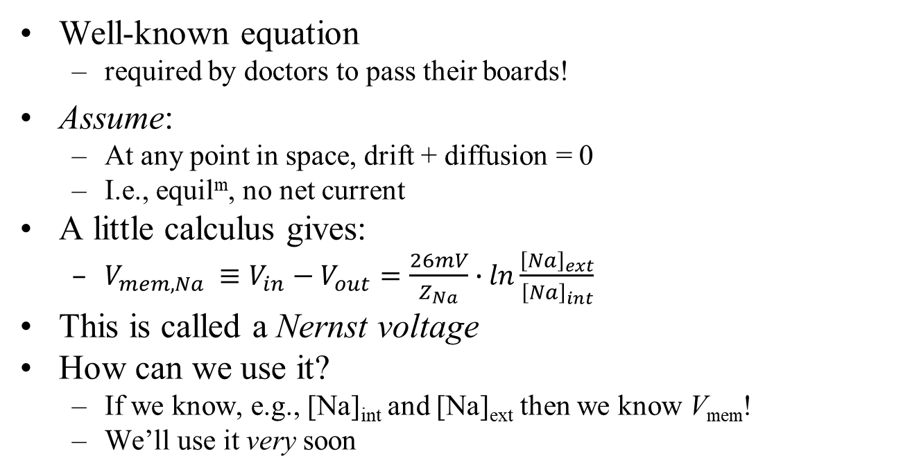
Nernst equation
Well-known equation
required by doctors to pass their boards!
Assume:
At any point in space, drift + diffusion = 0
I.e., equil^{m}, no net current
A little calculus gives:
$V_{mem,Na} ≡V_{in}−V_{out}=\frac{26mV}{Z_{Na}}∙ln\frac{{\left[Na\right]}_{ext}}{{\left[Na\right]}_{int}}$
This is called a Nernst voltage
How can we use it?
If we know, e.g., [Na]_{int} and [Na]_{ext} then we know V_{mem}!
We’ll use it very soon

Slide 44
Nernst assumptions
The big assumption: drift = diffusion
Why might that be true?
Biology is full of machines that create homeostasis
Maintain your body temp at 98.6°
Maintains chemical concentrations quite steady
Every flux leaving a cell is balanced by one entering
Drift and diffusion are “often” balanced at homeostasis
But not always
We’ll see why pretty soon, and make this more precise

Slide 45
Giant squid voltages
extra-cellular fluid
Remember: Pr⁻ cannot cross the cell membrane
Minor problem: K⁺, Na⁺, Cl⁻ cannot either!
So how can diffusion, drift happen?
[K⁺]=400mM
[Na⁺]=50mM
[Cl⁻]=52mM
Pr ⁻=408mM
[K⁺]=20mM
[Na⁺]=440mM
[Cl⁻]=560mM
other⁺=110mM
intra-cellular fluid
The membrane has ion channels
little holes in the cell membrane that ions can diffuse through (aided by molecular machines)

Slide 46
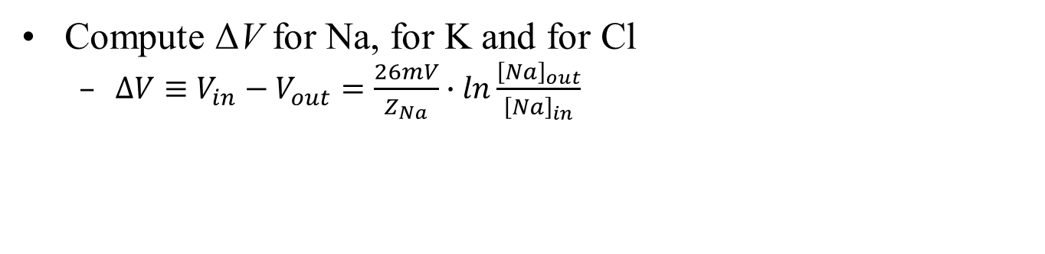
In-class exercise
extra-cellular fluid
Is ΔV the same for Na, K and Cl?
[K⁺]=400mM
[Na⁺]=50mM
[Cl⁻]=52mM
Pr ⁻=408mM
[K⁺]=20mM
[Na⁺]=440mM
[Cl⁻]=560mM
other⁺=110mM
intra-cellular fluid
Compute ΔV for Na, for K and for Cl
$∆V≡V_{in}−V_{out}=\frac{26mV}{Z_{Na}}∙ln\frac{{\left[Na\right]}_{out}}{{\left[Na\right]}_{in}}$

Slide 47
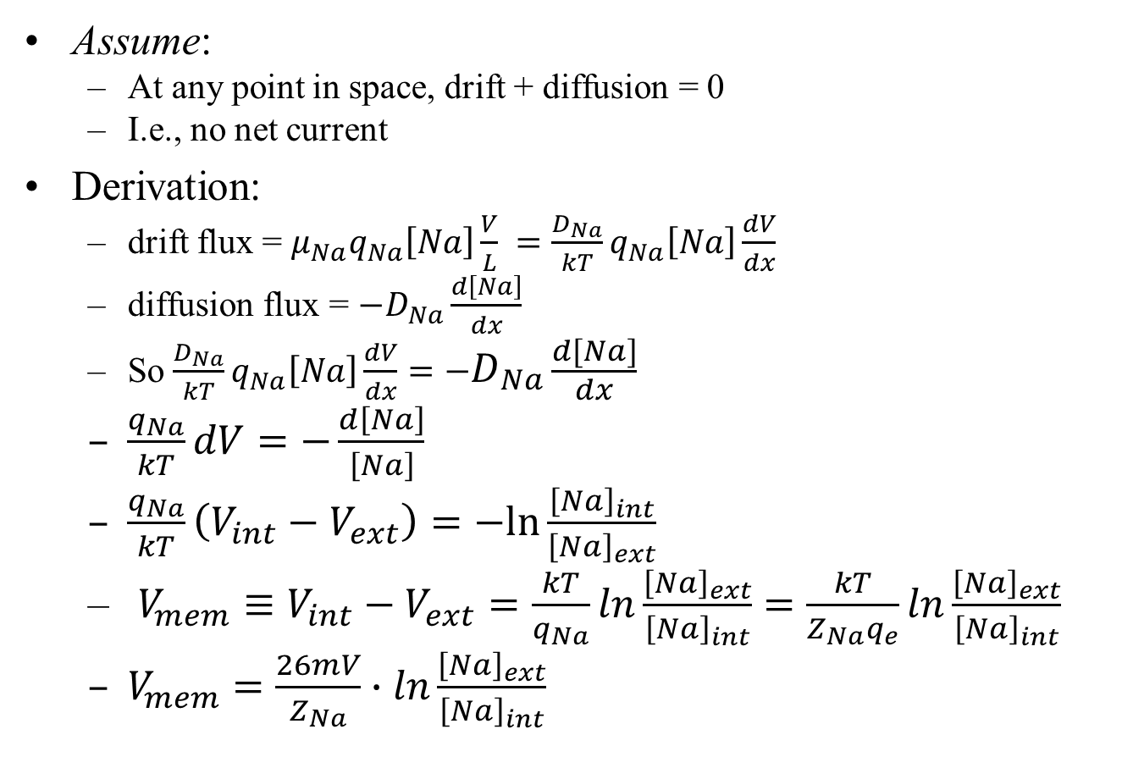
Nernst derivation
Assume:
At any point in space, drift + diffusion = 0
I.e., no net current
Derivation:
drift flux = $μ_{Na}q_{Na}\left[Na\right]\frac{V}{L} =\frac{D_{Na}}{kT}q_{Na}\left[Na\right]\frac{dV}{dx}$
diffusion flux = $−D_{Na}\frac{d\left[Na\right]}{dx}$
So $\frac{D_{Na}}{kT}q_{Na}\left[Na\right]\frac{dV}{dx}=−D_{Na}\frac{d\left[Na\right]}{dx}$
$\frac{q_{Na}}{kT}dV=−\frac{d\left[Na\right]}{\left[Na\right]}$
$\frac{q_{Na}}{kT}\left(V_{int}−V_{ext}\right)=−ln\frac{{\left[Na\right]}_{int}}{{\left[Na\right]}_{ext}}$
$V_{mem}≡V_{int}−V_{ext}=\frac{kT}{q_{Na}}ln\frac{{\left[Na\right]}_{ext}}{{\left[Na\right]}_{int}}=\frac{kT}{Z_{Na}q_{e}}ln\frac{{\left[Na\right]}_{ext}}{{\left[Na\right]}_{int}}$
$V_{mem}=\frac{26mV}{Z_{Na}}∙ln\frac{{\left[Na\right]}_{ext}}{{\left[Na\right]}_{int}}$
Einstein relation says D = μ kT
Backup

Slide 48
Outline for this section
Primer on Q, I, V, C
Diffusion current ($j_{Na}=−D\frac{d\left[Na\right]}{dx}$)
Drift current (j_{drift} = kV_{mem})
Diffusion + drift = Nernst ($V_{mem,Na}=\frac{26mV}{Z_{Na}}∙ln\frac{{\left[Na\right]}_{ext}}{{\left[Na\right]}_{int}}$)
Ion pumps
Electrical model of a cell (j_{total,Na} = g_{Na} (V_{mem}-V^{N}_{Na}) + j_{pump,Na})

Slide 49
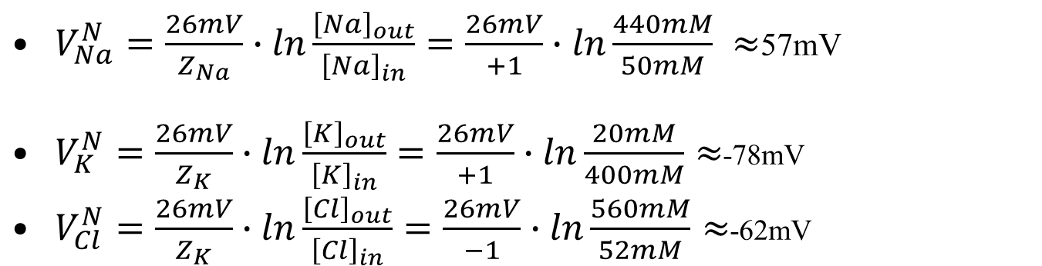
In-class exercise
extra-cellular fluid
Is V^{Nernst} the same for Na, K and Cl?
No!
But if V^{Nernst} is the ΔV across the cell membrane, it can only have one value ?!?
[K⁺]=400mM
[Na⁺]=50mM
[Cl⁻]=52mM
Pr ⁻=408mM
[K⁺]=20mM
[Na⁺]=440mM
[Cl⁻]=560mM
other⁺=110mM
intra-cellular fluid
$V_{Na}^{N}=\frac{26mV}{Z_{Na}}∙ln\frac{{\left[Na\right]}_{out}}{{\left[Na\right]}_{in}}=\frac{26mV}{+1}∙ln\frac{440mM}{50mM} ≈$57mV
$V_{K}^{N}=\frac{26mV}{Z_{K}}∙ln\frac{{\left[K\right]}_{out}}{{\left[K\right]}_{in}}=\frac{26mV}{+1}∙ln\frac{20mM}{400mM}≈$-78mV
$V_{Cl}^{N}=\frac{26mV}{Z_{K}}∙ln\frac{{\left[Cl\right]}_{out}}{{\left[Cl\right]}_{in}}=\frac{26mV}{−1}∙ln\frac{560mM}{52mM}≈$-62mV

Slide 50
Forces on the system
extra-cellular fluid
intra-cellular fluid
[K⁺]=20mM
[Na⁺]=440mM
[Cl⁻]=560mM
other⁺=110mM
[K⁺]=400mM
[Na⁺]=50mM
[Cl⁻]=52mM
Pr ⁻=408mM
First force: diffusion (our old friend)
Which way does diffusion flow for K⁺, Na⁺ and Cl⁻?
K⁺ out; Na⁺ and Cl⁻ in

Slide 51
Results of diffusion
extra-cellular fluid
[K⁺]=20mM
[Na⁺]=440mM
[Cl⁻]=560mM
other⁺=110mM
[K⁺]=400mM
[Na⁺]=50mM
[Cl⁻]=52mM
Pr ⁻=408mM
If diffusion happen long enough and there is no drift, what will happen to the concentrations [K⁺], [Na⁺] and [Cl⁻] inside vs. outside of the cell?
For each ion, the concentration inside and outside the cell will eventually become equal
This is not what actually happens!
As we’ve explained, there is drift

Slide 52
Drift currents
--- +++ 60mV
[K⁺]=20mM
[Na⁺]=440mM
[Cl⁻]=560mM
other⁺=110mM
[K⁺]=400mM
[Na⁺]=50mM
[Cl⁻]=52mM
Pr ⁻=408mM
Blue arrows = diffusion
Green arrows = electric current
In fact, the cell stabilizes to V_{mem} ≈ -60mV
(given the amount of unbalanced charge, and Q=CV)
This voltage will push the ions around, as we’ve discussed
Which way do drift currents flow?

Slide 53
Nernst sanity check
--- +++ 60mV
[K⁺]=20mM
[Na⁺]=440mM
[Cl⁻]=560mM
other⁺=110mM
[K⁺]=400mM
[Na⁺]=50mM
[Cl⁻]=52mM
Pr ⁻=408mM
Blue arrows = diffusion
Green arrows = drift current
First look at Cl⁻. Can drift and diffusion currents balance?
Yes; drift current out, and diffuses in
V_{Cl}^{Nernst} = -62mV ≈ V_{mem}. Cool!

Slide 54
Nernst sanity check
--- +++ 60mV
[K⁺]=20mM
[Na⁺]=440mM
[Cl⁻]=560mM
other⁺=110mM
[K⁺]=400mM
[Na⁺]=50mM
[Cl⁻]=52mM
Pr ⁻=408mM
Blue arrows = diffusion
Green arrows = drift current
Next look at K⁺. Can drift current and diffusion balance?
Yes; drift current in, and diffuses out
V_{K}^{Nernst} ≈ -78mV
Not quite right ?!?

Slide 55
Nernst sanity check
--- +++ 60mV
[K⁺]=20mM
[Na⁺]=440mM
[Cl⁻]=560mM
other⁺=110mM
[K⁺]=400mM
[Na⁺]=50mM
[Cl⁻]=52mM
Pr ⁻=408mM
Blue arrows = diffusion
Green arrows = drift current
Finally, look at Na⁺. Can drift current and diffusion balance?
No – they both flow inwards!
V_{Na}^{Nernst} ≈ +57mV
Not even close ?!?
What’s going on here?

Slide 56
Another ion-flow source
--- +++ 60mV
3Na⁺
2K⁺
[K⁺]=20mM
[Na⁺]=440mM
[Cl⁻]=560mM
other⁺=110mM
[K⁺]=400mM
[Na⁺]=50mM
[Cl⁻]=52mM
other⁻=408mM
Blue arrows = diffusion
Green arrows = drift current
Red arrows = ion pump
Drift and diffusion currents do not balance
another molecular machine at work: ion pumps
Ion pumps pump 3 Na⁺ out and 2 K⁺ in
Na⁺ flows in (drift & diffusion currents) through ion channels, and gets pumped right out again (inward and outward flows balance at steady state)
K⁺ flows in from drift current and is also pumped in; diffusion out exactly balances this total inwards flow
Why was Cl⁻ the only ion whose V^{Nernst} exactly matched the cell voltage?
There is no Cl⁻ pump

Slide 57
Steady state
--- +++ 60mV
3Na⁺
2K⁺
[K⁺]=20mM
[Na⁺]=440mM
[Cl⁻]=560mM
other⁺=110mM
[K⁺]=400mM
[Na⁺]=50mM
[Cl⁻]=52mM
P ⁻=408mM
Blue arrows = diffusion
Green arrows = drift current
Red arrows = ion pump
Steady state: all concentrations and rates are unchanging over time
Cl:
Na:
K:
diffusion in = drift out
diffusion in + drift in = pump out
diffusion out = drift in + pump in
No net flow in/out
concentrations unchanging
flow rates unchanging
We are at steady state
Nernst is only true for Cl

Slide 58
Where are we?
We learned what drift and diffusion are
When drift = diffusion, Nernst is true and we know V_{mem}
But for a cell, that’s only true for Cl
The cell is at SS
Nernst is not true for Na, K
Clearly the cell “works;” it can stay at SS essentially forever
Our nice Nernst formula doesn’t always work
Now we know why – but we still have a problem
How do we model/analyze a cell?

Slide 59
Definitions
Backup
Define some terms:
detailed balance: every forwards reaction is balanced by a reverse reaction
equilibrium: everything is unchanging over time, and no energy is being expended
steady state: all concentrations and rates are unchanging over time. Energy can be expended.
Nernst is true
You are dead
You are alive
Ion pumps require energy
Steady state doesn’t imply detailed balance
and thus does not imply Nernst
Na, K pumps run
Cl has no pumps
Nernst is false
Nernst is true
Notes:
This is partly a backup slide. The important thing is not the definitions of detailed balance, equilm and steady state (though we will use those terms, and redefine them each time). Really, the important thing is the notion that pumps break Nernst.

Slide 60
Outline for this section
Primer on Q, I, V, C
Diffusion current ($j_{Na}=−D\frac{d\left[Na\right]}{dx}$)
Drift current (j_{drift} = kV_{mem})
Diffusion + drift = Nernst ($V_{mem,Na}=\frac{26mV}{Z_{Na}}∙ln\frac{{\left[Na\right]}_{ext}}{{\left[Na\right]}_{int}}$)
Ion pumps
Electrical model of a cell (j_{total,Na} = g_{Na} (V_{mem}-V^{N}_{Na}) + j_{pump,Na})

Slide 61
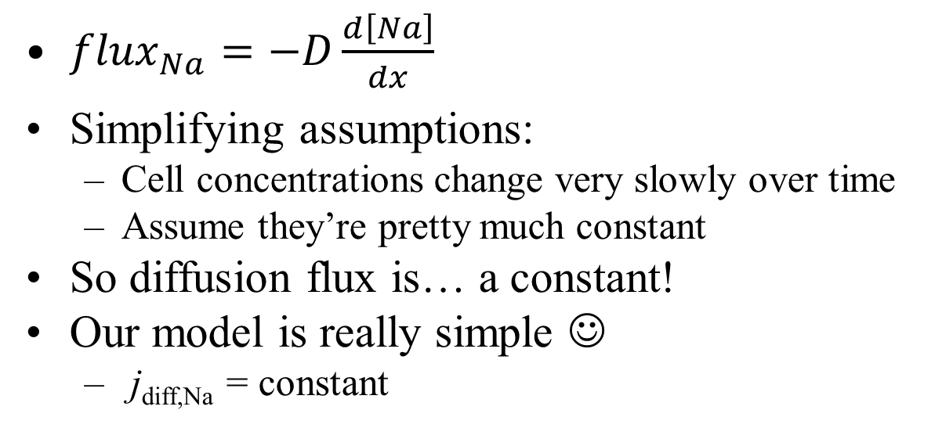
Modeling diffusion in a cell
Because the ion channels are small compared to cell volume
${flux}_{Na}=−D\frac{d\left[Na\right]}{dx}$
Simplifying assumptions:
Cell concentrations change very slowly over time
Assume they’re pretty much constant
So diffusion flux is… a constant!
Our model is really simple ☺
j_{diff,Na} = constant
It’s only constant for a given set of concentrations!
If [Na] changes over time, then so does j_{diff,Na}

Slide 62
Modeling drift in a cell
Use Ohm’s Law
j_{drift,Na} = V_{mem} / R_{Na}
j_{drift,Na} = g_{Na}V_{mem} (where g_{Na}≡ 1 / R_{Na})
G_{Na} is conductance of Na ion channels

Slide 63
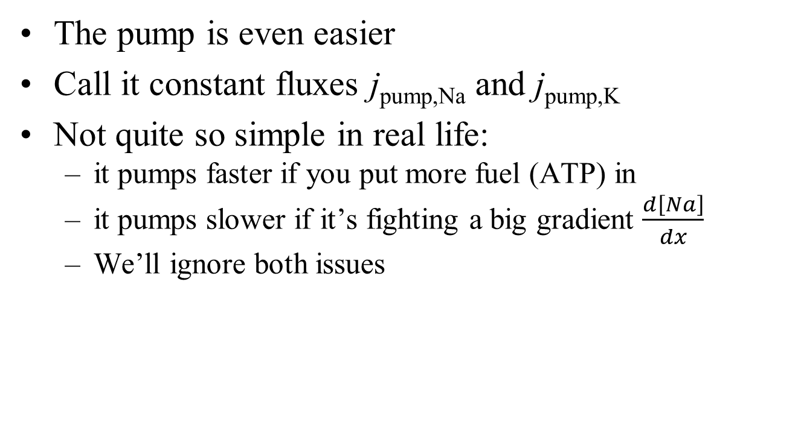
Modeling the ion pumps
The pump is even easier
Call it constant fluxes j_{pump,Na} and j_{pump,K}
Not quite so simple in real life:
it pumps faster if you put more fuel (ATP) in
it pumps slower if it’s fighting a big gradient $\frac{d\left[Na\right]}{dx}$
We’ll ignore both issues

Slide 64
Simple equation
j_{total,Na} = j_{diff,Na} + g_{Na}V_{mem} + j_{pump,Na}
= g_{Na} (V_{mem} + (j_{diff,Na}/g_{Na})) + j_{pump,Na}
This is reasonably simple, but we can do even a bit better
Ignore the pump for a moment
We know that, without pumps, diffusion and drift balance (i.e., no net flux) at the Nernst voltage
So a revised equation:
Is this surprising?
The units work, of course
We know that V_{mem} * g_{Na} = j_{drift,Na} , which must equal j_{diff} when V=V^{N}_{Na}. So it’s not at all surprising
This is bioelectricity in a nutshell! Does it make sense?
j_{total,Na} = g_{Na} (V_{mem} - V^{N}_{Na}) + j_{pump,Na}

Slide 65
What the model says
Main input: V_{mem}
There’s a separate model for each ion. Cl doesn’t have a pump
Output: flux (how fast the ion is entering the cell)
j_{total,Na} = g_{Na} (V_{mem} - V^{N}_{Na}) + j_{pump,Na}
V^{N}_{Na} and j_{pump,Na} depend on [Na]
How many ion channels there are
There’s only one V_{mem}, shared by all ions
Drift
Hidden input: [Na]_{int}
And [Na]_{ext} is usually assumed constant
Diffusion
Notes:
Any reason why Vnernst might represent diffusion? Because it’s proportional to [out]/[in]!

Slide 66

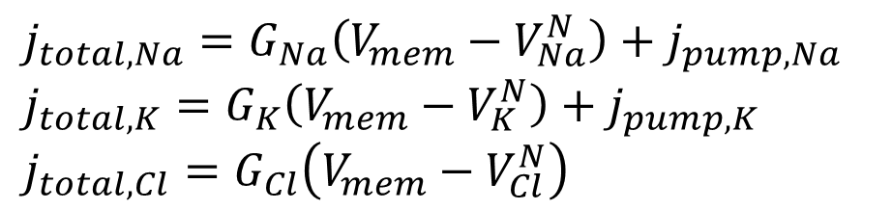


Modeling our cell as a circuit
$$j_{total,Na}=G_{Na}\left(V_{mem}−V_{Na}^{N}\right)+j_{pump,Na}$$
$$j_{total,K}=G_{K}\left(V_{mem}−V_{K}^{N}\right)+j_{pump,K}$$
$$j_{total,Cl}=G_{Cl}\left(V_{mem}−V_{Cl}^{N}\right)$$
ICF
A current source simply provides a constant current
V_{mem}
j_{Na}
j_{K}
G_{Na}
G_{K}
G_{Cl}
$$V_{Na}^{N}$$
$$V_{K}^{N}$$
$$V_{Cl}^{N}$$
77mV
-89mV
-71mV
ECF

Slide 67

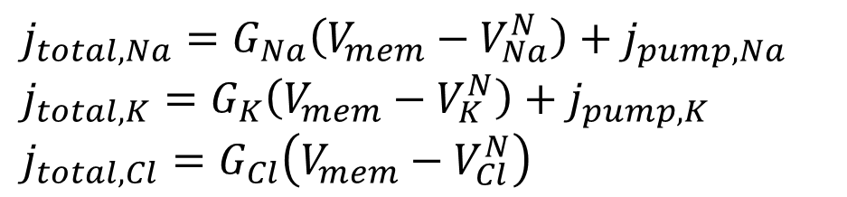


Modeling our cell as a circuit
$$j_{total,Na}=G_{Na}\left(V_{mem}−V_{Na}^{N}\right)+j_{pump,Na}$$
$$j_{total,K}=G_{K}\left(V_{mem}−V_{K}^{N}\right)+j_{pump,K}$$
$$j_{total,Cl}=G_{Cl}\left(V_{mem}−V_{Cl}^{N}\right)$$
ICF
A voltage source (a.k.a. a battery) simply provides a constant voltage
V_{mem}
j_{Na}
j_{K}
G_{Na}
G_{K}
G_{Cl}
$$V_{Na}^{N}$$
$$V_{K}^{N}$$
$$V_{Cl}^{N}$$
77mV
-89mV
-71mV
ECF

Slide 68
Modeling our cell as a circuit
$$j_{total,Na}=G_{Na}\left(V_{mem}−V_{Na}^{N}\right)+j_{pump,Na}$$
$$j_{total,K}=G_{K}\left(V_{mem}−V_{K}^{N}\right)+j_{pump,K}$$
$$j_{total,Cl}=G_{Cl}\left(V_{mem}−V_{Cl}^{N}\right)$$
ICF
A resistor operates according to Ohm’s Law: I=V/R (or I=GV with G≡1/R)
V_{mem}
j_{Na}
j_{K}
G_{Na}
G_{K}
G_{Cl}
$$V_{Na}^{N}$$
$$V_{K}^{N}$$
$$V_{Cl}^{N}$$
77mV
-89mV
-71mV
ECF

Slide 69
What to do with our model
We can build a simulator (BITSEY)
flux tells us how fast the concentrations are changing
If there are 2 moles of Na in the cell, and a flux of .3 M/second entering, then if we simulate for 1s
there are now 2.3 moles of Na.
A simulator just does this over and over (each time computing new j_{diff}, g and V_{N} for the new [Na]
We said that total charge in the cell determines V_{mem} (Q=CV)
So our simulator will also tell us V_{mem} over time
Run the simulator until things stabilize
Then we’ve computed the steady-state V_{mem} for a cell
In fact, that’s Lab #2
Simulate short transients around steady state
that’s how neurons work

Slide 70
Done with the basics!
The main part of bioelectricity is done ☺
But we haven’t built anything yet ☹
What’s coming next:
lab #1 (Skittles diffusion) is hopefully a bit fun
lab #2 (simple Bitsey) solidifies what we’ve learned
add a few more details (QSS) and build a neuron
add one more detail (GJs) and build cardiomyocytes
build worms
But the hard part is done ☺

Slide 71

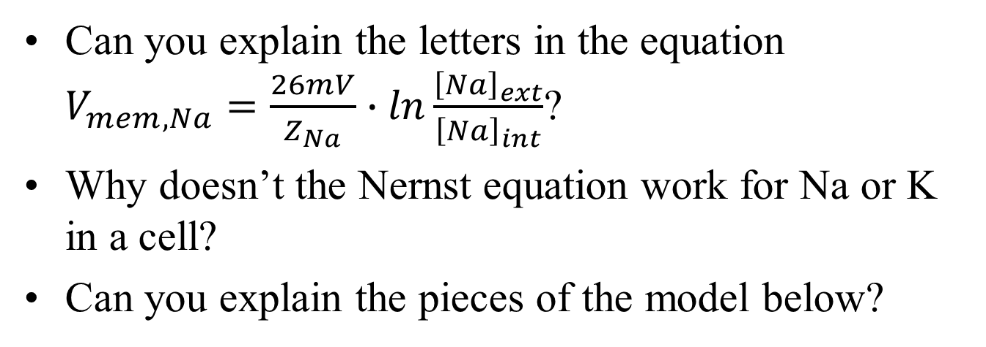


Mini quiz
Can you explain the letters in the equation $V_{mem,Na}=\frac{26mV}{Z_{Na}}∙ln\frac{{\left[Na\right]}_{ext}}{{\left[Na\right]}_{int}}$?
Why doesn’t the Nernst equation work for Na or K in a cell?
Can you explain the pieces of the model below?
j_{Na}
j_{K}
G_{Na}
G_{K}
G_{Cl}
$$V_{Na}^{N}$$
$$V_{K}^{N}$$
$$V_{Cl}^{N}$$
77mV
-89mV
-71mV
ECF

Slide 72
BACKUP

Slide 73
Start of Lab #2
Start Lab #2 in class
Learn about Bitsey
Run the 5-second simulations
Then run the long simulations at home

Slide 74



Material to potentially be taught by the EEs:
Draw the model as an equivalent ckt that has V & R for Na & K, R for Cl.
Show how it reaches a final voltage
Show how changing each R affects the voltage (for lab #1)
ICF
I_{Na}
I_{K}
G_{Na}
G_{K}
G_{Cl}
$$V_{Na}^{N}$$
$$V_{K}^{N}$$
$$V_{Cl}^{N}$$
ECF
77mV
-89mV
-71mV

Slide 75
Ions in a giant squid
extra-cellular fluid
[K⁺]=400mM
[Na⁺]=50mM
[Cl⁻]=52mM
Pr ⁻=408mM
[K⁺]=20mM
[Na⁺]=440mM
[Cl⁻]=560mM
other⁺=110mM
intra-cellular fluid
Q = CV
Observation: ICF and ECF each have high ion concentrations, but are roughly charge neutral
Consequence: a small charge flow can greatly change the net charge
and hence the net voltage
That’s what allows our nervous system to react quickly
Notes:
If we had Q=100 C, then a ΔQ of 1C would make only a 1% change in Vmem. But if Q=1 C, then the same ΔQ doubles Vmem

Slide 76
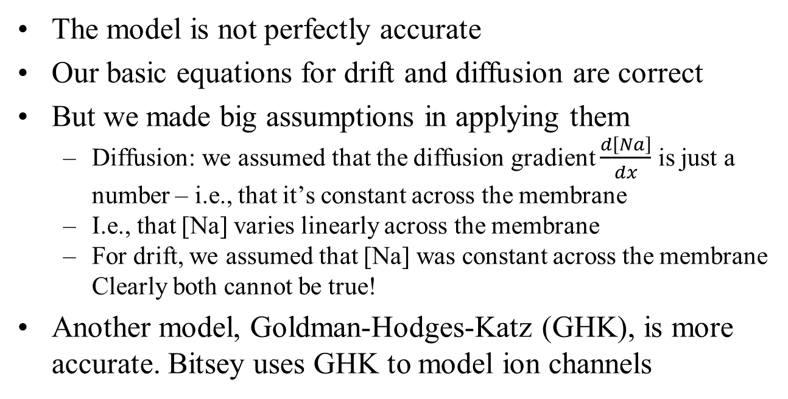
Inaccuracies
The model is not perfectly accurate
Our basic equations for drift and diffusion are correct
But we made big assumptions in applying them
Diffusion: we assumed that the diffusion gradient $\frac{d\left[Na\right]}{dx}$ is just a number – i.e., that it’s constant across the membrane
I.e., that [Na] varies linearly across the membrane
For drift, we assumed that [Na] was constant across the membrane Clearly both cannot be true!
Another model, Goldman-Hodges-Katz (GHK), is more accurate. Bitsey uses GHK to model ion channels
potential final project

Slide 77
Our model is imperfect
“All models are wrong. Some are still useful,” George Box
Our model had a hidden input [Na]_{int}
The model only works at that [Na]_{int}
But the model is still “reasonably” good if we’re “reasonably” near that [Na]_{int}
We must re-compute g, V_{N} and j_{pump} when [Na]_{int} changes substantially
Most important
simple model = intuitive
helps us to understand how cells behave
j_{total,Na} = g_{Na} (V_{mem} - V^{N}_{Na}) + j_{pump,Na}

