Slide 1
Bioelectricity
Fall 2020
Tufts University
Instructor: Joel Grodstein
joel.grodstein@tufts.edu
Bioelectricity 1b – QSS and neurons

Slide 2
Big picture of the course
Where does bioelectricity come from?
Neurons and working with the nervous system
Cardiac bioelectricity
Worms

Slide 3
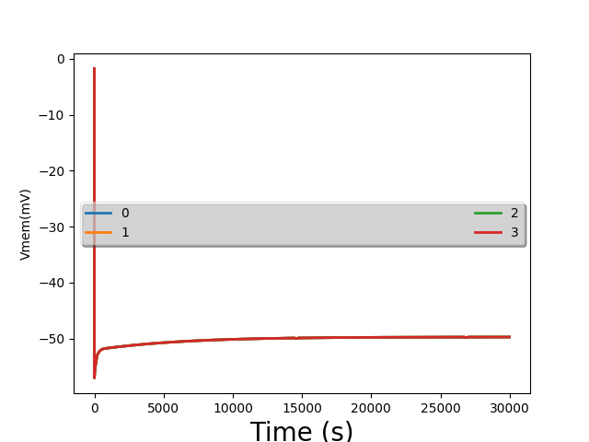
VLab #1, first plots

Slide 4
Problem for the day
We ran a bunch of simulations of cells
They created voltage. Cool!
“Minor” problem:
Our sims took several hours of simulated time to reach steady state
Our brains run on bioelectricity
Any problem there?

Slide 5
How can our brain be so fast?
We humans can think pretty fast
We can react pretty fast, too
Cannot work if each neuron takes hours to settle!
Result: humans evolved a new way to use bioelectricity
Operation at quasi-steady-state
It’s how neurons work
Levin-lab hypothesis
Steady-state bioelectricity is used to build body shape
We’re in the womb for 9 months
Our cuts & scrapes heal over days/weeks
But it’s not OK for brains ☹
Or for animorphs https://www.youtube.com/watch?v=jEKPDgjERt0&list=PL9AC274019AC09106&index=5
Notes:
At the “react fast” part, throw something!

Slide 6
What we will learn
How to use bioelectricity to compute really fast
This will be how neurons work

Slide 7
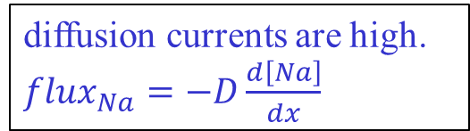
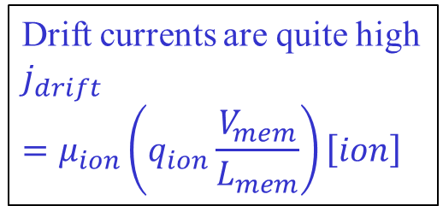
Why so fast
How can neurons be so fast?
Four facts:
Cells are very small
Biology has built sensitive sensors – we need only move V_{mem} by 50mV
Inside and outside have very different concentrations from each other
Each has quite a lot of charge
So capacitance C is small
So ∆V is also small. And q = CV, ∆q = C∆V
diffusion currents are high. ${flux}_{Na}=−D\frac{d\left[Na\right]}{dx}$
60mV
--- +++
Drift currents are quite high
$$j_{drift}=μ_{ion}\left(q_{ion}\frac{V_{mem}}{L_{mem}}\right)\left[ion\right]$$
[K⁺]=20mM
[Na⁺]=440mM
[Cl⁻]=560mM
other⁺=110mM
[K⁺]=400mM
[Na⁺]=50mM
[Cl⁻]=52mM
Pr ⁻=408mM
3Na⁺
2K⁺
Notes:
Biological voltages are small: 50mV or so. Compare to your IPhone CPU >1V. This is partly why your brain is so power efficient!
And your house is 120V. This also gives your body a lot of safety margin against getting electrocuted if something goes wrong. You would not want to be electrocuted every time you catch a cold!

Slide 8
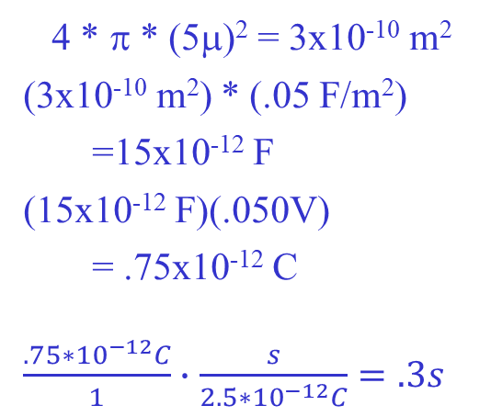
Back of the envelope speed
Quick electricity problem:
If the cell membrane is a capacitor C
How much charge Δq must enter the cell to change the voltage by ΔV?
Δq=CΔV
Typical planaria values:
Radius of a cell = 5μ
Capacitance of the cell membrane = .05 F/m²
ΔV = 50mV
What is Δq?
How long will it take to move V_{mem} by 50mV?
Current = 2.5*10⁻¹² C/s
Area of membr. =
C =
Δq = CΔV =
Time =
4 * π * (5μ)² = 3x10⁻¹⁰ m²
(3x10⁻¹⁰ m²) * (.05 F/m²)
=15x10⁻¹² F
(15x10⁻¹² F)(.050V)
= .75x10⁻¹² C
$\frac{.75∗{10}^{−12}C}{1}∙$ $\frac{s}{2.5{∗10}^{−12}C}=.3s$
Notes:
First convince them that Δq=CΔV is true by showing a few numbers: 10=2*5, and (10+2*3)=2*(5+3)
This works because the equation is linear

Slide 9
It only takes .3s to move V_{mem} around as much as needed!
That’s a planaria; humans are <1ms
Random factoids… anybody know why human nerves are so much faster than worms?
That’s a lot faster than hours! Nice, but…

Slide 10
So why was VLab #1 so slow?
--- +++ 60mV
3Na⁺
2K⁺
[K⁺]=20mM
[Na⁺]=440mM
[Cl⁻]=560mM
other⁺=110mM
[K⁺]=400mM
[Na⁺]=50mM
[Cl⁻]=52mM
other⁻=408mM
Blue arrows = diffusion
Green arrows = electric current
Red arrows = ion pump
Bioelectricity has another trick up its sleeve
Consider increasing G_{Na}
Lookahead… neurons work by quickly changing G_{Na} and G_{K}
Notes:
Assume we were in SS before we increased G_{Na}

Slide 11
So why was VLab #1 so slow?
--- +++ 60mV
3Na⁺
2K⁺
[K⁺]=20mM
[Na⁺]=440mM
[Cl⁻]=560mM
other⁺=110mM
[K⁺]=400mM
[Na⁺]=50mM
[Cl⁻]=52mM
other⁻=408mM
Blue arrows = diffusion
Green arrows = electric current
Red arrows = ion pump
If we increase G_{Na}
Na+ is flowing inwards from both diffusion and drift, and then being pumped out
Increasing G_{Na} will increase the inwards flow; and not affect the outwards flow
Analyzing only Na for now…
More [Na]_{int} → V_{mem} ↑
Higher V_{mem} pushes Na⁺ out again
V_{mem} rises enough so reduced drift balances increased diffusion
This is negative feedback
Concentrations barely change, so it’s fast
V_{mem} will get more positive (i.e., closer to 0) very quickly
Are we done yet? At this new V_{mem}, is the flow of, say, Cl⁻ balanced?
Notes:
Assume we were in SS before we increased G_{Na}

Slide 12
We’re not at steady state
--- +++ 60mV
3Na⁺
2K⁺
[K⁺]=20mM
[Na⁺]=440mM
[Cl⁻]=560mM
other⁺=110mM
[K⁺]=400mM
[Na⁺]=50mM
[Cl⁻]=52mM
other⁻=408mM
Blue arrows = diffusion
Green arrows = electric current
Red arrows = ion pump
Cl⁻ has no pump. It’s only balanced when drift=diffusion. Are they balanced?
Cl⁻ diffusion is unchanged, but drift is changed…
Cl⁻ is not balanced
Ditto for K⁺, in fact
What must change for Cl⁻ to balance again at this new V_{mem}?
ICF [Cl] must change enough to make a new diffusion
But that is what takes hours and not ms.
Remember: unbalanced charge flow changes V_{mem} very fast, but [] changes slowly
So what’s going on? Why do we think we can compute fast?

Slide 13
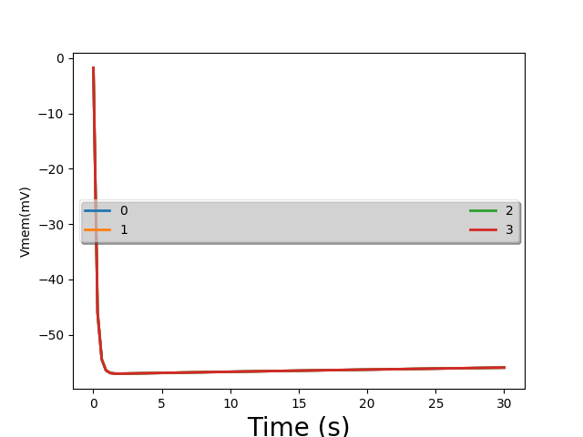
VLab #1 picture again
This time in more detail, from t=0 to t=30:
really fast change
really slow change
Notes:
We see one

Slide 14
--- +++ 60mV
3Na⁺
2K⁺
[K⁺]=5mM
[Na⁺]=145mM
[Cl⁻]=140mM
[K⁺]=400mM
[Na⁺]=50mM
[Cl⁻]=9mM
other⁻=408mM
Blue arrows = diffusion
Green arrows = electric current
Red arrows = ion pump
Big picture: if you make V_{mem} more positive
Diffusion and pump flows are unchanged
Drift currents push positive ions out, negative ions in

Slide 15
flux (mM/m²s) into cell
Na drift+diff
K pump
K drift+diff
-71 0 V_{mem} (mV)
Na pump
Consider the situation at SS before we changed G_{Na}
Pump 3 Na out, 2 K in
Drift & diffusion must balance the pump
Now increase G_{Na}
Na is no longer balanced
Increase V_{mem} → positive charges drift out
We can pick a new V_{mem} to balance Na
but then K isn’t balanced
Notes:
Note that we’ve moved to voltage & concentration values that are more like human neurons, not giant squid.

Slide 16
charge (C/m²s) into cell
flux (mM/m²s) into cell
Na drift+diff
K pump
K drift+diff
-71 0 V_{mem} (mV)
Na pump
Net + charge into cell
Net 0 charge into cell
Net - charge into cell
Add Cl to the picture
There is some increased V_{mem} with net zero charge into the cell!
That is where we quickly settle!

Slide 17
charge (C/m²s) into cell
flux (mM/m²s) into cell
Na drift+diff
K pump
K drift+diff
-71 0 V_{mem} (mV)
Na pump
Net + charge into cell
Net 0 charge into cell
Net - charge into cell
No individual ion is balanced
Non-zero charge flux into cell for each of Na, K, Cl
But they all cancel out!

Slide 18
Mini-quiz
In a few sentences, explain how neurons can operate so fast
What does it mean for cells to use negative feedback to arrive at a stable voltage point?

Slide 19
flux (mM/m²s) into cell for drift+diffusion
Na drift+diff
Cl drift+diff
K pump
-89 -71 0 +77 V_{mem} (mV)
Na pump
K drift+diff
Consider the situation at SS before we changed G_{Na}
Pump 3 Na out, 2 K in
V_{N,Na}=+77mV; V_{N,K}=-89mV; V_{N,Cl}=-71mV
Can you draw the ion-channel flux-vs-V_{mem} lines:
the line for Cl?
the line for K?
the line for Na?
Let’s understand this a bit better
BACKUP
Notes:
How do we draw these lines? 1. Each line is drift + diffusion; so we must have flux_line=0 at that ion’s Vnernst. 2. At Vss=-70mV, both Na and K must have flux_pump + flux_line =0. So we’ve fully determined the lines for Na and K; and have the y intercept (but not the slope) for Cl. Then just pick a reasonable slope for the Cl line.
Also note that we’ve moved to voltage & concentration values that are more like human neurons, not giant squid.

Slide 20
flux (mM/m²s) into cell for drift+diffusion
Na drift+diff
Cl drift+diff
K pump
-89 -71 0 +77 V_{mem} (mV)
Na pump
K drift+diff
Consider the situation at SS before we changed G_{Na}
Pump 3 Na out, 2 K in
V_{N,Na}=+77mV; V_{N,K}=-89mV; V_{N,Cl}=-71mV
At the SS V_{mem} of -71mV, what is the net flux of each ion?
BACKUP
Notes:
Every single ion has a net flux of 0. That’s why we’re in SS!

Slide 21
flux (mM/m²s) into cell for drift+diffusion
Na drift+diff
Cl drift+diff
K pump
-89 -71 0 +77 V_{mem} (mV)
Na pump
K drift+diff
Consider the situation at SS before we changed G_{Na}
Pump 3 Na out, 2 K in
V_{N,Na}=+77mV; V_{N,K}=-89mV; V_{N,Cl}=-71mV
As V_{mem}↑, what happens to the flux of Na, K and Cl into the cell?
What happens to the flux of charge into the cell?
What happens if some random + charge enters the cell?
Negative feedback → stability
BACKUP
Notes:
Higher V inside pushes Na, K out and Cl in.
All three of those make the cell more negative.

Slide 22
flux (mM/m²s) into cell for drift+diffusion
Na drift+diff
Cl drift+diff
charge into cell
K pump
charge into cell
-89 -71 0 +77 V_{mem} (mV)
Na pump
K drift+diff
Change the Y axis from “flux of ion ” to “flux of positive charge”
First the K pump
Charge of K = +1; line doesn’t change
Ditto for the Na pump
BACKUP

Slide 23
flux (mM/m²s) into cell for drift+diffusion
Na drift+diff
Cl drift+diff
charge into cell
-89 -71 0 +77 V_{mem} (mV)
charge into cell
K drift+diff
Change the Y axis from “flux of ion ” to “flux of positive charge”
Now the Na ion channel
Charge of Na = +1; line doesn’t change
Next, the K ion channel (charge = +1)
BACKUP

Slide 24
flux (mM/m²s) into cell for drift+diffusion
charge into cell
Cl drift+diff
-89 -71 0 +77 V_{mem} (mV)
charge into cell
Change the Y axis from “flux of ion ” to “flux of positive charge”
Finally, the Cl ion channel
Charge of Cl = -1; flip the line before adding it in
Bottom line: V_{mem} rises → positive charge leaves the cell
Negative feedback; and it’s fast
We quickly settle to a stable V_{mem} – but what is its value?
BACKUP
Notes:
Honestly, these last few slides were mostly just to gain some fluency in how the charges work. We really could skip them.

Slide 25



Circuit model computes V_{mem}
ICF
I_{Na}
I_{K}
.4
2.2
.4
60 40
$$V_{Na}^{N}$$
$$V_{K}^{N}$$
$$V_{Cl}^{N}$$
ECF
77mV
-89mV
-71mV
Units?
G is (mmoles/m³·s) per mVolt
I_{pump} is mmoles/m³·s
Note the 3:2 ratio of pump currents
Notes:
In Bitsey, the units on Gth are (ions entering the cell/m2s) per Volt of Vmem; thus Gth tends to be negative for Na and K, and positive for Cl.
The slide makes them all positive, which assumes you know what you’re doing when you calculate flows!

Slide 26
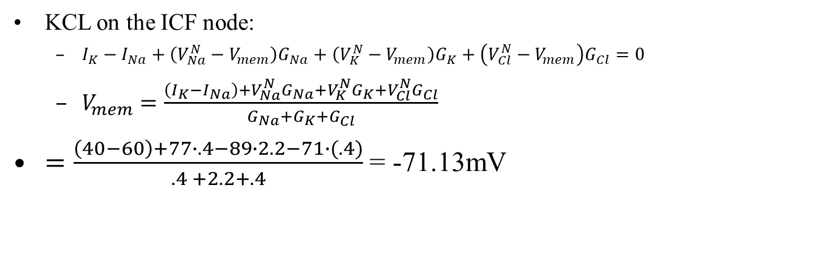
Circuit model computes V_{mem}
ICF
I_{Na}
I_{K}
.4
2.2
.4
60 40
$$V_{Na}^{N}$$
$$V_{K}^{N}$$
$$V_{Cl}^{N}$$
ECF
77mV
-89mV
-71mV
KCL on the ICF node:
$I_{K}−I_{Na}+\left(V_{Na}^{N}−V_{mem}\right)G_{Na}+\left(V_{K}^{N}−V_{mem}\right)G_{K}+\left(V_{Cl}^{N}−V_{mem}\right)G_{Cl}=0$
$V_{mem}=\frac{\left(I_{K}−I_{Na}\right)+V_{Na}^{N}G_{Na}+V_{K}^{N}G_{K}+V_{Cl}^{N}G_{Cl}}{G_{Na}+G_{K}+G_{Cl}}$
$=\frac{\left(40−60\right)+77∙.4−89∙2.2−71∙(.4)}{.4 +2.2+.4}$ = -71.13mV
Notes:
In Bitsey, the units on Gth are (ions entering the cell/m2s) per Volt of Vmem; thus Gth tends to be negative for Na and K, and positive for Cl.
However, Bitsey then scales the resultant ion fluxes by each ion’s Z to get charge fluxes. If we’re restricted to Z=+1 and Z= -1, then we get the same effect by simply assuming that all G values are positive (which is what this slide does)

Slide 27
KCL = biology?
ICF
I_{Na}
I_{K}
.4
2.2
.4
60 40
$$V_{Na}^{N}$$
$$V_{K}^{N}$$
$$V_{Cl}^{N}$$
ECF
77mV
-89mV
-71mV
What is KCL really doing?
It’s saying that the sum of currents into the node = 0
We already said the cell quickly settles at a V_{mem} where net flux = 0
These are the same thing!
KCL computes the V_{mem} that we quickly settle to
But ignores how long it takes to get there
Notes:
To figure out how long things take, we would have to add the membrane capacitor to this circuit

Slide 28
Individual ion currents
ICF
V_{mem}=-71mV
I_{Na}
I_{K}
Compute the current for each ion
.4
2.2
.4
60 40
$$V_{Na}^{N}$$
$$V_{K}^{N}$$
$$V_{Cl}^{N}$$
ECF
77mV
-89mV
-71mV
Cl
Voltage drop across resistor = (-71) - (-71) = 0 mV
Current = V/R = 0
Na:
ion channel = (77 - -71) * .4 ≈ 60 entering the cell
pump = 60 leaving the cell
K:
ion channel = (-89 - -71) * 2.2 ≈ -40 entering the cell
pump = 40 entering the cell
Each individual ion is balanced!
That’s the definition of steady state
Notes:
This slide is for the original SS, before we changed G_Na

Slide 29
What if we change G_{Na}?
ICF
V_{mem}=-71mV
I_{Na}
I_{K}
Remember our original question?
What if we increase G_{Na} (lookahead – neurons do this)?
I.e., turn on more Na ion channels?
.4
2.2
.4
60 40
$$V_{Na}^{N}$$
$$V_{K}^{N}$$
$$V_{Cl}^{N}$$
ECF
77mV
-89mV
-71mV

Slide 30
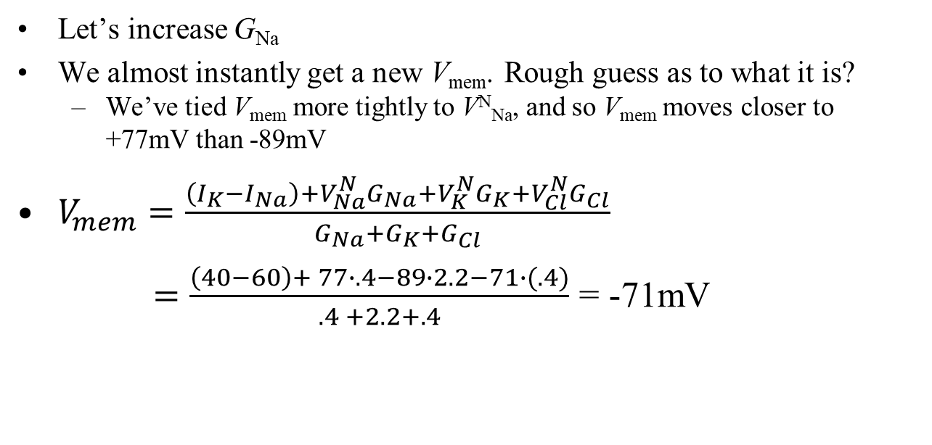



V_{mem}=19mV
ICF
V_{mem}=-71mV
I_{Na}
I_{K}
5
2.2
.4
.4
60 40
$$V_{Na}^{N}$$
$$V_{K}^{N}$$
$$V_{Cl}^{N}$$
ECF
77mV
-89mV
-71mV
Let’s increase G_{Na}
We almost instantly get a new V_{mem}. Rough guess as to what it is?
We’ve tied V_{mem} more tightly to V^{N}_{Na}, and so V_{mem} moves closer to +77mV than -89mV
$V_{mem}=\frac{\left(I_{K}−I_{Na}\right)+V_{Na}^{N}G_{Na}+V_{K}^{N}G_{K}+V_{Cl}^{N}G_{Cl}}{G_{Na}+G_{K}+G_{Cl}}$
$=\frac{\left(40−60\right)+ 77∙.4−89∙2.2−71∙(.4)}{.4 +2.2+.4}$ = -71mV
5
19
5
Notes:
In Bitsey, the units on Gth are (ions entering the cell/m2s) per Volt of Vmem; thus Gth tends to be negative for Na and K, and positive for Cl.
However, Bitsey then scales the resultant ion fluxes by each ion’s Z to get charge fluxes. If we’re restricted to Z=+1 and Z= -1, then we get the same effect by simply assuming that all G values are positive (which is what this slide does)
The actual Vmem is +18.52

Slide 31
ICF
V_{mem}=+19mV
Na: (77-19)*5≈292
I_{Na}
I_{K}
Cl: (-71-19)*.4≈-36
5
2.2
.4
60 40
$$V_{Na}^{N}$$
$$V_{K}^{N}$$
$$V_{Cl}^{N}$$
K: (-89-19)*2.2≈-236
ECF
77mV
-89mV
-71mV
Let’s look at the new currents
Which way does Na flow?
K?
Cl?
Observation: each ion is individually unbalanced!
In total: net charge flow into cell via ion channels =
net flow leaving via pumps =
Into the cell, since V_{mem}=19mV and 19<77
Out of the cell, since 19 > -89
Net charge flux=0
Charge out (Cl in) the cell, since 19 > -71
292 -236 - 36 = 20
60 - 40 = 20
Notes:
The actual Vmem is +18.52, which makes the numbers on the slide actually work right without needing the “approximately equals.”

Slide 32
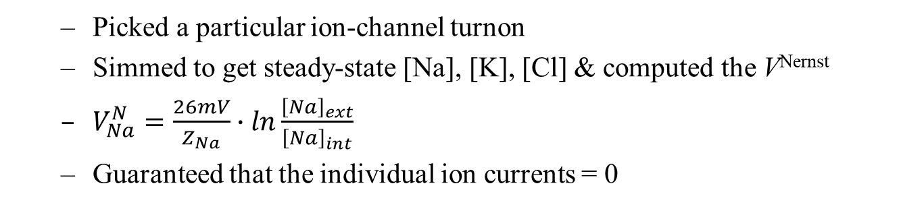
What’s going on?
ICF
V_{mem}=-71mV
I_{Na}
I_{K}
5
.4
2.2
.4
60 40
$$V_{Na}^{N}$$
$$V_{K}^{N}$$
$$V_{Cl}^{N}$$
Our original SS setup
I hand-built this example
ECF
77mV
-89mV
-71mV
Picked a particular ion-channel turnon
Simmed to get steady-state [Na], [K], [Cl] & computed the V^{Nernst}
$V_{Na}^{N}=\frac{26mV}{Z_{Na}}∙ln\frac{{\left[Na\right]}_{ext}}{{\left[Na\right]}_{int}}$
Guaranteed that the individual ion currents = 0

Slide 33



What’s going on?
ICF
V_{mem}=-71mV
Now, turn on ion channels more
We move to our new V_{mem} where net charge flux = 0
Slowly or quickly?
I_{Na}
I_{K}
5
2.2
.4
.4
60 40
$$V_{Na}^{N}$$
$$V_{K}^{N}$$
$$V_{Cl}^{N}$$
ECF
77mV
-89mV
-71mV
As we reach this new V_{mem}, have ion concentrations changed much?
No, that would take much longer
Remember the concentrations are large – changing a large number by, e.g., 10% takes time
So the V^{Nernst} values don’t change much either
New V_{mem} → new ion-current values
They all sum to 0, but are not individually 0

Slide 34
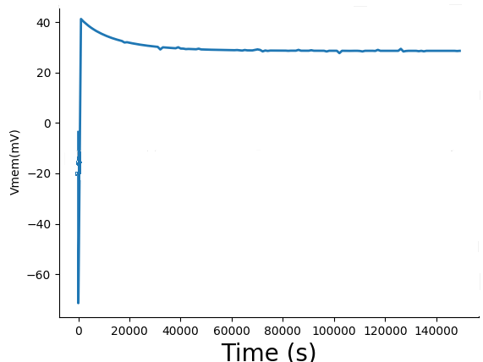
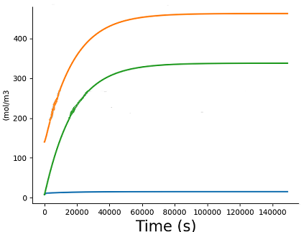
Setup:
G_{Na} and G_{K} originally set for -71mV
At t=100s, they suddenly change
Eventually we reach true SS
Na⁺
K⁺
Cl⁻
Dynamic phase: V_{mem} swinging rapidly
Thus so does V_{mem}
QSS: concentrations changing very slowly
Notes:
Oops… the last slide popped up to 30mV, and this slide does 40mV. I could redo this if I have extra time.

Slide 35
QSS big picture
Change how many Na, K ion channels are on
and that quickly swings V_{mem} positive, negative
That’s how neurons work
Large-scale [Na], [K], [Cl] don’t really change

Slide 36
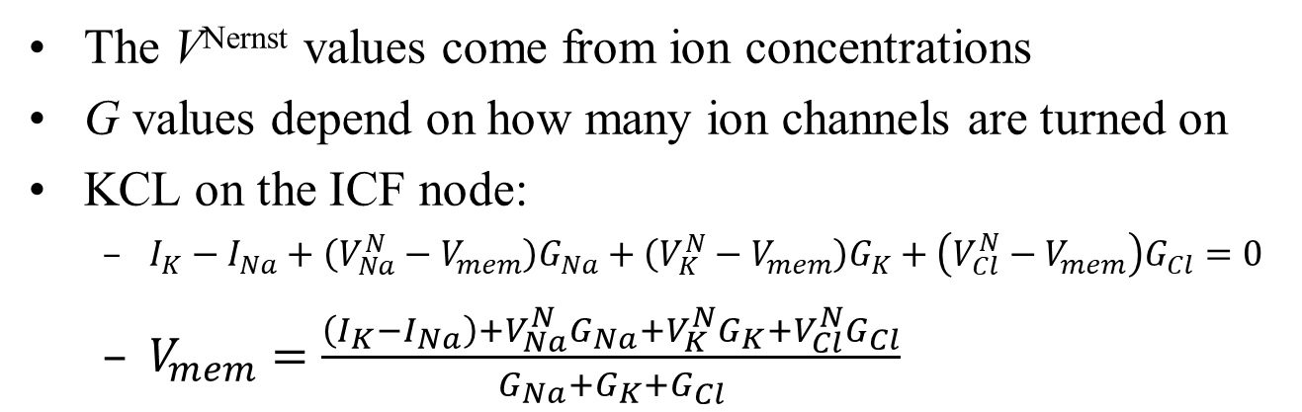



Summary
ICF
We have a nice equivalent circuit that we can analyze
I_{Na}
I_{K}
G_{Na}
G_{K}
G_{Cl}
$$V_{Na}^{N}$$
$$V_{K}^{N}$$
$$V_{Cl}^{N}$$
ECF
77mV
-89mV
-71mV
The V^{Nernst} values come from ion concentrations
G values depend on how many ion channels are turned on
KCL on the ICF node:
$I_{K}−I_{Na}+\left(V_{Na}^{N}−V_{mem}\right)G_{Na}+\left(V_{K}^{N}−V_{mem}\right)G_{K}+\left(V_{Cl}^{N}−V_{mem}\right)G_{Cl}=0$
$V_{mem}=\frac{\left(I_{K}−I_{Na}\right)+V_{Na}^{N}G_{Na}+V_{K}^{N}G_{K}+V_{Cl}^{N}G_{Cl}}{G_{Na}+G_{K}+G_{Cl}}$

Slide 37
QSS
Change G value → V_{mem} changes rapidly (ms to seconds)
Large-scale concentrations change much more slowly (minutes to hours) – quasi-steady state
Eventually we reach a new steady state again, where each ion flux is 0

Slide 38
What’s up next?
VLab #2, cell voltages in QSS

Slide 39
Mini quiz
ICF
I_{Na}
I_{K}
G_{Na}
G_{K}
G_{Cl}
$$V_{Na}^{N}$$
$$V_{K}^{N}$$
$$V_{Cl}^{N}$$
ECF
77mV
-89mV
-71mV
What is the value of V_{mem} if, e.g., G_{Na} gets very big?
What is the value of V_{mem} if, e.g., G_{K} gets very big?
What if G_{Na} and G_{K} are both close to 0?

Slide 40
BACKUP

Slide 41
analyze_equiv_network() tries to keep results pretty
It sometimes only prints to one significant digit
Here are some better numbers
 | Na | K | Cl
G (mol/m²s per mV) | 3.19 | 38.4 | 4.44
V_{nernst} (mV) | 71 | -86 | -25
I_{pump} (mol/m²s) | 810 | 540

Slide 42
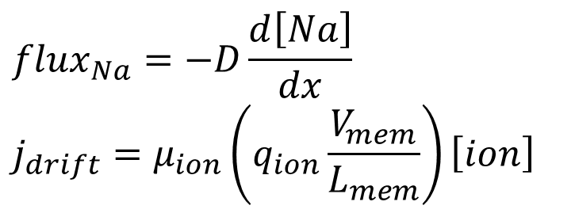
--- +++ 60mV
3Na⁺
2K⁺
[K⁺]=5mM
[Na⁺]=145mM
[Cl⁻]=140mM
[K⁺]=400mM
[Na⁺]=50mM
[Cl⁻]=9mM
other⁻=408mM
Blue arrows = diffusion
Green arrows = electric current
Red arrows = ion pump
Big picture: if you increase G_{Na}
Pump flows are unchanged
Diffusion and drift both scale
$${flux}_{Na}=−D\frac{d\left[Na\right]}{dx}$$
$$j_{drift}=μ_{ion}\left(q_{ion}\frac{V_{mem}}{L_{mem}}\right)\left[ion\right]$$

Slide 43
flux (mM/m²s)
-89 -70 0 +77 V_{mem} (mV)
V_{mem} where Na flux=0
So let’s increase G_{Na}. How would that change the picture?
Remember we’re not at SS
Total flux for Na need not be 0 at the SS V_{mem}
There is a V_{mem} where Na flux = 0
But at that V_{mem}, clearly total flux for Cl
and for K
>0
<0

Slide 44
--- +++ 50mV
3Na⁺
2K⁺
[K⁺]=5mM
[Na⁺]=145mM
[Cl⁻]=140mM
[K⁺]=400mM
[Na⁺]=50mM
[Cl⁻]=9mM
other⁻=408mM
Blue arrows = diffusion
Green arrows = electric current
Red arrows = ion pump
Big picture: if you make V_{mem} more positive
Diffusion and pump flows are unchanged
Drift currents push positive ions out, negative ions in
Net result
Cell trends more negative
So it’s a negative-feedback system again

Slide 45
flux (mM/m²s)
V_{mem} where total flux of charge=0
-89 -70 0 +77 V_{mem} (mV)
V_{mem} where Na flux=0
As V_{mem} gets larger, what happens to flux of
Na?
K?
Cl?
What happens to total flux of charge?
Is there some V_{mem} where total charge flux is zero?
becomes more negative
becomes more negative
becomes more positive
more negative

Slide 46
flux (mM/m²s)
We reach this V_{mem} quite quickly
-89 -70 0 +77 V_{mem} (mV)
What is the flux of individual ions at this V_{mem}?
Na?
K?
Cl?
At this V_{mem}, the charge in the cell stays constant
so this V_{mem} is stable
Individual ions typically have flux
Ion concentrations change – but very slowly
net flux into the cell ++
net flux out of the cell -
net flux into the cell -

