Slide 1
Bioelectricity
Fall 2020
Tufts University
Instructor: Joel Grodstein
joel.grodstein@tufts.edu
Bioelectricity 2a – neurons

Slide 2
Big picture of the course
Where does bioelectricity come from?
Neurons and working with the nervous system
Cardiac bioelectricity
Worms
How a single neuron works
Lots of neurons – the nervous system
EMG, NCS, SCS, PNS, electroceuticals

Slide 3
This slide set
How a single neuron works
Lots of neurons – the nervous system

Slide 4
Turning off cytokine storms
Can you explain the science here?
www.setpointmedical.com (white paper at https://setpointmedical.com/sp-content/uploads/2018/09/Setpoint_Medical_White_Paper_digital.pdf )
https://spectrum.ieee.org/the-human-os/biomedical/devices/handheld-vagus-nerve-stimulator-gets-emergency-approval-for-covid19-use

Slide 5
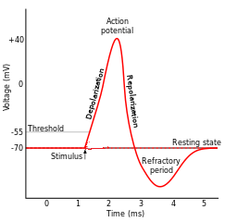



How neurons spike
Nature has built a pretty amazing system
By altering G_{Na} and G_{K}, we can quickly swing between -89mV and +77mV
We can build any waveshape by suitably altering G_{Na} and G_{K}
ICF
I_{Na}
I_{K}
G_{Na}
G_{K}
G_{Cl}
$$V_{Na}^{N}$$
$$V_{K}^{N}$$
$$V_{Cl}^{N}$$
ECF
77mV
-89mV
-71mV

Slide 6



How neurons spike
If you were to guess, how do you think G_{Na} and G_{K} change over the course of a spike? Draw it
ICF
I_{Na}
I_{K}
G_{Na}
G_{K}
G_{Cl}
$$V_{Na}^{N}$$
$$V_{K}^{N}$$
$$V_{Cl}^{N}$$
ECF
77mV
-89mV
-71mV

Slide 7
How neurons spike
If you were to guess, how do you think G_{Na} and G_{K} change over the course of a spike? Draw it
V^{N}_{Na}=+54mV; V^{N}_{K}=-90mV; V^{N}_{Cl}=-70mV
Na has high G
Both return to baseline
K has high G
Na and K both have low G

Slide 8
How neurons spike
If you were to guess, how do you think G_{Na} and G_{K} change over the course of a spike? Draw it
V^{N}_{Na}=+54mV; V^{N}_{K}=-90mV; V^{N}_{Cl}=-70mV
The Hodgkins-Huxley model:
Differential equations for the blue and green curves
Basic idea is voltage-sensitive ion-channel turnon
G_{Na} contains an increasing function of V_{mem}; fast positive feedback → rising spike with a turnon threshold
Slow negative-feedback mechanism shuts the spike off
Can you explain the refractory period?
G_{K} is the blue curve
G_{Na} is the green curve
Notes:
The Na gate is m^3*h; m is a monotonically increasing function of Vmem (with a fast tau), and h is a monotonically decreasing function of Vmem (with a slow tau). So overall they work to make G_Na actually shut itself off even without needing G_K.
In fact, to really explain the refractory period you need to know about “h”; the refractory period is when h is low, and thus the Na ion channels cannot turn on until h (slowly) goes back to 1. But we can roughly explain the refractory period by saying that it’s when G_Na is stuck low (without explaining *why* it’s stuck low).

Slide 9
It’s nice that APs are short & sweet
Neurons are fast
Change G_{Na} and/or G_{K} → near instant change in V_{mem}
But…
the march to a new steady state starts instantly too
if the changes in G_{Na} and/or G_{K} lasted long enough, the internal [Na], [K] and [Cl] would change
Any consequences of that?
the neuron would function differently at the next spike
But it doesn’t happen; we saw that neurons return to baseline quite quickly
There’s a good reason why action-potential spikes are short and sweet!
Notes:
This one is a semi-backup. Mention that!

Slide 10
Why do we have neurons?
Any ideas?
Brains are nice things to have ☺
Bacteria can “think” without brains!
On Having No Head: Cognition throughout Biological Systems, 2016
As animals get big, chemical communication by diffusion gets quite slow
Electricity travels much faster
Human neurons can be > 1 meter long!

Slide 11
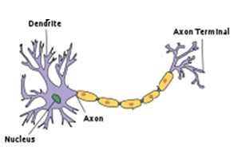
APs travel
+40
Speed=0.5 – 150 m/s
0
V_{mem}(mV)
-55
-70
0
1
2
3
4
5
Time(ms)

Slide 12
Mechanism of travel
Start with an action potential (AP) at one end of a neuron
it started when V_{mem} was pushed high enough
Diffusion:
it travels and damps
but this pushes V_{mem} higher nearby
V_{mem} nearby
This is high enough to…
trigger an AP over there!
and over and over

Slide 13
Traveling APs
Why don’t they reverse direction?
Why doesn’t the green AP at x=2 diffuse to x=1 as well as to x=3?
It does diffuse. But x=1 is in refractory mode
Rising above threshold won’t kick off an AP
x=2
+40
x=1
0
V_{mem}(mV)
-55
-70
0
1
2
3
4
5
Time(ms)

Slide 14

Myelin
Neurons are coated with myelin
A fatty, non-conductive layer
What good is myelin?
Makes neurons propagate an action potential fast
A big evolutionary step in our brains being useful ☺
But how does it work?
Remember capacitance? Thick membrane → low C
Q=CV, so low C means faster or slower?
Multiple sclerosis is an auto-immune disease where (among other issues) nerves get demyelinated
$$C=\frac{εA}{d}$$
faster. Takes less Δq to make enough ΔV

Slide 15
The problem with myelin
ion channels
Neuron without myelin
Action potential travels slowly
Gets regenerated frequently
Neuron with myelin
Ion channels cannot traverse the sheath
Diffusion can make V_{mem} wave spread much faster. But…
Without ion channels, action potentials cannot regenerate!
Die out before reaching the other end of the neuron ☹
Solution:
Nodes of Ranvier
Occasional gaps in the myelin sheath, big enough to allow AP regeneration

Slide 16
That’s a neuron!
Takes inputs from upstream neurons
Generates an AP
The AP travels
Myelin makes it go fast
Drives downstream neurons

Slide 17
This section
How a single neuron works
Lots of neurons – the nervous system

Slide 18
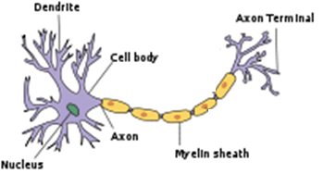
Lots of neurons
synapse
The brain has ≈100B neurons.
Each dendrite takes inputs from ≈1000 other neurons and decides when to fire
Each input pulse raises V_{mem} slightly; when we hit a threshold we fire
An action potential then travels along the axon to the next downstream synapse(s)
Notes:
For those of you who are into NNs, is this exciting? It’s a very nonlinear response, which ANNs depend on. Of course, your brain doesn’t really care if some computer scientist built an ANN like a real brain or not, but it’s probably comforting for the CS person :-).

Slide 19
How neurons talk to each other
synapse
Driving neuron stores neurotransmitter molecules. AP → release them into the synapse
Neurotransmitter diffuses across the synapse, binds to receptor proteins
Receptor protein acts as an open ion channel, thus allowing a packet of charge to enter or leave it, changes receiver V_{mem}
Cardiac lookahead – some neurons talk with GJs

Slide 20
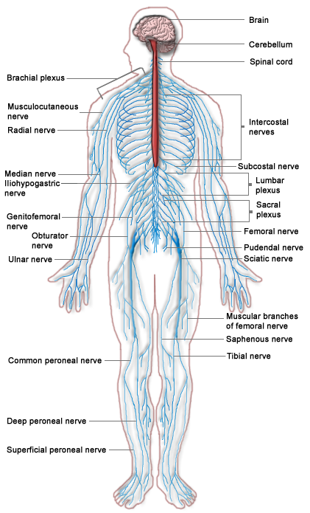
Central nervous system (CNS, red)
brain + spinal cord
controls most everything
big mystery
Peripheral nervous system (PNS, blue)
everything but the CNS
signals from CNS must usually travel through PNS to do anything
typically 100s of neurons per nerve
electroceuticals target here

Slide 21
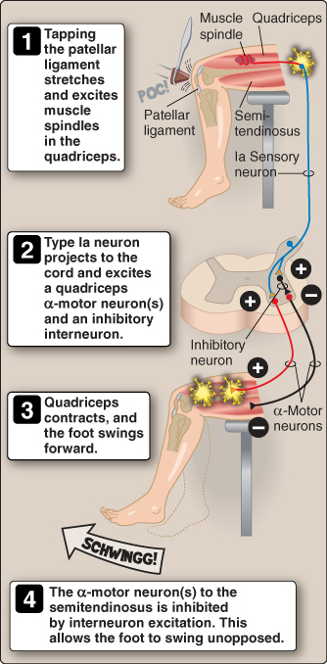
Reflexes
What is a reflex?
A sensory nerve detects a signal
Travels into spine
Synapses with a motor nerve to come right back
Example: tap under your kneecap and your leg kicks
Lippincott Ch 11

Slide 22
Mini-quiz
What is a refractory period?
What does myelin do?
What do neurotransmitters do?
What is a reflex?

