Slide 1
EE 123 Bioelectricity
Fall 2020
Tufts University
Instructor: Joel Grodstein
joel.grodstein@tufts.edu
Lecture 4a: Biology backgrounder

Slide 2
Big picture of the course
Where does bioelectricity come from?
Neurons and working with the nervous system
Cardiac bioelectricity
Worms

Slide 3
Biology backgrounder
The fun part in a class with a wide variety of people
getting everyone up to speed
learn each others’ basic concepts and terminology
Non-goals
turn everyone into a biology major
A little knowledge is a dangerous thing: give everybody just enough knowledge to be dangerous
Goals
Give everybody enough biology background for morphogenesis
Ultimate goal: give non-biologists enough background to work productively with biologists in a team
Or, look reasonably intelligent on a job interview ☺
Or understand what an “enveloped RNA virus” means

Slide 4
Proteins
Spoiler: DNA is software, telling the cell’s HW what to build
What do cells build? Proteins
So: what’s a protein, and why are they so important?
A protein is one or more chains of 20 different amino acids
Nested-definition alert: what’s an amino acid?
It’s the main component of proteins ☺
The cell assembles amino acids into proteins

Slide 5
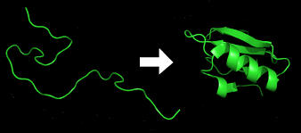
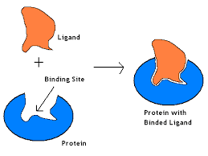
Why are proteins important?
They have powerful magic:
They quickly fold themselves into intricate shapes
Because of this, they are amazingly good at recognizing and binding to other molecules in an extremely selective manner

Slide 6
So what?
Proteins can fold, bind and change shape. So what?
Most of the molecular machines in the body are largely built from proteins
Example of a molecular machine: your muscles. To get protein in your diet, you eat meat
Proteins can be part of logic gates

Slide 7
The central dogma
So the key to what a cell does is what proteins it makes. How do cells make protein?
The method is so important it’s described by what’s called the central dogma of biology
biologists’ equivalent of “in the beginning… and it was good”
in the cell: DNA creates mRNA, which creates protein

Slide 8
What is DNA?
DNA is a long molecule that is a sequence of bases. Each base can be adenine (A), guanine (G), cytosine (C) and thymine (T)
The punch-line: a long sequence of DNA (e.g., AUGGCUAGUUAG) specifies a long chain of amino acids that build a protein
But how can 4 DNA bases specify 20 amino acids? Any ideas?

Slide 9
What is DNA?
DNA is a code in base 4
Three bases = one codon ⇒ specifies one of 20 AAs, or a start/stop codon
Alanine
Leucine
gene
AUGGCUAGUUAG
promoter AUG GCU AGU UAG terminator…
says when to make this protein
The coding sequence (CDS)
Three bases = 1 codon
start and stop codons bound the CDS

Slide 10
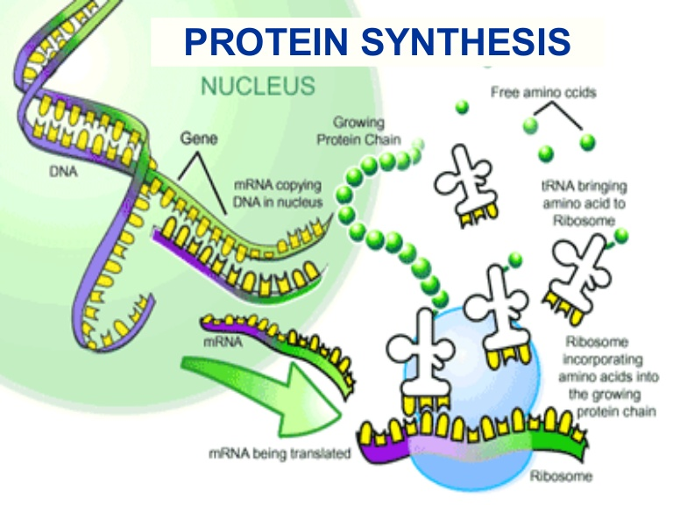
mRNA and tRNA
Central dogma of biology
Transcription reads the DNA and turns a CDS (A, G, C, T) into a roughly-equivalent chain of messenger-RNA (mRNA) bases. They are A, G, C and uracil (U)

Slide 11
mRNA and tRNA
Central dogma of biology
Translation uses a ribosome to turn the mRNA molecule into a protein – chains of amino acid
each codon of mRNA mates with a specific tRNA molecule
tRNA has an anti-codon on one end (that mates w/mRNA); the other end of tRNA is the appropriate amino acid

Slide 12
The big picture
Humans have 23 pairs of chromosomes
Each chromosome is one long molecule of DNA
One chromosome contains many genes
Each gene makes one protein (not quite true)
All of this is in one cell
If you’re a bacteria or a yeast:
you are one cell and one cell is you
Humans have about 37 trillion cells!
Every single one (mostly) has the above mechanisms

Slide 13
Morphogenesis
One of the black mysteries of biology
An egg and sperm unite to form one cell. That cell contains all of your DNA
Fast forward 9 months or so. You now have 37 T cells
Each has roughly the same DNA as the one starting cell
DNA has the instructions to create proteins
proteins control most everything
So how can (e.g.,) your eyes be different from your toes?
Time to add some detail to our DNA picture

Slide 14
What is DNA?
DNA is a long molecule that is a sequence of bases. Each base can be adenine (A), guanine (G), cytosine (C) and thymine (T)
promoter AUG GCU AGU UAG terminator…
says when to make this protein
Leucine, Alanine
The coding sequence (CDS)
Three bases = 1 codon, that works in base 4
start and stop codons bound the CDS

Slide 15
What is DNA?
The promoter controls whether the DNA builds mRNA (and thus protein) or not – i.e., whether transcription happens or not
It’s an if statement
if (
promoter AUG GCU AGU UAG terminator…
) {
}
But what controls whether the promoter is True or False?

Slide 16
Promoters
Does this sound like software yet?
What turns a promoter on or off?
A number of possibilities
For us, a transcription factor (TF)
A TF is a protein. It can itself be activated or deactivated based on, e.g., the presence or absence of other proteins or small molecules
So:
A gene builds its protein if its promoter is on
A promoter is on if its TF is present and activated
A TF is activated if the right inputs are present
We can thus control, at any given time, what subset of all of a cell’s genes get expressed
Promoters can use more complex logic functions
E.g., AND of two TFs, or NOR, …

Slide 17
A
True
protein1
if (True):
build protein1
B
promoter
protein2
if (A):
build protein2
if (protein1 and A):
build protein2
if (protein2 and (not B)):
build protein3
promoter
protein3
if (A and (not B)):
build protein3
Notation: arrow turns on, right-angle line is off
External inputs can be small molecules
canaries for many internal and environmental factors
can also be other protein TFs
What function of A and B did we build above?
Now we can compute!
These structures can get very complex

Slide 18
Lots of logic
How important are these TFs?
Differentiating a toe cell from an eye cell
The if/then network is key
Toe cell and an eye cell have the same DNA
But different TFs and activators sitting in and around
So they express very different proteins
 | E.Coli | Humans
# of genes | 4300 | 30K
Genome size | 4.3x10⁶ base pairs | 3200x10⁶
% of bps in a CDS | 89% | 1.5%

Slide 19
What can we do with software?
Side trip: synthetic biology
We can now modify DNA. I.e., can now not only learn how organisms compute, but change their software!
The main obstacle:
other than fairly simple model organisms (e.g., E.coli and yeast), we have no idea what most of the software does!
So what do people do, then?
Mostly: make small changes/additions to bacteria and yeast
Try to understand the building blocks; low-level functions that get called over and over

Slide 20
Other resources
Plenty of YouTube videos on the central dogma
https://www.youtube.com/watch?v=gG7uCskUOrA

Slide 21
BACKUP

Slide 22
mRNA and tRNA
We’ve talked about computing
What is the HW and what is the SW?
The SW is the DNA
The HW is everything else
The entire cell (and your entire body) just build whatever proteins your DNA tells them to
DNA is the software that makes you you.

