Slide 1
EE 123 Bioelectricity
Fall 2020
Tufts University
Instructor: Joel Grodstein
joel.grodstein@tufts.edu
Lecture 4b: morphogenesis

Slide 2
Big picture of the course
Where does bioelectricity come from?
Neurons and working with the nervous system
Cardiac bioelectricity
Worms
Bio backgrounder
Morphogenesis
Building a worm V_{mem} pattern

Slide 3
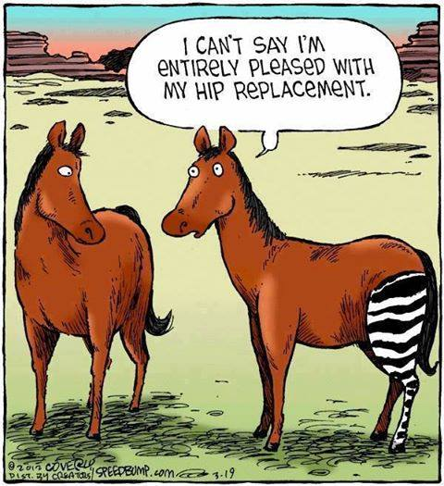
We said that cells express proteins based on chemicals in their environment. Do you think the stripes will eventually go away?
From Speedbump, by Dave Coverly

Slide 4
Regenerative medicine
Various diseases are best treated with organ transplants
Kidney transplants for diabetes
Liver (cirrhosis, hepatitis)
Heart (various heart diseases)
Organ transplants have problems
Typically far more requestors than available organs
Rejection is a constant problem
A lifetime of immune-suppressant drugs is no picnic
Is there a better way?
Regenerative medicine
Notes:
Heart transplants are not super common, but are not uncommon either. They are a last resort if drugs, pacemaker, & other surgeries have not worked

Slide 5
Regenerative medicine
Not quite ready for prime time yet
Hope #1
Start with induced pluripotent stem cells and grow organs in vitro
Precisely controlling every detail of growing a kidney in a lab seems impossible
We need a high-level API
Hope #2:
stimulate the body to regrow its own organs
adult humans don’t really do that

Slide 6
The Big Picture
Morphogenesis is a big cool mystery
If we understand it, we may understand regenerative medicine
Observations:
planaria and tadpoles can regrow organs
what can we learn from them?
Our plan for morphogenesis:
Look at the weird, wonderful things that animals can do
Hypothesize: what algorithms are they using?
Might it be bioelectrical?

Slide 7
Why is morphogenesis hard?
If babies can do it, how hard can it be?
 | Hydra | Human
Genes | 20K | 30K
Neurons | 1000 | 100 billion
The game of evolution is not so much about inventing new proteins, but rather about assembling the same ones in new ways (Rafael Yuste)
DNA just creates protein, not structure
Similar DNA sequences encode very differently-shaped animals
No clue how to look at a genome and predict animal shape
Or to determine which DNA sequence will create an arbitrary shape
Is there a higher-level interpretation somewhere?
A string of 3 billion DNA bases is daunting
A high-level API would be really nice!
Notes:
The Hydra quote came from a talk by Rafael Yuste at the Allen Center seminar series on Nov 28, 2018
Another interesting fact: mice & people share about 97.5% of our DNA! (that’s why we use them for drug trials).
The Hydra was a Greek serpent that could regrow its heads – Hercules killed it with fire.
Real Hydra are good enough at regenerating the we mostly believe them to be immortal

Slide 8
Hypothesis #1
Maybe the DNA is just a set of (very intricate) instructions
Like building Legoland from 37T Legos!
Twins
When an embryo splits into twins, each twin grows perfectly
Do you think that identical twins have identical fingerprints?
(Albert Ebeneezer Fox and Ebeneezer Albert Fox, born 1857)
Running the same set of instructions should produce the same results
We’ll look at some data & then revisit this hypothesis

Slide 9
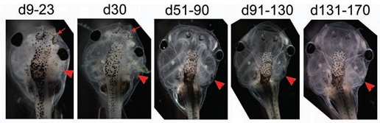
Picasso tadpoles
Inject one cell of a two-celled embryo with V_{mem}-disturbing mRNA → one-sided growth defects
Defects largely correct themselves over 170 days
mRNA is diluted as cells multiply
Eye location corrects, though eye functionality does not
Are Picasso tadpoles consistent with hypothesis #1?
Difficult to see how
Credit: Normalized Shape and Location of Perturbed Craniofacial Structures in the Xenopus Tadpole Reveal an Innate Ability to Achieve Correct Morphology, Dev.Dynamics 2012

Slide 10
Hypothesis #2
DNA doesn’t specify an exact sequence of instructions
Life is hard!
In the nanoworld, everything is dancing (Philip Nelson)
Biology at the cell level is a noisy, statistical business
Somehow we develop body shape very reliably
Instead:
DNA (somehow) specifies a target shape
A machine compares current vs. target and keeps adjusting
Really useful in our noisy, dangerous world!
Does this explain the Picasso tadpole?
Seems to
Next question: what form are the inputs to this machine?
I.e. – what data structures are we using?
Notes:
Remember diffusion? That was our first experience of how noisy biology is

Slide 11
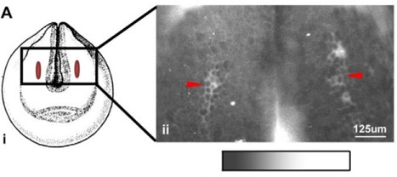
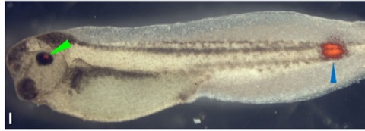
Electric tadpoles
We’ve shown robustness in growth
Next: argue that bioelectricity is involved
Measured V_{mem} on a developing tadpole embryo to get a map. Future eyes correspond to hyperpolarized V_{mem}
Inject chemicals to disrupt V_{mem} at future eyes ⇒ deformed eyes
Inject chemicals to alter V_{mem} at unrelated locations ⇒ ectopic eye (blue arrow). And green arrow = normal eye
The ectopic eye only happens if they hit the right V_{mem}. Doesn’t matter which chemical they use, or which ion channel they disrupt, as long as they hit the V_{mem}
depolarized … hyperpolarized
Credit: Transmembrane voltage potential controls embryonic eye patterning in Xenopus laevis, Development 2012

Slide 12
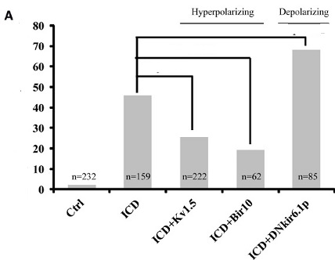
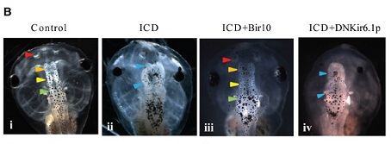
Yes, it’s the voltage
Inject tadpole embryo with Notch ICD (depolarizes V_{mem}) → later brain defects in 46%.
Also inject with Kir6.1 mRNA (which further depolarizes V_{mem}) → defects in 68%
Pair Notch ICD with Kv1.5 or Bir10 mRNA (hyperpolarizers) → defects are rescued!
Arrow color key:
Blue = malformed brain part
Red, orange, yellow, green = locations of various correctly-formed brain parts
Other data (omitted) shows that brains occur at a specific V_{mem}
malformed
Brains
%
Credit: Endogenous Gradients of Resting Potential Instructively Pattern Embryonic Neural Tissue via Notch Signaling and Regulation of Proliferation, J.Neuroscience 2015
Notes:
One might think that Notch is having brain-damaging effects that have nothing to do with bioelectricity
But then Kv1.5 and Bir10 would be unlikely to cancel out Notch’s effects

Slide 13
Layers
Is this evidence for a layered system?
the tadpole builds a good brain or good eyes wherever V_{mem} tells it to
This is exactly what we wanted!
Short-cut some of the complexity
The growing body acts as a layered piece of software
The upper layer creates a pattern of V_{mem}
The lower layer sees that pattern, and creates body shapes based on it
Note that both layers are controlled by DNA, but it’s still a layered system
Create V_{mem} pattern
API
current
target
Differentiate cells following V_{mem} pattern
compare
growth directions
Notes:
The “all done” signal tells the body we no longer need all of the extra mechanism involved in body growth. In humans, for many functions, the “all done” signal implements changes that we don’t really know how to undo. But induced pluripotent stem cells suggest it’s still possible.

Slide 14
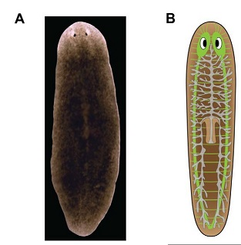
The amazing planaria
World champion of regeneration
The planaria is a flatworm
It has a brain and can learn
It has nerves (in green)
Typically 3-15mm in length
And – more or less immortal
Credit: Modeling Planarian Regeneration: A Primer for Reverse-engineering the worm, PLOS Comp Bio 2012

Slide 15
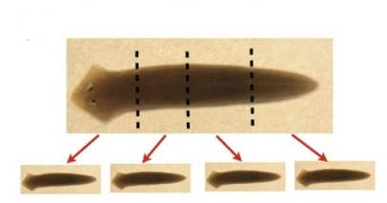
Adult planaria retain a large proportion of stem cells
Cut one into n pieces (n≤279)
Every piece regenerates into an entire planarian
The head-tail polarity is retained!
While individual cells die, the planarian can regenerate itself (essentially) forever
Individual planarian cells die after ≈1 month; D.japonica as a whole seemingly lives forever
Planarians reproduce primarily asexually
anchor their tails and pull themselves apart into front and back halves
then regrowing into two “genetically-identical” children
Credit: Planarian regeneration as a model of anatomical homeostasis: recent progress, Semin Cell Dev Biol 2018

Slide 16
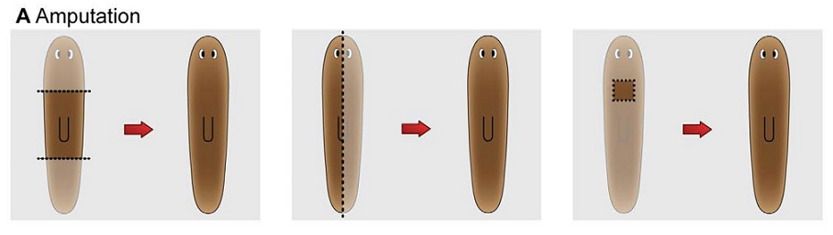
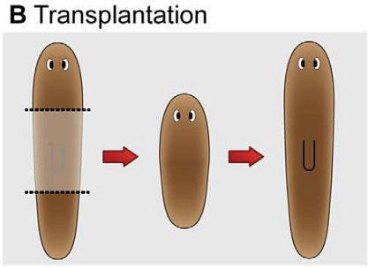
Chop it up most any way at all
It regenerates, remembering which side its head was on
Take a front 1/3 from one planarian and a rear 1/3 from another planarian and abut them
Still works fine!
Most planaria have a mish-mash of different genes
Planaria retain/accumulate mutations “forever”
Different cells may have different numbers of chromosomes – and the planarian still functions correctly as an organism!
Compare that to any computer program you’ve ever written ☺
Credit: Modeling Planarian Regeneration…

Slide 17
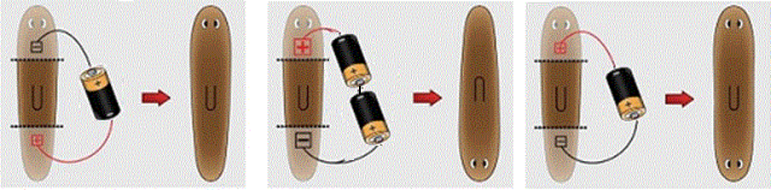
Electricity is involved again
Polarity: head is +, tail is -
What do you think will happen in this experiment?
How about this?
Two-headed worm!
+
H
H
V_{mem}
H
T
H
T
-
T
Credit: Modeling Planarian Regeneration…
Notes:
Note that the paper cited here had the batteries reversed from this picture – I believe the paper is wrong, and I changed the picture. He cites two very early papers for his belief; I looked at them quickly and I believe the papers support the conventional view that the head is more positive. Actually, a more detailed read of the early papers shows that they indeed were reversed from modern work – but they used a different planarian species.

Slide 18
Building the outer layer
Planarian regeneration: more evidence that a V_{mem} pattern is the API
Next question: how do we build the V_{mem} pattern?
We used batteries & needles to build V_{mem}, but how might nature do it?
Create V_{mem} pattern
API
current
target
compare
growth directions

Slide 19
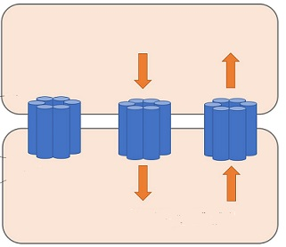
Gap junctions and neurons
Morphogenesis is a marvel of distributed computing
Clearly that implies cells must talk to each other!
How?
Via neurons & the brain
Via gap junctions (GJs), like the heart
GJ: a little tube that connects two nearby cells
Molecules can travel between the two cells
Think wires between gates
If a GJ connects two cells with different V_{mem}, then negative ions move towards the + cell
+10mV
Na⁺
Cl⁻
-20mV
Na⁺
Cl⁻
Notes:
We’ve seen two ways to communicate between cells so far in the course. First, neurons for long distances (and the brain is good at image recognition!). Second, GJs in the heart.

Slide 20
Cell #1, V₁
Lots of feedback between the electrical and chemical networks
Cell voltage can turn on/off GJs, which pass ions
Ions can control ion channels, which control voltage; or can activate TFs
Cell #2, V₂

Slide 21
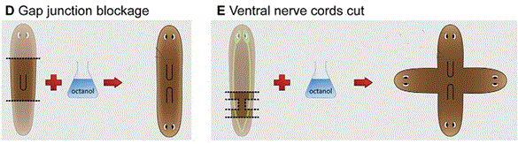
Block GJs → occasionally get a 2H worm
Block GJs and neurons → really weird results
Conclusions about how V_{mem} patterns are formed?
GJs and neurons both working together somehow
Proof of concept for regenerative medicine
we are using a high-level API to control what grows
Credit: Modeling Planarian Regeneration…
Notes:
Yes, it’s a proof of concept. But we really don’t want to build 4H humans!

Slide 22
The miracle of Bambi
Male deer shed and regenerate their antlers every year
Antler shape changes slightly every year until maturity
Becomes more complex
After maturity, the shape is fixed
Except… if an antler is injured during its growth
Injury pattern is remembered several years (even propagating to the uninjured antler!)
Antler shape will revert to “normal” in a few years
Notes:
From 4H humans… to Bambi!

Slide 23
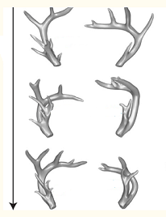
Injury to left antler, year 6
left
right
Normal mature antler shape
year 6 7 8
Injured shape persists two years
Uninjured right antler changes shape, too!
Not shown: antlers will eventually return to their normal shape
Credit: A linear-encoding model explains the variability of the target morphology in regeneration, Interface, 2014

Slide 24
Where is the deer hiding its memory?
Even though the antlers are completely lost every year, the memory of the new shape persists
Where is the memory of the new shape held?
Clearly somewhere outside of the antlers themselves
Not in any DNA (no reason to suspect DNA mutation)
Harry Potter and the Chamber of Secrets:
“Ginny!” said Mr. Weasley, flabbergasted. “Haven’t I taught you anything? What have I always told you? Never trust anything that can think for itself if you can’t see where it keeps its brain?”
Do we really believe that a pixel-by-pixel image of the antlers is stored somewhere in the deer’s body?

Slide 25
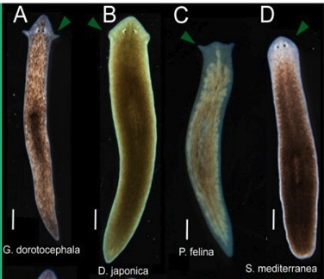
The amazing planaria: head shape
Procedure:
Start with Girardia dorotocephala, a particular planarian species.
Cut off head and tail; preserve the trunk.
Dunk in octanol (blocks GJs) 3 days
Regenerate 7 days in water.
Results:
The worm regrows with a new head shape
The head always resembles some planarian species – never a new shape.
Probabilistic head-shape distribution; frequency mirrors evolutionary distance to the original species
After several weeks: head reverts back to its original shape in a second repatterning!
Credit: Gap junctional blockade stochastically induces different species-specific head anatomies in genetically wild-type Girardia dorotocephala flatworms, 2018

Slide 26
Theories?
Cells communicating via GJs, neurons to build a pattern
Each cell has the same DNA
Each “knows” how to build the whole pattern
How is the target state stored?
Partly in V_{mem} patterns – rewritable, redundant/nonlocal
DNA tends to snap it to one of a small number of “reasonable” goals stored in DNA
Redundant storage is used in all computers (ECC, chipkill)
Notes:
Rewritable – or else Bambi would make no sense at all
Redundant & nonlocal – to explain how losing the antler didn’t totally remove its shape memory
Snapping – because the original antler shape reverted

Slide 27
Primitive cognition
Where do we keep our brains, again?
Neurons & brain play a part in growth, regeneration. But…
this must work in an embryo without much of a brain yet!
And in planaria whose head has been cut off!
How could this be?
Hypothesis – the cells themselves act as a sort of brain
One that has no actual neurons!
Is this feasible?
The basic machinery of ion channels, GJs and bioelectricity came earlier in evolution than did neurons.
Single-celled organisms used neurotransmitters to communicate with each other
Neurons “merely” made V_{mem} fast enough to control muscles in real time

Slide 28
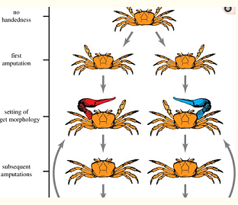
More weird stories: crabs
A normal fiddler crab has no inherent asymmetry
Cut off either one of its front “crusher” legs during growth (accidents happen in nature)
It keeps growing until normal sized – but its partner gets huge!
Now cut off both front crushers. What happens?
a
The first amputation is remembered!
Credit: A linear-encoding model explains the variability of the target morphology in regeneration, Interface, 2014

Slide 29
More amazing planaria feats
Not all memory is stored in the brain
Experiment, part 1:
Feed planaria on a textured surface
Remove for two weeks
They now feed on a textured surface quicker than untrained planaria
Conclusion: “long-term” memory is possible. Long enough to regrow!
Experiment, part 2:
cut off their heads, regrow (14 days)
Will they still retain their training?
No?
Memories are stored in your brain
If you regrow a new one, they’re gone
Yes?
Morphogenesis clearly create neurons.
Human newborns can cry, suckle, etc.
Credit: An automated training paradigm reveals long-term memory in planarians and its persistence through head regeneration, 2013
Notes:
More data:
the worms did not try to feed *at all* until their brains regrew; so this isn’t just, e.g., a spinal-cord reflex
previous work in the area was discredited due to experimenter bias; this data was automated via image analysis of camera data. The hypothesis is that memories are distributed, and guide the regrowth of new neurons. It’s like a “chipkill” memory system, that has enough redundancy to survive the loss of its brain!

Slide 30
Layered systems are awesome
Engineers build layered HW/SW systems frequently
They’re often quite complex!
But way simpler than one big system
We can manipulate shape without understanding the lower layer
We just need the API – which we’re saying is the V_{mem} pattern
V_{mem} is an instructive signal; it tells the lower layer what to do
The lower layer doesn’t care how we make a V_{mem} pattern
Abstraction is a powerful tool
Create V_{mem} pattern
API
current
target
compare
growth directions

Slide 31
Where do we go from here?
Next up: dig into a planarian V_{mem} hypothesis
Understand & program a way it might build a V_{mem} pattern to distinguish head from tail

Slide 32
Background material
https://vimeo.com/184365295
Very nice overview and introduction, from talk at the Wyss institute 2016
https://allencenter.tufts.edu/
More background and context
https://allencenter.tufts.edu/our-research/publications/
Full bibliography, and lots more reading

Slide 33
Debate
Take some time to think about:
What animal facts does our model explain?
What doesn’t it explain?

Slide 34
BACKUP

Slide 35
More amazing planaria feats
Why is this experiment interesting?
Currently neurons in the human CNS do not regrow. But what if, e.g., stem-cell treatments can regrow neurons for humans with neurological disease? What connections will they have?
More evidence that bioelectrical patterns are stored throughout the body and can have wide-ranging effects on regrowth
Does this help to explain the moose & crab data?
Credit: An automated training paradigm reveals long-term memory in planarians and its persistence through head regeneration, 2013

Slide 36
Layers
The growing body acts as a layered piece of software.
The upper layer creates a pattern of V_{mem}.
The lower layer sees that pattern, and creates body shapes based on it.
Note that both layers are controlled by DNA, but it’s still a layered system.
“Neural” networks are part of one or both layers
In the upper layer, could decide what to build
In the lower layer, could implement “current state vs. desired state → what to do next”
Lower layer also outputs “All done” signal
Create V_{mem} pattern
API
current
target
Differentiate cells following V_{mem} pattern
compare
growth directions
Notes:
The “all done” signal tells the body we no longer need all of the extra mechanism involved in body growth. In humans, for many functions, the “all done” signal implements changes that we don’t really know how to undo. But induced pluripotent stem cells suggest it’s still possible.

Slide 37
Layers
Answer to “how do we build the V_{mem} pattern?”
Can we drill down into these two black boxes?
How might these machines be built?
What computations could they be implementing?
Hint – we haven’t talked about neural networks yet
Create V_{mem} pattern
Create V_{mem} pattern with GJs
API
current
target
compare
growth directions

Slide 38
What does this explain?
The repeated observation (tadpoles, planaria) that we can control shape by controlling V_{mem}
Reimplementation of the same shape repeatedly (deer, crab, Emmons-Bell)
The top level is picking the shape (and remember last year’s shape, even if it’s “wrong”). The lower level is implementing that shape, over and over.
Some specific V_{mem} patterns (planarian head-tail reversal)

Slide 39
What does this not explain?
Where the shape is stored in the deer & crab
Why it regenerates after a few years.
Most of the implementation details ☺
and speaking of which…

Slide 40
Hypothesis #1, again
What if:
There is an explicit set of growth rules stored in the DNA
The injuries during growth change the growth rules, leading to a new end result
When we regrow again, the changed rules then merely produce the same result over and over again
Is that reasonable?
Physical injuries do not really mutate DNA; they just mechanically break (e.g.,) bones
It is not reasonable to believe that, in future years, a little machine inside the organism somehow breaks their crushers again, at just the right time, the newly-correct shape
So let’s look at another piece of data

Slide 41
Why are good theories hard to find?
Why is it hard to come up with good theories?
you can’t hit what you can’t see
it’s hard to explain what you can’t dissect
Classic technique in biology:
kill a specimen
examine it under a microscope
Doesn’t work for bioelectricity
Consider a bioelectric memory cell
Can store either a 0 or a 1
The basic parts of the cell are identical either way
The only difference is the electricity, which you don’t see under a microscope
Measurement techniques are improving
but need much more improvement still
killing a cell destroys its bioelectrical state
Notes:
You could argue that many/most advances in our knowledge of biology come from new techniques in measurement/observation!

Slide 42
Divide and conquer
GJs allow cells to communicate when needed
to decide where your eyes are and where your nose is
Once that’s done, we can turn off some GJs
thus create smaller, independent subnetworks
now decide where your retina is vs. your iris
and septum vs. nose hair
I.e., solve a huge problem by divide and conquer.

Slide 43
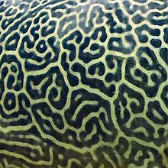
Cell #1, V₁
There are feedbacks between the electrical and chemical networks
Cell voltage can turn on/off GJs, which pass ions
Ions can control ion channels, which control voltage; or can activate TFs
The feedback system can create patterns of ions and V
very like reaction-diffusion
called gating-electrodiffusion
See The Chemical Basis of Morphogenesis, Alan Turing 1952
Or Wikipedia
Cell #2, V₂

Slide 44
Hypothesis #3
Morphogenesis is a multi-step process
Step 1: DNA specifies a target shape that is then (at least in deer) stored elsewhere
Step 2: regeneration aims for the stored shape
but what is that format?
Suggestion: a pattern of V_{mem}
Step 4: occasionally the stored shape gets refreshed from DNA in deer
For the technically minded, step #3 is called an inverse problem
inverse problems are hard
unless the function is simple (i.e., easy to invert)

Slide 45
A hypothesis
The planaria is a remarkable animal
It is well studied
We have a lots of data
But we don’t have any proven theory for how it works!
Are we ready to put together some ideas?
hopes?
hypotheses?

Slide 46
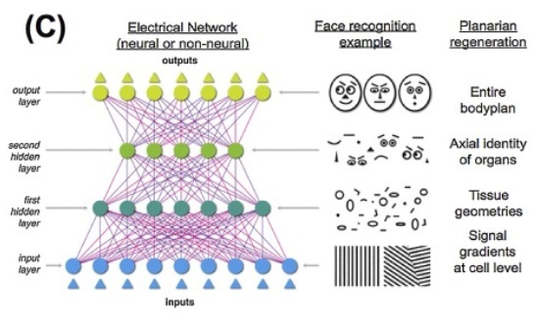
Image processing
BACKUP
Deep artificial neural networks (ANN) usually process images in layers
Each layer works at a slightly higher level
Credit: The bioelectric code… (Justin Guay)

Slide 47
ANN inside animals?
BACKUP
Hypothesis: ANNs can simplify & abstract the shape images
Any evidence for this?
Not really ☺. But…
less data for the deer for keep?
comparison is easier at a high level?
And one more piece of data…
Create V_{mem} pattern with GJs
API
current
target
compare
ANN
ANN
growth directions

Slide 48
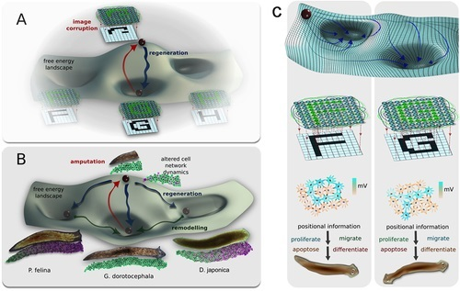
BACKUP
A simple character-recognition neural network also picks the most likely character for any input image
Many stabilization processes are modeled as a free-energy landscape
Credit: The bioelectric code: an ancient computational medium for dynamic control of growth and form, 2018

Slide 49
Theories?
BACKUP
For an organism that can regrow itself from chopped-up pieces, choosing a target is almost mandatory
Seems like one worm is storing multiple targets?!
Hopfield networks
Neural-network variant with similar capabilities
Stores several stable states; finds the nearest one to a given input
Perhaps the Hopfield network gives us the target that a linear mechanism implements?
Perhaps some weights are stored as GJ conductivity, and the octanol thus changes them
But why would a planaria store multiple states?
Did their “G. dorotocephala” have cells from other worms? Would that matter?
Reversion to initial shape is similar to deer

Slide 50
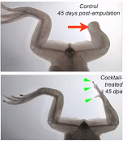
Build whatever goes here
They induced leg regrowth in an adult frog by imposing an embryonic V_{mem} pattern and then letting it sit for 7 weeks.
Original work: they found a drug cocktail that affected V_{mem} and induced regrowth of an amputated tail
Then the same cocktail also worked for leg regrowth
Credit: Cracking the bioelectric code: probing endogenous ionic controls of pattern formulation, 2013
Notes:
Their original work was to find a drug cocktail that induced regrowth of a tail. They then tried to exact same cocktail on a rear leg, and it worked fine. Note that the regrowth was not complete. The message is that inducing a Vmem really is a “build whatever normally goes here” signal.

