Slide 1
Easy Testing & Development w/ django-fixtureless
by Rico Cordova

Slide 2
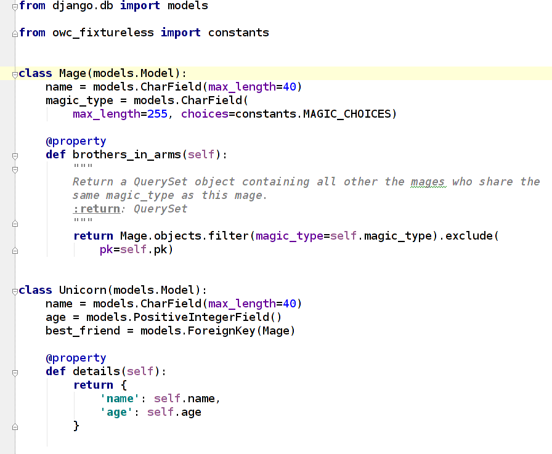
Data Model

Slide 3
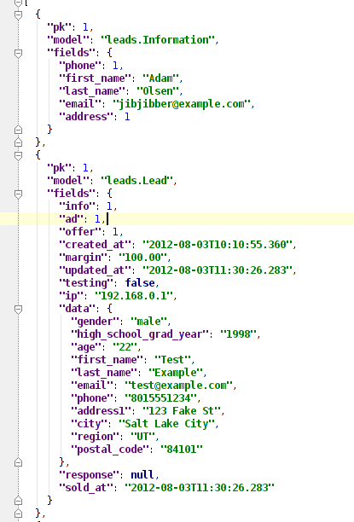
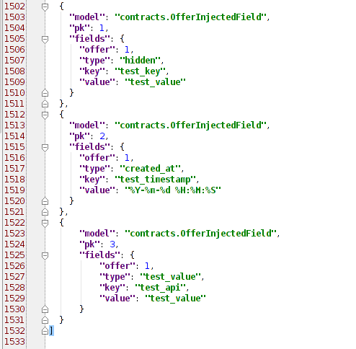
Motivation: Fixtures

Slide 4


Enter Fixtureless
https://pypi.python.org/pypi/django-fixtureless/1.4.2.2
https://github.com/ricomoss/django-fixtureless

Slide 5
Practical Example
https://github.com/ricomoss/open-west-2015-fixtureless

Slide 6
Thanks For Playing Along!
Rico Cordova
rico.cordova@gmail.com
https://github.com/ricomoss
https://github.com/ricomoss/django-fixtureless
https://github.com/ricomoss/open-west-2015-fixtureless
https://joind.in/13997
@RicoCordovaRSB

