Slide 1
Best place for restaurant in toronto

Slide 2
introduction
Find the best place to start a restaurant in Toronto
K-means clustering

Slide 3
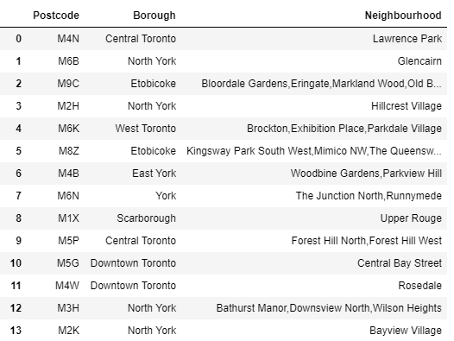
Data
Location data of Toronto
Foursquare venue data

Slide 4
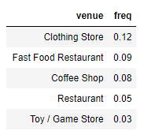
Methodology
K-means clustering is a method of vector quantization, originally from signal processing, that is popular for cluster analysis in data mining.
use the frequency of the venues of a place as the feature

Slide 5
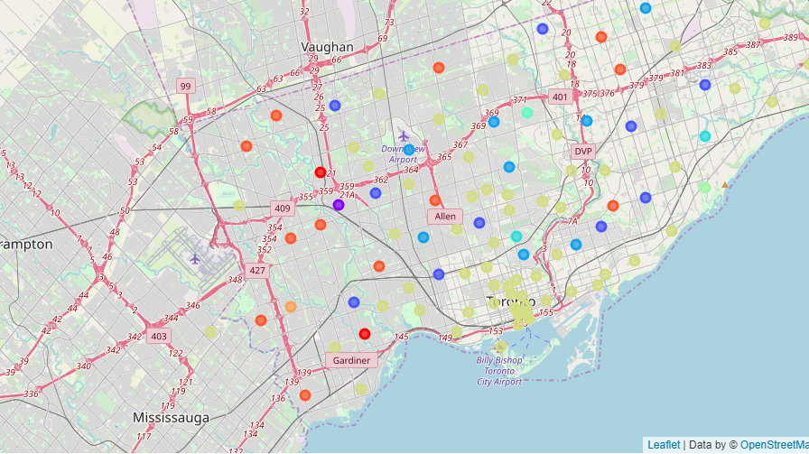
Result
10 clusters

Slide 6
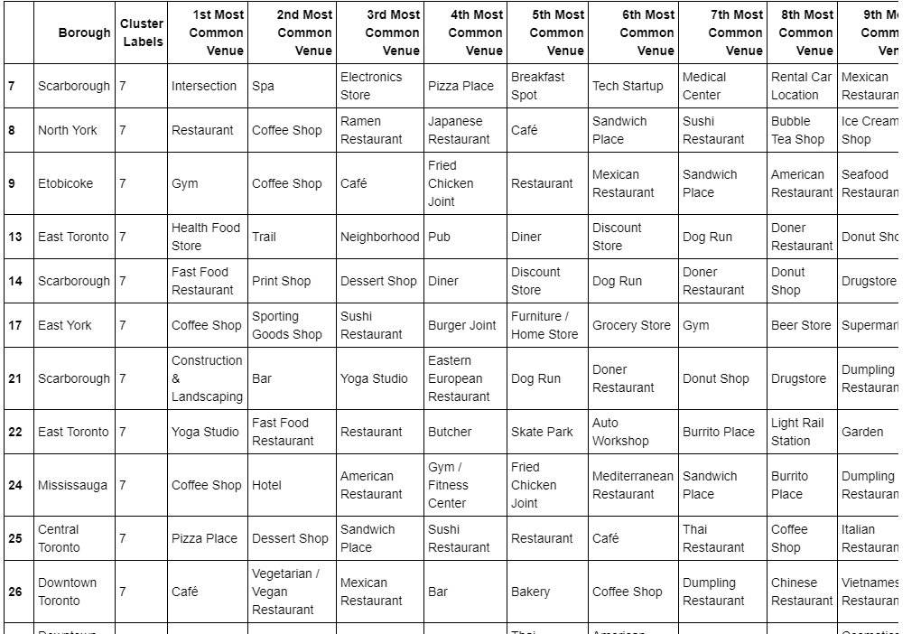
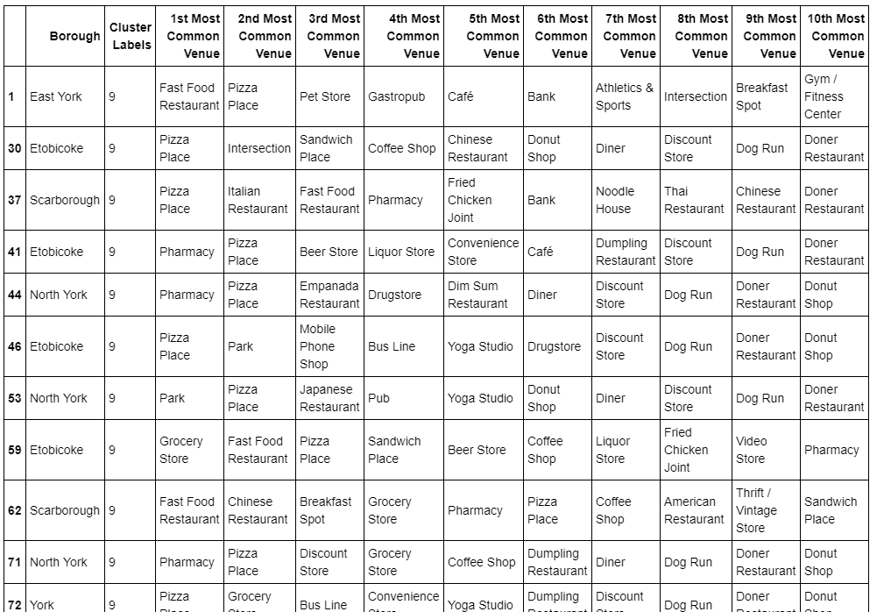
Result

Slide 7
Conclusion
2 clusters are good to start a restaurant
Downtown Toronto and North York are best places

