Slide 1


iSecure
Home security solution when you are away
Notes:
HOSES home security system
iSecure IoT based security system

Slide 2
Description
An Internet of Things (IoT) based system that provides home security for people while they are away.
Features:
Intruder Detection
Notify users when there is an intruder in their empty houses
Fire Detection
Notify users when fire is detected in their houses
Lamp Detection
Notify users if they forget to turn off the light when they are away
Real-Time Home Monitoring
Give a real-time home picturing information

Slide 3
Sensor
Passive InfraRed (PIR)
Detect motion of human being (intruder)
InfraRed (IR)
Detect lamp state (on/off)
Camera
Capture images of house condition
Temperature
Sense the presence of fire based on temperature value

Slide 4
Communication Interface
Wi-Fi Connection
Raspberry Pi 3 <-> Android Device

Slide 5
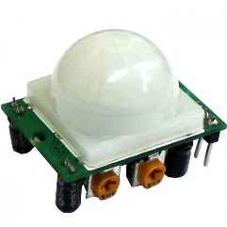
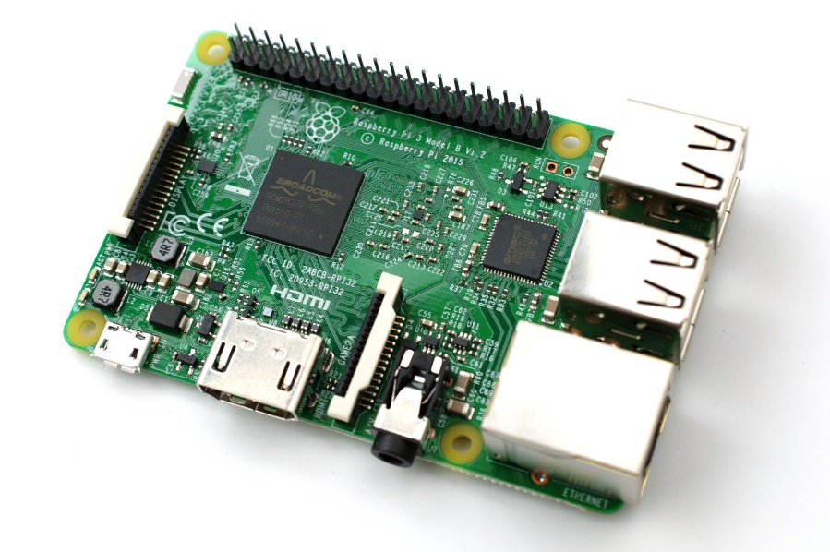
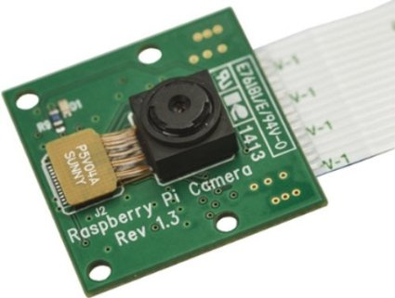
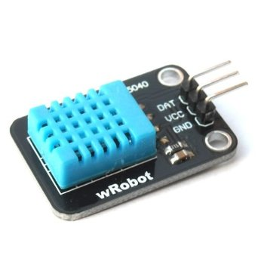


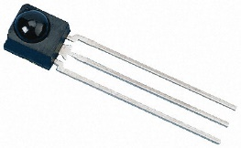
Architecture

