Slide 1
Connecting Sensors to RPi
2016. 09. 22.
Jinhyuk Yim (jinhyuk@uns.ajou.ac.kr)
Eungkyu Lee (eungkyu@uns.ajou.ac.kr)

Slide 2
Practice
Raspberry PI GPIO tutorial
Connects Arduino to the Raspberry Pi
Amazon Web Service (AWS)
Introduction
How to use AWS
Tutorial

Slide 3
Practice

Slide 4
Raspberry Pi GPIO Tutorial
There are two different approaches to reading and driving the Raspberry Pi’s GPIO pins
Python API and Examples
RPi.GPIO API – An overview of the Python functions you can use to drive GPIO.
RPi.GPIO Example – An example Python script that shows off both input and output functionality.
C (and WiringPi) API and Examples
WiringPi API – An overview of the basic functions provided by the WiringPi library.
WiringPi Example – A simple example program that shows off WiringPi’s input and output capabilities.
GPIO Pinout – An overview of the Pi’s GPIO header.

Slide 5
Install WiringPi
WiringPi
GPIO accesses library written in C language
Step 1
Check your internet connection whether it is connected or not
Ex) ping google.com
Sudo apt-get update
Sudo apt-get upgrade
Update
Update a “list” of available packages and versions
Upgrade
Upgrade “packages” to the latest version

Slide 6
Install WiringPi
Step 2
Sudo apt-get install git-core
Git
Git is popular version control system designed to handle very large projects with speed and efficiency
It is used for many open source projects.
Ref : https://en.wikipedia.org/wiki/Git

Slide 7
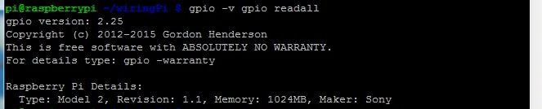
Install WiringPi
Step 3
git clone git://git.drogon.net/wiringPi
cd wiringPi
./build
Step 4
Check your installation of wiringPI
Type this command : “gpio –v gpio readall”

Slide 8
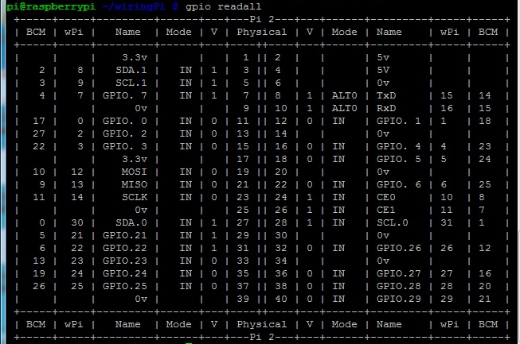
Install WiringPi
Step 5
Print GPIO map
Type this command : “gpio readall”

Slide 9
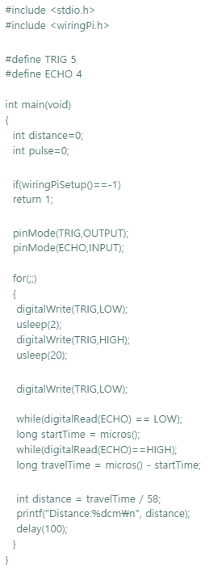
Ultrasonic Example
Step 1
mkdir test
cd test
nano test.c
Type the code
Step 2
gcc –o test test.c –lwiringPi
gcc –o <output> <sourcefile> -lwiringPi
Execute Program
sudo ./test

Slide 10
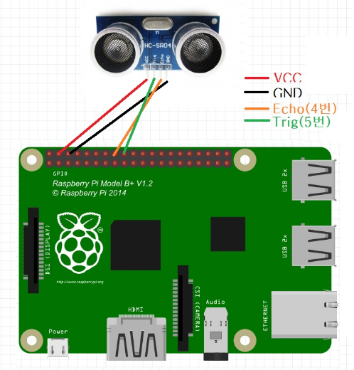
UltrasonicExample
Step 3
Connect Ultrasonic sensor to the RPi3
VCC : 5v
GND : Pin 06 or 09 or 25 or ...
ECHO : GPIO23 (Pin16)
TRIGGER : GPIO24 (Pin18)
Execute Program
sudo ./test

Slide 11
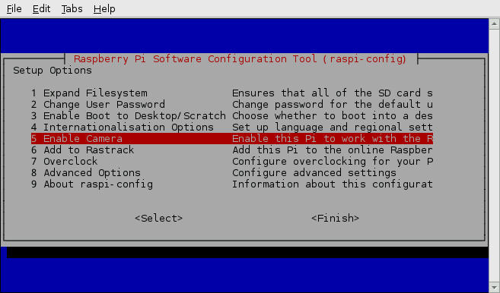
Raspberry Pi Camera
Step 1
sudo raspi-config
Selects “Enable Camera”

Slide 12
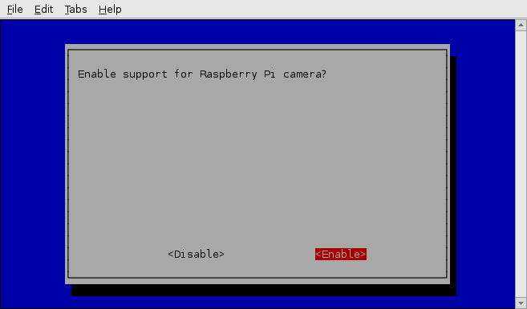
Raspberry Pi Camera
Step 2
Selects “Enable” and reboot

Slide 13
Raspberry Pi Camera
Commands
Capture image
raspistill –o image.jpg
Capture video
raspivid –o video.h264
Option
-o <filename> : Save the file
-t <milliseconds> : capture image after the time (Default : 5sec)
-w,-h : set the width and the height
-f : fullscreen preview mode

Slide 14
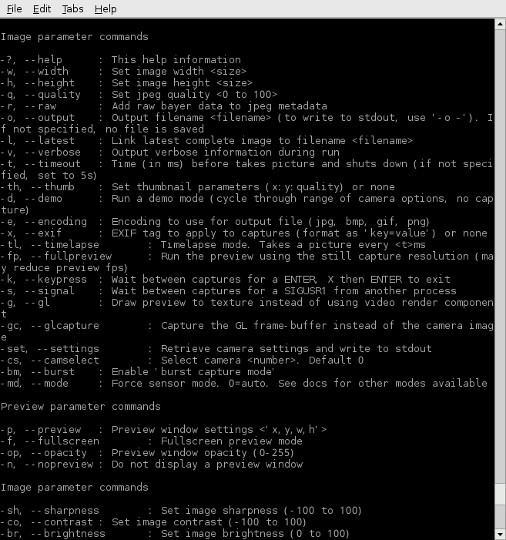
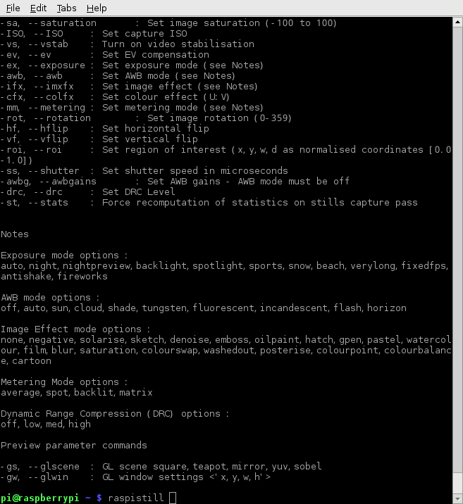
Raspberry Pi camera commands

Slide 15
Raspberry Pi Camera
Python code
https://www.raspberrypi.org/learning/getting-started-with-picamera/worksheet/

Slide 16
Connect Arduino to the RPi3

Slide 17
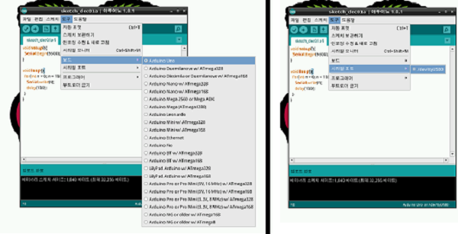
Install Arduino IDE
Install Arduino IDE
Sudo apt-get install Arduino
Get permission for access to the Serial port
Sudo usermode –a –G tty pi
Sudo usermod –a –G dialout pi
Check board and serial port (/dev/ttyACM0)

Slide 18
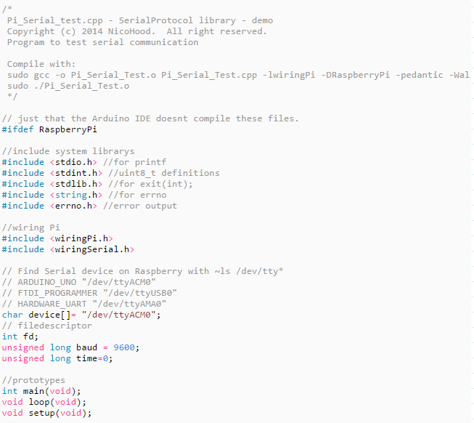
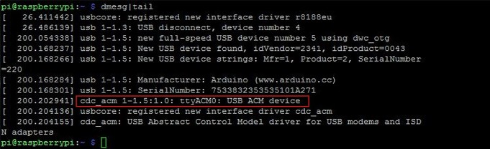
Raspberry Pi code
Copy the RPI code and compile it
Nano hello.c
Copy and paste
Sudo gcc –o hello hello.c –l wiringPi –DRaspberryPi
Sudo ./hello
Check your Arduino’s port
Dmesg | tail
#ifdef RaspberryPi
//include system librarys
#include <stdio.h> //for printf
#include <stdint.h> //uint8_t definitions
#include <stdlib.h> //for exit(int);
#include <string.h> //for errno
#include <errno.h> //error output
//wiring Pi
#include <wiringPi.h>
#include <wiringSerial.h>
// Find Serial device on Raspberry with ~ls /dev/tty*
// ARDUINO_UNO "/dev/ttyACM0"
// FTDI_PROGRAMMER "/dev/ttyUSB0"
// HARDWARE_UART "/dev/ttyAMA0"
char device[]= "/dev/ttyACM0";
// filedescriptor
int fd;
unsigned long baud = 9600;
unsigned long time=0;
//prototypes
int main(void);
void loop(void);
void setup(void);
void setup(){
printf("%s \n", "Raspberry Startup!");
fflush(stdout);
//get filedescriptor
if ((fd = serialOpen (device, baud)) < 0){
fprintf (stderr, "Unable to open serial device: %s\n", strerror (errno)) ;
exit(1); //error
}
//setup GPIO in wiringPi mode
if (wiringPiSetup () == -1){
fprintf (stdout, "Unable to start wiringPi: %s\n", strerror (errno)) ;
exit(1); //error
}
}
void loop(){
// Pong every 3 seconds
if(millis()-time>=3000){
serialPuts (fd, "Pong!\n");
// you can also write data from 0-255
// 65 is in ASCII 'A'
serialPutchar (fd, 65);
time=millis();
}
// read signal
if(serialDataAvail (fd)){
char newChar = serialGetchar (fd);
printf("%c", newChar);
fflush(stdout);
}
}
// main function for normal c++ programs on Raspberry
int main(){
setup();
while(1) loop();
return 0;
}
#endif //#ifdef RaspberryPi
Notes:
#ifdef RaspberryPi
//include system librarys
#include <stdio.h> //for printf
#include <stdint.h> //uint8_t definitions
#include <stdlib.h> //for exit(int);
#include <string.h> //for errno
#include <errno.h> //error output
//wiring Pi
#include <wiringPi.h>
#include <wiringSerial.h>
// Find Serial device on Raspberry with ~ls /dev/tty*
// ARDUINO_UNO "/dev/ttyACM0"
// FTDI_PROGRAMMER "/dev/ttyUSB0"
// HARDWARE_UART "/dev/ttyAMA0"
char device[]= "/dev/ttyACM0";
// filedescriptor
int fd;
unsigned long baud = 9600;
unsigned long time=0;
//prototypes
int main(void);
void loop(void);
void setup(void);
void setup(){
printf("%s \n", "Raspberry Startup!");
fflush(stdout);
//get filedescriptor
if ((fd = serialOpen (device, baud)) < 0){
fprintf (stderr, "Unable to open serial device: %s\n", strerror (errno)) ;
exit(1); //error
}
//setup GPIO in wiringPi mode
if (wiringPiSetup () == -1){
fprintf (stdout, "Unable to start wiringPi: %s\n", strerror (errno)) ;
exit(1); //error
}
}
void loop(){
// Pong every 3 seconds
if(millis()-time>=3000){
serialPuts (fd, "Pong!\n");
// you can also write data from 0-255
// 65 is in ASCII 'A'
serialPutchar (fd, 65);
time=millis();
}
// read signal
if(serialDataAvail (fd)){
char newChar = serialGetchar (fd);
printf("%c", newChar);
fflush(stdout);
}
}
// main function for normal c++ programs on Raspberry
int main(){
setup();
while(1) loop();
return 0;
}
#endif //#ifdef RaspberryPi

Slide 19
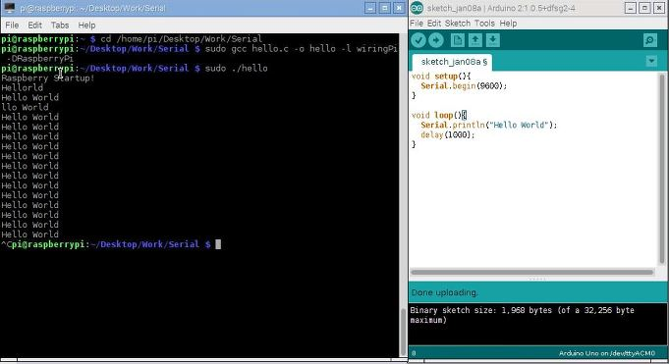
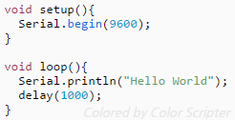
Arduino code
Execute Arduino IDE
Type this code
Result

Slide 20
Amazon Web Service (AWS)

Slide 21
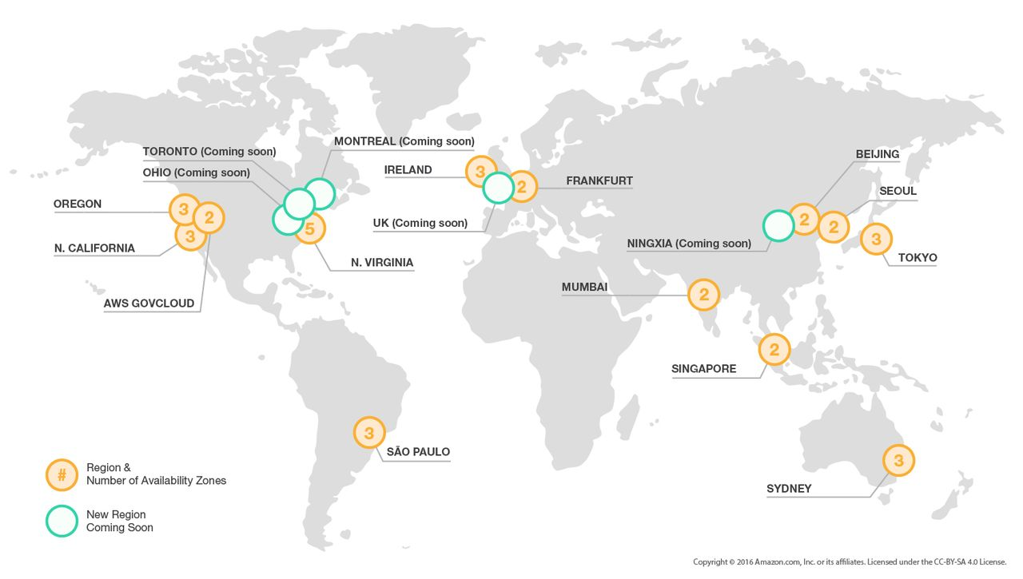
Amazon Web Service (AWS)
Amazon Web Service (AWS)
Offers a suite of cloud-computing services that make up an on-demand computing platform
Available from 13 regions across the world

Slide 22
Amazon Web Service (AWS)
List of products
Compute (Elastic Compute Cloud, EC2)
Networking (Route53)
Storage and content delivery (Simple Storage Service, S3)
Database (Relational Database Service, RDS)
Deployment (CodeDeploy)
Management (CloudWatch)
Application services (API Gateway)
Analytics (Machine Learning, EMR-Hadoop, Kinesis)
Miscellaneous (Identity and Access Management, IAM)
You can access these services using HTTP and SOAP
HTTP: HyperText Transfer Protocol
SOAP: Simple Object Access Protocol (using xml)

Slide 23
How to use AWS?
http://hyeonstorage.tistory.com/145

Slide 24
AWS IoT
http://docs.aws.amazon.com/iot/latest/developerguide/iot-device-sdk-c.html

