Slide 1


iSecure
Home security solution when you are away
Notes:
HOSES home security system
iSecure IoT based security system

Slide 2



Description
An Internet of Things (IoT) based system that provides home security for people while they are away.
Features:
Intruder Detection
Notify users when there is an intruder in their empty houses
Lamp Detection
Notify users if they forget to turn off the light when they are away
Real-Time Home Monitoring
Give a real-time home picturing information

Slide 3
Sensor
Passive InfraRed (PIR)
Detect motion of human being (intruder)
Illuminate Sensor
Detect lamp state (on/off)
Camera
Capture images of house condition

Slide 4
Communication Interface
Serial Connection
Arduino UNO -> Raspberry Pi 3
Wi-Fi Connection (MQTT protocol)
Raspberry Pi 3 <-> Android Device

Slide 5
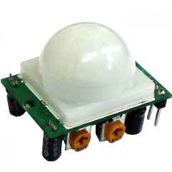
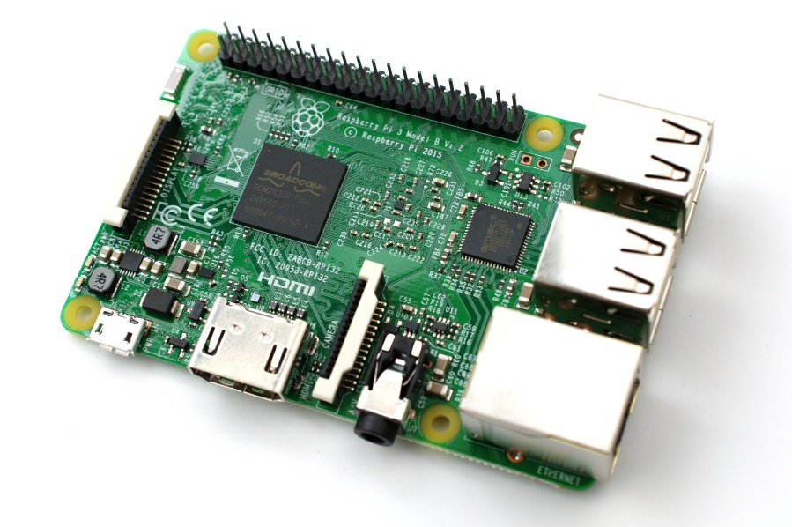
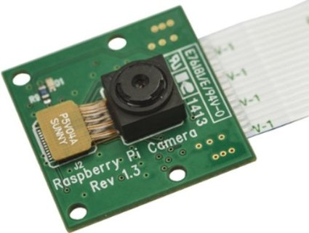




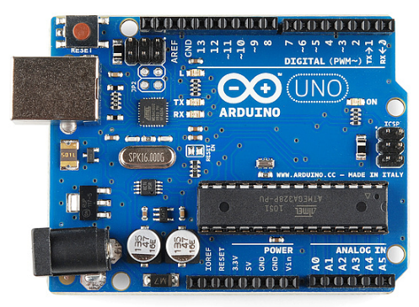
Architecture
MQTT

Slide 6
Demo

Slide 7
Future Development
ADC usage
Locked-door detection feature
Adaptive lamp detection feature

