Slide 1
Raspberry Pi Camera
2016. 09. 26.
Jinhyuk Yim (jinhyuk@uns.ajou.ac.kr)
Eungkyu Lee (eungkyu@uns.ajou.ac.kr)

Slide 2
Practice

Slide 3
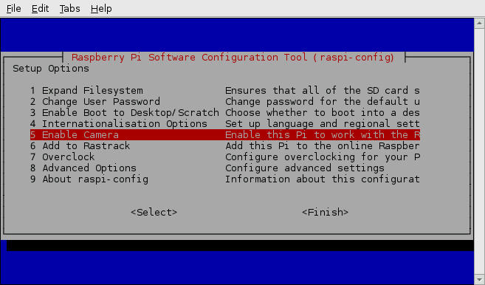
Raspberry Pi Camera
Step 1
sudo raspi-config
Selects “Enable Camera”

Slide 4
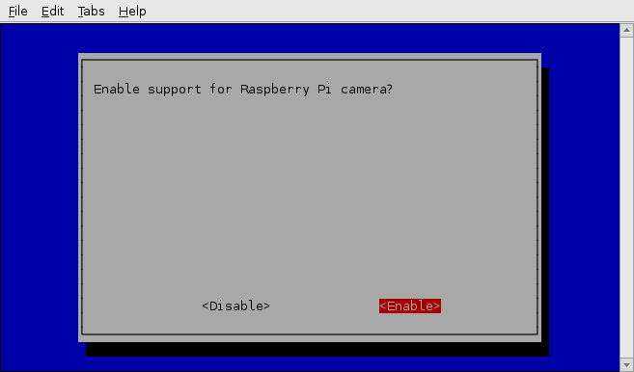
Raspberry Pi Camera
Step 2
Selects “Enable” and reboot

Slide 5
Raspberry Pi Camera
Commands
Capture image
raspistill –o image.jpg
Capture video
raspivid –o video.h264
Option
-o <filename> : Save the file
-t <milliseconds> : capture image after the time (Default : 5sec)
-w,-h : set the width and the height
-f : fullscreen preview mode

Slide 6
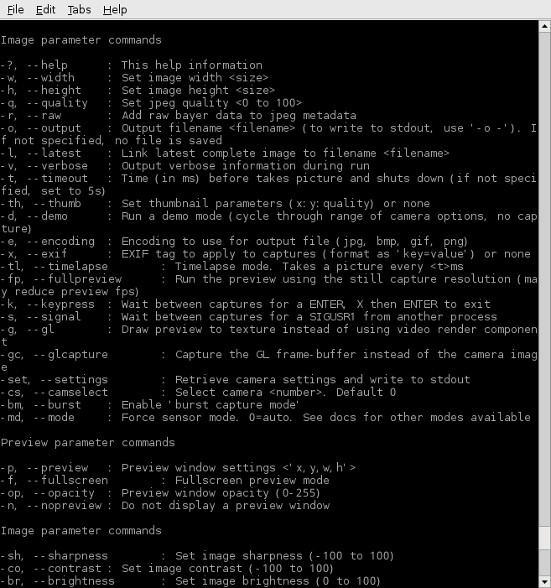
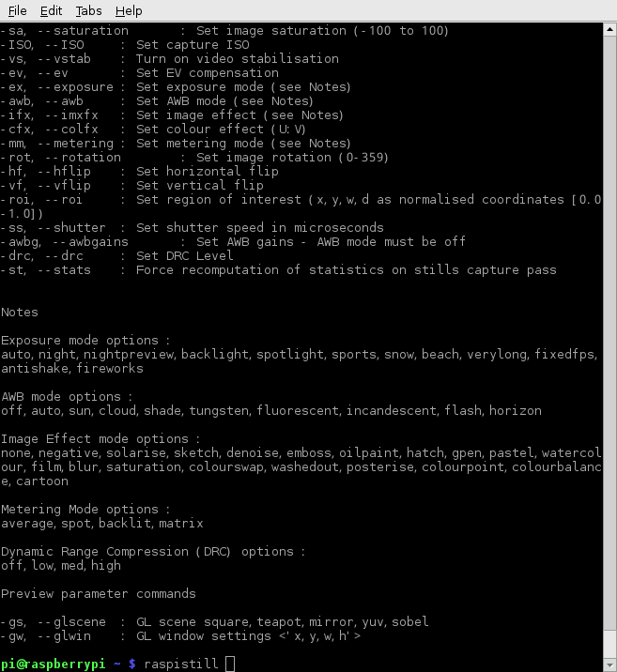
Raspberry Pi camera commands

Slide 7
Raspberry Pi Camera
omxplayer
omxplayer is a video player specifically made for the Raspberry Pi (RPI already has library for omxplayer)
Command
omxplayer <filename> ex) omxplayer test.h264, omxplayer test.mp4
But it plays the video through HDMI cable, so it needs Monitor for watching video.
But we cannot provide a monitor to each person, therefore now we are going to talk about Streaming service

Slide 8
Raspberry Pi Camera Streaming
Streaming media
Streaming media is multimedia that is constantly received by and presented to an end-user while being delivered by a provider.
In this class we are going to use a “Gstreamer”
Gstreamer
GStreamer is a framework for creating streaming media applications
Install GStreamer
sudo apt-get install gstreamer1.0
Start Streaming service in the Raspberry Pi
raspivid -t 0 -w 800 -h 600 -fps 30 -hf -vf -b 50000000 -o - | gst-launch-1.0 -e -vvvv fdsrc ! h264parse ! rtph264pay pt=96 config-interval=5 ! udpsink host =[Tartget computer IP] port=5000

Slide 9
Start streaming service
Start Streaming service in the Window
Install gstreamer for window
32bit : http://gstreamer.freedesktop.org/data/pkg/windows/1.4.5/gstreamer-1.0-x86-1.4.5.msi
64bit : http://gstreamer.freedesktop.org/data/pkg/windows/1.4.5/gstreamer-1.0-x86_64-1.4.5.msi
Execute gstreamer in the Window
Ctrl + r -> cmd -> Enter
cd gstreamer
cd 1.0
cd x86_64 (if 32bit then cd x86)
cd bin
gst-launch-1.0 -e -v udpsrc port=5000 ! application/x-rtp, payload=96 ! rtpjitterbuffer ! rtph264depay ! avdec_h264 ! fpsdisplaysink sync=false text-overlay=false

