Slide 1
Bluetooth Communication with Android
2016. 09. 08.
Jinhyuk Yim (jinhyuk@uns.ajou.ac.kr)
Eungkyu Lee (eungkyu@uns.ajou.ac.kr)

Slide 2
Bluetooth
Make Bluetooth Chatting Application
Project Introduction

Slide 3
Bluetooth

Slide 4
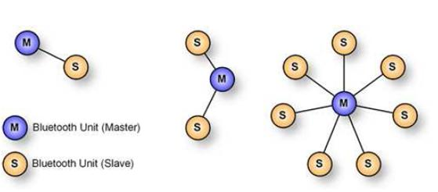
Bluetooth (1/2)
Bluetooth
Bluetooth is a wireless technology standard for exchanging data over short distances from fixed and mobile devices. And one of the popular wireless communication technologies because of its low power consumption, low cost.
Master and Slaves
Bluetooth networks use a master/slave model to control when and where devices can send data.
The master can send data to any of its slaves and request data from them as well.
Slaves are only allowed to transmit to and receive from their master.

Slide 5
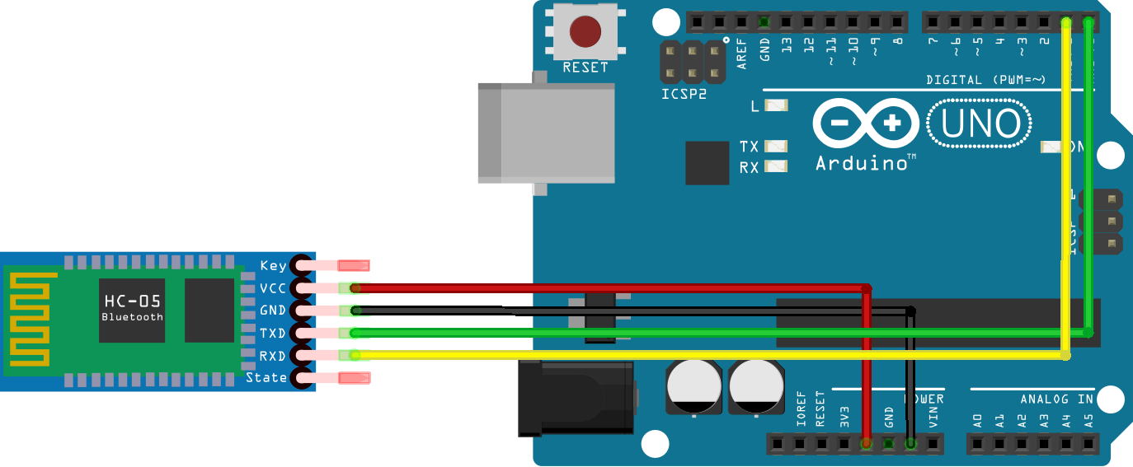
Bluetooth (2/2)
Bluetooth devices for Arduino
Bluetooth module
Connects the Arduino using cable.
Bluetooth shield
Mount the Bluetooth Shield on the headers of Arduino.

Slide 6
Make Bluetooth Chatting Application

Slide 7
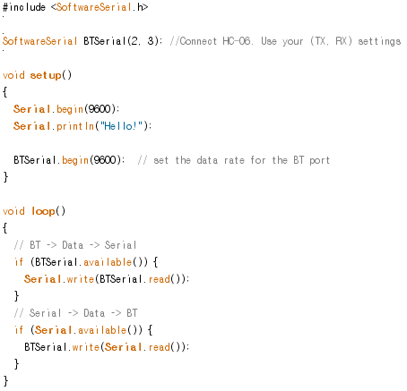
Bluetooth Slave Example Code
Arduino Bluetooth Codes
Notes:
TX →2
RX→3

Slide 8
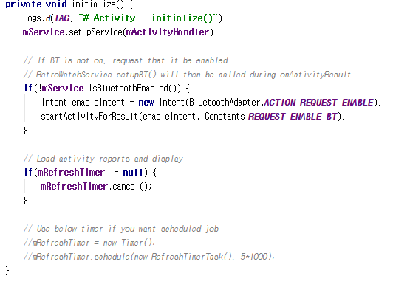
Activate Bluetooth
File path: Java -> com.hardcopy.btchat -> MainActivity
Notes:
mService.isBluetoothEnabled() → activate code→ di MainActivity
Kalau sudash on harus dilistening

Slide 9
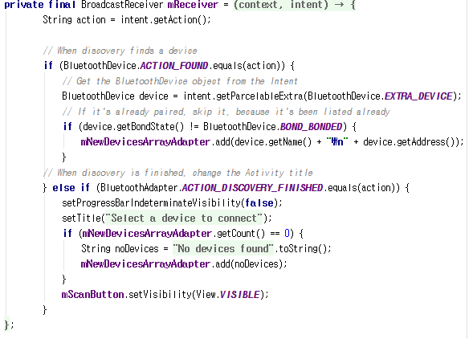
Listening for discovered devices
File path: java -> com.hardcopy.btchat -> DeviceListActivity

Slide 10
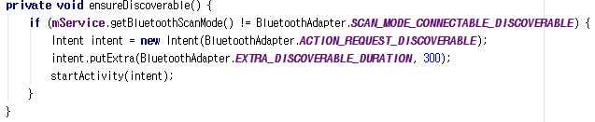
Ensure this device is discoverable
File path: Java -> com.hardcopy.btchat -> MainActivity

Slide 11
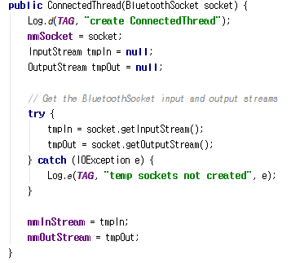
Handles transmission data
File path: Java -> com.hardcopy.btchat -> Bluetooth -> BluetoothManager.java -> Private class ConnectedThread extends Thread { }
Notes:
Ini buat master, kalua data masuk, masuk di getInputStream();

Slide 12
Project Introduction

Slide 13
Team Project
Implementing prototype of your IoT service
Does not have to be Home IoT service
Project Description & Requirement
1. Implement Raspberry Pi 3 based sensing environment
Use basic sensor that we already provided
You can use additional sensors
2. Use 1 communication interface (Wi-Fi/Bluetooth/BLE)
Pi 3 has embedded Wi-Fi and BLE
3. Implement Smartphone Application
4. If you want to enhance the quality of your project, use Amazon Web service
1~3 ➔ mandatory, 4 ➔ optional

Slide 14
Assignment
Design your own IoT application
Must contain below information
Application that you try to implement
Sensors you need and how to use these sensors
Communication interface that you try to use
Overall architecture
Due date: 19/Sep/2016
Submit your assignment in power point format (PPT)
E-mail: jinhyuk@uns.ajou.ac.kr
Notes:
Solution when you are away

