Slide 1
Arduino Communication
2016. 09. 06.
Jinhyuk Yim (jinhyuk@uns.ajou.ac.kr)
Eungkyu Lee (eungkyu@uns.ajou.ac.kr)

Slide 2
Communication Interface
Serial communication
I2C communication
SPI communication
Wi-Fi communication
Bluetooth communication
Practice

Slide 3
Communication Interface

Slide 4



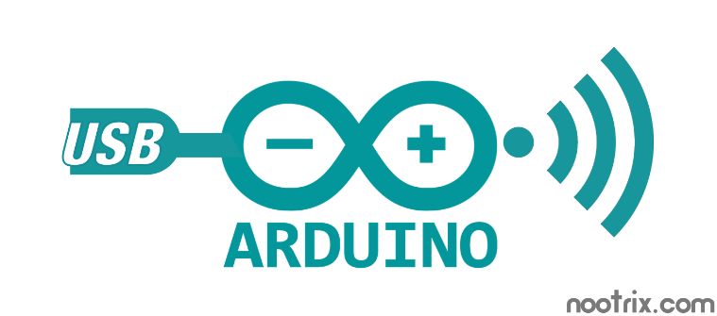
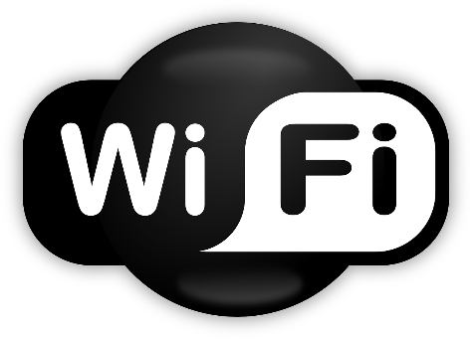

Arduino Communications
There are lots of communication interfaces for Arduino
I2C, Serial, Bluetooth, W-iFi …

Slide 5
Interface types
Wired interface vs Wireless interface
Wired interface
Connects to the other device using cable.
Serial communication
Software serial communication
Wireless interface
Connects to the module or shield
Wi-Fi
Bluetooth
Bluetooth Low Energy (BLE)

Slide 6
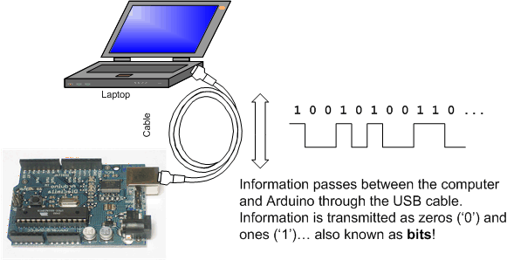
Serial Communication
Serial Communication
Also known as USB communication and UART communication
Information passes between the computer and Arduino through the USB cable.

Slide 7
API’s for Serial Communication
Functions for serial communication
Serial.begin()
Serial.end()
Serial.available()
Serial.read()
Serial.peek()
Serial.parseInt()
Serial.write()
Serial.flush()
If you want more information,
https://www.arduino.cc/en/Reference/HomePage

Slide 8
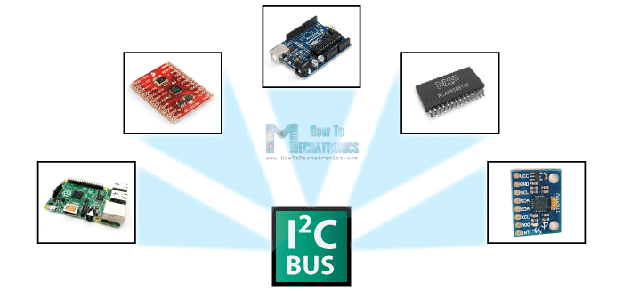
I2C Communication (1/3)
I2C (Inter-integrated circuit)
I2C communication bus is very popular and broadly used by many electronic devices.
it can be easily implemented in many electronic designs which require communication between a master and multiple slave devices or even multiple master devices.

Slide 9
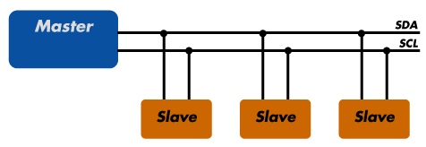
I2C Communication (2/3)
I2C has a master/slave protocol. The master initiates the communication.
The sequence of events are :
The Master device issues a start condition. This condition informs all the slave devices to listen on the serial data line for instructions.
The Master device sends the address of the target slave device and a read/write flag.
The Slave device with the matching address responds with an acknowledgement signal.
Communication proceeds between the Master and the Slave on the data bus. Both the master and slave can receive or transmit data depending on whether the communication is a read or write. The transmitter sends 8-bits of data to the receiver which replies with a 1-bit acknowledgement.
When the communication is complete, the master issues a stop condition indicating that everything is done.

Slide 10
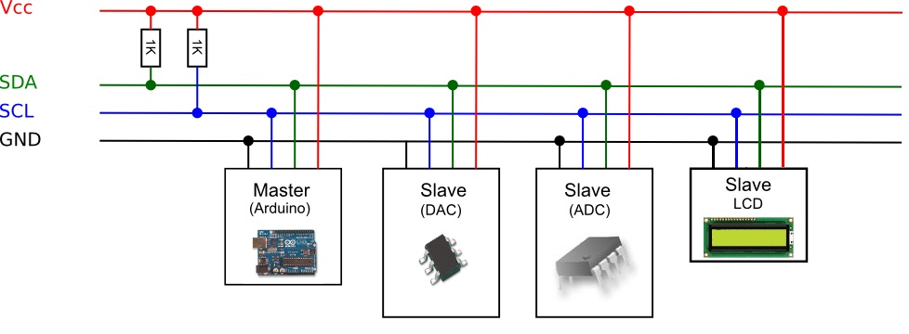
I2C Communication (3/3)
Connect devices using breadboard.
SDA (Serial data)
For data transmission
SCL (Serial clock)
For clock signal transmission

Slide 11
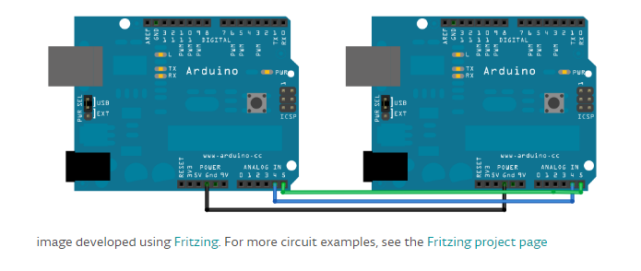
I2C Example using two Arduino
Master device
Slave device
It must share one common ground pin
https://www.arduino.cc/en/Tutorial/MasterWriter

Slide 12
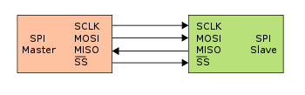
SPI Communication (1/2)
SPI (Serial Peripheral Interface)
A synchronous serial communication interface used for short distance communication
Communicate in Full-Duplex mode using master-slave architecture with single master
Commonly used to send data between microcontrollers and small peripherals such as shift registers, sensors, and SD cards
SCLK: Serial Clock (output from master)
MOSI: Master Output, Slave Input (output from master)
MISO: Master Input, Slave Output (output from slave)
SS: Slave Select (output from master)

Slide 13
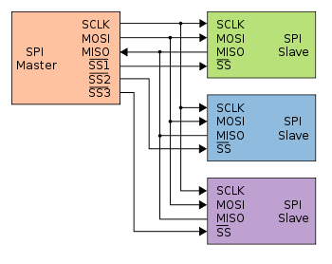
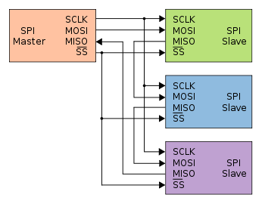
SPI Communication (2/2)
Two types of slave
Independent
Independent slave select line exists
Daisy-chain
1st slave’s output becomes 2nd slave’s input
Act like shift register
Typical SPI bus
3 independent slaves
Daisy-chained SPI bus
3 cooperative slaves

Slide 14
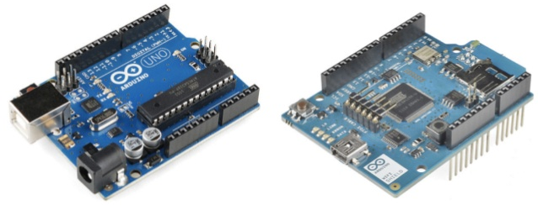
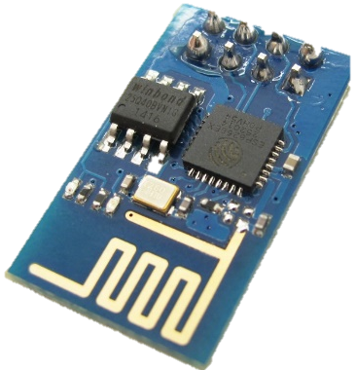
Wi-Fi Communication
Wi-Fi
Technology that allows electronic devices to connect to a wireless LAN (WLAN) network
Wi-Fi devices for Arduino
The Arduino Wi-Fi Shield / Module allows an Arduino board to connect to the internet using the 802.11 wireless specification
Wi-Fi shield
Mount the Wi-Fi Shield on the headers of Arduino.
Wi-Fi module
Connects the Arduino using cable.
Arduino UNO
Arduino Wi-Fi Shield
Arduino Wi-Fi Module

Slide 15
API’s for Wi-Fi Communication
WiFi class
The WiFi class initializes the Ethernet library and network settings
Wifi.begin()
Wifi.disconnect()
Wifi.config()
Wifi.setDNS()
Wifi.SSID()
Wifi.BSSID()
Wifi.RSSI()
Wifi.encryptionType()
Wifi.scanNetworks()
Wifi.status()
Wifi.getSocket()
Wifi.macAddress()
If you want more information,
https://www.arduino.cc/en/Reference/WiFi

Slide 16
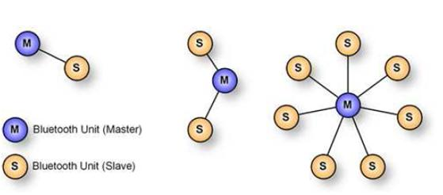
Bluetooth Communication (1/2)
Bluetooth
Bluetooth is a wireless technology standard for exchanging data over short distances from fixed and mobile devices. And one of the popular wireless communication technologies because of its low power consumption, low cost.
Master and Slaves
Bluetooth networks use a master/slave model to control when and where devices can send data.
The master can send data to any of its slaves and request data from them as well.
Slaves are only allowed to transmit to and receive from their master.

Slide 17
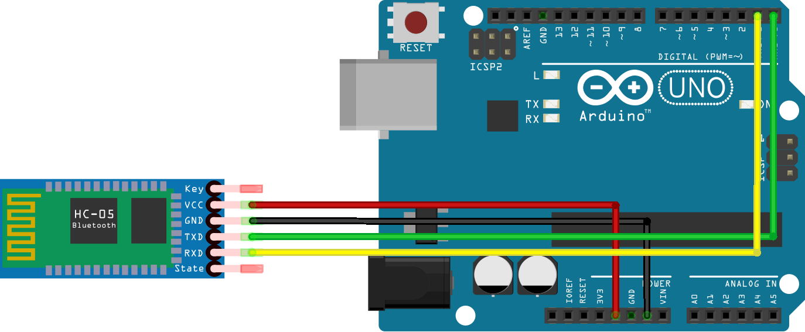
Bluetooth Communication (2/2)
Bluetooth devices for Arduino
Bluetooth module
Connects the Arduino using cable.
Bluetooth shield
Mount the Bluetooth Shield on the headers of Arduino.

Slide 18
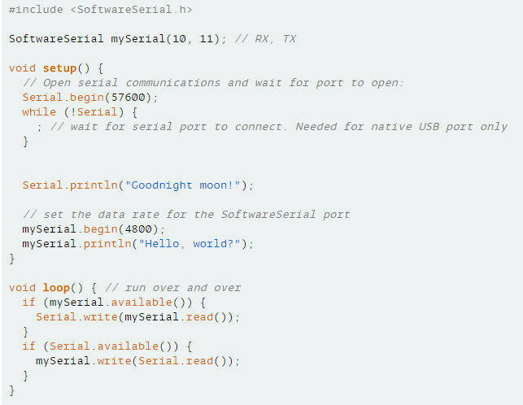
API’s for Bluetooth Communication
Using Software serial communication

Slide 19
Practice

Slide 20
Practice #1 – Serial communication
Control the LED through serial communication
Enter the number that how long the LED will blink.
Function for serial communication (PC to Arduino)
Serial.available()
Get the number of bytes (characters) available for reading from the serial port.
Serial.read()
Reads incoming serial data.
Serial.peek()
Returns the next byte (character) of incoming serial data without removing it from the internal serial buffer.
Serial.parseInt()
Returns the first valid (long) integer number from the serial buffer.

Slide 21
Notes:
Research Team on Autonomous Network SW for Smart Collaboration among Heterogeneous Devices

