Slide 1
PRODUCT DEMO · 2026.08.02
London Market
Desk
Evidence-first agent for London office research
正式數值 coverage：UK Bank Rate
Notes:
開場：這是可驗證的市場研究 PoC，而不是泛用聊天機器人。今天的正式 numeric launch scope 只有 UK Bank Rate。
[Sources]
- README.md
- wiki/research/chatbot-dashboard-decision.md

Slide 2
對話只能走受控的路徑，不能直接碰資料庫
01 Browser
02 Agent runtime
03 Trusted data plane
同源 Dashboard
Bearer session + SSE
只顯示 host-finalized brief
Pi AgentSession
6 個受控 tools
日期未指定 → latest canonical
Facade → SQLite + evidence
read-only model surface
macOS host 執行 ingestion
02
Notes:
重點是 authority boundary：模型只透過 typed Facade 讀取 canonical data；沒有 SQL、shell、filesystem、collector 或 raw evidence tool。Linux Docker 僅服務讀取 runtime，ingestion 留在 macOS host。
[Sources]
- docs/first-use-and-data-pipeline.md
- wiki/questions/Test_result/TC-01-runtime-live-test-2026-08-02.md

Slide 3
13 種資料來源的 Tool、Skill 與 Availability
中欄是 data-plane function / research Skill；只有 Bank Rate 已在 production Pi runtime 開放。
Data source (13) | Tool / Skill | Availability / why
01 Office rent BNP report | fetch_public_market_report collect-office-market-metrics | Unavailable · manual review / restricted retention; no City Prime canonical series
02 Stock / availability VOA + BNP | fetch_voa_office_stock + report collect-office-market-metrics · track-office-supply | Partial · VOA stock operational; BNP vacancy / availability remains manual review
03 Leasing transactions BNP report | fetch_public_market_report collect-office-market-metrics | Unavailable · report-derived evidence only; no canonical transaction series
04 Supply pipeline PLD | search_planning_applications + fetch_planning_application track-office-supply | Unavailable · PLD licence + retention approval pending
05 Rates / MPC Bank of England | describe → query → citation → finalizer track-uk-macro | Available · Bank Rate only; MPC RSS discovery-only / content approval pending
06 GDP ONS v1 | fetch_uk_gdp track-uk-macro (not runtime-exposed) | Data plane operational · not in production runtime allowlist
07 Inflation ONS v1 | fetch_uk_inflation track-uk-macro (not runtime-exposed) | Data plane operational · not in production runtime allowlist
08 Employment market ONS + Nomis | fetch_uk_labour_market + fetch_london_labour_market track-uk-macro (not runtime-exposed) | Data plane operational · not in production runtime allowlist
09 Office demand Rightmove tracker | No scraper; browser review assess-office-demand | Unavailable · manual reading only; enquiry signal is a proxy
10 Hybrid working ONS OPN | fetch_hybrid_working assess-office-demand | Data plane operational proxy · not in production runtime allowlist
11 ESG / energy MHCLG EPC | fetch_non_domestic_epc_ratings check-office-esg | Data plane operational proxy · not in production runtime allowlist
12 Market news / events GOV.UK + MPC | search_market_news + fetch_content_item monitor-market-news | Unavailable · GOV.UK review/access unapproved; MPC not canonical
13 Submarket geography ONSPD + GLA | lookup_postcode + query_town_centres map-london-submarkets | Partial · ONSPD is retention-gated/on-demand; GLA approval pending; no broker polygon
03
Notes:
不要把工程 workflow 或 discovery data 說成產品 coverage。TC-01 對 Prime office rent 的正確行為是 unavailable，不是生成租金 KPI。
[Sources]
- wiki/research/datasource/01-office-rent.md through 13-submarket-geography.md (13 category/source mappings)
- src/nan_fung/datasources/catalog.py (operational, blocked, manual_review and legacy_adapter states)
- docs/datasource-acceptance.md (product-coverage gates and TC-01 reason)
- agent-runtime/README.md; agent-runtime/src/server.ts; agent-runtime/skills.manifest.json (Bank Rate-only production allowlist and preloaded skills)
- skills/*/SKILL.md (research runbooks shown in the Tool / Skill column)

Slide 4

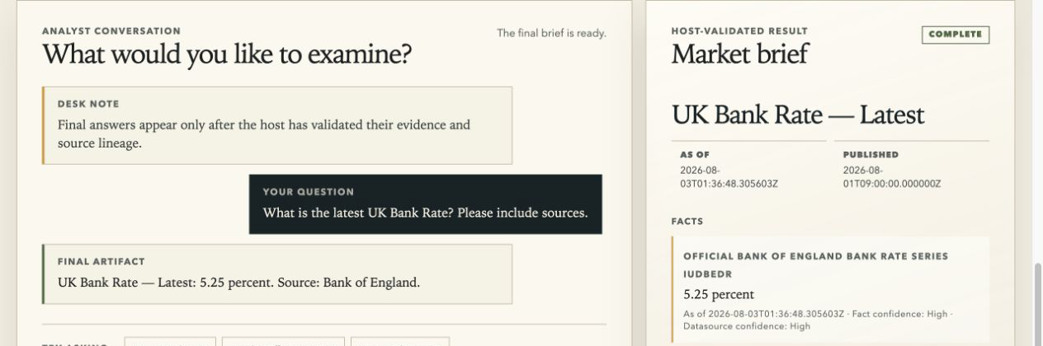
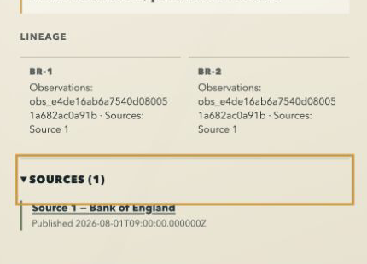
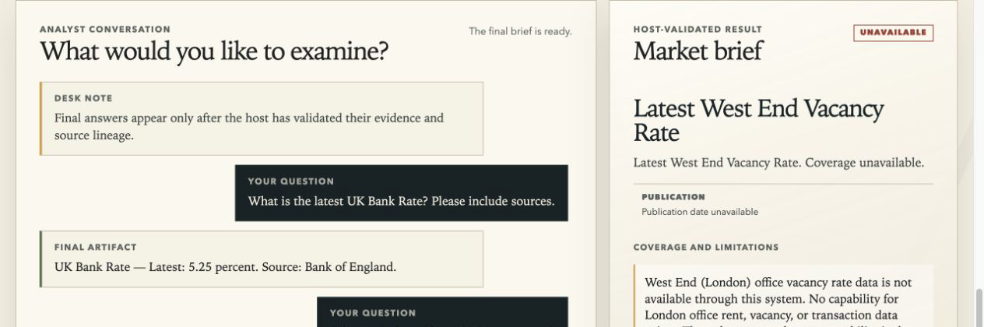
真實 UI 驗收：Pi AgentSession × GLM-5.2
Docker fixture disclosure → real GLM turn → host-validated result / lineage → safe unavailable
01 Runtime + fixture disclosure
02 Real GLM answer + canonical facts
03 Host lineage + safe Source 1
04 Safe unavailable — no invented vacancy KPI
04
Notes:
本頁四張截圖均來自本 repo 的 Docker Demo，並在瀏覽器實際執行 Pi createAgentSession 與 glm/GLM-5.2。UI 不顯示未驗證的 streaming model prose；聊天區顯示 host-validated 數值與來源，右側只呈現 host-finalized market_brief.v1。Bank Rate 顯示 canonical fixture 5.25 percent、confidence、lineage 與 browser-safe Source 1；West End vacancy 正確顯示 unavailable，沒有生成 vacancy KPI。
[Sources]
- agent-runtime/src/boot.ts; agent-runtime/src/turn-runner.ts; agent-runtime/src/server.ts
- agent-runtime/public/app.js; agent-runtime/public/index.html
- tests/Test case.md (sanitized Docker browser / Pi / GLM acceptance traces)
- Local acceptance captures generated from docker compose up --build --wait; no credentials are embedded in the screenshots

Slide 5

Dashboard 把 Bank Rate 與 coverage 狀態放在同一頁
實際 browser run
同源 session
受控 overview
4 個 London cards 均為 unavailable
5.25% 是 temporary fixture，
不是即時市場數值。
05
Notes:
這是實際 browser screenshot。可見 Bank Rate fixture、資料來源與 4 個 unavailable market coverage cards。5.25 percent 是隔離 fixture，只用於 UI to Facade to SQLite chain 驗證。
[Sources]
- wiki/questions/Test_result/TC-01-dashboard-ui-test-2026-08-02.md
- wiki/questions/Test_result/screenshots/dashboard-overview-bank-rate.png

Slide 6
未來發展：從單一可信訊號走向多意圖研究
擴充原則
不把搜尋結果直接當作市場事實。
每個新 intent 先定義：
• approved 資料範圍
• ad-hoc evidence / canonical data 分離
• evidence / freshness contract
• host 可授權的工具
Roadmap
01 有來源的 news RAG
approved / licensed corpus
02
Intent routing：data query / refresh / news research / unavailable
03
Office source coverage + freshness monitoring
04
Production auth / tenancy（後續） 安全擴展 host capability
06
Notes:
本頁全是提案中的後續能力，不是目前已交付 scope。news RAG 只應檢索 approved/licensed corpus，並把 ad-hoc evidence 和 canonical market facts 分開；intent routing 先把使用者要求送往資料查詢、refresh、新聞研究或 unavailable；任何新 office source 都要先經 evidence、freshness 和 promotion gate。
[Sources]
- wiki/architecture/agent-runtime.md (v1 excludes non-canonical ad-hoc results; production auth and tenant policy are deferred)
- docs/datasource-acceptance.md (datasource workflow and promotion coverage context)
- wiki/research/chatbot-dashboard-decision.md (chatbot/dashboard capability direction)

