Slide 1

D5.4 Development of input price risk management tools
Authors: Riccardo Spada, Lukas Akerman, Simone Cerroni, Laura Moritz, Miranda Meuwissen, Tobias Dalhaus
Reviewers: Jens Rommel, Frederic Ang
14/01/2026
This work has received funding from the Swiss State Secretariat for Education, Research and Innovation (SERI)

Slide 2
Introduction
Fertilizer prices have experienced substantial volatility in the past few decades
Price risk management tools can reduce the financial exposure to price volatility in the short run (Hardaker et al., 2015)
Objective: design a behaviorally-informed financial contract and evaluate farmers adoption decisions

Slide 3
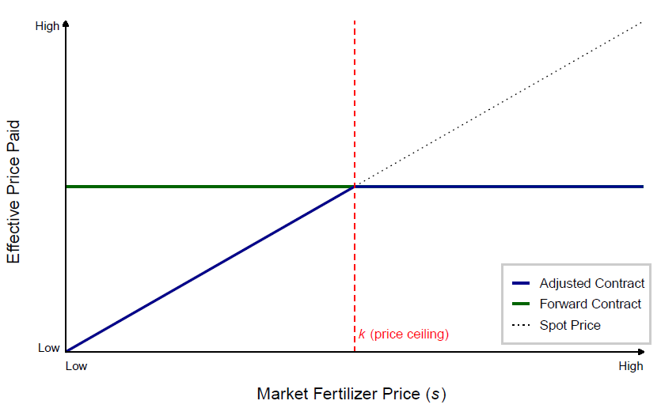
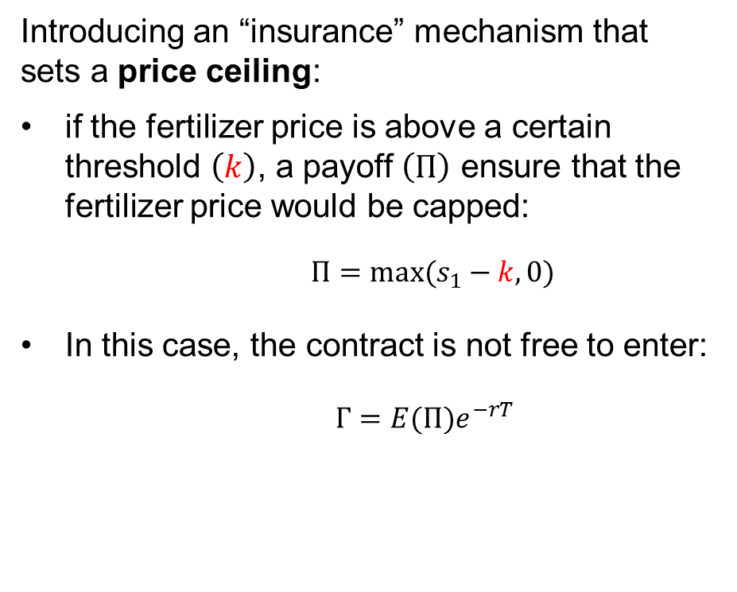
Adjusted contract design
Introducing an “insurance” mechanism that sets a price ceiling:
if the fertilizer price is above a certain threshold $\left.\left(k\right.\right)$, a payoff $\left(Π\right)$ ensure that the fertilizer price would be capped:
$Π=max(s_{1}−k,0)$
In this case, the contract is not free to enter:
$Γ=E(Π)e^{−rT}$
Figure 2. Payoff diagram for fertilizer price contracts

Slide 4
Methodology
Case Study: representative farm in West Germany producing Winter Wheat.
Montecarlo simulation under different decision theories:
Expected Utility Theory (EUT): standard model where farmers seek to maximize overall utility based on risk preferences.
Cumulative Prospect Theory (CPT): model accounting for loss aversion and probability weighting.
…and framing:
Broad Framing: Viewing the contract as a holistic risk management strategy.
Narrow Framing: Viewing the contract as a standalone investment.

Slide 5
Key results and Conclusion
 | Broad Framing (Risk Strategy) | Narrow Framing (Investment)
EUT | Attractive | Unattractive
CPT | Unattractive | Unattractive
Under broad framing, profits are mainly driven by output prices and yield fluctuations, limited gains in utility
Under narrow framing, the adoption of the adjusted risk management tool does not appear to be justified
Results suggest that introducing a maximum-price adjustment to forward contracts is unlikely to generate widespread adoption among farmers

Slide 6

Thank you
Riccardo Spada
riccardo.spada@wur.nl

Slide 7
Methodology and Data
Nitrogen-yield relationship
Crop simulation model
Stochastic production function (Just & Pope 1978; 1979)
Nitrogen prices – Yield prices relationship
Quantile Vector Autoregression (QVAR) (Li & Chavas, 2023)
Contract pricing
Burn analysis
Price Data
Farm-level data Cologne Bay area (North Rhine-Westphalia region, Germany)
Fertilizer: Calcium Ammonium Nitrate, bi-weekly (2007-2025)
Crop: Wheat, bi-weekly (2007-2025)

Slide 8
References
Barberis, N., Huang, M., & Thaler, R. H. (2006). Individual Preferences, Monetary Gambles, and Stock Market Participation: A Case for Narrow Framing. American Economic Review, 96(4), 1069–1090. https://doi.org/10.1257/aer.96.4.1069
Ghirardato, P., Maccheroni, F., & Marinacci, M. (2004). Differentiating ambiguity and ambiguity attitude. Journal of Economic Theory, 118(2), 133–173. https://doi.org/10.1016/j.jet.2003.12.004
Hardaker, J. B., Huirne, R. B. M., Anderson, J. R., & Lien, G. (2015). Coping With Risk in Agriculture (3rd ed.). CABI Publishing. https://www.cabidigitallibrary.org/doi/book/10.1079/9781780645742.0000
Just, R. E., & Pope, R. D. (1978). Stochastic specification of production functions and economic implications. Journal of Econometrics, 7(1), 67–86. https://doi.org/10.1016/0304-4076(78)90006-4
Just, R. E., & Pope, R. D. (1979). Production Function Estimation and Related Risk Considerations. American Journal of Agricultural Economics, 61(2), 276–284. https://doi.org/10.2307/1239732
Knight, F. H. (1921). Risk, uncertainty and profit (Vol. 31). Houghton Mifflin.
Li, J., & Chavas, J.P. (2023). A dynamic analysis of the distribution of commodity futures and spot prices. American Journal of Agricultural Economics, 105(1), 122–143. https://doi.org/10.1111/ajae.12309
Mattos, F., Garcia, P., & Pennings, J. M. E. (2008). Probability weighting and loss aversion in futures hedging. Journal of Financial Markets, 11(4), 433–452. https://doi.org/10.1016/j.finmar.2008.04.002
Spada, R., Moritz, L., Rommel, J., Cerroni, S., Meuwissen, M. P. M., & Dalhaus, T. (2025). Behavioral Preferences Affecting the Adoption of Financial Price Risk Management Tools in Agriculture: A Systematic Literature Review. https://doi.org/10.22004/ag.econ.356632
Tversky, A., & Kahneman, D. (1981). The Framing of Decisions and the Psychology of Choice. Science, 211(4481), 453–458. https://doi.org/10.1126/science.7455683
Tversky, A., & Kahneman, D. (1992). Advances in prospect theory: Cumulative representation of uncertainty. Journal of Risk and Uncertainty, 5(4), 297–323. https://doi.org/10.1007/BF00122574

