Slide 1

Impact of Drug Usage on Population in the US
Notes:
To uncover insights into accidental drug-related deaths in the United States over an 11-year period (2012-2023).The focus is on demographic trends, regional patterns, and substance usage.

Slide 2
Content
Data Overview
The Alarming Rise of Drug-Related Deaths in the US.
Gender Distribution Across Top Counties.
Drug Usage Trends Across Years (Parallel Coordinates).
Age Distribution of Drug-Related Incidents.
Correlation Matrix: Substances and Demographics.
Drug-Related Incidents Over Time.
Proportion of Drug-Related Deaths Compared to Other Causes (2014–2018).
Notes:
It Presents the outline of the presentation.

Slide 3
Dataset Overview
Two Datasets Used:
Accidental Drug-Related Deaths (2012-2023):
Contains over 11,000 records of drug-related deaths across the United States.
Key attributes include Age, Gender, Substances (e.g., Fentanyl, Heroin), and Location (County and State).
Monthly Death Counts by Cause (2014-2018):
Includes data on deaths categorized by cause (e.g., Drug Overdose, Accidents, Suicide, Natural Causes).
Allows comparison of drug-related deaths with other leading causes of mortality.
Notes:
Both datasets are sourced from the U.S. Government. I have used them to offer a comprehensive analysis of drug-related deaths. One dataset provides information on the drugs being used, along with demographic details such as age, sex, and residence, allowing for a more in-depth understanding of the issue. The other dataset compares drug-related deaths with those caused by other factors.

Slide 4
The Alarming Rise of Drug-Related Deaths in the US
A Growing Public Health Crisis:
Drug-related deaths in the United States have been increasing dramatically over the past decade.
In 2021 alone, over 100,000 deaths were reported due to drug overdoses.
Synthetic opioids like Fentanyl are major contributors to this trend.
Why This Matters:
Drug-related deaths are preventable, yet they remain a leading cause of accidental mortality in the US.
Understanding patterns and trends is essential for targeted interventions and public health strategies.
Notes:
Focus on Key Drug:
We need to give attention to synthetic opioids, particularly Fentanyl, which has become one of the most critical factors driving these deaths.
The Fentanyl is 50 to 100 times more potent than morphine, making even small amounts deadly.
It’s crucial to understand that this synthetic drug is often mixed with other substances, unknowingly increasing the risk for overdose.
Why This Crisis Matters:
The deaths are largely preventable, meaning there is an opportunity to reduce them with the right interventions and education.
The drug overdoses have become a leading cause of accidental death in the U.S., surpassing other causes such as motor vehicle accidents..

Slide 5
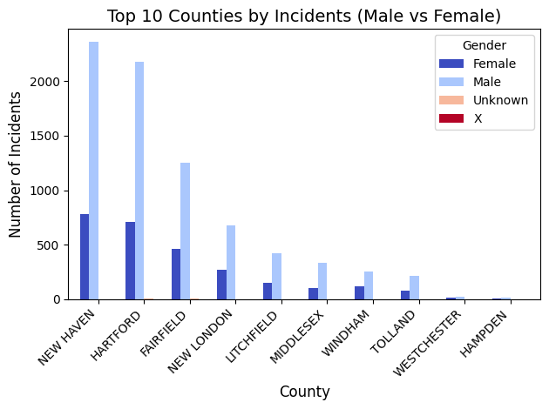
Gender Distribution Across Top Counties(Male vs Female)
Gender Distribution Across Top Counties
Males consistently account for most drug-related incidents across all top 10 counties.
Counties like New Haven and Hartford show particularly high numbers of incidents for both genders.
Notes:
Regional Hotspots and Public Health Implications:
Counties like New Haven and Hartford report significantly higher drug-related incidents compared to others, making them critical areas for focused public health interventions.
Strategies such as expanding addiction treatment centers, increasing community outreach, and improving access to healthcare resources should prioritize these regions.
Gender Disparity and Targeted Strategies:
Males consistently account for a larger share of incidents across all counties, underscoring the need for gender-specific solutions.
Tailored programs aimed at education, prevention, and rehabilitation for men could help address the underlying causes of this disparity.

Slide 6
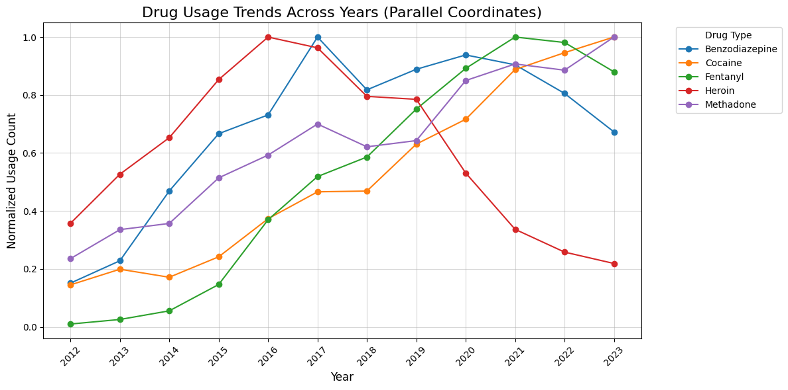
Drug Usage Trends Across Years (Parallel Coordinates)
This graph shows normalized drug usage trends from 2012 to 2023, focusing on Fentanyl, Cocaine, Heroin, Benzodiazepine, and Methadone.
Fentanyl shows a dramatic increase from 2016 to 2023, highlighting the growing opioid crisis. Cocaine has a steady rise but shows a slight decline after 2020.Heroin continues to rise, especially around 2017, reflecting the opioid epidemic. Benzodiazepine fluctuates, likely due to its use in addiction treatment. Methadone shows some fluctuation, reflecting its role in opioid dependency treatment.
The sharp rise in Fentanyl usage emphasizes the need for targeted interventions in the opioid crisis.
Notes:
Conclusion from the graph:
The graph effectively highlights Fentanyl as the primary drug of concern, showing a dramatic rise in usage over the last decade.
Cocaine and Heroin usage also exhibit significant increases, though not as steeply as Fentanyl, indicating ongoing concerns about these substances.
Benzodiazepine and Methadone exhibit more fluctuating trends, suggesting more specific, treatment-focused contexts or shifts in usage over time.

Slide 7
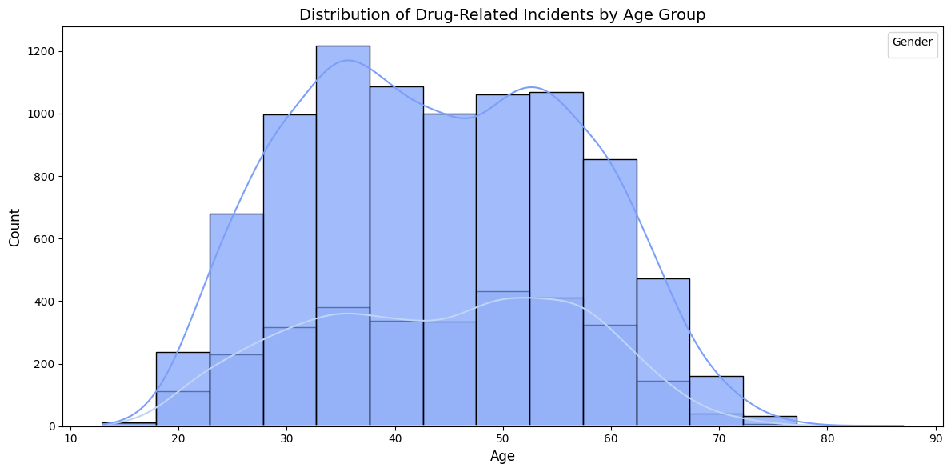
Age Distribution of Drug-Related Incidents
Most incidents are concentrated in the 40–60 age group.
Individuals aged 20–40 also represent a significant proportion.
Incidents decline sharply for individuals over 60 years of age.
Notes:
Age Demographics:
The 40–60 age group is the most affected, followed by the 20–40 age group.
These two age ranges combined account for the majority of drug-related incidents, highlighting the mid-life vulnerability to substance abuse.
Implications:
These findings underscore the need for age-targeted prevention programs.
Resources such as educational campaigns, addiction support groups, and healthcare interventions should prioritize these age groups to mitigate risks.

Slide 8
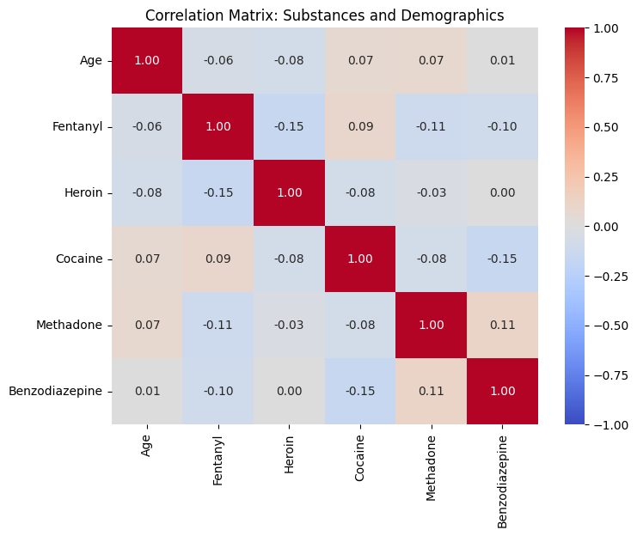
Correlation Matrix: Substances and Demographics
Key Observations:
Weak or negligible correlations between Age and substance usage (e.g., Fentanyl, Heroin, Cocaine).
Some minor correlations observed between certain substances, such as Fentanyl and Cocaine, but overall values are low.
Notes:
Interpreting the Correlations:
The correlation matrix shows that substance usage is largely independent of age, with no strong positive or negative correlations.
Substances like Fentanyl and Heroin exhibit very weak relationships with demographic factors like Age.
Implications for Analysis:
The lack of strong correlations suggests that substance usage patterns may be influenced more by other factors (e.g., social, economic, or environmental) than by age.

Slide 9
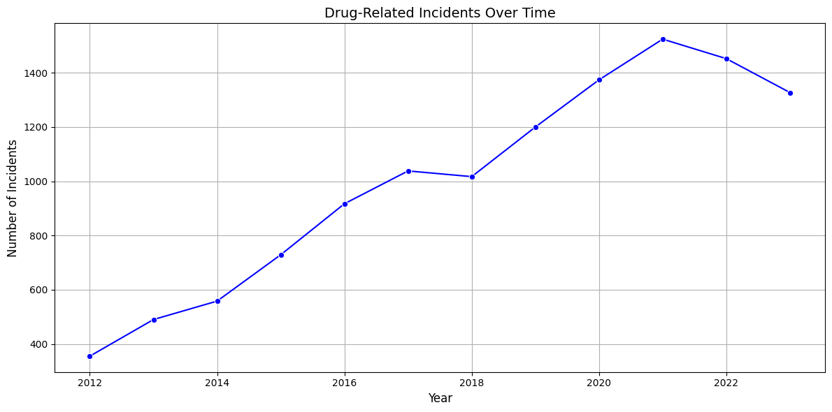
Drug-Related Incidents Over Time
A clear upward trend in drug-related incidents from 2012 to 2020, with incidents nearly tripling over this period.
A slight decline is observed after 2021, though the overall rate remains high.
Notes:
Increasing Trend:
The number of incidents has shown a sharp increase, especially between 2014 and 2020, indicating a worsening drug crisis.
This could be attributed to the rise of synthetic opioids like Fentanyl and increased substance availability.
Policy Implications:
The decline observed after 2021 may indicate the impact of recent public health interventions, but sustained efforts are necessary.
Policymakers should prioritize expanding treatment access, education campaigns, and early intervention strategies to reverse this trend.

Slide 10
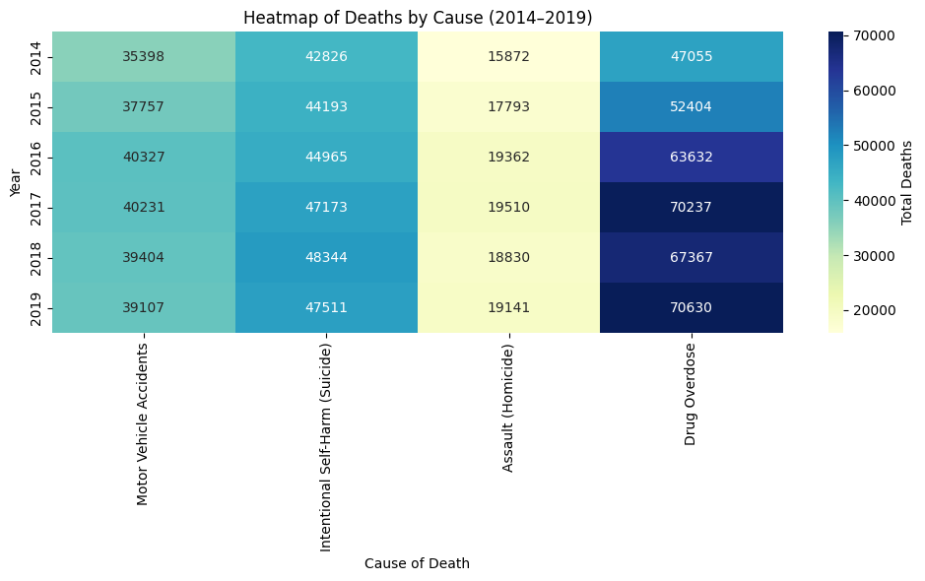
Proportion of Drug-Related Deaths Compared to Other Causes (2014–2018)
Looking at the Drug Overdose column , we see a steep increase in deaths, especially from 2017 onward, indicating the growing opioid crisis in the country."
The Motor Vehicle Accidents column shows a steady decline in the number of deaths over the years, particularly after 2017, suggesting that road safety improvements and laws may be having a positive effect.
The Intentional Self-Harm (Suicide) row remains relatively stable, with a noticeable spike in 2017.
The Assault (Homicide) row shows an overall increase, with 2019 having the highest number of deaths in the period.
Notes:
This heatmap visualizes the total deaths across years (2014–2019) for various causes, such as Motor Vehicle Accidents, Intentional Self-Harm (Suicide), Assault (Homicide), and Drug Overdose.
The rows represent the years from 2014 to 2019, and the columns represent the different causes of death.
Overall, the heatmap clearly shows drug overdoses as the most significant cause of death during the 2014–2019 period, with a continuing rise in fatalities. Addressing this crisis, along with mental health and violence prevention, should be top priorities for public health policy.

Slide 11
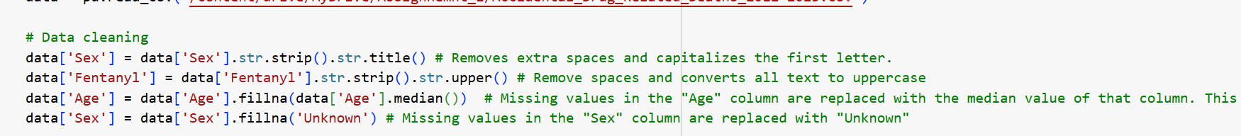
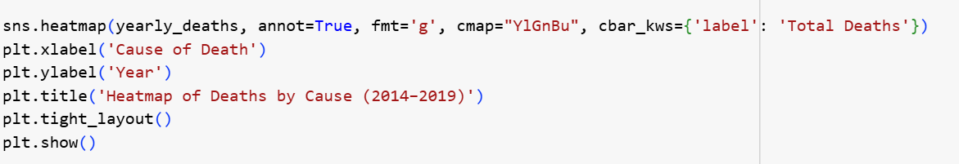
Challenges with the code
1. Challenge: There was Missing values in critical columns like Age and Sex which was potentially hinder to the analysis. Additionally, inconsistent formatting in categorical columns (e.g., Sex with different cases or spaces, Fentanyl with inconsistent naming conventions like 'Yes', 'No', 'Y', 'N’) was causing incorrect grouping or visualizations.
Solution Used:
For Age, missing values were imputed with the median to avoid bias and ensure consistent data for analysis.
For Sex, the values were standardized by removing extra spaces and capitalizing the first letter, which helped in grouping and further analysis.
For Fentanyl, extra spaces were removed, and all text was converted to uppercase to ensure consistency.
2. Challenge : While working with heatmaps in Python, I noticed that large numbers were getting often displayed in scientific notation (e.g., 1e+05 for 100,000).
Solutions Used : To address this, I used fmt='g', which ensures numbers are displayed in full, either as integers or decimals, rather than in scientific notation. This enhances readability and makes it easier to interpret exact values in heatmaps
Notes:
Shows the challenges faced during working with the two data.

Slide 12
Challenges Faced
3.Challenge : The legend was not appearing correctly as the hue="Sex" parameter did not properly match the data.
Solution Used : I used the below plt.legend to ensure that the legend displays correctly with the proper title and categories.
4. Challenge : The drug columns contained inconsistent values (e.g., "Y", "N", "yes", "no"), leading to errors.
Solution Used: By using map({'Y': 1, 'N': 0}), I have ensured that the data was standardized and only had the expected "Y" and "N" values, simplifying the analysis.

