Slide 1


Data Anonymisation CDM Coursework 2
Group 1
Anu, Alex, Emily, Daniel, Mehak
Notes:
To do:
Add modules
Fix refs
Maybe future perspectives and conclusions slides?

Slide 2
background
Task
Anonymise data from iInsureU123 with three groups in mind:
Imperial researchers: investigating the association between the DRD4 variant and travel
Government: investigating the association between the DRD4 variant and educational and geographical background
The public
Avoiding re-identification with k-anonymity
Example: University of Texas combined anonymized Netflix data with public IMDB data to identify people¹
K-anonymity is a privacy model that quantifies the anonymity of subjects in the dataset
Attributes are suppressed/generalized until each row is identical with at least k-1 rows
At worst, an individual can be narrowed down to a group of k individuals
[6]
Notes:
https://www.wired.com/2007/12/why-anonymous-data-sometimes-isnt/

Slide 3
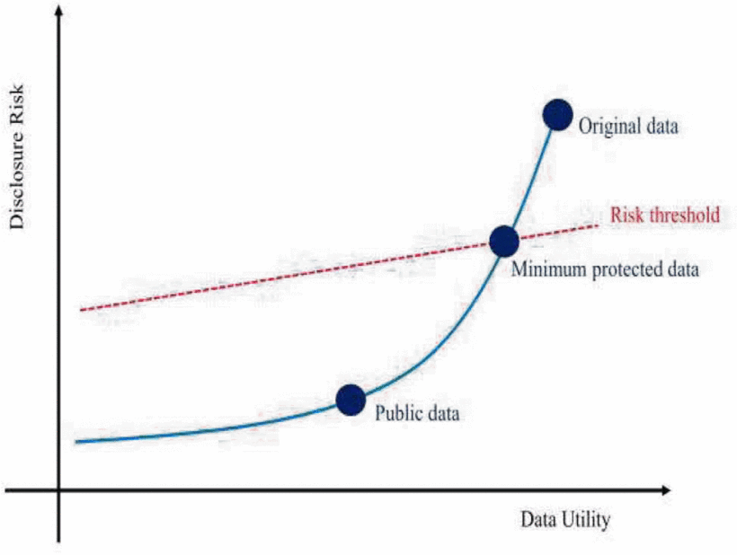
aims
Maximise data anonymisation whilst fulfilling the goals of the Imperial researchers and the Government
Privacy-utility balance
Priority: anonymisation
Obtain greater than or equal to 2-anonymity
Prevent re-identification via other records
Data utility vs disclosure risk
Reproduced from Lee et al. 2018²

Slide 4
Classifying the data³
Direct identifiers
Quasi-identifiers
Sensitive data
Identify someone in combination with other data
Personal information that users may not be comfortable sharing
Identify someone directly
First name
Last name
National insurance
Number
Bank Account Number
Phone Number
Gender
Birthdate
Country of birth
Current country
Postcode
Level of education
Wanderlust gene
Blood group
Phone number
Bank account number
(All can be sensitive depending on context)
Notes:
So we then classified the variables within this dataset.
Within our dataset, the direct identifiers were .. While
Quasi-identifiers that do not identify the subject by themselves, but can be used to identify a subject in combination with other data are the following variables and finally
Sensitive identifiers were : may not identify the users directly, but might be personal information which users may not be comfortable sharing are .. But since this data was anonymised with the intent of being shared publicly, other direct/quasi identfiers such as names, phone number and postcode can be sensitive too.

Slide 5
Methods: forming a unique identifier
Rationale: National Insurance number is a unique direct identifier
Therefore, an optimal target for creating a hashed identifier
Used the one-way cryptographic hash algorithm "SHA-2”
Column named as sample ID
Reference table contains NIN, hashed NIN (sample ID), key, and salt
Reference table
NIN
Hashed NIN
Original dataset
Anonymised dataset
Hash function
Notes:
To create a unique identifier, we used the national insurance number in SHA-2 hash function using a common key (16 bites) and unique salt (16 bites) for each row. This was stored as a column sample ID in the anonymised dataset such that both original and anonymised dataset are linked to a reference table containing the NIN, hashed NIN/sample ID with the key and salt.
Extra notes -
16 * 8 = 128 bits
Converted NIN into the correct format back into the reference table.

Slide 6

Methods: dropped values
First name
Last name
Phone number
Direct identifiers +
Unnecessary for analysis
National insurance number
Bank account number
Blood group
Unnecessary for analysis
Current country
The same for all participants
Notes:
Next, we decided to drop variables that were direct identifiers and unnecessary for the analysis by both parties. We also removed blood group for the same reason and current country since this was common for all individuals in the dataset.

Slide 7
Methods: banding I.
Birthdate
Selected birth year only and banded into 20-year intervals
Time of data collection unknown → age unable to be calculated
Birthdate
05/07/1984
17/06/1997
...
Birth year
1975–1995
1995–2015
...
Education level
phD
Primary
Bachelors
Higher
Secondary
BasicOther
Masters
Other
Notes:
Convert, remove month and day, band (5, 10 then 20) as we checked k-anonymity

Slide 8
Methods: banding ii.
Postcode
Banded using the letters before the first number (”partial postcode")
Banded into region within UK
Mapped postcode to country within the UK (England, Scotland, Northern Ireland, Wales)
Countries further grouped into England and Other (Scotland, NI, Wales) to preserve anonymity
1
2
3
Region
South-West England
Scotland
...
4
Postcode
TQ2 6BE
PA68 9JH
...
Partial postcode
TQ
PA
...
UK country
England
Other
…
Notes:
Reference for postcode to region resource - https://ideal-postcodes.co.uk/guides/postcode-areas
# Reading in postcode_region.csv to map given postcode to countries in the UK - 'England' and 'Other'(includes Wales, Scotland, Northern Ireland)
postcode_dictionary = pd.read_csv('Data/postcode_region.csv')

Slide 9
Methods: banding iii.
2
1
Continent
Africa
Asia
North America
South America
Europe
Antarctica
Oceania
Country
Ireland
Morocco
South Africa
Indonesia
…
Birth country
Banding with ‘GeoPy’ module
Initially banding by continent
Identifying for Oceania + Antarctica
Attempted banding continents further
Still identifying for Oceania + Antarctica
Banding by hemisphere (by matching latitude)
Only way to preserve anonymity
N.B. Two territories were not found by the GeoPy module (Svalbard/Micronesia) and needed to be hard-coded
3
4
Further grouping
Africa
Asia
Americas
Europe
Oceania + Antarctica
Location of birth
Northern Hemisphere
Southern Hemisphere

Slide 10
Methods: data perturbation
Rationale:
Modifies values by a certain fraction
Protects original sensitive data whilst maintaining population-level statistical properties
Method: add randomized number (chosen from normal distribution with mean 0, SD 1)
data['weight’] + np.random.normal(0,1,1000)*5
Gaussian noise added to the following variables:
Weight
Height
Average alcohol intake per week
Average cigarettes smoked per week
Number of countries visited
Notes:
https://aircconline.com/ijdkp/V4N3/4314ijdkp03.pdf

Slide 11
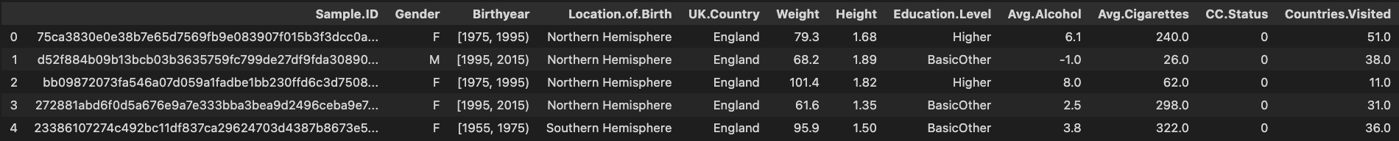
Final dataset
given_name
surname
gender
birthdate
country_of_birth
current_country
phone_number
NIN
bank_account
cc_status
weight
height
blood_group
avg_n_drinks
avg_n_cigret
education_level
n_countries

Slide 12
Calculation of k-anonymity
Anonymity can be breached by linking together quasi-identifiers between datasets
If K > 1, definite identification cannot occur
Quasi-identifiers:
Gender
Birth year
Location of birth
Education level
UK Country
Using pandas.groupby () to count the
number of individuals in each permutation.
Code:
Final
K = 2
# Checking k-anonymity for quasi-identifiers
df_count = anon_data.groupby(['Gender', 'Birthyear', 'Location.of.Birth', 'UK.Country', 'Education.Level']).size().reset_index(name = 'Count')
# Print rows where k-anonymity is 1
print(df_count[df_count['Count']==1])
[5]

Slide 13

Data encryption and data sharing
Anonymised dataset encrypted with AES (Advanced Encryption Standard)
AES is a symmetric type of encryption, as it uses the same key to both encrypt and decrypt data.
Performed with the 'Fernet' module under the 'Cryptography' package
AES in CBC (block cipher) mode with a 128-bit key
Wrapper function 'encrypt' outputs encrypted file and key to specified destination
Wrapper function 'decrypt' outputs decrypted file using key from specified location

Slide 14



limitations
Compromises utility, e.g., hemisphere
Scalability for large datasets
Data perturbation
k-anonymity
2
4
K
1
3
Wide banding
Use of online API (hemisphere)
Underlying signals hidden
Negative values
Ideally k-anonymity > 2

Slide 15
CONCLUSIONS
Conclusions
Anonymizing data can be time-consuming and labour-intensive
Striking a good balance between privacy and utility is challenging
Individuals in low-population groups are particularly susceptible
Future work
Larger datasets are preferrable
Could have created separate datasets for Imperial/Government per different requirements
Different degrees of anonymisation depending on need
Novel de-anonymization techniques are being researched⁴
Keeping up-to-date with anonymisation procedures is crucial

Slide 16
References
A. Narayanan and V. Shmatikov, "Robust De-anonymization of Large Sparse Datasets," 2008 IEEE Symposium on Security and Privacy (sp 2008), 2008, pp. 111-125, doi: 10.1109/SP.2008.33.
Y. J. Lee and K. H. Lee, "What are the optimum quasi-identifiers to re-identify medical records?," 2018 20th International Conference on Advanced Communication Technology (ICACT), 2018, pp. 1025-1033, doi: 10.23919/ICACT.2018.8323926.
O’Keefe, C.M. et al. (2016) “Anonymization for outputs of Population Health and health services research conducted via an online data center,” Journal of the American Medical Informatics Association, 24(3), pp. 544–549. Available at: https://doi.org/10.1093/jamia/ocw152.
Rocher, L., Hendrickx, J.M. & de Montjoye, YA. Estimating the success of re-identifications in incomplete datasets using generative models. Nat Commun 10, 3069 (2019). https://doi.org/10.1038/s41467-019-10933-3
Introduction to K-anonymity: Python (no date) campus.datacamp.com. Available at: https://campus.datacamp.com/courses/data-privacy-and-anonymization-in-python/more-on-privacy-preserving-techniques?ex=7 (Accessed: December 14, 2022).
Devane, H. (2022) Everything you need to know about K-anonymity, Immuta. Available at: https://www.immuta.com/blog/k-anonymity-everything-you-need-to-know-2021-guide/ (Accessed: December 15, 2022).

