Slide 1
Parallel K-Means
Issues and proposed improvements:
Correctness
CUDA maxDist race condition
Possible CUDA optimizations
MPI initialization
MPI Safety
Pragma correctness

Slide 2
Correctness
The correctness of the proposed implementations is evaluated using the correctness.py script.
We see that OpenMP + MPI version has a 100% accuracy compared to the sequential version, while CUDA only stops at 90%
This is probably because of float precision differences between GPU and CPU, in particular in the difference between results of sqrtf() on CPU and GPU.

Slide 3
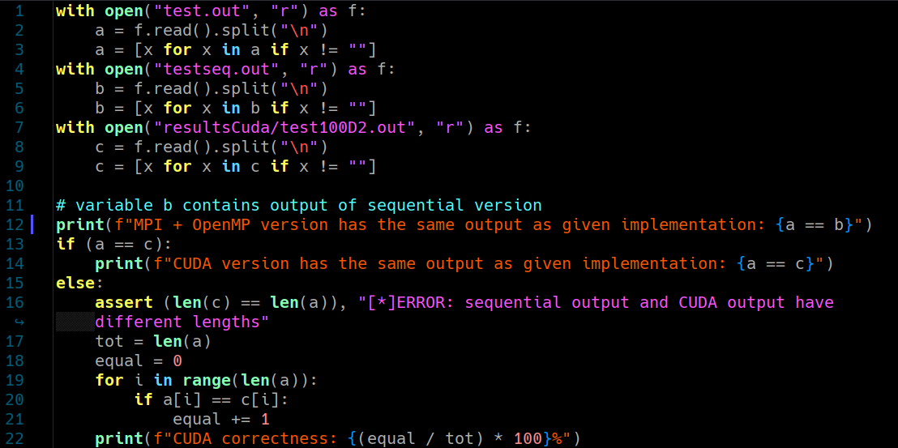

Slide 4
CUDA maxDist Issue
There is a race condition between threads that update the variable maxDist in one of the kernels of the CUDA version. This is due to the fact that CUDA does not have a native implementation that performs the atomic version of the max operation for floating point numbers.
There are many possible solutions to this problem, while arguably the best solution would be to implement the operation yourself.

Slide 5
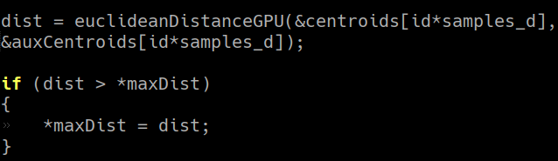
maxDist Issue
In our code we ignore this problem on purpose, based on the assumption that it does not cause calculation errors and that the worst it could do would be to slow down the program by making it perform more iterations.
However, it would be an issue if the precision of our application was a major concern.

Slide 6
Possible CUDA optimizations
Possible code optimizations could be:
Aggregating kernels: recalculateCentroidsStep2GPU and Step3 could just be one kernel.
Move the entire loop logic to one __global__ kernel, and handle the rest with __device__ functions.
Implement another algorithm that is more suited to a GPU architecture.

Slide 7

MPI initialization
MPI is initialized using MPI_Init(NULL, NULL), but it would be more correct to use the following initialization:
Like this we correctly initialize MPI to MPI_THREAD_FUNNELED in order to allow only the main threads to call MPI functions.

Slide 8
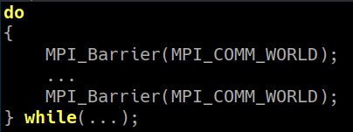
MPI safety
We do not actively check that ranks in MPI are always on the same iteration of the loop.
There are collective operations that mitigate heavily the possible occurrence of this issue, but a more correct approach would be to enclose the logic between two barriers.

Slide 9
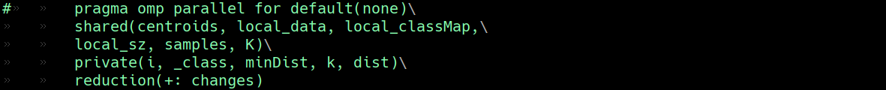
Pragma correctness
Some pragmas have redundancy issues. The first pragma should be slightly changed like so to be more correct:
default(none) needs to be specified if we want to use shared() and private() clauses. Also, atomic addition on the variable *changes* can be transformed in a reduction.

Slide 10
Thank you!

