Slide 1
GRAPH Data Structure
Subject:
Data Structures and Files
Guided By:
Ms. Swati Patil
Group Members:
232069 Namrata Thakur
232071 Riddhi Pawar
232072 Nilima Patole
232074 Pranav Wagh

Slide 2
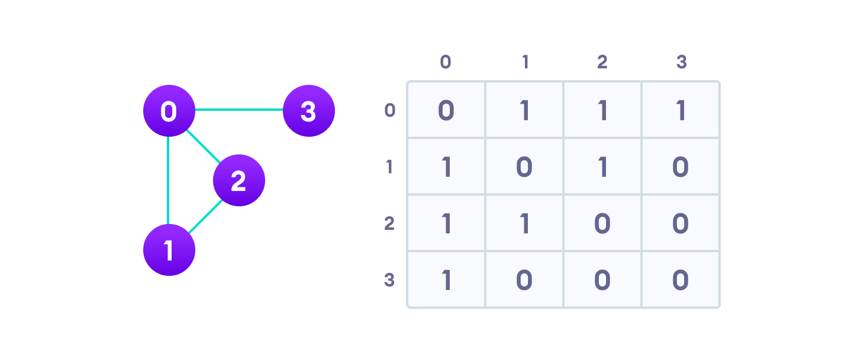
What is GRAPH?
A Graph is a non-linear data structure consisting of nodes and edges. The nodes are sometimes also referred to as vertices and the edges are lines or arcs that connect any two nodes in the graph. More formally a Graph can be defined as,
A Graph consists of a finite set of vertices(or nodes) and set of Edges which connect a pair of nodes.
Graph is a data structure (V, E) that consists of
A collection of vertices V
A collection of edges E, represented as ordered pairs of vertices (u,v)
In this graph,
V = {0, 1, 2, 3}
E = {(0,1), (0,2), (0,3), (1,2)}
G = {V, E}

Slide 3
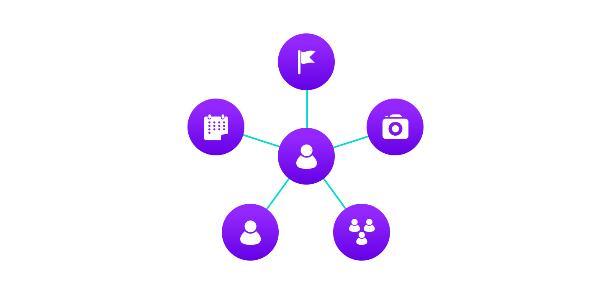
Example
Facebook uses a graph data structure to store its data.
On Facebook, everything is a node.
That includes User, Photo, Album, Event, Group, Page, Comment, Story, Video, Link, Note...anything that has data is a node.
Every relationship is an edge from one node to another. Whether you post a photo, join a group, like a page, etc., a new edge is created for that relationship.
It means, all of Facebook is a collection of these nodes and edges.

Slide 4
Graph Terminologies
Path
It is a sequence of alternating edges such that each successive vertex is connected by the edge.
Spanning Tree
Spanning tree is a spanning subgraph that is also a tree. Methods to find the spanning Tree:
1. Cutting- down method
Start choosing any cycle in Graph .
Remove one of cycle's edges.
Repeat this process until there are no cycles left.
2. Building - up method
Select edges of graph one at a time. In such a way that there are no cycles are created.
Forest
A forest is an undirected graph in which any two vertices are connected by at most one path.

Slide 5

Graph Representations
Adjacency Matrix
An adjacency matrix is a 2D array of V x V vertices. Each row and column represent a vertex.
Time complexity: O(1)
Space complexity: O(V²)

Slide 6
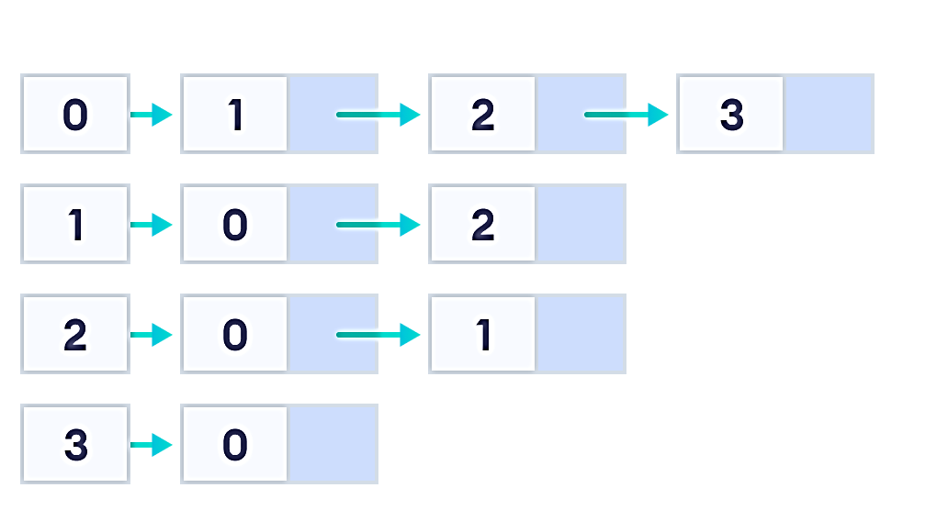
Graph Representation
2. Adjacency List
An adjacency list represents a graph as an array of linked lists.
Time complexity: O(V)
Space complexity: O(V+E)

Slide 7
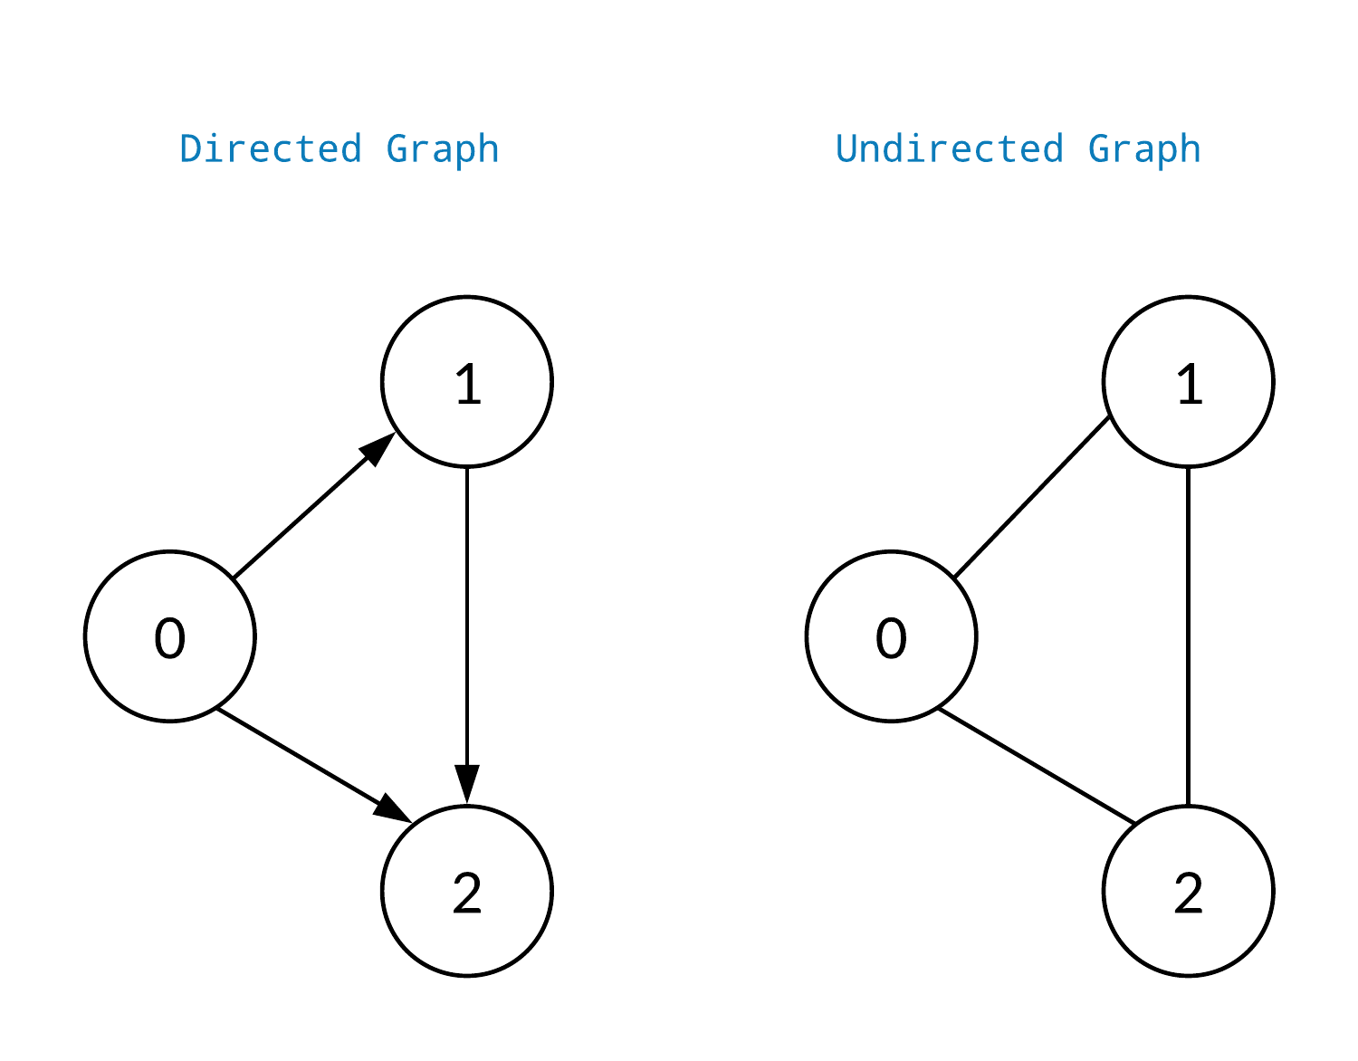
Graph Types
1. Undirected Graphs:
These graphs have edges that do not have a direction. The edges indicate a two-way relationship.
Each edge can be traversed in both directions.

Slide 8
Graph Types
2. Directed graphs:
These graphs have edges with direction.
The edges indicate a one-way relationship.
Each edge can only be traversed in a single direction.

Slide 9
Graph Operations
The most common graph operations are:
Check if the element is present in the graph
Graph Traversal
Add elements to graph
Finding the path from one vertex to another

Slide 10
Breadth First Search (BFS)
The algorithm works as follows:
Start by putting any one of the graph's vertices at the back of a queue.
Take the front item of the queue and add it to the visited list.
Create a list of that vertex's adjacent nodes. Add the ones which aren't in the visited list to the back of the queue.
Keep repeating steps 2 and 3 until the queue is empty.
BFS Algorithm Complexity
The time complexity of the BFS algorithm is represented in the form of O(V + E), where V is the number of nodes and E is the number of edges.
The space complexity of the algorithm is O(W).
BFS Algorithm Applications
To build index by search index
For GPS navigation
Path finding algorithms
In Ford-Fulkerson algorithm to find maximum flow in a network
Cycle detection in an undirected graph
In minimum spanning tree

Slide 11
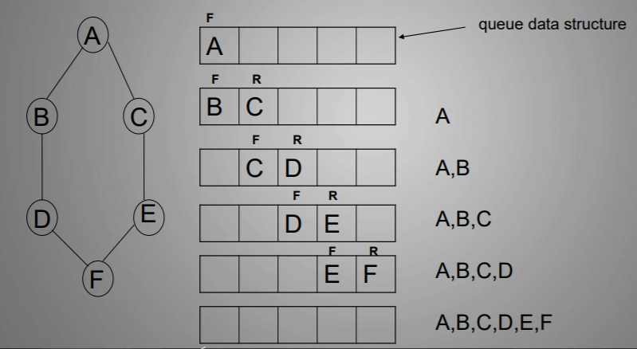
Working of BFS

Slide 12
Depth First Search (DFS)
The DFS algorithm works as follows:
Start by putting any one of the graph's vertices on top of a stack.
Take the top item of the stack and add it to the visited list.
Create a list of that vertex's adjacent nodes. Add the ones which aren't in the visited list to the top of the stack.
Keep repeating steps 2 and 3 until the stack is empty.
Complexity of Depth First Search
The time complexity of the DFS algorithm is represented in the form of O(V + E), where V is the number of nodes and E is the number of edges.
The space complexity of the algorithm is O(H).
Application of DFS Algorithm
For finding the path
To test if the graph is bipartite
For finding the strongly connected components of a graph
For detecting cycles in a graph

Slide 13
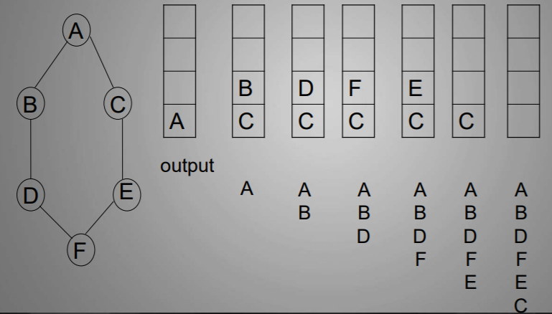
Working of DFS

Slide 14

Demonstration
Friends Circle App:
Create Account
Login
Connect with friends
See friends activities

Slide 15
Thank You

