Slide 1

GAME THEORY
Role of Discrete Mathematics in Business and Economics
Subject: Discrete Mathematics
Guided By: Mr. Futane Sir
Presented By: 232071 Riddhi Pawar

Slide 2

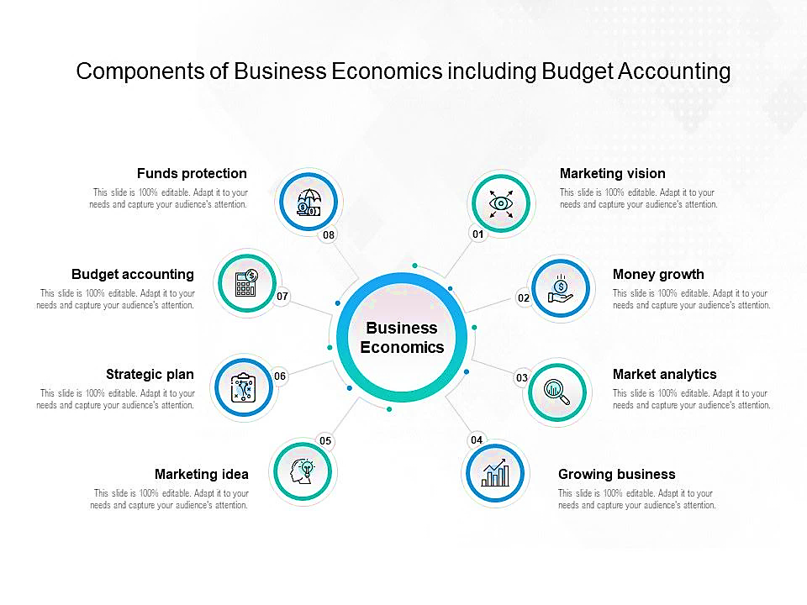
Business Economics

Slide 3
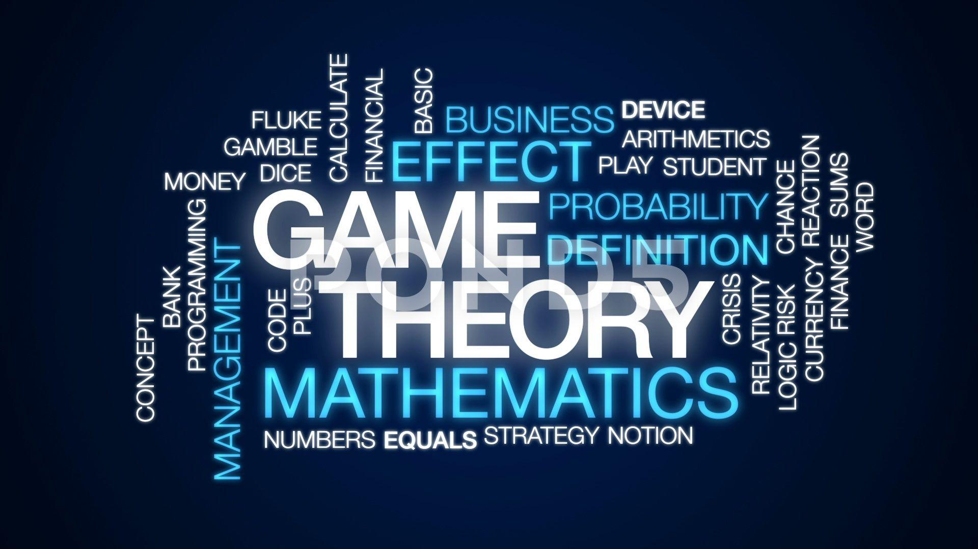
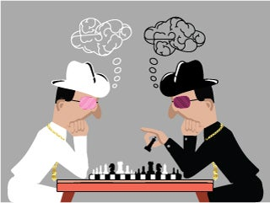
Game Theory

Slide 4

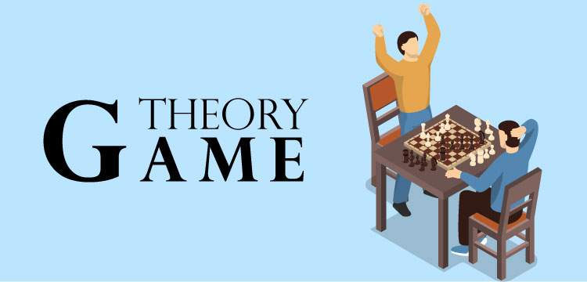

Game & Players
- Rules
- Pay-offs
- Strategies

Slide 5
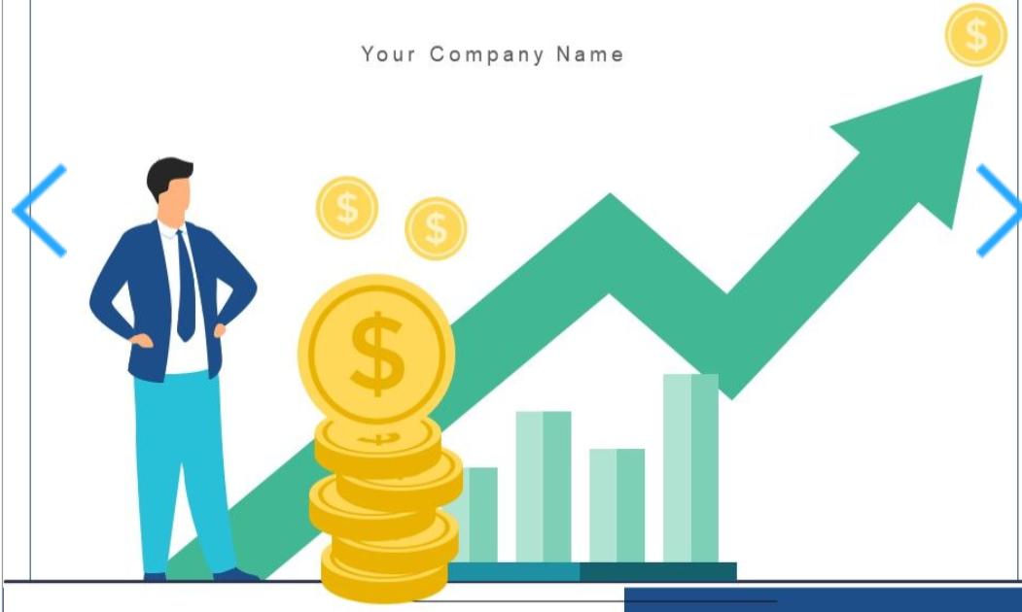
Game Theory in Business Economics
Keep existing products
or Develop new ones ?

Slide 6
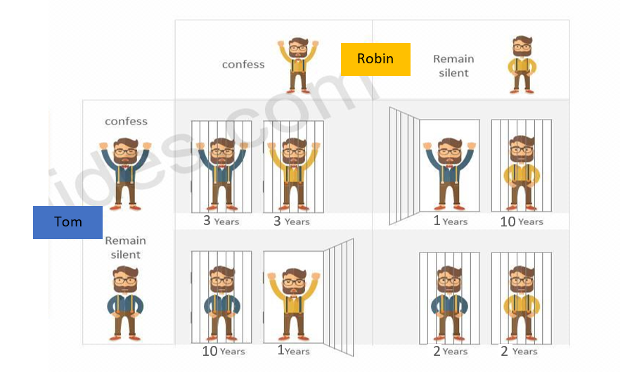
The Prisoner’s Dilemma

Slide 7
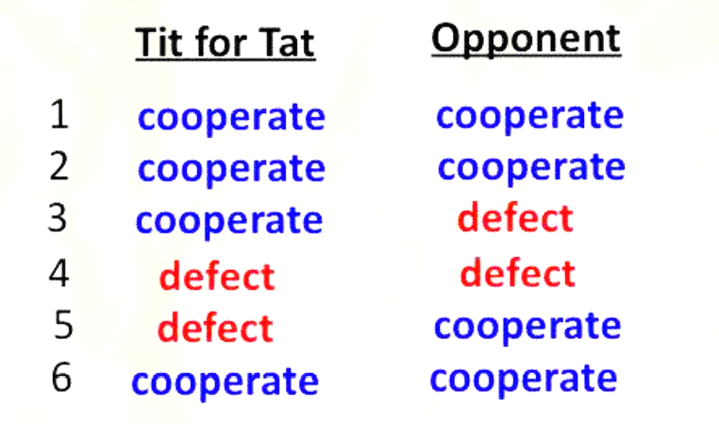

Tit for Tat Strategy
$

Slide 8
THANK YOU !

