Slide 1
ARRAY
Subject :
Fundamental Data Structure
Group members :
Nilima Patole 232072
Riddhi Pawar 232071
Namrata Thakur 232069

Slide 2
Overview
What is Array?
Advantages and Disadvantages
Applications of Arrays
Types of Array
Array Operations
Array Real Life Example

Slide 3
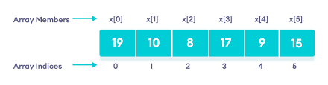
Introduction
Array is a collection of similar data items stored at contiguous memory locations.
It’s elements can be accessed randomly using indices, which starts from 0.
The idea of an array is to represent many instances in one variable.

Slide 4
Advantages
Random access of elements using array index.
Less code.
Traversal through the array becomes easy using loop.
Searching becomes easy.
2D Array is used to represent matrices.

Slide 5
Disadvantages
Array is static. It has fixed size.
Insertion and deletion are costly, as it needs shifting operations.
It leads to wastage of memory space.

Slide 6
Applications
For sorting data elements
To perform matrix operations
For CPU scheduling
To implement other data structures like Stack, Queue, Heap, Hash table etc.

Slide 7
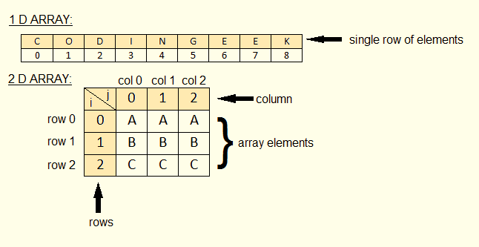
Types of Array
One dimensional array
Multi-dimensional array

Slide 8
Array Operations
Traversing: It prints all the array elements one after another.
Inserting: It adds an element at given index.
Deleting: It is used to delete an element at given index.
Searching: It searches for an element(s) using given index or by value.
Updating: It is used to update an element at given index.

Slide 9
Vector
Vector is a class in C++ STL that represents dynamic array.
Vectors have many in-built functions like,
- begin()
- size()
- capacity()
- pushback()
- erase()

Slide 10
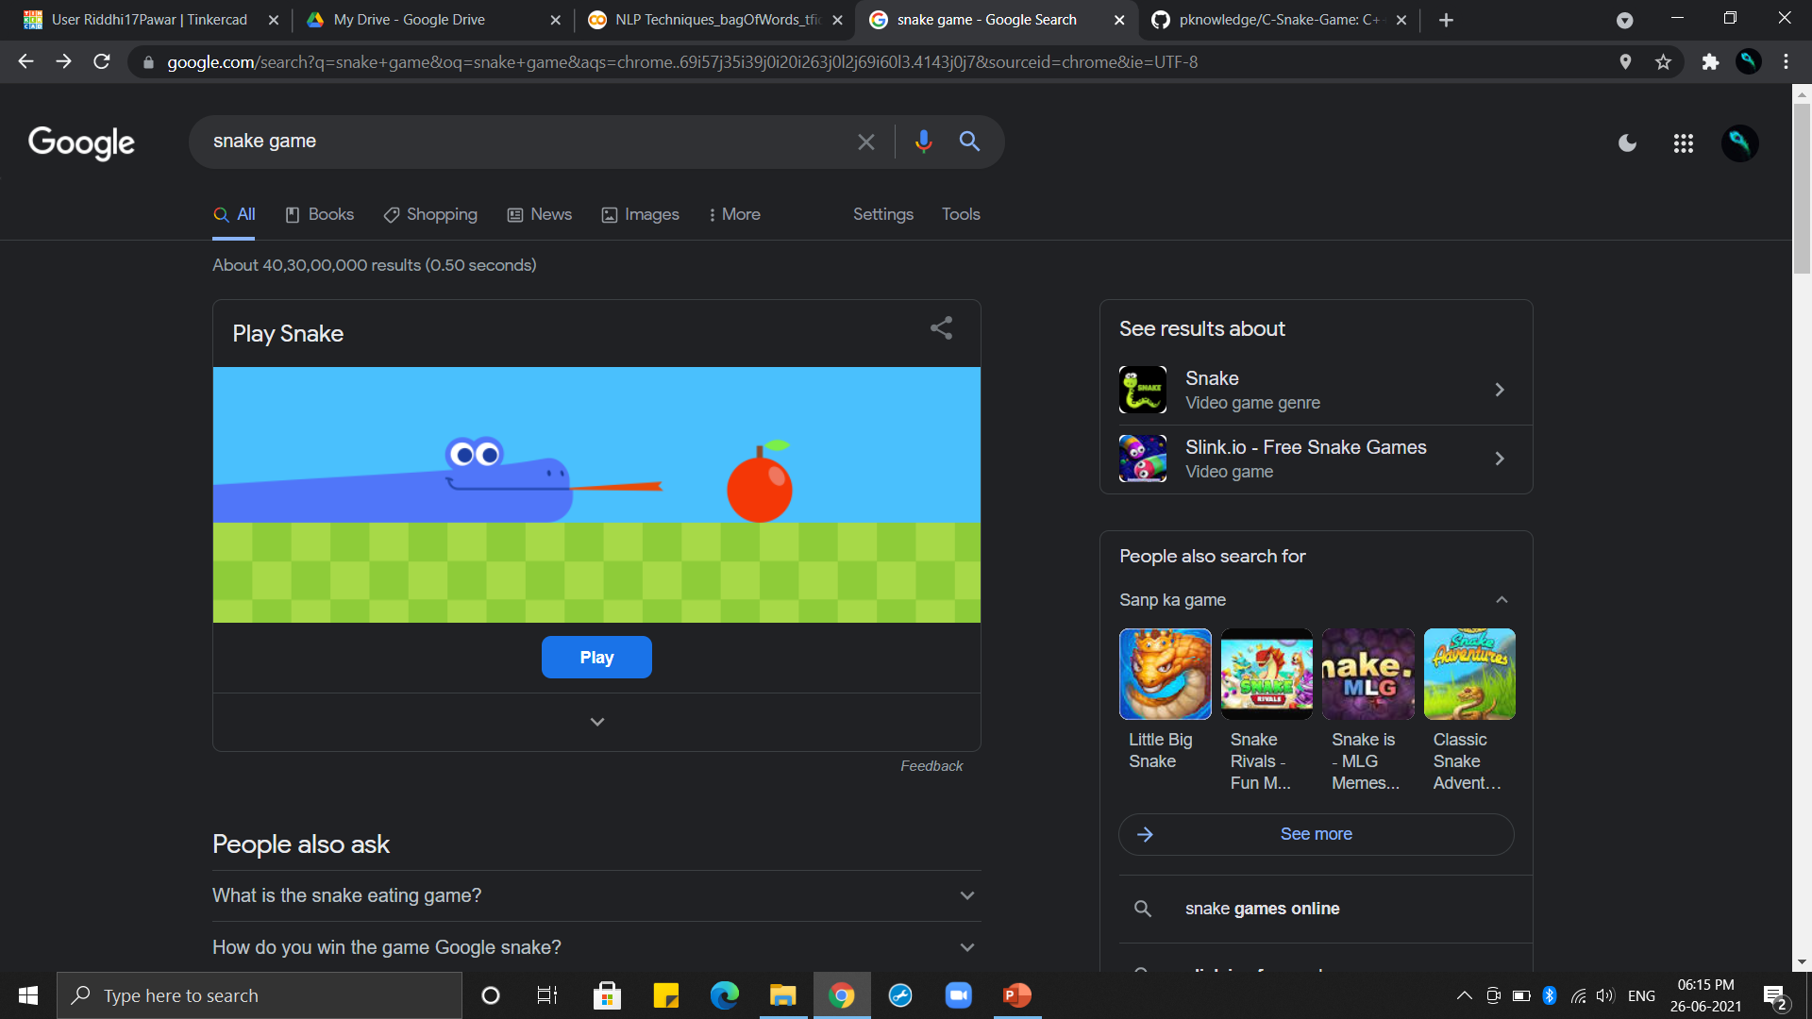
Demonstration: Snake Game
Time complexity: O(w*h) ,board width: 50, height: 25
Space complexity: O(n) ,n is length of snake

