Slide 1
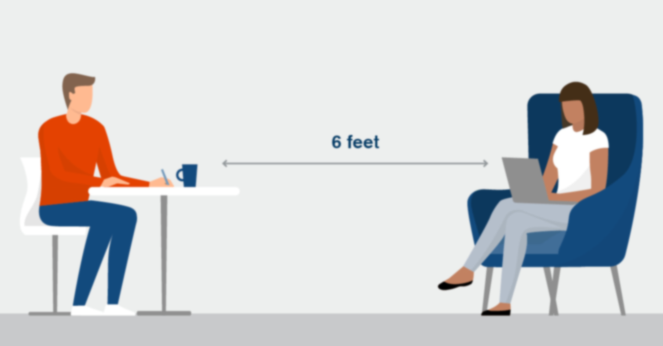

Social Distancing Detector System
Subject: Analog and Digital electronics
Guided By: Mr. Wawage Sir
Group Members:
232069 Namrata Thakur
232071 Riddhi Pawar
232072 Nilima Patole

Slide 2
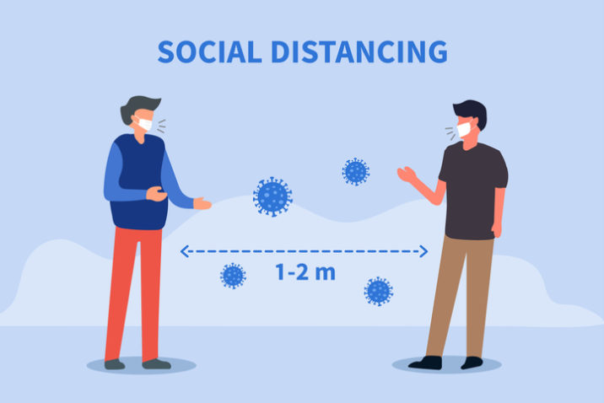
1. Introduction
The whole World is fighting with COVID-19 virus, it is our duty safeguard ourselves as well as our families. As we know, COVID-19 spreads mainly among people who are in close contact (within about 6 feet) for a prolonged period.
As we know Social Distancing plays vital role to slow down spread of COVID-19, we have made a gadget to help ensure it. Our social distancing alarm will detect if someone comes closer to you i.e within 6 feet distance.

Slide 3
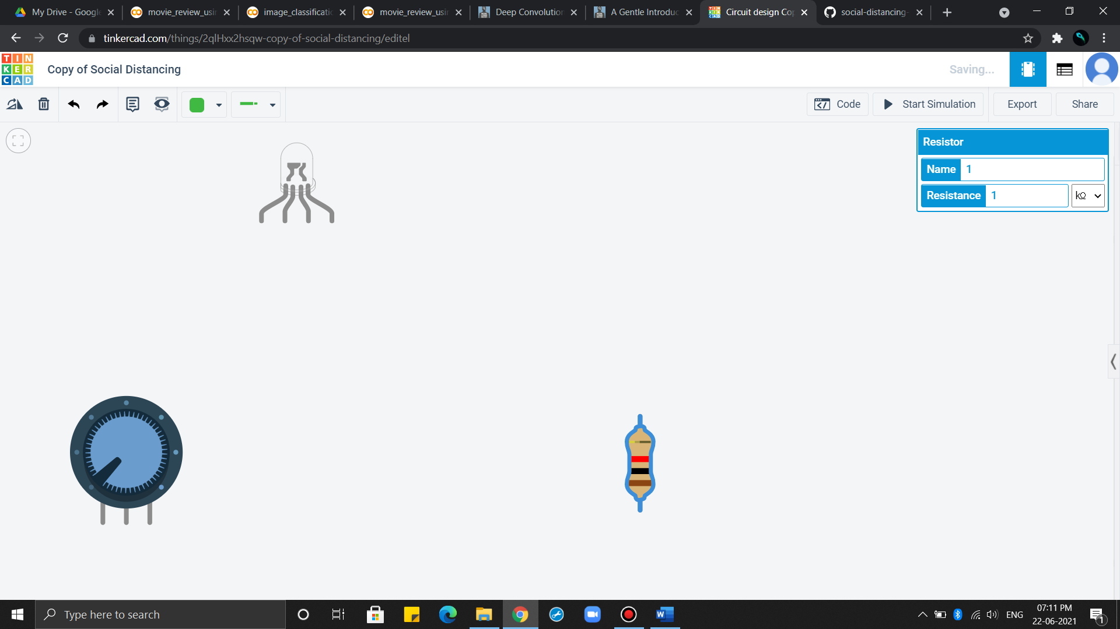
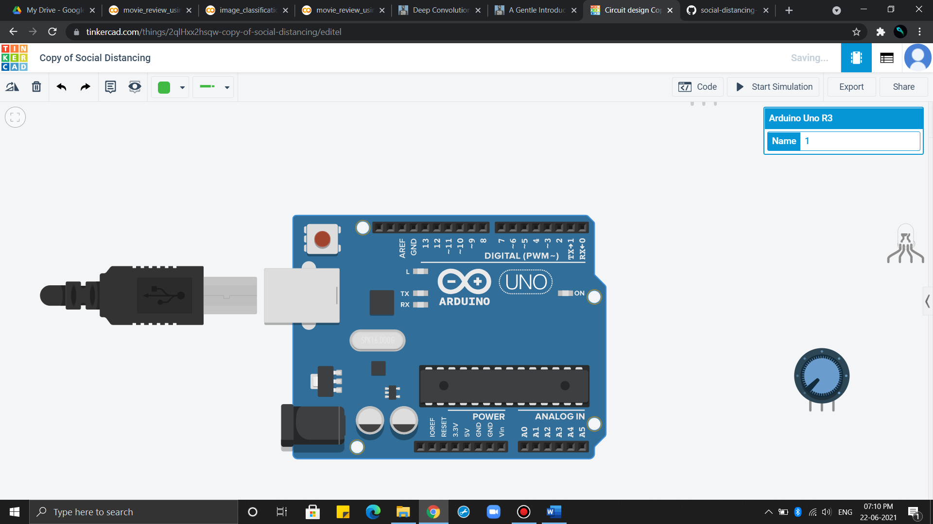
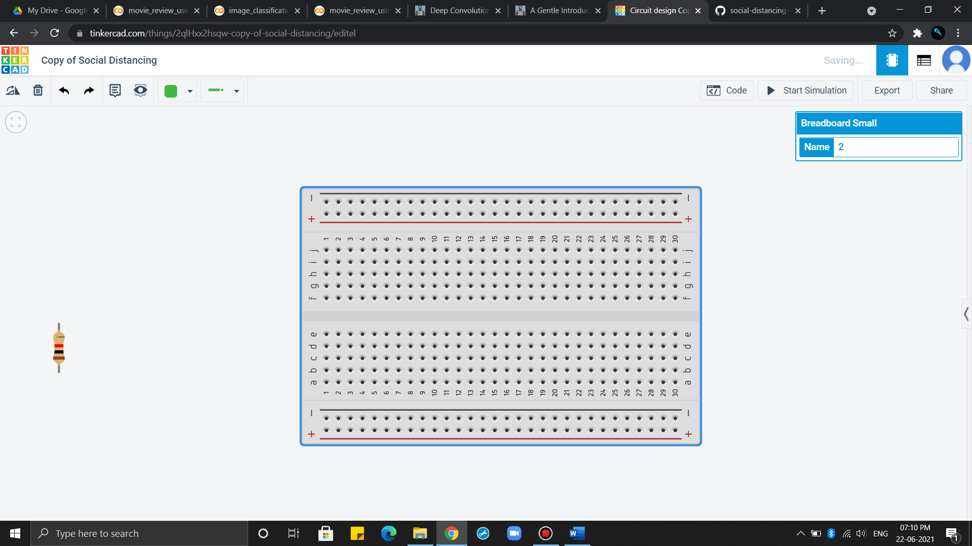
2. Components
Resistor
Potentiometer
Arduino Uno R3
LED RGB
Breadboard Small

Slide 4
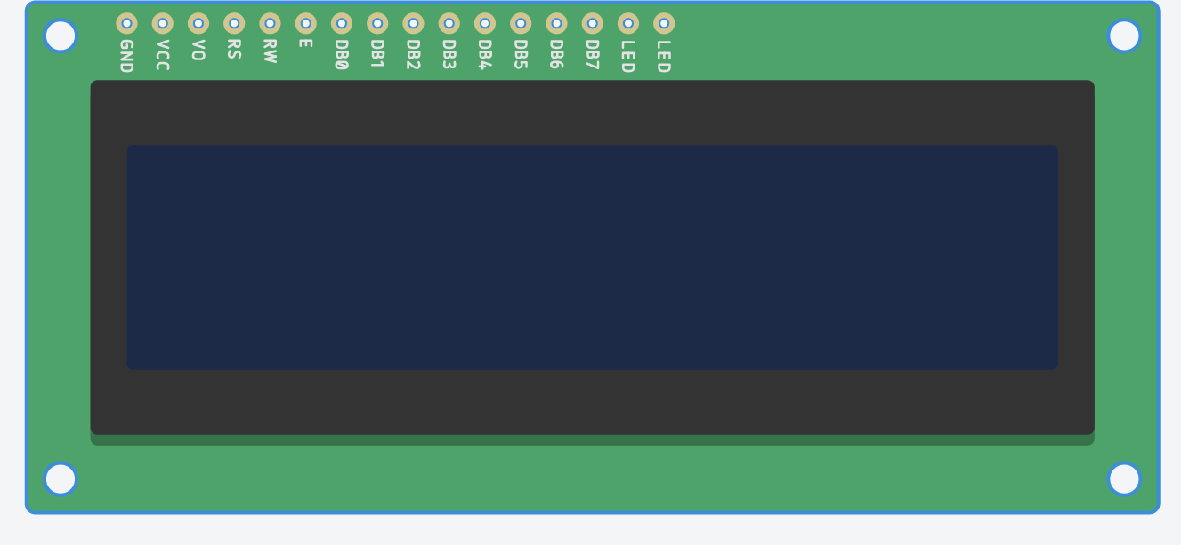
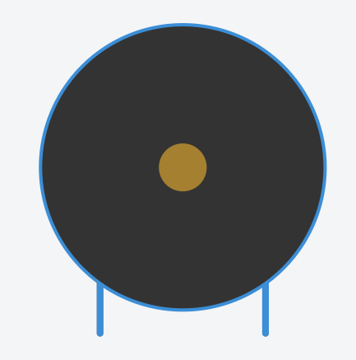
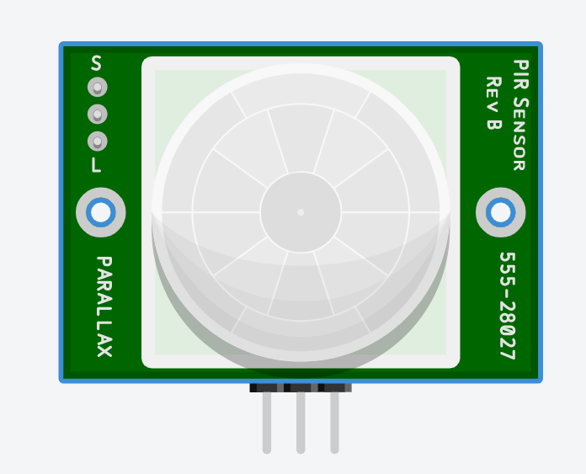
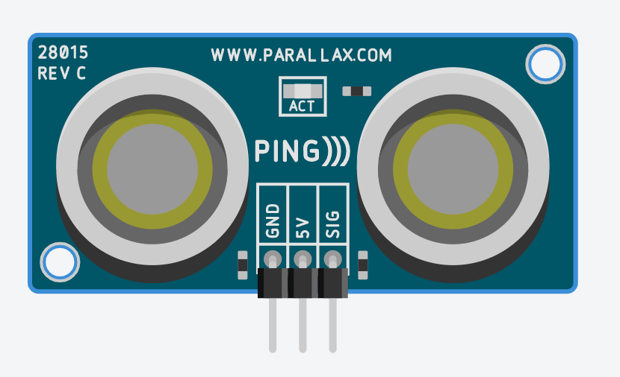
2. Components
Piezo
LCD 16x2
PIR Sensor
Ultrasonic Distance Sensor

Slide 5
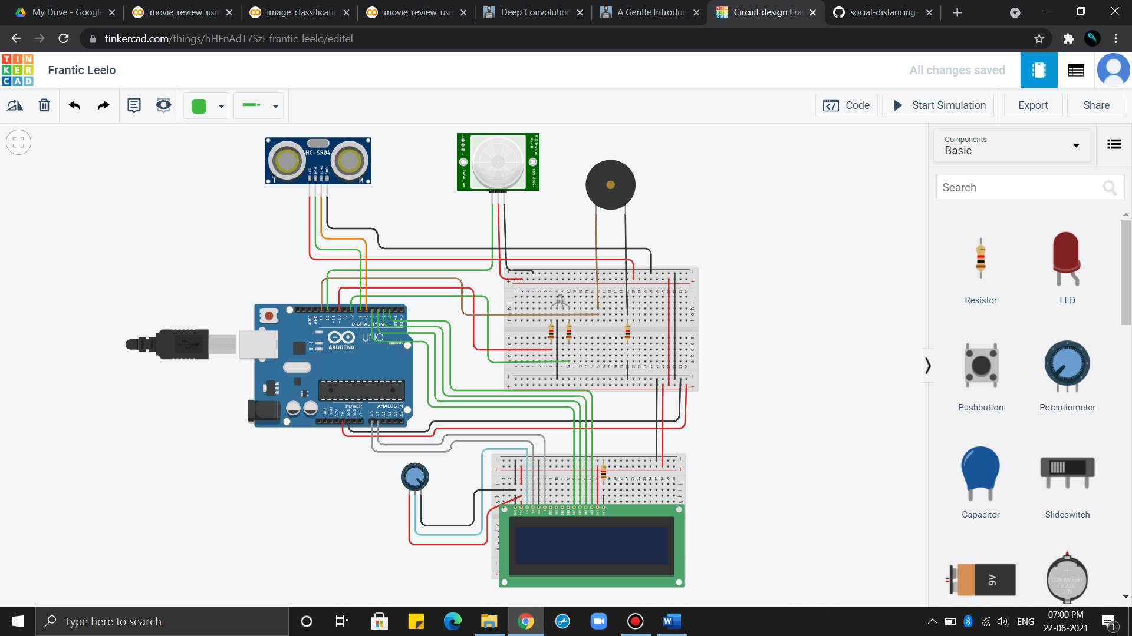
3. Circuit

Slide 6
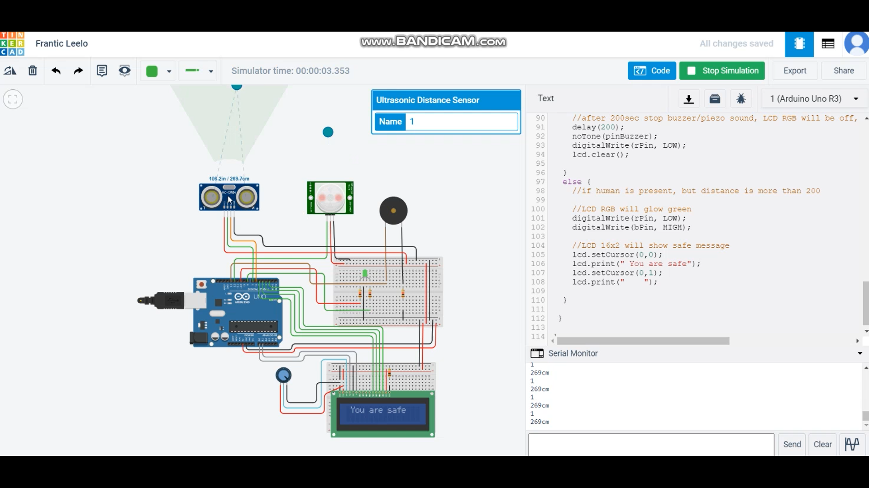
4. Working
( when moving object is at distance more than 200 )

Slide 7

4. Working
( when moving object is at distance less than 200 )

Slide 8

5. Conclusion
We analysed the circuit components and its simulation for Social Distancing Detector system using Arduino. This will prove quite helpful in ensuring social distancing in COVID-19 situation, and safeguard public health.

Slide 9


