Slide 1
Optical Analysis of different glass types and wave aberrations
Ridhesh goti
University : Pandit deendayal petroleum university
Course : B.Sc. Physics (hons.) 3rd year

Slide 2
Objective
Find the dispersion for different glass types
Thermal analysis of glass types and how temperature affects the refractive index
Verification of the calculated data with reference data
Modelling of different optical systems with ray tracing method and analysing the different wave aberrations.

Slide 3
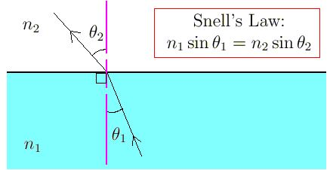
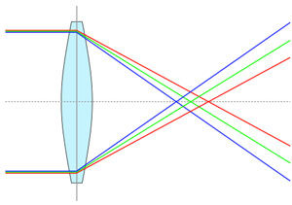
Basics of dispersion
Refractive index depends on the wavelength of the electromagnetic wave
Due to dispersion, different wavelengths bend with different angle after refraction
Dispersion mainly depends on the glass composition and surrounding conditions.

Slide 4

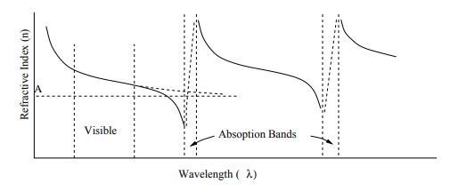


Mathematics behind dispersion
General dispersion relation is given by cauchy’s formula,
This Normal behaviour is valid only for certain wavelength range. Outside the range there is absorption region where refractive has not valid value.
In Anomalous dispersion, There are many absorption region and with almost same repetition of pattern.
Light’s electric field interacts with medium. Due to that refractive index is given by,
Sellmeier equation
Solution come from using forced oscillator and dielectric theory
General equation for medium with multiple absorption region

Slide 5

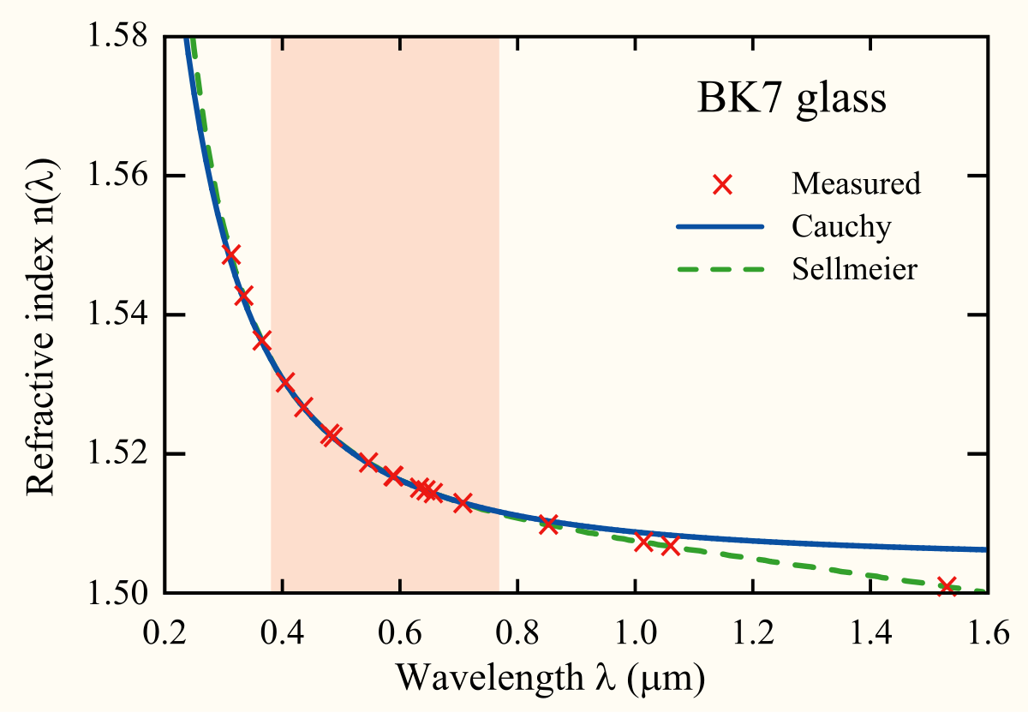
Measurement of dispersion and trends
Abbe number : Low abbe number means that dispersion is high and vice versa.
nD, nF, nC are refractive index of material at wavelengths of Fraunhofer D,F and C lines(589.3 nm, 486.1 nm, 656.3 nm respectively).
Flint glass has abbe number V < 50 and crown glass has V > 50.
General relation trends :
(1) Refractive index of substance increases with decreasing of wavelength
(2) The rate of change becomes greater at shorter wavelength.

Slide 6
ZEMAX catalogues
There are 13 dispersion formulas for different glass types. ZEMAX catalogues provide the experimentally verified constants values in catalogues (ohara, sumita, schott).
How to read catalogues (schott – N-BK7)
NM N-BK7 2 517642.251 1.5168 64.17 0 1
GC step 0.5 available
ED 7.100000 8.300000 2.510000 -0.000900 0
CD 1.039612120E+00 6.000698670E-03 2.317923440E-01 2.001791440E-02
1.010469450E+00 1.035606530E+02 0.000000000E+00 0.000000000E+00
TD 1.860000E-06 1.310000E-08 -1.370000E-11 4.340000E-07 6.270000E-10
1.700000E-01 2.000000E+01
OD 1.0000 1.0000 0.0000 1.0000 2.3000 2.3000
LD 3.00000E-01 2.50000E+00
IT 3.00000E-01 5.00000E-02 2.50000E+01
IT 3.10000E-01 2.50000E-01 2.50000E+01
...................................................................

Slide 7
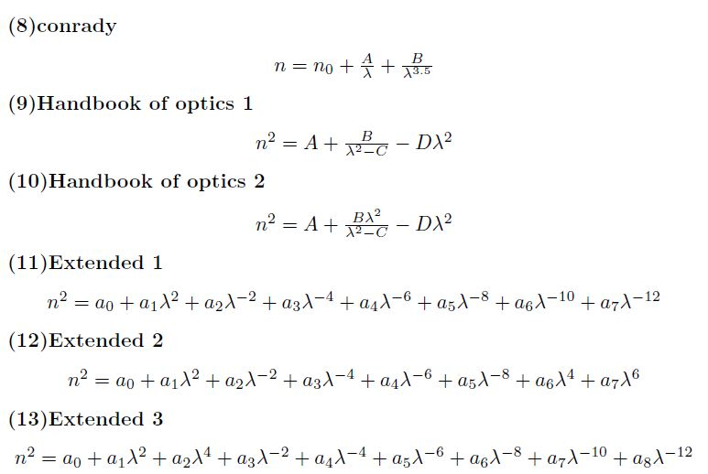
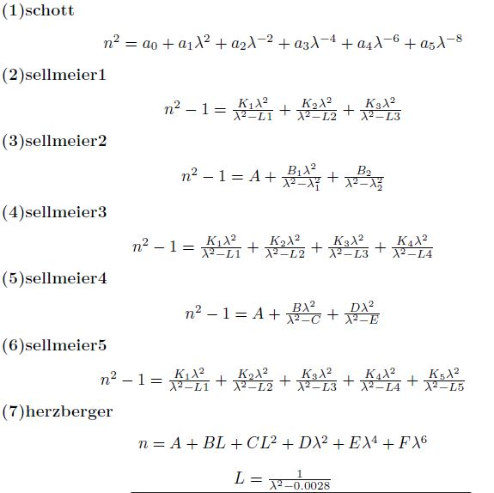

Slide 8
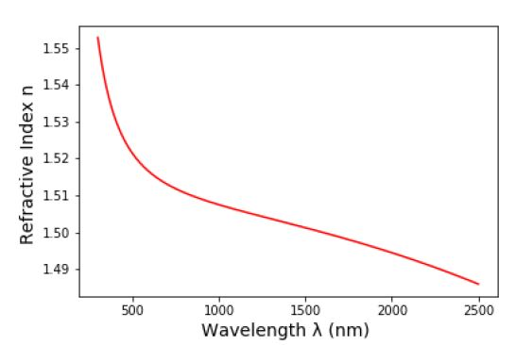
Dispersion data for N-BK7 glass
Glass name : N-BK7
Wavelength range : 300 nm to 2500 nm
Reference temperature : 20 C
Pressure : 101325 Pa
Abbe number : 64.13319920721142
No | Wavelength (nm) | Refractive index
1 | 400 | 1.5308485382492993
2 | 1060 | 1.5066875568966998
3 | 2000 | 1.4945016229008292

Slide 9
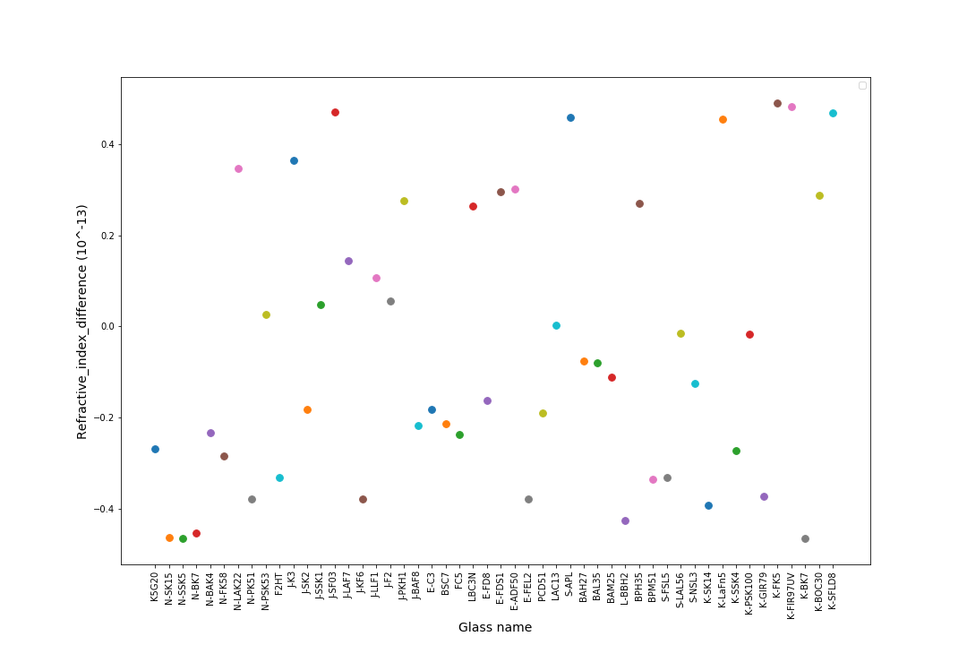
Verification of data

Slide 10
Thermal Analysis

Slide 11
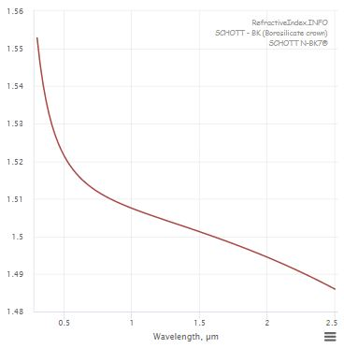
From reference data

Slide 12
https://www.math.ubc.ca/~cass/courses/m309-01a/chu/Fundamentals/snell.htm
https://en.wikipedia.org/wiki/Cauchy%27s_equation
https://refractiveindex.info/?shelf=glass&book=SCHOTT-BK&page=N-BK7

