Slide 1
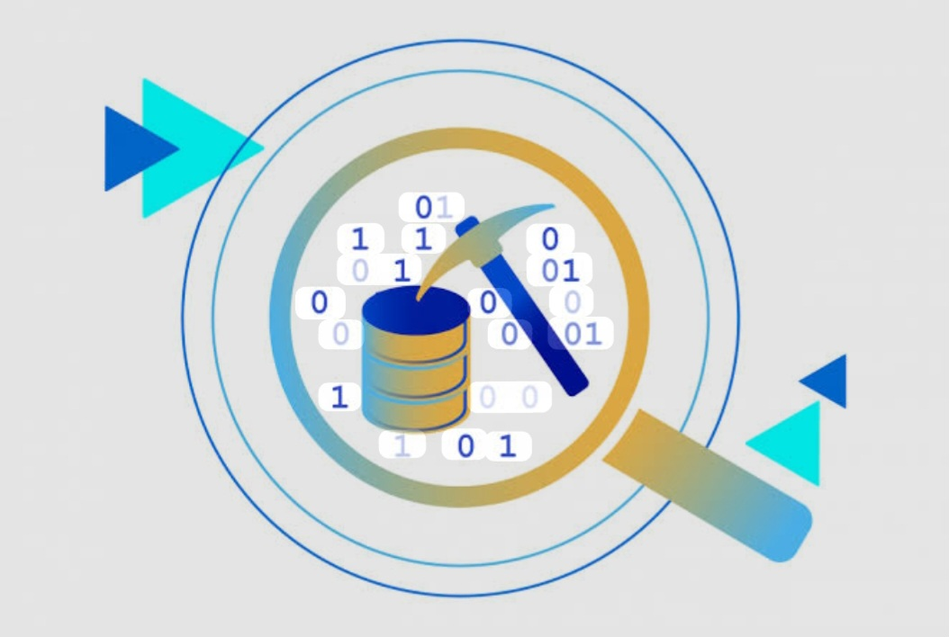
Data Science – Fall 2025/2026
INTRODUCTION TO DATA MINING
Lecture 1 - Introduction

Slide 2
 What is Data Mining ?
 What is Machine Learning ?
 KDD Process
 Database
Basic Statistical Description of Data
Data Mining Resources

Slide 3
 What is Data Mining ?
 What is Machine Learning ?
 KDD Process
 Database
Basic Statistical Description of Data
Data Mining Resources

Slide 4
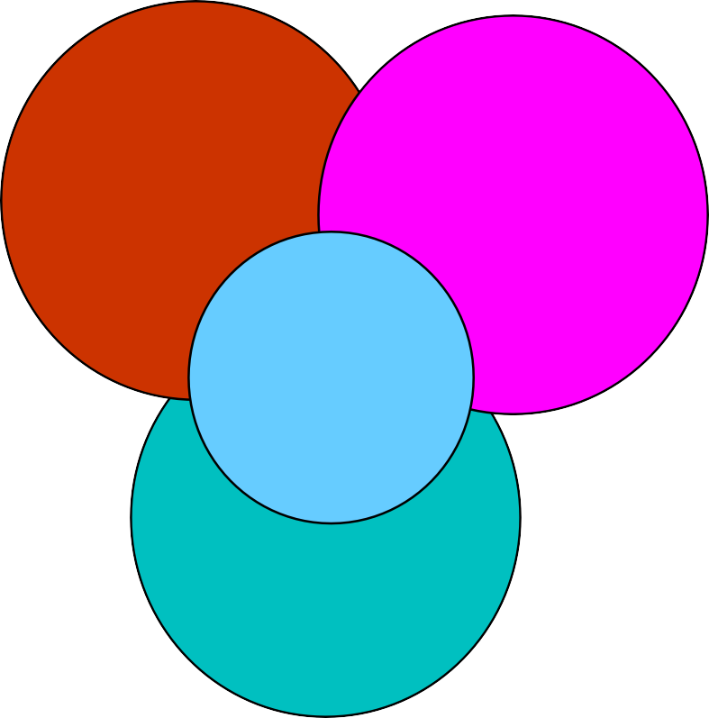
What is DM ?
Data Mining (DM), also known as Knowledge Discovery in Databases (KDD), is the process of extracting meaningful patterns, trends, and insights from large datasets.
DM combines techniques from fields like machine learning, statistics, and database systems to enable data-driven decision-making
Machine Learning/
Pattern Recognition
Statistics
“ The ultimate goal of Data Mining is to
turn data into knowledge and
knowledge into action. ”
Data Mining
Database
systems
“ It is estimated that to extract enough gold to make a single gold ring, you’d need to sort through around 26 tons of rock and other stuff. ”

Slide 5
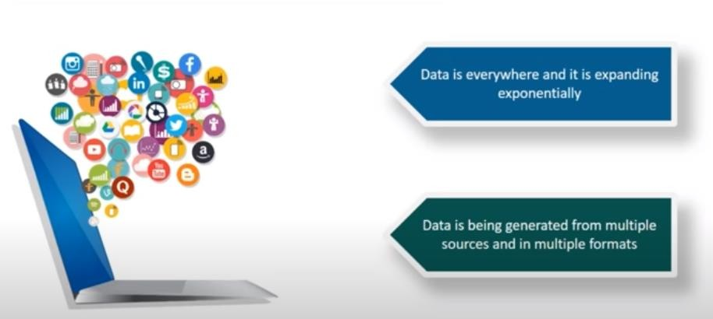
What is DM ?: Data Deluge
Explosive Growth of Data: from terabytes (10¹² bytes) to petabytes (10¹⁵ bytes) or even brontobytes (10²⁷bytes)
Data collection and data availability: Automated data collection tools, database systems, Web, Computerized Society …
http://www.internetlivestats.com/one-second/
“ Every second, there is:
7,998 Tweets sent
839 Instagram photos uploaded
1,364 Tumblr posts
3,083 Skype calls
55,560GB of Internet traffic
66,335 Google searches
73,391 YouTube videos viewed
2,681,874 Emails sent “
“ We are drowning in Data and straving for knowledge !!! ”

Slide 6
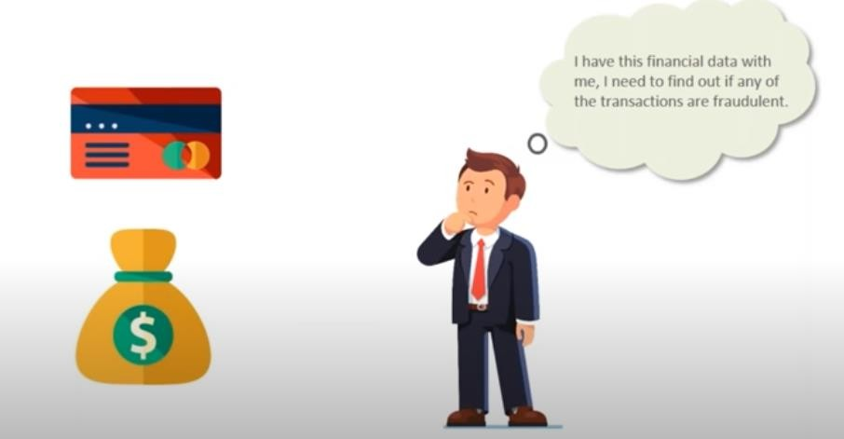
What is DM ? : DM Scenario 1
6

Slide 7
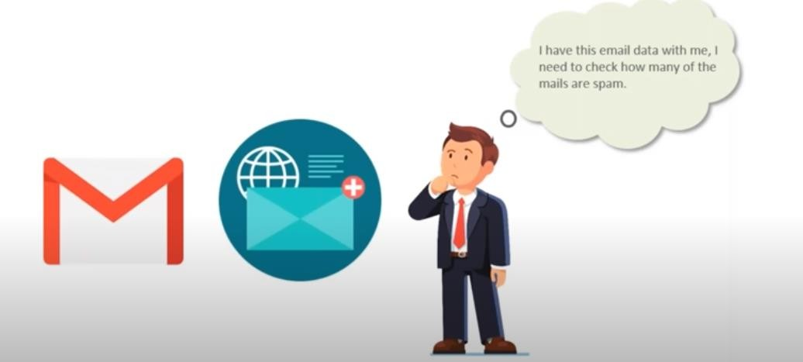
What is DM ? : DM Scenario 2
7

Slide 8
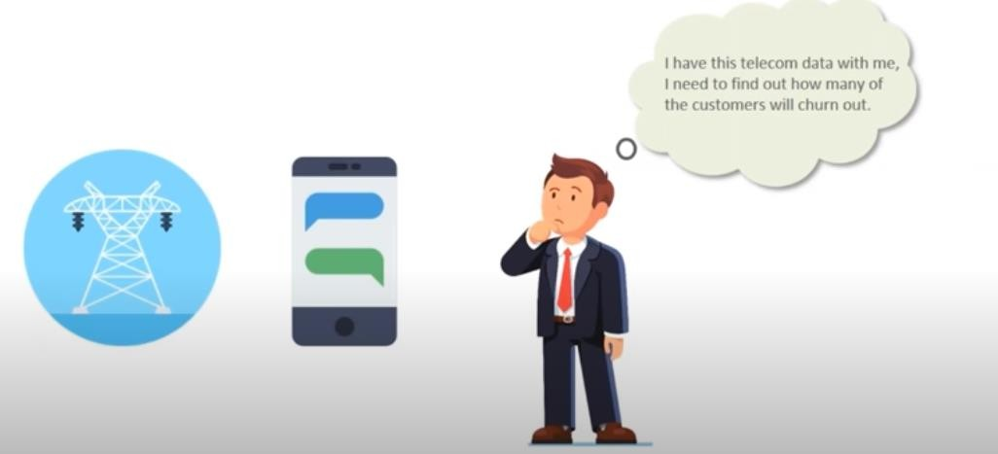
What is DM ? : DM Scenario 3
8

Slide 9
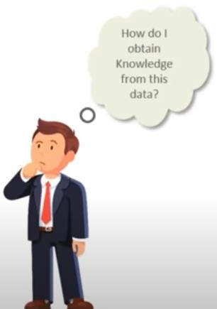
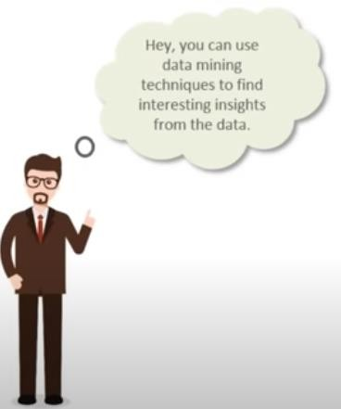

What is DM ? A RESCUE
9

Slide 10
What is DM ? Where DM is Used
Business & Marketing
Goal : Understand customer behavior and improve sales.
Example: Market basket analysis (e.g., “People who buy bread often buy butter”
Finance & Banking
Goal : Detect fraud, evaluate risk, and manage investments.
Example: Credit card fraud detection ; Predicting loan defaults.
Education
Goal : Improve diagnosis and healthcare.
Example: Predicting diseases in healthcare ; finding patterns in patient records
Telecommunications
Goal : Improve service and reduce churn (loss of customers)
Example: Identifying customers likely to switch providers; Detecting network problems early
Where there is Data, there is Data Mining
10

Slide 11
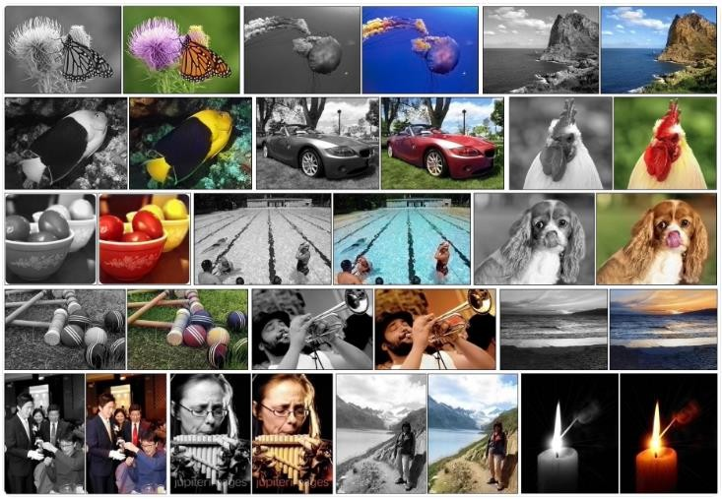
What is DM ? Where DM is Used
black and white image colorization
Zhang, Isola, Efros. Colorful Image Colorization.
In ECCV, 2016.
http://richzhang.git hub.io/colorization/
See also https://machinelearningmastery.com/inspirational-applications-deep-learning/
11

Slide 12
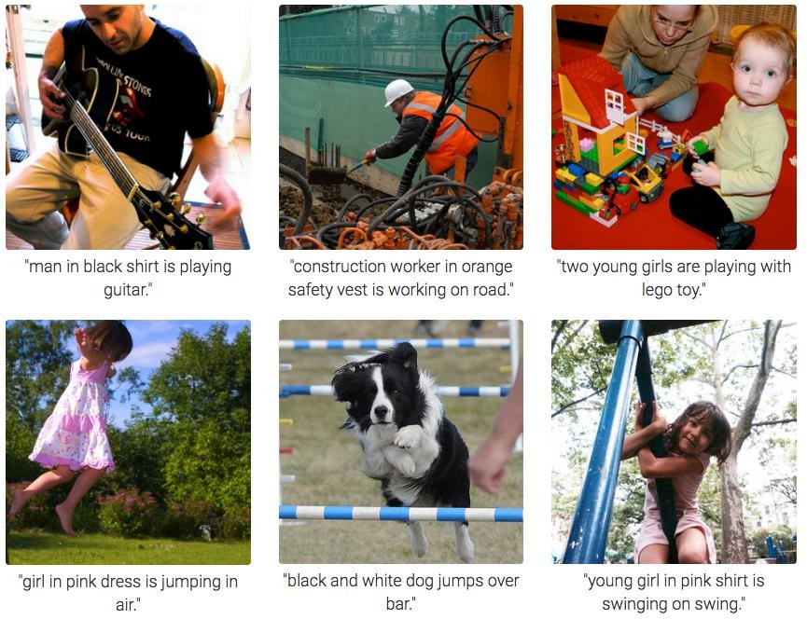
What is DM ? Where DM is Used
Image recognition using deep neural networks
Andrej Karpathy & Li Fei-Fei “Deep Visual-Semantic Alignments for Generating Image Descriptions”
CVPR 2015
https://cs.stanford.edu/people
/karpathy/deepimagesent/
12

Slide 13

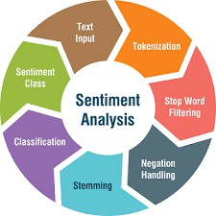
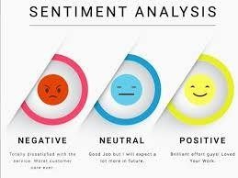
What is DM ? Where DM is Used
Document sentiment
analysis
Email spam filtering
Blanzieri, E. & A. Bryl. “A survey of learning- based techniques of email spam filtering” Artificial Intelligence Review
March 2008, Vol. 29, Issue 1, pp 63–92
Liu B., Zhang L. “A Survey of Opinion Mining and Sentiment Analysis.”
In: Aggarwal C., Zhai C. (eds)
Mining Text Data. Springer, Boston, MA. 2012
13

Slide 14
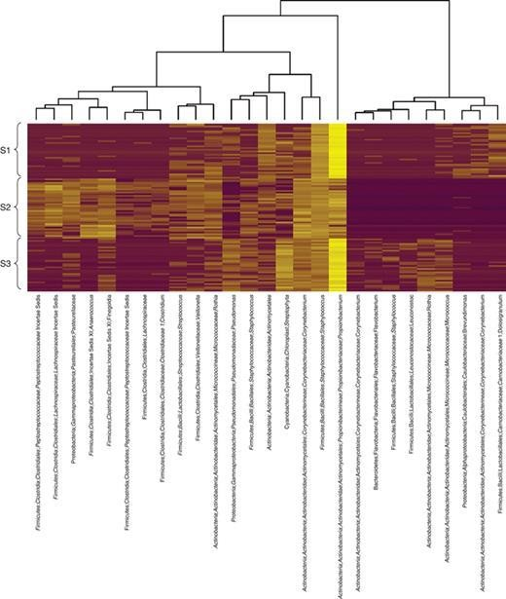
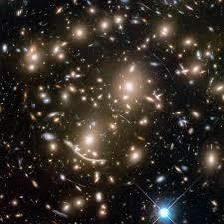
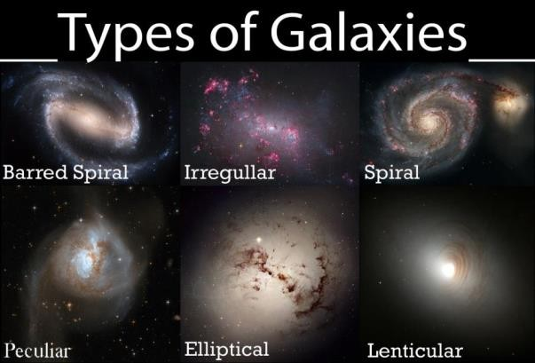
What is DM ? Where DM is Used
Identifying important groups of microorganisms in the human body
Classifying galaxies in
the universe
Dan Knights Elizabeth K. Costello Rob Knight “Supervised classification of human microbiota” FEMS Microbiology Reviews, Volume 35,
Issue 2, 1 March 2011, Pages 343–359
Fowler, L., Schawinski, K., & Brandt, B.-E. Galaxy Classification using Machine Learning. Paper presented at the American Astronomical Society Meeting Abstracts. 2017
14

Slide 15









What is DM ?: Where DM is Used
Image and video processing
Audio and voice processing
Personal assistants
https://www.classaction.org/blog/facebook-sued-
over-face-recognition-feature
recommender systems
Bgr.com/tag/siri
15

Slide 16
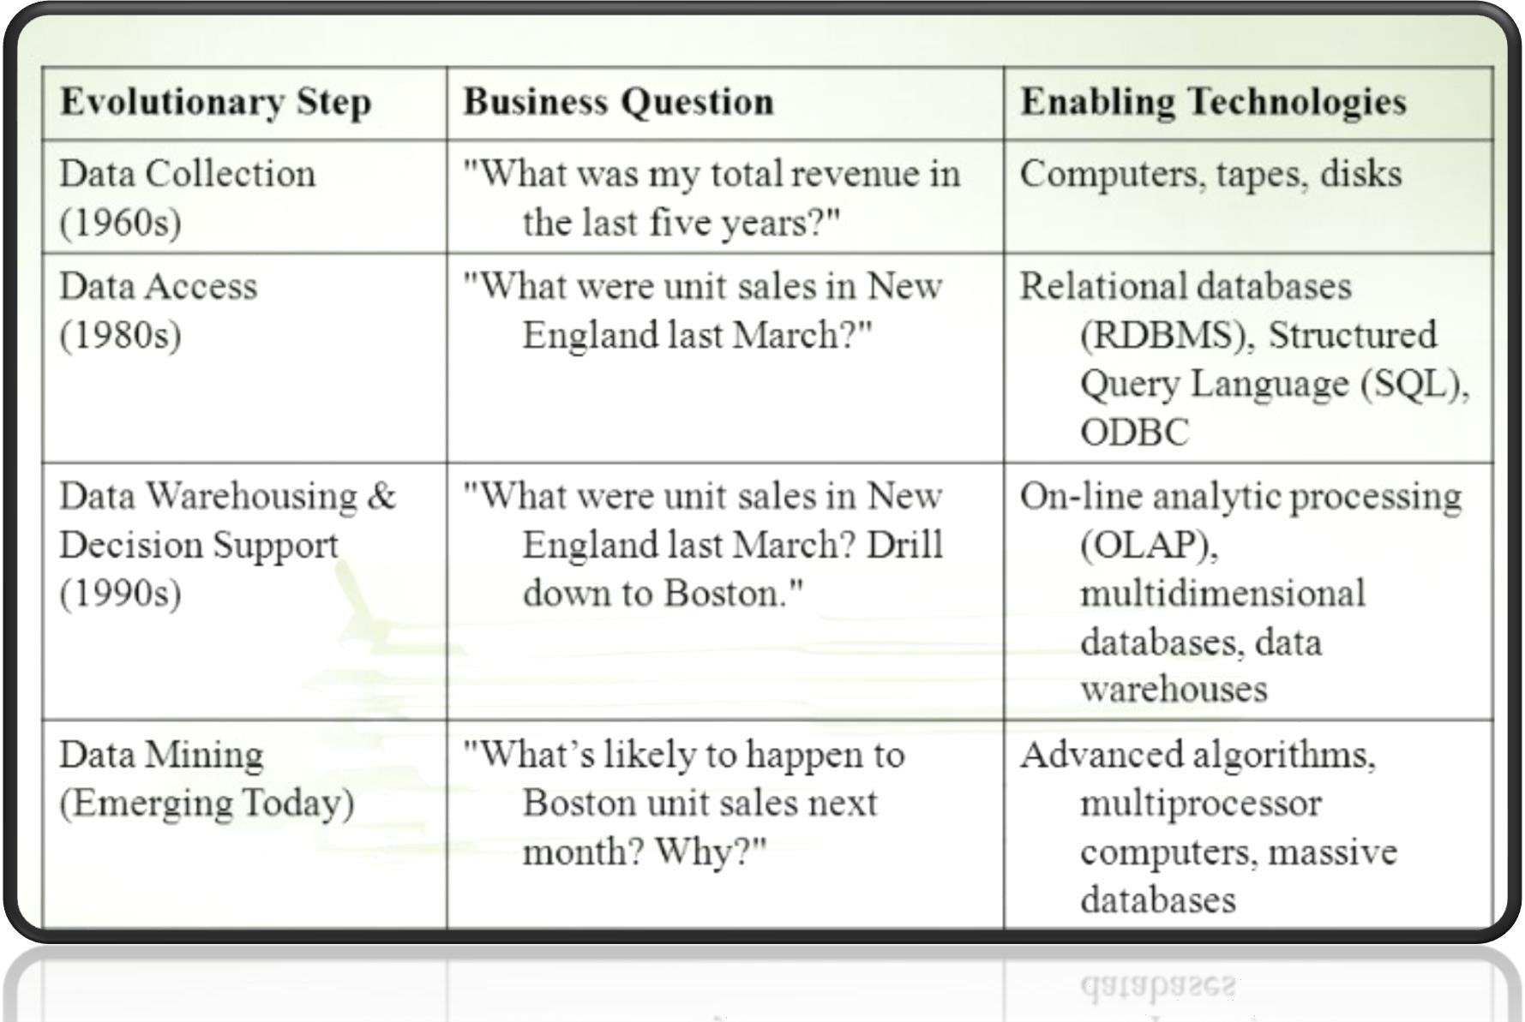
What is DM ? : Evolution of DM

Slide 17
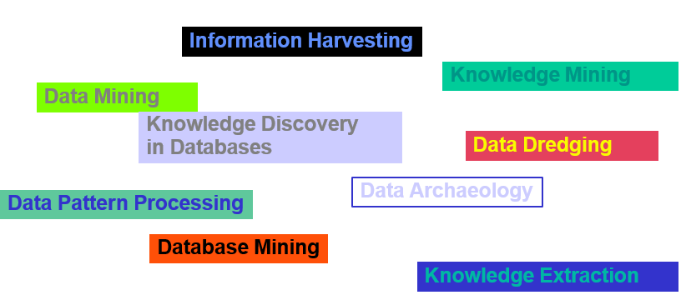
What is DM ? : Synonyms of DM
17

Slide 18
 What is Data Mining ?
 What is Machine Learning ?
 KDD Process
 Database
Basic Statistical Description of Data
Data Mining Resources

Slide 19
What is Machine Learning ?
Machine Learning (ML) is a field of study within AI (Artificial Intelligence) concerned with the development and study of statistical algorithms that can learn from data and generalize to unseen data, and thus perform tasks without explicit instructions (auto-learns).
ML finds application in many fields, including NLP ( natural language processing), image recognition, email filtering, agriculture, medecine and other applications
Pattern recognition in machine learning is the automated discovery of regularities and structures within data, allowing a system to categorize new observations or make predictions based on what it has learned from past examples.
19

Slide 20
ML: Pattern Recognition
We will return to the actual topic in two minutes. In the meantime, we are going to play a quick game.
I am going to show you some problems which were shown to pigeons!
Let’s see if you are as smart as a pigeon!

Slide 21




Pigeon Problem 1
ML: Pattern Recognition
What class is this
object?
Examples of class A
Examples of class B
3 4
5
2.5
8
1.5
What about this one,
A or B?
1.5
5
5 2
6 8
8 3
4.5 7
2.5 5
4.5 3
21

Slide 22

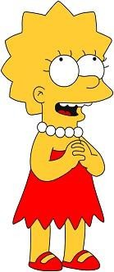

Pigeon Problem 1
ML: Pattern Recognition
This is a B!
Examples of class A
Examples of class B
3 4
5
2.5
8 1.5
1.5
5
5 2
Here is the rule. If the left bar is smaller than the
right bar, it is an A, otherwise it is a B.
6 8
8 3
2.5 5
4.5 3
22

Slide 23




Pigeon Problem 2
ML: Pattern Recognition
Oh! This one is
hard!
Examples of class A
Examples of class B
4 4
5 2.5
8 1.5
Even I know this one
5
5
2 5
6 6
5 3
7
7
3
3
2.
5
3
23

Slide 24



Pigeon Problem 2
ML: Pattern Recognition
Examples of class A
Examples of class B
The rule is as follows, if the two bars are equal sizes, it is an A. Otherwise it is a B.
4 4
5 2.5
5
5
2 5
So this one is an A.
6 6
5 3
7
7
3
3
2.
5
3
24

Slide 25


Pigeon Problem 3
ML: Pattern Recognition
Examples of class A
Examples of class B
6
6
4 4
5 6
This one is really hard!
What is this, A or B?
1
5
7 5
6 3
4 8
3
7
7 7
25

Slide 26



Pigeon Problem 3
ML: Pattern Recognition
It is a B!
Examples of class A
Examples of class B
6
6
4 4
5 6
The rule is as follows, if the sum of the two bars is less than or equal to 10, it is an A. Otherwise it is a B.
1
5
7 5
6 3
4 8
3
7
7 7
26

Slide 27



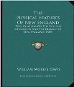



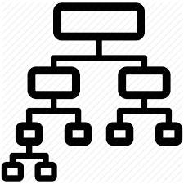


ML: Classification
Classification is a supervised learning process where labeled data is used to assign new data to predefine categories or classes
Classification Model
art
science
politic
geography
art
…
New book
Predicted category
history
Data: Large collection of books. For each book: title,
info, full text and a category

Slide 28
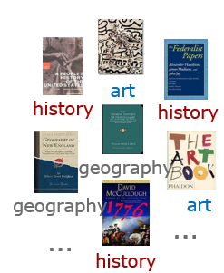
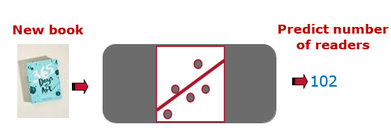
ML: Regression
Regression is a supervised learning process where a model predicts a continuous numerical value based on input data
Regression Model
Data: Large collection of books. For each book: title, info, full text and number of users that accessed the books in the past 12 months

Slide 29
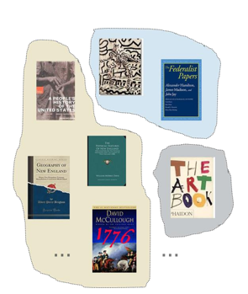
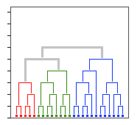
ML: Clustering
Clustering is an unsupervised learning process that groups data points into clusters based on their similarities, without using labeled data.
We can derive from these data a set of clusters that group books by similarity
Data: Large collection of books. For each book: title, author, info, full text …

Slide 30
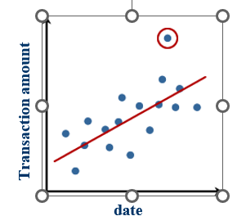

ML: Outlier Analysis
Outlier analysis (or Anomaly Detection) is an unsupervised learning process that identifies data points that are significantly different from the rest of the dataset.

Slide 31
 What is Data Mining ?
 What is Machine Learning ?
 KDD Process
 Database
Basic Statistical Description of Data
Data Mining Resources

Slide 32
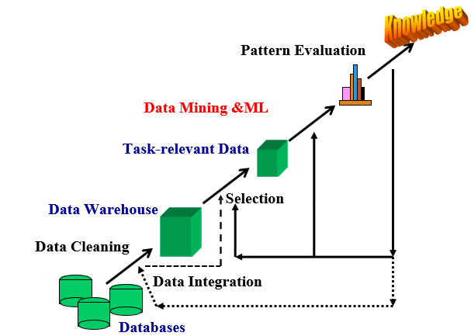
KDD Process
Databases: raw data provided from multiple sources
Data Cleaning: errors and inconsistencies are detected and corrected
Data Integration: data from different sources are
combined into a single and unified view
Data Warehouse: integrated data are stored
in a centralized repository for analysis
Selection: relevant data are retrieved from
the data warehouse for specific analysis
DM & ML: ML techniques
are applied to discover patterns
Pattern Evaluation: discovered patterns
are assessed for their usefulness and validity
Knowledge: valuable insights and actionable
knowledge are extracted for decision-making
32

Slide 33
KDD Process : A hieracrhical process
Decision Making
DB Presentation
Visualization Techniques
Machine Learning
Information Discovery
DB Exploration
Statistical Summary, Querying, and Reporting
DB Preprocessing/Integration, Data Warehouses
DB Sources
Paper, Files, Web documents, Scientific experiments, Database Systems
33

Slide 34

KDD Process : Evaluation of Discovered Patterns
The evaluation step in the KDD process is crucial. It ensures that the discovered patterns are valid, novel, useful and understandable for effective knowledge extraction.
Valid: The pattern accurately represents the data and holds true across different samples
Novel: The pattern reveals new or unexpected information not previously known
Useful : The pattern provides insights that can support decisions or actions
Understandable: The pattern is simple, clear and easy for humans to interpret and apply
Re
REMEMBER
34

Slide 35
 What is Data Mining ?
 What is Machine Learning ?
 KDD Process
 Database
Basic Statistical Description of Data
Data Mining Resources

Slide 36
Database : A Global vision
Data Typology
Nominal
Categorical
Nature of Data
Ordinal
Discrete
Ordinales
Qualitative
Numerical
Continuous
Quantitative
Structured
Textual
Primary
Unstructured
Point-based
Time-Data
Secondary
Time
Interval
Image

Slide 37
Database : Categorical Database
Categorical data represent groups or categories (not numbers) that describe qualities or characteristics, such as colors, gender..
Nominal Data : A type of categorical data where the categories have no specific order
Ordered Data : A type of categorical data where the categories follow a meaningful order or rank
Feature | Nominal Data | Ordinal Data
Definition | Categories with no natural order | Categories with a meaningful order
Type of data | Qualitative (labels or names) | Qualitative (ordered labels)
Order or ranking | ❌ No | ✅ Yes
Examples | Colors (red, blue, green), gender (male, female) | Satisfaction (low, medium, high), education (high school, college, master)
Statistical measures | Mode | Mode and Median
Graph type | Bar chart (unordered) | Bar chart (ordered categories)

Slide 38
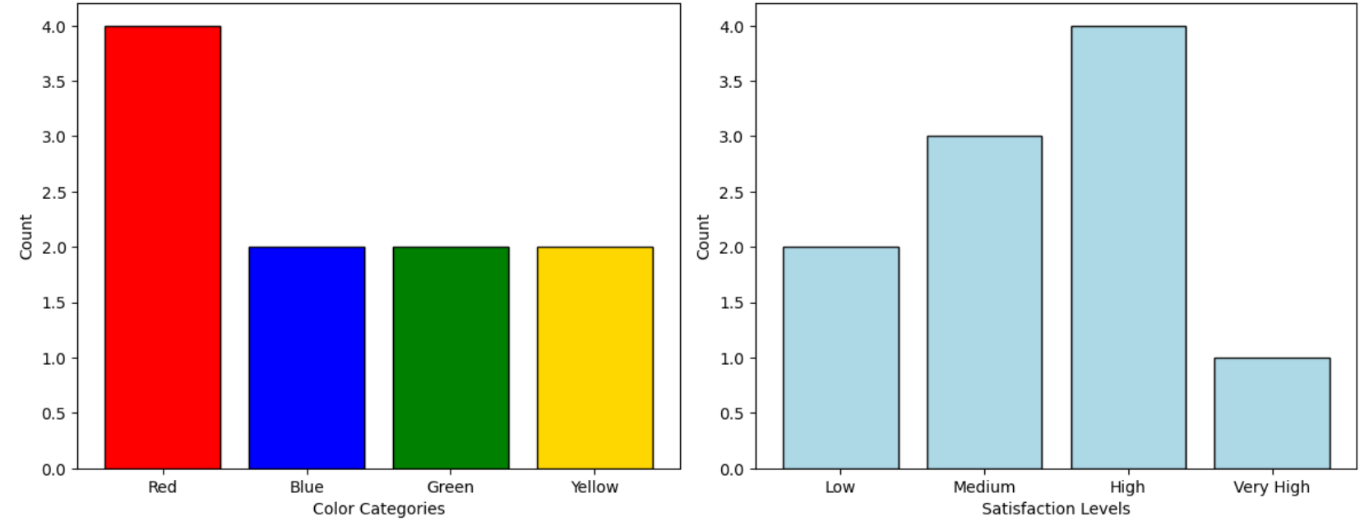
Database : Nominal VS Ordinal Data
Representation of Nominal Data
Representation of Ordinal Data

Slide 39
Database : Numerical Database
Numerical data describe data that can be expressed as numbers.
Allow for measurement, comparison, and calculation
Show how much or how many of something
Examples: 25°C, 170 cm, 60 kg, 5 hours
Type | Description | Example
Discrete Data | Countable numbers (no decimals) | Number of students, cars, books …
Continuous Data | Measurable values that can take any value within a range (including decimals) | Measures of height, weight, temperature, time…
39

Slide 40
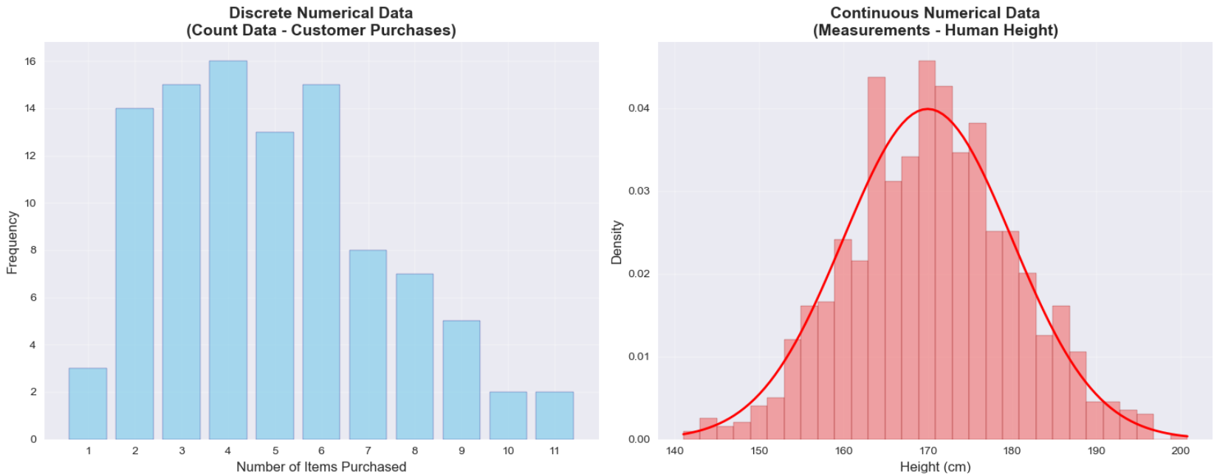
Database : Discrete VS Continuous Data
40

Slide 41
Database : Textual Database
Textual data base is made up of words, sentences, or paragraphs usually written in natural language (like Arabic, English, French …).
Structured data is organized in a fixed format, like rows and columns in a table. Example: an Excel sheet with “Name”, “Age”, “Salary” columns.
Unstructured data has no fixed format or structure.
Contextual and nuanced richness: Unstructured data containing sentiments expressed in free-text comments
Name | Address | Mail | Date of birth | Date of comment | Comment
Smith | New York | b.smith@gmail.com | 07/08/1987 | 01/02/2024 14:30:45 | Very Good
Le grand | Paris | l.johnson@gmail.com | 14/08/1997 | 01/02/2024 14:20:25 | Parfait
William | London | e.willimam@yahoo.com | 11/02/2001 | 01/02/2024 14:36:00 | I did not like
@Smith : Very good
@Le grand : Parfait
@William: I did not like
41

Slide 42
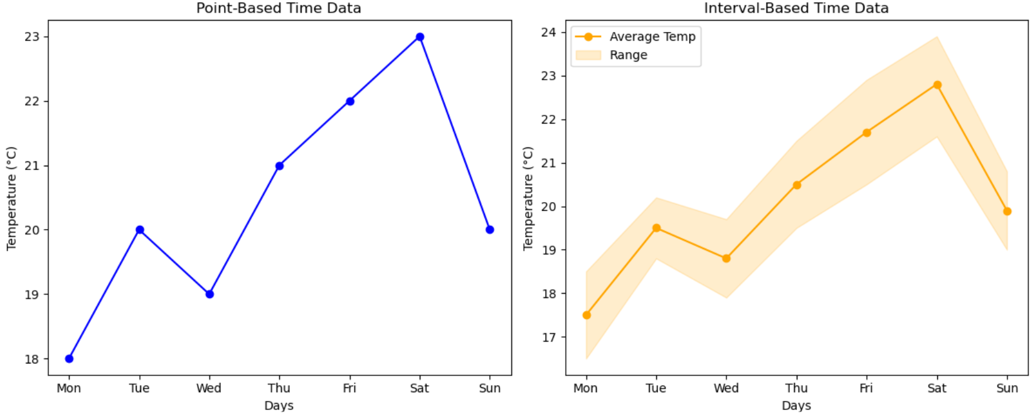
Database : Time Data
Time-based data is associated with specific timestamps, showing when events occurred or measurements were taken.
Point-based time data is associated with specific timestamps, showing when events occurred or measurements were taken.
Interval time data is measured data over duration period (e.g., hourly sales, daily temperature averages, monthly revenue).
42

Slide 43
Database : Primary VS Secondary Database
Primary Databse : A main database that stores raw, original, and experimentally verified data
Secondary Databse : Existing data originally collected by others for different purposes.
Feature | Primary Database | Secondary Database
Cost | High | Low
Data Type | Raw and unprocessed | Analyzed and interpreted
Bias | Known kollection Method | Unknown: potential biases
Reliability | High | Low
43

Slide 44
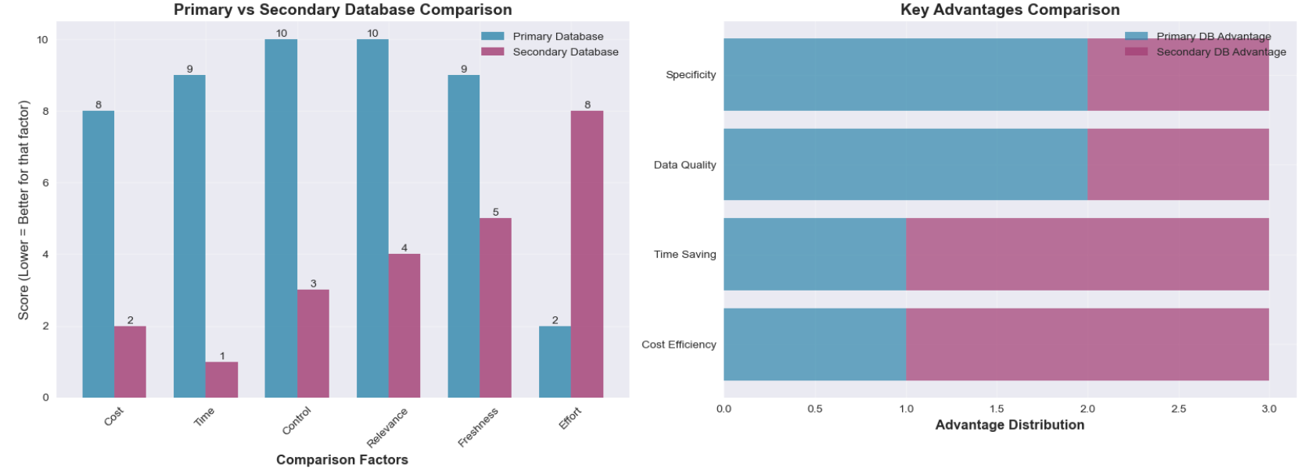
Database : Primary VS Secondary Database
44

Slide 45
Database : Models with Examples
Different types of databases are designed to store and manage data in various formats, each optimized for specific structures, relationships, and use cases
Relational DB: Employee list (ID, name, department, salary, …)
Transactional DB: Bank transfers (account number, debit, credit, date, …)
Document DB: Medical reports (patient ID, diagnosis, notes, …)
Key-Value DB: Shopping cart (cart ID, items)
Graph DB (nodes & relationships): Social network (user, friend connections)
Time series DB (data over time): Energy usage (meter ID, kilowatts, date)
Spatial DB ( geographic & geometric data ) : City Locations ( city ID, latitude, longitude, … )
Hierarchical DB: Airline reservation system ( Univ. => Dep. => Course => Student)
45

Slide 46
 What is Data Mining ?
 What is Machine Learning ?
 KDD Process
 Database
Basic Statistical Description of Data
Data Mining Resources

Slide 47
Basic Statistical Description of Data : Statistical Metrics
Measures of central tendency describe the location of the middle or center (average)
of a data distribution.
Given a Random Variable, they indicate where most of its values fall?
The main measures are: mean, median, mode
Dispersion of the data describe how the data are spread out around the center.
It can be summarized using the range, quartiles, and interquartile range.
It can be represented visually with the five-number summary and boxplots
The variance also measure how much the data values deviate from the mean.
Graphic displays provide visual representations of basic statistical descriptions to help us inspect and understand our data.
Common examples include bar charts, pie charts, and line graphs, as well as quantile plots, quantile–quantile (Q–Q) plots, histograms and scatter plots.
47

Slide 48
Basic Statistical Description of Data : The Mean
Arithmetic mean: most common type of average. It shows the central value of the data. It tells what value each item would have if all were the same.
Geometric mean: the average obtained by multiplying all the values together and then taking the nth root, (n is the number of values). It shows the typical value in a set of numbers that grow or change by percentages or ratios, such as growth rates.
Trimmed mean: the average obtained after removing a predefined percentage of the smallest and largest values from the data set before calculating the mean. It shows the typical central value of the data while reducing the effect of extreme or unusual values.
Weighted mean: the average of values that takes into account their relative importance or weights. It shows the central value when some numbers count more than others. For example, when certain scores or items have greater significance in the calculation
+: Simple and intuitive
-: can be skewed by outliers : it doesn’t deal well with wildly varying samples. For example, the monthly income (in $) of 5 person:1000, 1200, 1100, 900, 10000
The everage income is 2840 $ => It does not represent all people
48

Slide 49

Basic Statistical Description of Data : The Median
Median: The middle value in a set of ordered data values. It is used for skewed asymmetric data
N values of observations, sorted in increasing order
If N is odd => median is the middle value ELSE the median is the average of the two middlemost values
Salaries of 10 staff
15 16
12 14 15 15
18 17 90 95
$$median = \frac{15+16}{2}=15.5$$
15 +16 _{= 15.5}
2
+: Handles outliers well. Splits data into two groups, each with the same number of items
-: Not easy to calculate: you need to sort the list first => High Computing Cost
49

Slide 50
Basic Statistical Description of Data : The Mode
Mode: value that occurs most frequently in the set.
Data sets with one, two, or three modes are respectively called unimodal, bimodal, and trimodal.
If each data value occurs only once, then there is no mode.
Salaries of 10 staff
mode = 15
+:
Works well for exclusive voting situations (this choice or that one => no compromise)
Gives a choice that the most people wanted (whereas the average can give a choice that nobody wanted).
-:
Requires more effort to compute (have to count the votes)
50

Slide 51

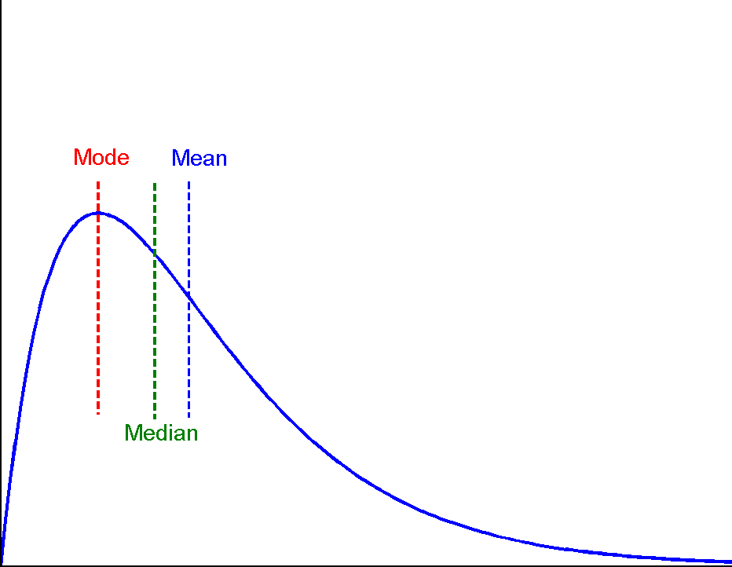
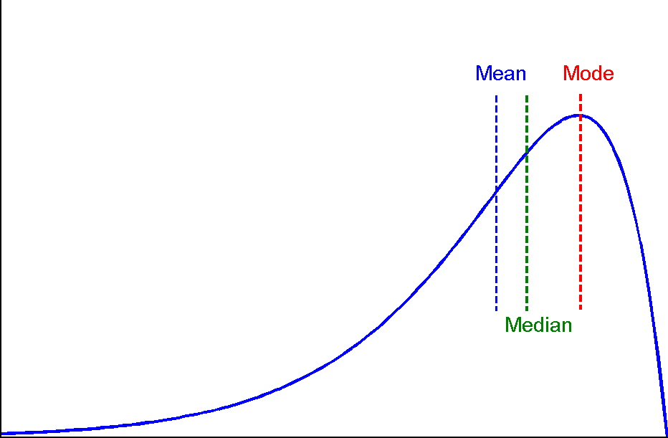
Basic Statistical Description of Data : Symetric VS Skewed Data
In symmetric data, values are evenly distributed around the center, while in skewed data, values stretch more to one side, either right (positive skew) or left (negative skew).
Positively skewed Mode < median
Negatively skewed Mode > median
51

Slide 52
Basic Statistical Description of Data : Dispersion of Data
Dispersion metrics are used only for numerical data
The dispersion of data answers the following question: “How much does my data vary?”
A measure of spread gives us an idea of how well the mean represents the data. If the spread of values in the data set is large, the mean is not as representative of the data as if the spread of data is small.
Range, Quartiles, and Interquartile Range
Five-Number Summary, Boxplots, and Outliers
Variance and Standard Deviation
Dispersion Metrics
52

Slide 53
Basic Statistical Description of Data : Percentiles and Quartiles
Consider the Maximum value of a distribution. Think of it as the value in a set of data that has 100% of the observations at or below it. We call it 100th percentile
From this perspective, the median, (which has 50% of the observations at or below it), is the 50th percentile (it is called second quartile)
p^{th} percentile of a distribution is the value such that p percent of the observations fall at or below it
The most commonly used percentiles other than the median are 25th percentile and the 75th percentile
53

Slide 54
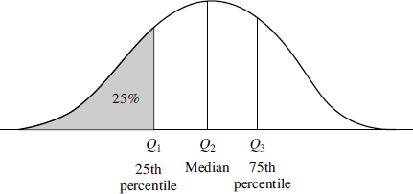
Basic Statistical Description of Data : Percentiles and Quartiles
25th percentile <=> first quartile
50th percentile (median) <=> second quartile
75th percentile <=> third quartile
Quartiles are a useful measure of spread because they are much less affected by outliers or a skewed data set than the equivalent measures of mean and standard deviation.
Quartiles are often reported along with the median as the best choice of measure of spread and central tendency, respectively, when dealing with skewed and/or data with outliers
54

Slide 55
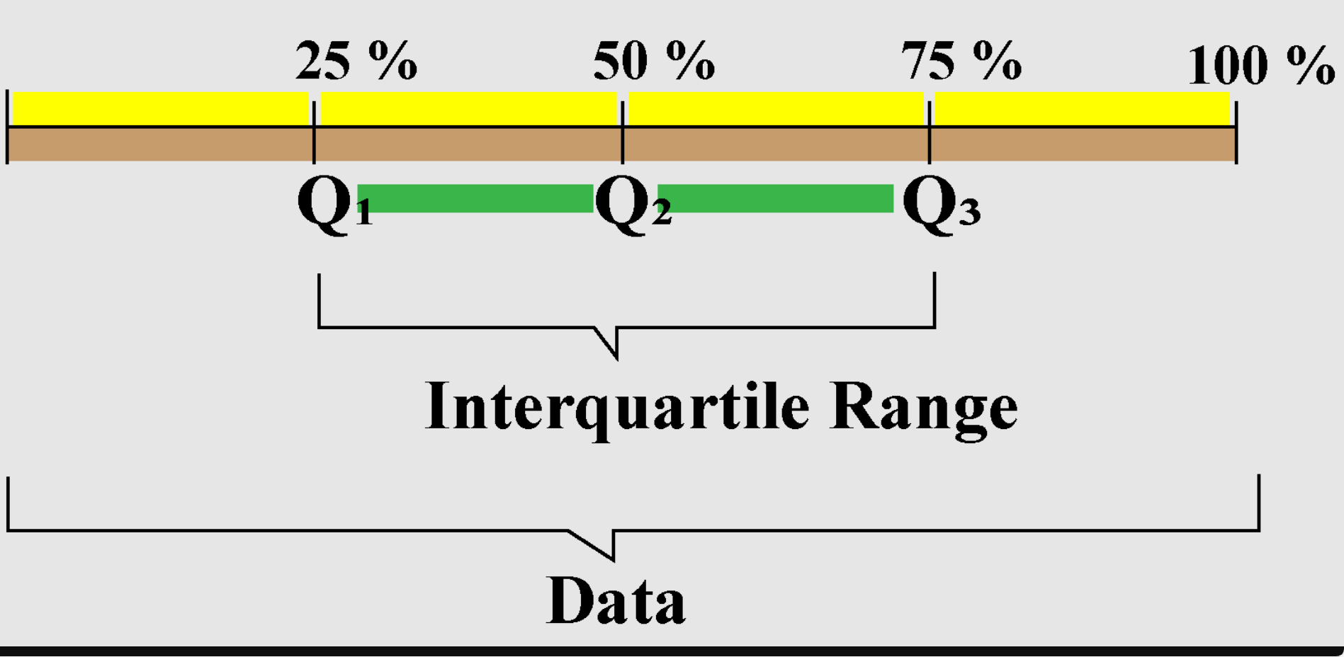
Basic Statistical Description of Data : The Interquartile Range
The interquartile range (IQR) is the difference between the third quartile (Q3) and the first quartile (Q1)
It measures the spread of the middle 50% of the data, showing how concentrated or dispersed the central values are.
55

Slide 56
Basic Statistical Description of Data : The five numbers
There is no single numeric measure of spread that is very useful for describing skewed distributions.
The five-number summary of a distribution consists of:
Minimum, Q1, Median, Q3, Maximum
A common rule for identifying suspected
outliers is to single out values falling:
Below Q1 – 1.5 × IQR
Above Q3 + 1.5 × IQR
In our example:
» Q1 – 1.5 × IQR = 15 - 1.5 × 3 = 10.5 => no outliers on the lower side
» Q3 + 1.5 × IQR = 18 + 1.5 × 3 = 22.5 => outliers on the higher side are 90k and 95k
56

Slide 57
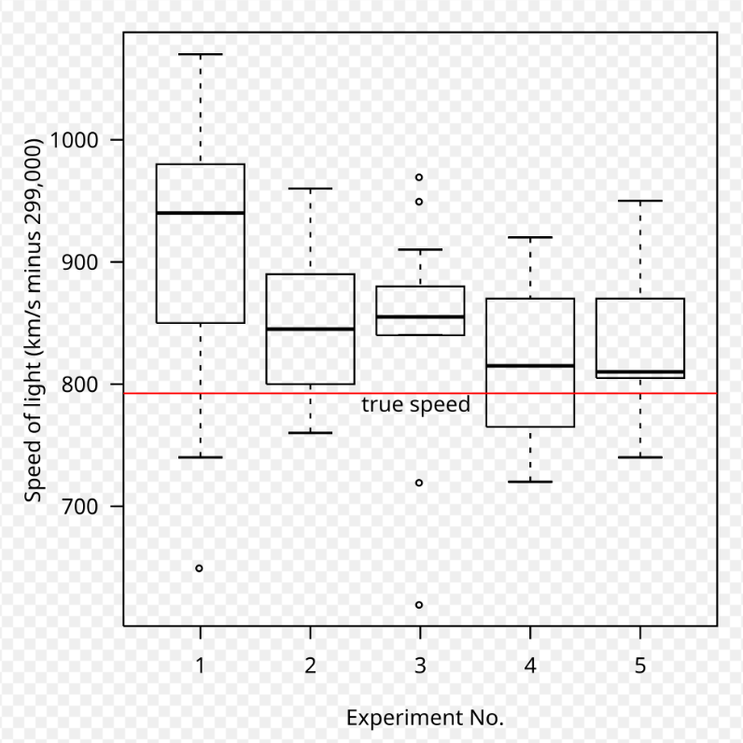
Basic Statistical Description of Data : Boxplots
A boxplot is a simple picture that shows how observations of database are spread out. It uses a box and whiskers to give the 5-number summary of your data.
The Box:
Left edge of box = 1st Quartile (Q1)
Right edge of box = 3rd Quartile (Q3)
Line inside box = Median (Q2)
The Whiskers:
Up whisker (Lowest normal value) = Q1 - 1.5×IQR
Down whisker (Highest normal value) =Q3 + 1.5×IQR)
Outliers:
Any dots outside the whiskers are unusual values
Speed of light Distribution.
57

Slide 58
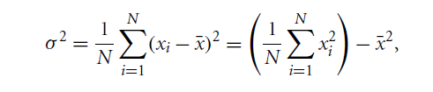
Basic Statistical Description of Data : The Variance
Variance measures how spread out a set of numbers is from their average value. It tells you how much your data points differ from the mean.
Low Variance => Numbers are all close to the average (consistent)
High Variance => Numbers are spread far from the average (widely dispersed)
Variance measures spread about the mean and should be considered only when the mean is chosen as the measure of center
(Var = 0) => there is no spread => all observations have the same value. Otherwise, var > 0.
Variance =
58

Slide 59
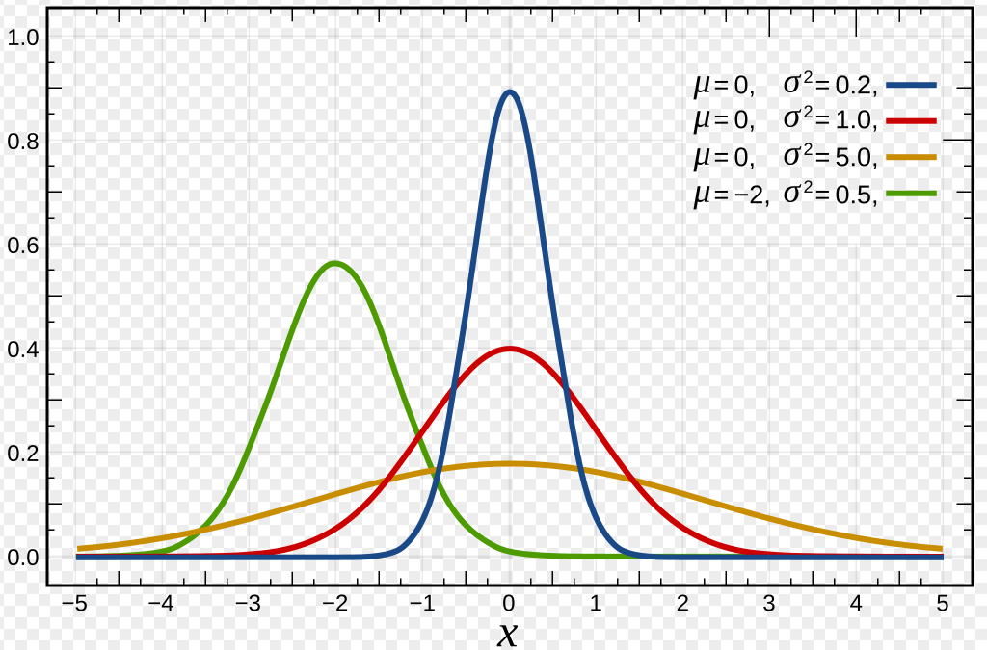
Basic Statistical Description of Data : The Variance
Normal Distribution with different Mean and Variance
59

Slide 60
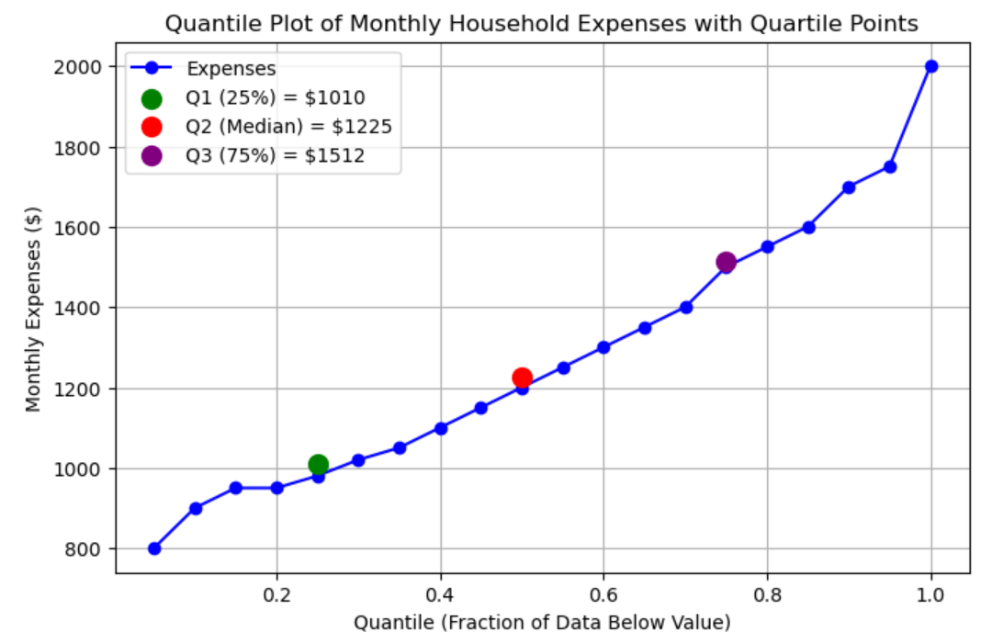
Basic Statistical Description of Data : Quantile Plot
A graph representing sorted data values versus their quantile levels to show how data are distributed across their range.
A first step in exploratory data analysis to understand the distribution of the data.
60

Slide 61
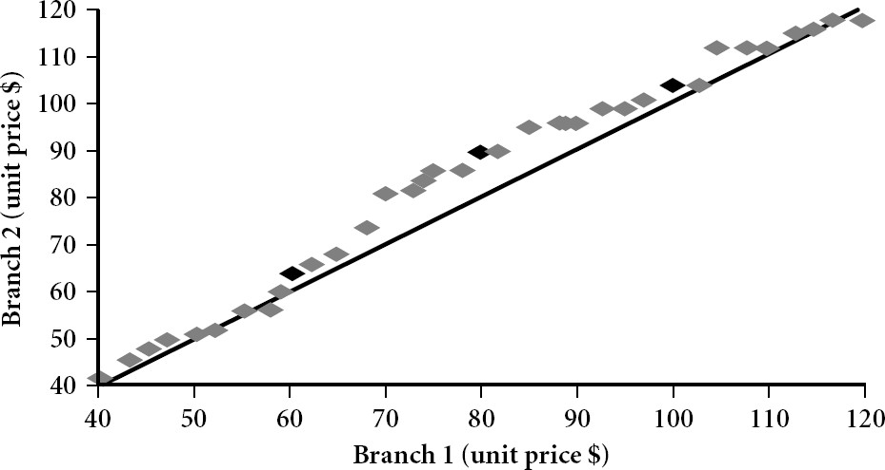
Basic Statistical Description of Data : Quantile-Quantile Plot ( Q-Q Plot )
Plots the quantiles of one univariate distribution against the corresponding quantiles of another
Test if two data sets come from populations with a common distribution
45-degree reference line (y=x) is also plotted. If the two sets come from a population with the same distribution, the points should fall approximately along this reference line.
The greater the departure from this reference line, the greater the evidence for the conclusion that the two data sets have come from populations with different distributions
Unit prices of items sold at Branch 1 tend to be lower than those at Branch 2.
61

Slide 62
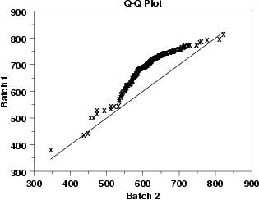
Basic Statistical Description of Data : Quantile to Quantile plot ( Q-Q Plot )
What does this Q-Q plot indicates?
These 2 batches do not appear to have come from populations with a common distribution.
The batch 1 values are significantly higher than the corresponding batch 2 values.
The differences are increasing from values 525 to 625. Then the values for the 2 batches get closer again.
62

Slide 63
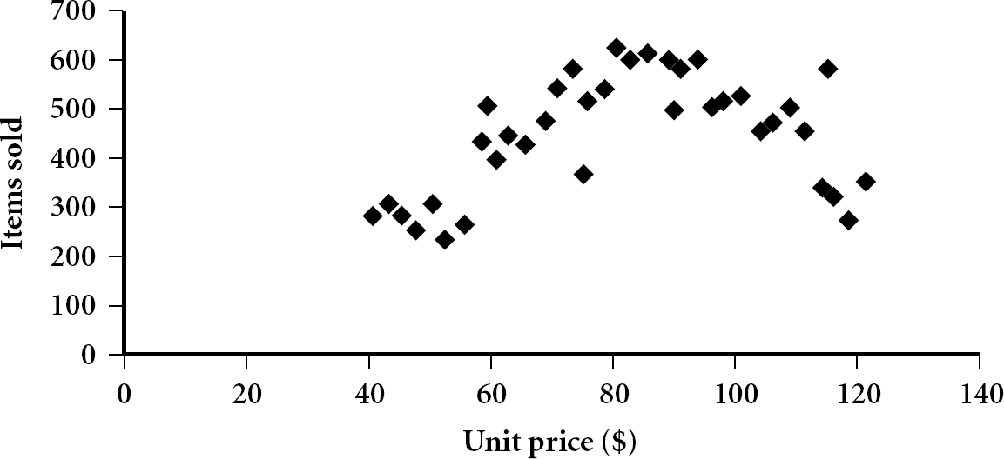
Basic Statistical Description of Data : Scatter Plot
Scatter plot: one of the most effective graphical methods for determining if there appears to be a relationship, pattern, or trend between two numeric attributes.
Provides a first look at bivariate data to see clusters of points, outliers, etc
Each pair of values is treated as a pair of coordinates and plotted as points in the plane
63

Slide 64
Basic Statistical Description of Data : Correlation
Linear correlation is a statistical relationship between two numerical variables where changes in one variable are associated with proportional changes in the other, forming roughly a straight-line pattern on a scatter plot.
Covariance measures the direction of the linear relationship between two numerical variables. It indicates whether the variables tend to increase or decrease together. A positive covariance means that as one variable increases, the other tends to increase as well, while a negative covariance means that as one variable increases, the other tends to decrease.
Correlation coefficient (denoted as r) standardizes covariance to a value between –1 and +1, allowing for easier interpretation of the strength and direction of the linear relationship. A correlation close to +1 indicates a strong positive relationship, close to –1 indicates a strong negative relationship, and around 0 suggests little to no linear correlation. Unlike covariance, correlation is unit-free, making it useful for comparing relationships between different datasets.
Nonlinear (curvilinear) correlation: the relationship follows a curved pattern rather than
a straight line.
64

Slide 65
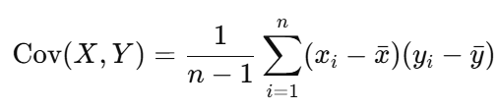
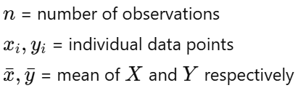

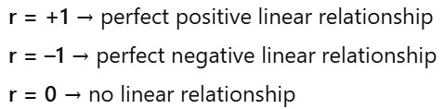
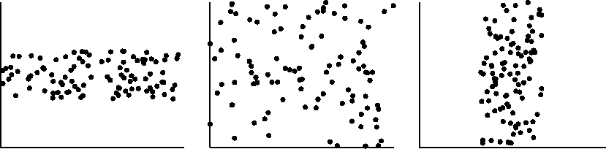
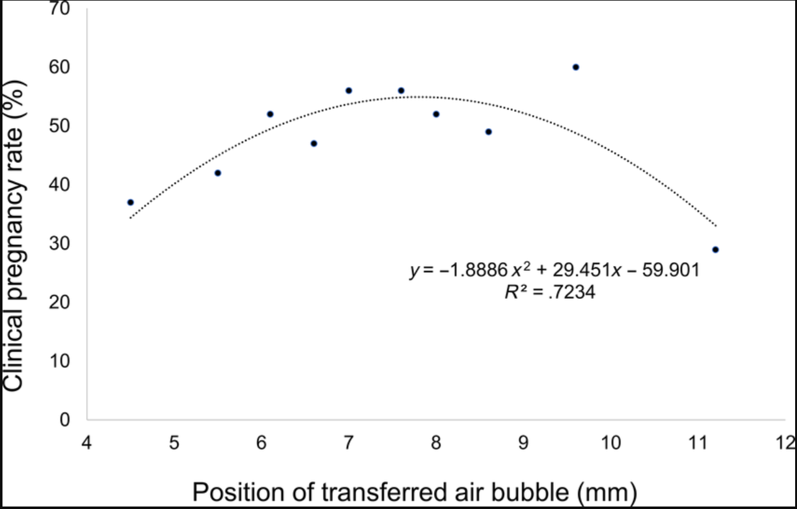
Basic Statistical Description of Data : Correlation
The left half fragment is positively correlated
The right half fragment is negative correlated
Uncorrelated data
Curvilinear Correlation
65

Slide 66
 What is Data Mining ?
 What is Machine Learning ?
 KDD Process
 Database
Basic Statistical Description of Data
Data Mining Resources

Slide 67
Data Mining Books
"Data Mining: Concepts and Techniques (3rd Edition)". J. Han and M. Kamber. Morgan Kaufmann Publishers. 2012. (Textbook)
Introduction to Data Mining (2nd edition) P.-N. Tan, M. Steinbach, A. Karpatne, V. Kumar. Pearson, 2018.
"Data Mining: Practical Machine Learning Tools and Techniques (4th Edition)" I.H. Witten, E. Frank, M. Hall, C. Pal. Morgan Kaufmann Publishers. 2017.
"Advances in Knowledge Discovery and Data Mining". Eds.: Fayyad, Piatetsky-Shapiro, Smyth, and Uthurusamy. The MIT Press, 1995.

Slide 68
Data Mining Journals
Data Mining and Knowledge Discovery Journal
ACM SIGKDD Explorations Newsletter
TKDE: IEEE Transactions in Knowledge and Data
Engineering
TODS: ACM Transactions on Database Systems
JACM: Journal of ACM
Data and Knowledge Engineering
JIIS: Intl. Journal of Intelligent Information Systems
…

Slide 69
Data Mining Conferences
KDD: ACM SIGKDD Intl. Conf. on Knowledge Discovery and Data Mining
ICDM: IEEE International Conference on Data Mining,
SIAM International Conference on Data Mining
PKDD: European Conference on Principles and Practice of Knowledge Discovery in Databases
PAKDD Pacific-Asia Conference on Knowledge Discovery and Data Mining
DaWak: Intl. Conference on Data Warehousing and Knowledge Discovery
Other related Conferences:
ICML: Intl. Conf. On Machine Learning
IDEAL: Intl. Conf. On Intelligent Data Engineering and Automated Learning
IJCAI: International Joint Conference on Artificial Intelligence
AAAI: American Association for Artificial Intelligence Conference
SIGMOD/PODS: ACM Intl. Conference on Data Management
ICDE: International Conference on Data Engineering
VLDB: International Conference on Very Large Data Bases

Slide 70
Data Mining Datasets
Univ. of California Irvine Machine Learning Data
Repository.
Univ. of California Irvine KDD Data Repository.
Datasets for Data Mining
Datamob - Public data put to good use.
Time Series Data Library
CMU's StatLib-Datasets Archive
Stanford Large Network Dataset Collection (SNAP)
100+ Interesting Data Sets for Statistics
…

Slide 71
71

Slide 72
72

Slide 73
73

Slide 74
74

Slide 75
75

Slide 76
76

Slide 77
77

Slide 78
78

Slide 79
79

Slide 80
80

Slide 81
81

Slide 82
82

Slide 83
83

Slide 84
84

Slide 85
85

Slide 86
86

Slide 87
87

Slide 88
88

Slide 89
89

Slide 90
90

Slide 91
91

Slide 92
92

Slide 93
93

Slide 94
94

Slide 95
95

Slide 96
96

Slide 97
97

Slide 98
98

Slide 99
99

Slide 100
100

Slide 101
101

Slide 102
102

Slide 103
103

