Slide 1



AI GOVER A CE
Secure, Responsible and Productive Use of Artificial Intelligence — Professional Training & Implementation Guide. Version 1.1 | September 2026 | Internal Use. This guide provides a practical framework to maximize AI value while protecting data, people, customers and the organization.

Slide 2


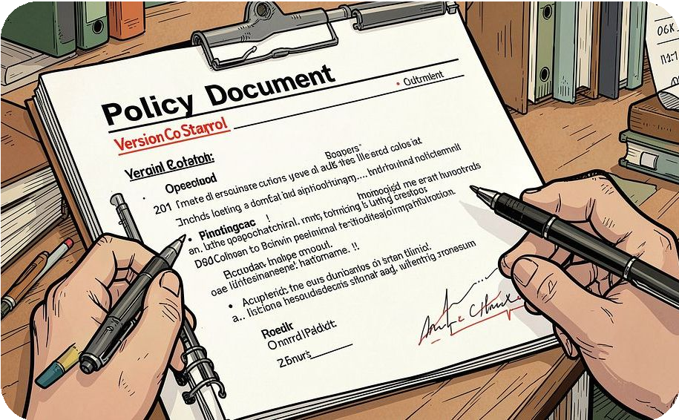
Document Control & Audience
Audience
Executives, managers, IT, security, privacy, legal, data teams, procurement and employees.
Review Cycle
Quarterly and after material regulatory, technology or business changes.
Document Title
AI Governance: Secure, Responsible and Productive Use of AI — purpose and scope documented for internal use.

Slide 3

Executive Summary
AI can accelerate productivity, improve customer experiences, strengthen analysis and automate routine work — but it also creates material risks when data is exposed, outputs are unreliable, decisions are biased, or unapproved tools are used without oversight. AI governance is the operating system that enables safe scale by combining policy, accountability, security architecture, privacy controls, technical guardrails, human oversight and continuous monitoring across the full AI lifecycle.

Slide 4
Learning Objectives
Purpose & Operating Model
Understand what AI governance does and how it operates.
Use & Risk Identification
Identify valuable business uses of AI and their associated risks.
Data Protection
Apply rules that protect
confidential and personal data.
Tool Selection
Select suitable AI platforms and subscription levels.
Implementation
Implement controls, monitoring and employee training for secure adoption.

Slide 5

AI Governance Fundamentals & Principles
AI governance directs how AI is selected, built, used, monitored and retired to make systems trustworthy, lawful, secure and aligned with business objectives—not to prevent innovation. Core principles include:
Accountability: named business and technical owners for every AI system. Transparency: users know when AI is used and how outputs are reviewed. Privacy & security: minimize, classify and protect data; authorize access. Fairness & safety: test material decisions for bias and harmful outcomes. Human oversight: people retain authority over high-impact decisions.
Lifecycle management: evaluate before launch and monitor continuously.

Slide 6





AI Value, Typical Risks & Required Responses
Productivity
Use: drafting, summarizing, research, workflow automation.
Risk: inaccurate or fabricated content. Response: verification, source checking and human review.
Marketing & Sales
Use: personalization, lead scoring, content. Risk: mishandling sensitive customer or brand data. Response: approved platforms,
minimal data, approval workflows.
Analytics
Use: forecasting, decision support. Risk: biased data, model drift. Response: validate data quality, test outcomes, monitor performance.
Customer Support
Use: virtual assistants, knowledge retrieval.
Risk: prompt injection, privacy leakage.
Response: guardrails,
access restrictions, logging and escalation.
AI Agents
Use: tool use and
workflow execution. Risk:
financial, operational or security impact.
Response: permission boundaries, approvals, rate limits and rollback procedures.

Slide 7

Risk Classification & Minimum Controls
High Risk
Hiring, credit, legal; strict review and governance
Medium Risk
Internal assistants; access controls and logging
Low Risk
Public drafting; minimal controls, transparency
Assess every AI use case before deployment. Risk increases when systems process restricted information, affect individuals, act autonomously, create external communications, or support regulated/high-impact decisions. Restricted or prohibited uses require explicit legal, ethics, security and executive approval.

Slide 8




Secure AI Operating Model & Roles
Executive Sponsor
Sets strategy, funds the program and accepts residual high-level risks.
Data Owner
Approves access, ensures classification and validates data quality.
Security Team
Defines identity, access, network, threat protection, monitoring and incident response.
Business Owner
Defines value, validates outputs and maintains human oversight.
End User
Privacy & Legal
Reviews data processing, contracts, retention and regulatory requirements.
Uses approved tools, protects data, verifies outputs and reports concerns.

Slide 9
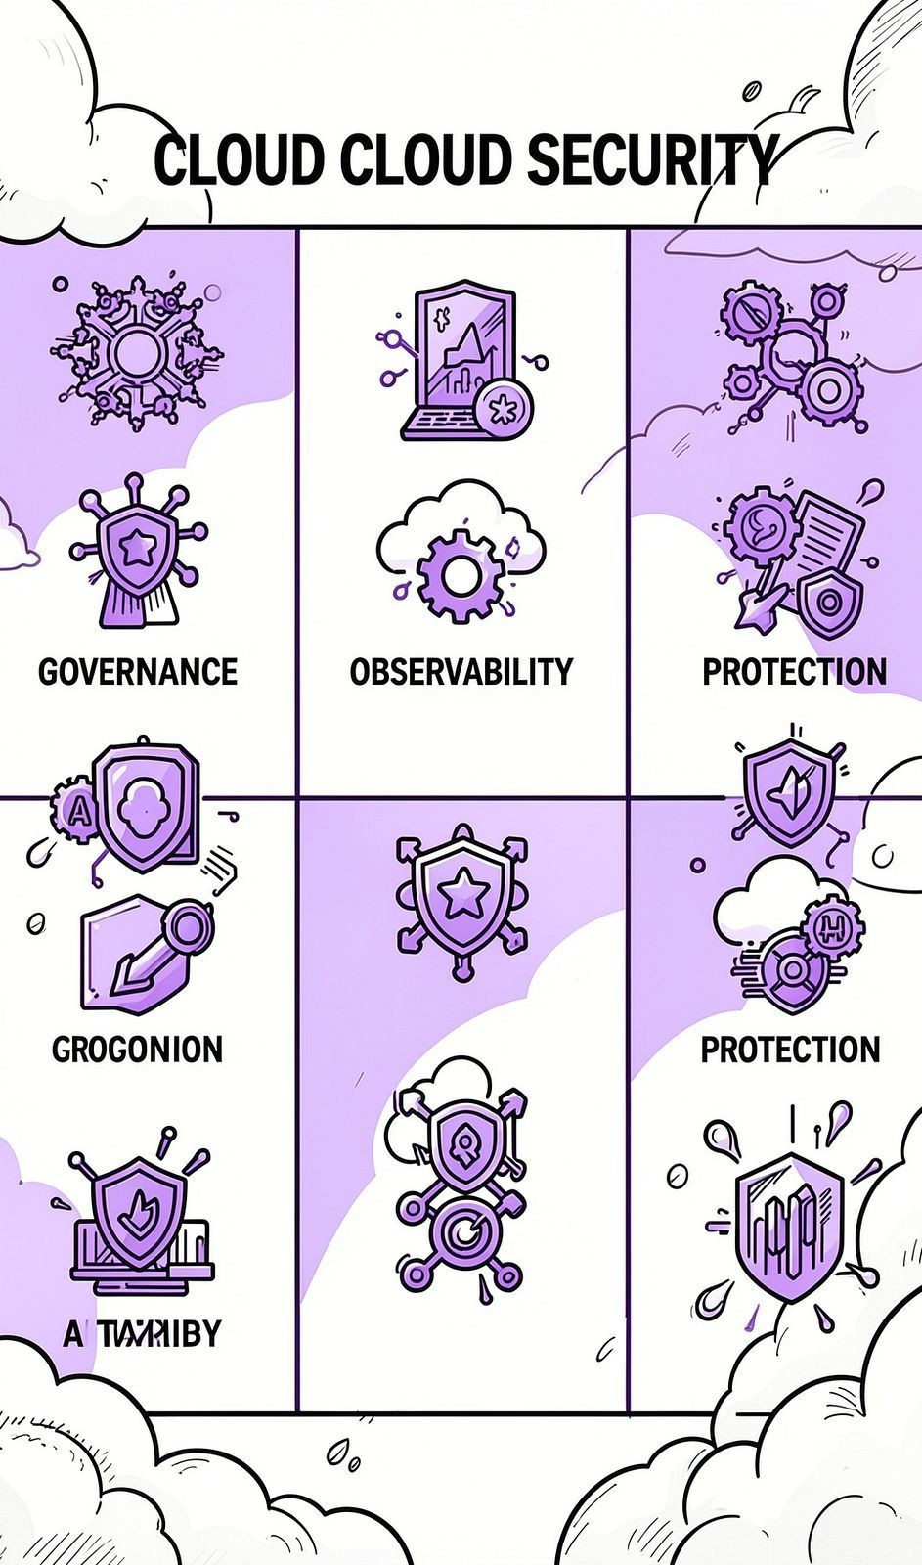
Data Protection, Tooling & Subscription Strategy
Data Protection Requirements
Classify data before AI workflows; use minimum necessary fields; never put passwords, API keys, payment data, government IDs or unredacted records into unapproved tools. Use enterprise subscriptions, SSO, MFA, RBAC, encryption, DLP, redaction/tokenization, logs and vendor due diligence for residency and subprocessors.
Tooling Strategy
Combine productivity platforms with governance, observability and runtime guardrails. Select products by use case and data sensitivity: governance/GRC, model observability, runtime guardrails, productivity AI, CRM AI and data protection tools.
Subscription Matrix
Free/consumer: experimentation only. Team/business: departmental use after review. Enterprise: SSO, SCIM, logs and contracts for company-wide and regulated work. Governance & security platforms complement but do not replace secure architecture.

Slide 10
Implementation Roadmap, KPIs, Policy & Closing Guidance
Days 1–30 — Assess & Prioritize
Appoint sponsor and governance lead; create tool/use-case inventory; classify risks; draft acceptable-use policy.
1
2
Days 31–60 — Design Controls
Approve tool catalog; complete vendor due diligence; establish data rules; deploy SSO/MFA/RBAC; select pilots.
Days 61–90 — Deploy & Monitor
Deliver training; publish AI registry; enable logging and DLP; test guardrails; establish incident playbook and KPI dashboard.
3
fi
Quarterly — Improve Continuously
Reassess high-risk systems; review vendor changes; audit access; refresh training; measure value and risk reduction.
Governance KPIs & Quick Reference
KPIs: registration & risk classification coverage, training completion, shadow-AI discoveries and remediation time, assessments for high-risk systems, incident counts and containment time, measured business value.
Quick Rules: use only approved tools, check data classification, never enter restricted data into unapproved systems, verify AI outputs, restrict agents from external commitments, report incidents immediately.
Begin with visibility: inventory tools and use cases, then establish approved platforms, data rules, owners, human oversight and monitoring to unlock AI value without compromising trust.

