Slide 1


Financial Computer Simulation (FM 617)
BS-Financial Mathematics (4TH Year)
Final Year Project (1)
Financial Forecasting Pipeline — Python Project Overview
Name: Rida
Father Name: Muhammad Rashid
Roll No: B21120206042

Slide 2
Introduction
Overview:
This project undertakes a comprehensive analysis of financial data from the BIST (Borsa Istanbul) dataset.
The core aim is to apply various data science and quantitative finance techniques to extract meaningful insights, assess risk, and model financial performance.
Key Objectives:
Explore & Visualize: Uncover relationships and trends within the financial metrics.
Predict & Forecast: Develop models for revenue prediction (both as a stock price proxy and directly) and forecast future revenue streams.
Assess Risk: Implement credit risk models to identify potential company defaults.
Valuation & Simulation: Apply standard financial engineering models for option pricing and stock price simulation.
This project will demonstrate a practical pipeline from raw financial data to actionable analytical output.

Slide 3
methodology
Data Import and Preparation:
Exploratory Data Analysis (EDA)
Feature
Engineering
Data
Visualization
Import Libraries:
Pandas
NumPy
Matplotlib
Seaborn
Scikit-learn
Load Data:
Read CSV file: BIST_financial_data.csv
Clean Data (drop NaN)
Calculate Correlation Matrix:
Generate Heatmap
Group Data by Company
Create new features:
Default Risk Calculation
Drop unnecessary columns
Line Plot (Revenue Trend)
Bar Chart (Top Companies by Revenue)
Scatter Plot (Revenue vs Net Profit)

Slide 4
methodology
Stock Price Prediction
Credit Risk Modeling
Revenue Forecasting
Simulations and Financial Models
Prepare Data for Linear Regression
Train-test split
Model Creation:
Fit Linear Regression Model
Predictions:
Evaluate with R², RMSE, MAE
Visualize Actual vs Predicted Prices
Prepare Data for Classification
Train-test split
Logistic Regression Model
Fit and Predict
Decision Tree Model
Fit and Predict
Confusion Matrix Evaluation for Both Models
Prepare Revenue Data
Train-test split
Fit Linear Regression for Forecasting
Predictions and Evaluation on Forecasted Revenue
Visualize Actual vs Predicted Revenue
Geometric Brownian Motion (GBM) Simulation
Simulate stock price path
Black-Scholes Model
Calculate Call Option Price
Binomial Tree Model
Evaluate Call Option Price

Slide 5
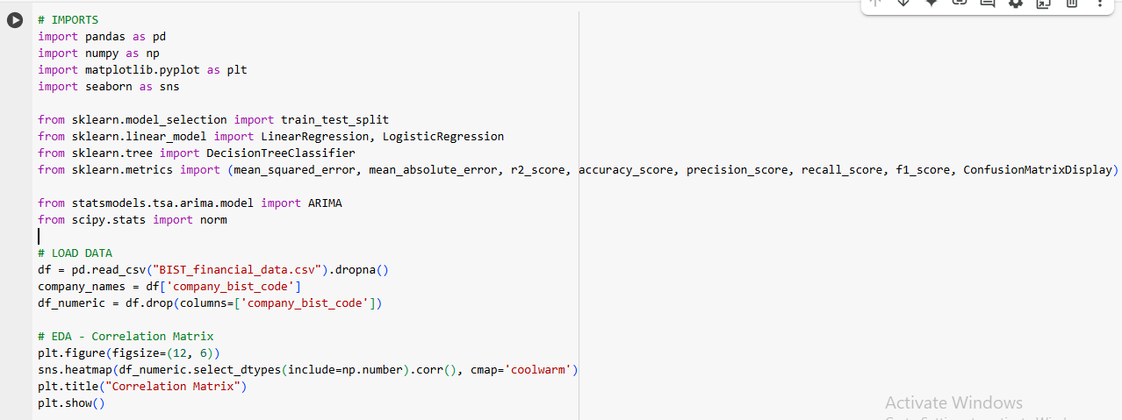
CODE WORKFLOW

Slide 6
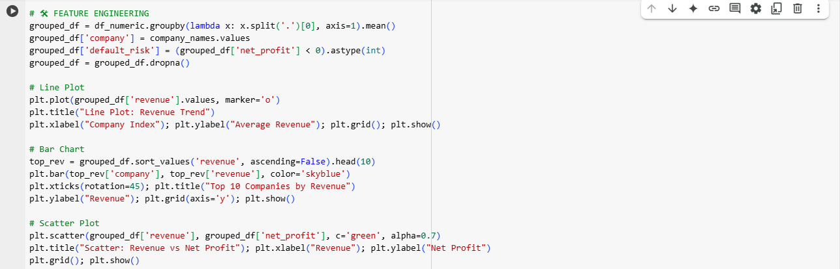
CODE WORKFLOW

Slide 7
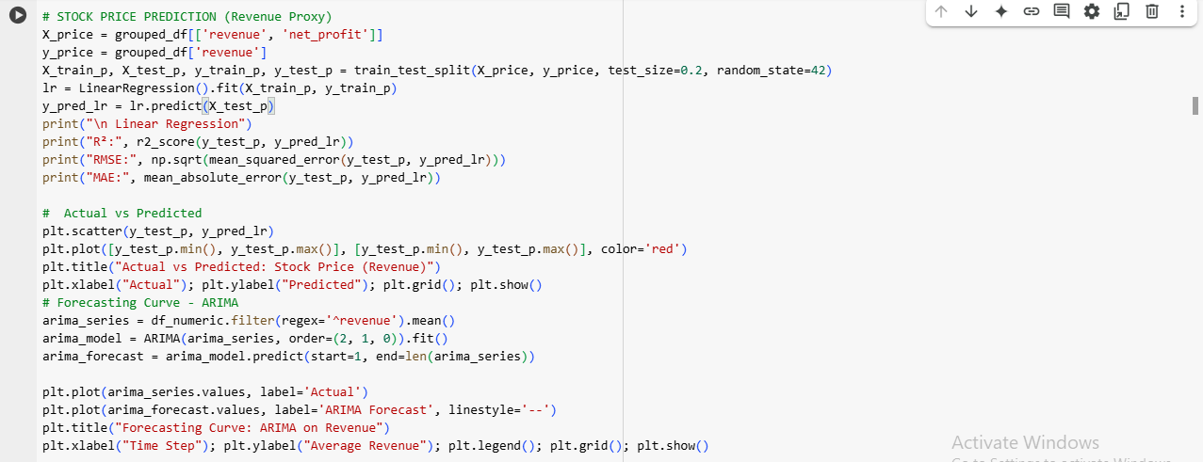
CODE WORKFLOW

Slide 8
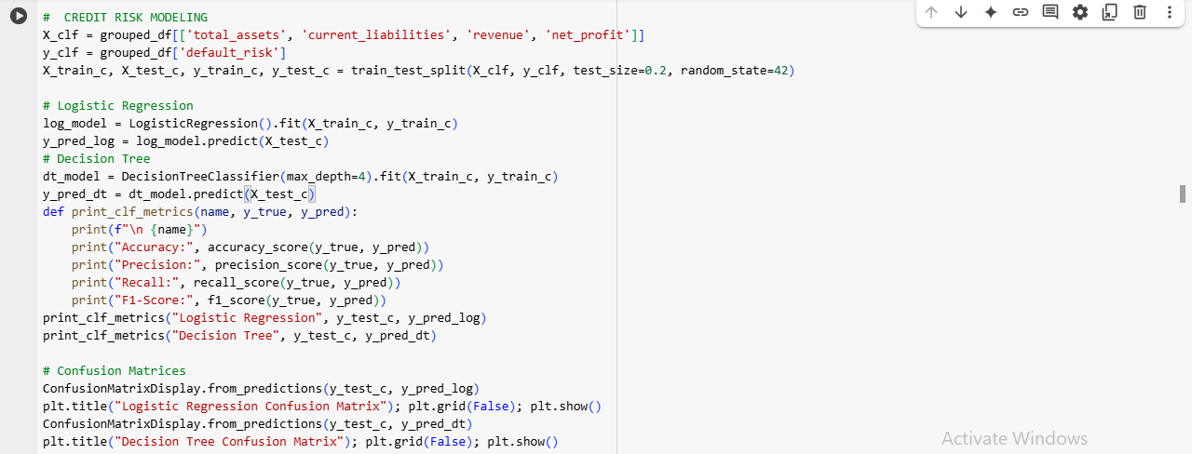
CODE WORKFLOW

Slide 9
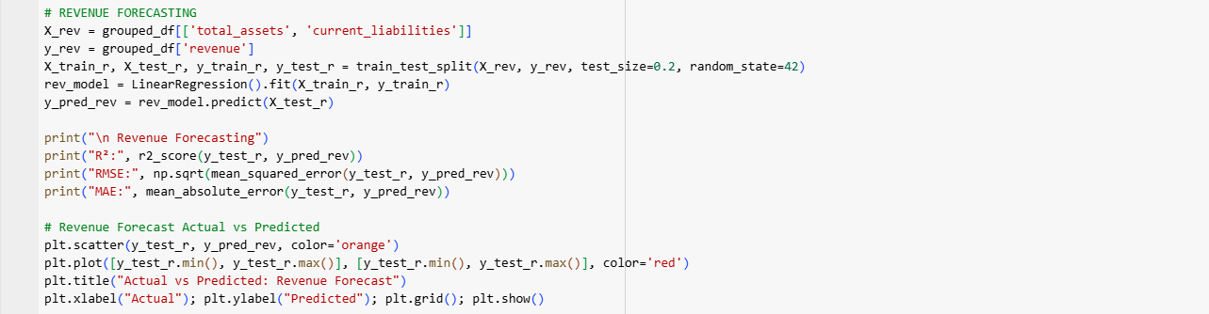
CODE WORKFLOW

Slide 10
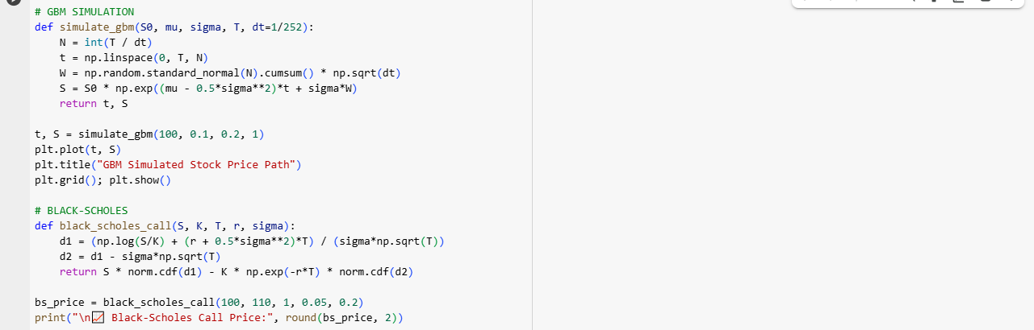
CODE WORKFLOW

Slide 11
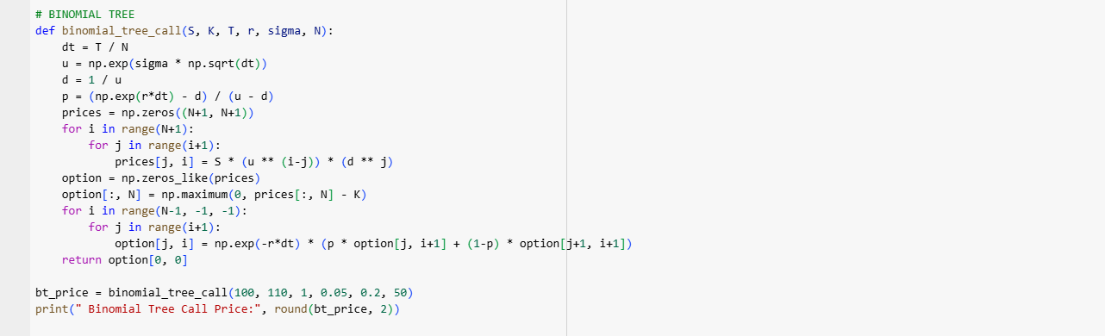
CODE WORKFLOW

Slide 12

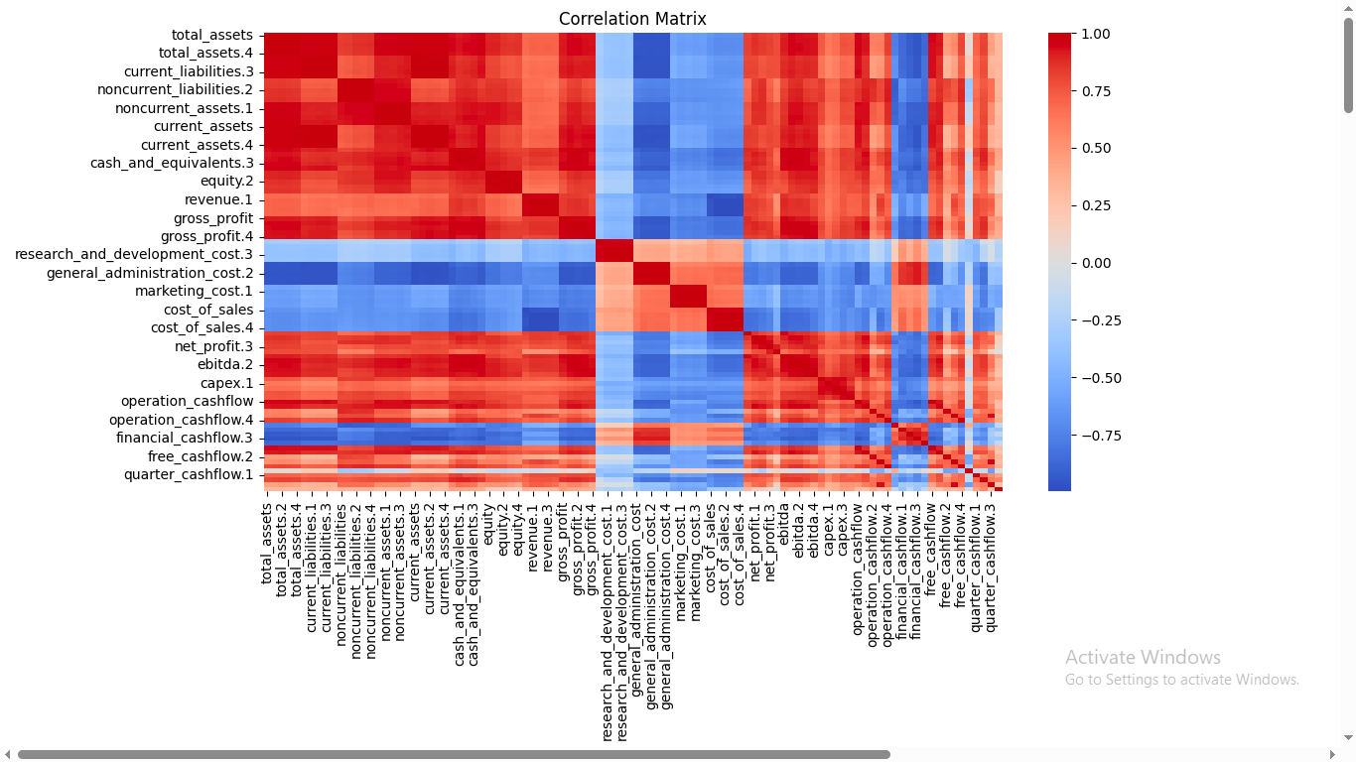
OUTPUT
A correlation matrix represented through a heatmap, which illustrates the relationships between various financial metrics and variables. Each square's color intensity shows the strength and direction of correlations: red indicates a high positive correlation, while blue signifies a negative correlation. The matrix includes variables like total assets, current liabilities, gross profit, net profit, and various cash flows, allowing for a visual assessment of how these metrics interact and influence one another in a financial context. This visual tool is essential for identifying patterns and potential areas of concern or opportunity within financial data.

Slide 13
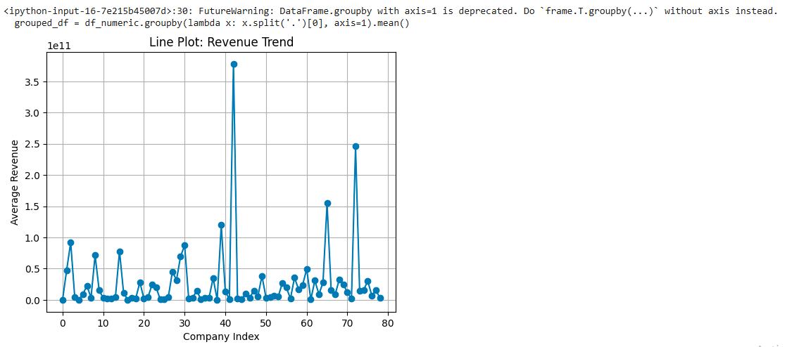
OUTPUT
The image presents a line plot illustrating the revenue trend across various companies, labeled as "Company Index" on the x-axis and "Average Revenue" on the y-axis. The plot features numerous data points, some of which show significant spikes in revenue, particularly around company indices 40 and 45, indicating periods of high revenue generation. Additionally, there's a warning message indicating that a specific grouping method used in the code is deprecated, suggesting a need for an updated approach in the data manipulation process. Overall, the graph visually represents variations in average revenue among companies, with noticeable peaks and troughs throughout the dataset.

Slide 14
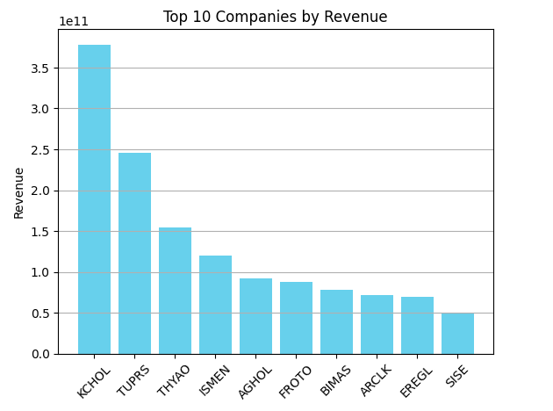
OUTPUT
The bar chart titled "Top 10 Companies by Revenue" displays the revenue of the leading companies in a structured format. KCHOL stands out as the highest revenue earner, approaching 3.5 trillion units. TUPS follows at a significantly lower level of just over 2 trillion, with THYAO and ISMEN also performing strongly but beneath the two leaders. The remaining companies, including AGHOL, FROTO, BIMAS, ARCLK, EREGL, and SISE, show progressively decreasing revenues, all remaining below the 1 trillion mark. The chart effectively highlights the stark differences in revenue among these top companies, illustrating KCHOL's dominant market position.

Slide 15
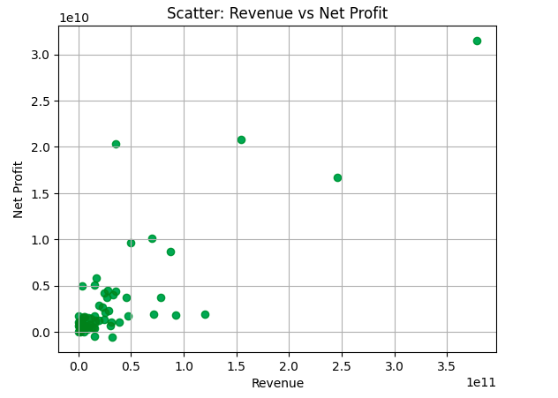
OUTPUT
The scatter plot titled "Scatter: Revenue vs Net Profit" displays the relationship between a company's revenue and its net profit. The x-axis represents revenue, while the y-axis indicates net profit, both with values reaching into the tens of billions. Most data points are clustered in the lower left quadrant, indicating that a majority of companies generate low revenue and net profit. A few outliers with significantly higher revenue and net profit are visible towards the upper right, suggesting that while the majority of firms may have minimal profit margins, a small number have achieved substantial financial success.

Slide 16
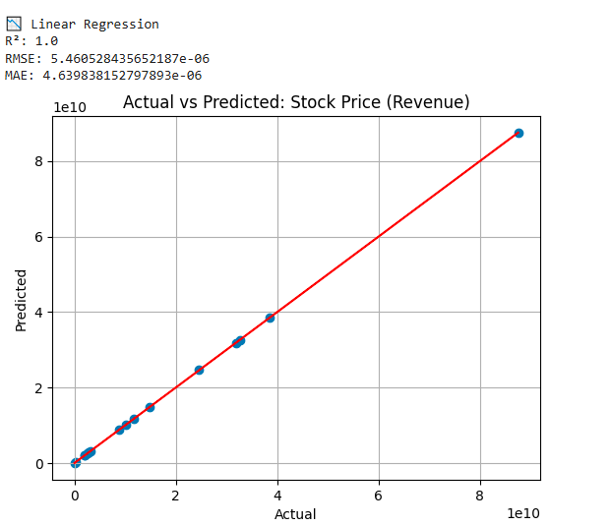
OUTPUT
The image shows a graph comparing actual stock prices to the predicted stock prices based on revenue. The blue dots represent the actual stock prices, while the red line shows the predicted prices. Since the points closely follow the red line, this means the predictions were very accurate. Key numbers on the graph indicate an R² value of 1.0, meaning a perfect fit, and very low error values (RMSE and MAE), which further shows how well the model performed in making predictions.

Slide 17
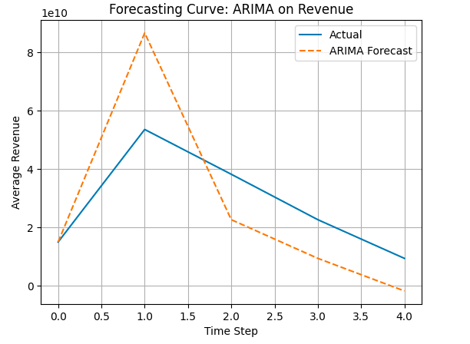
OUTPUT
The graph illustrates a comparison between actual revenue and forecasted revenue using the ARIMA model over a series of time steps. The "Actual" revenue is represented by a solid blue line, whereas the "ARIMA Forecast" is depicted as a dashed orange line. The vertical axis indicates the average revenue, measured in billions, while the horizontal axis represents time steps from 0 to 4. The actual revenue initially peaks before declining, while the forecasted revenue shows a less pronounced trend, suggesting a divergence between actual performance and the predictive model's output as time progresses.

Slide 18
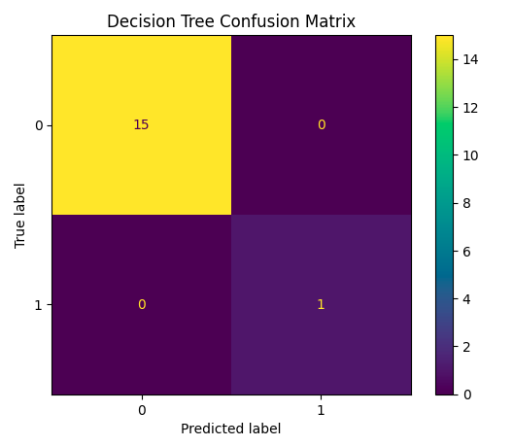

OUTPUT
The decision tree model demonstrates exemplary performance across various metrics, achieving an accuracy, precision, recall, and F1-score of 1.0, indicating flawless prediction capability. The confusion matrix further validates this exceptional performance, as it shows 15 true positives and 1 true negative, with no false positives or negatives, clearly categorizing each instance correctly. Overall, these results suggest that the model is highly reliable and effective in its classifications.

Slide 19
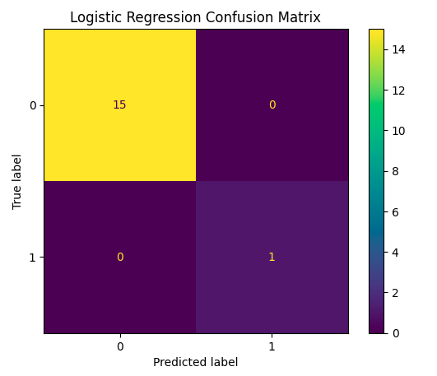
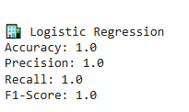
OUTPUT
It shows perfect scores (100% accuracy, precision, recall, and F1-score), meaning the model made no mistakes in predicting financial outcomes—like perfectly identifying good or bad loans. However, the second image (the confusion matrix) tells a different story: it shows 15 correct predictions but also 1 mistake. This inconsistency suggests there might be an error in how the results were calculated or reported. In finance, even one wrong prediction—such as approving a risky loan—can lead to losses, so it’s important to double-check the model’s performance carefully.

Slide 20
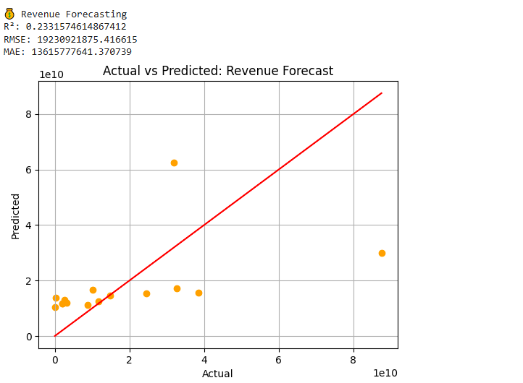
OUTPUT
The graph shows a revenue forecasting model with weak performance—the R² score is only 0.23, meaning the model explains just 23% of revenue changes, which isn’t very reliable. The high RMSE (19.2 billion) and MAE (13.6 billion) errors mean the predictions are often far off from actual revenue, sometimes by billions. In finance, such large errors could lead to poor budgeting, cash flow mismanagement, or bad investment decisions. Businesses should improve the model or use additional data to make more accurate forecasts.

Slide 21
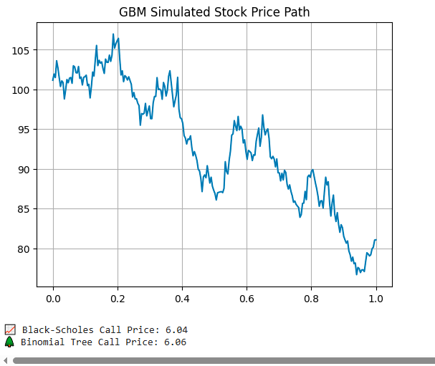
OUTPUT
This graph shows a simulated stock price path using the Geometric Brownian Motion (GBM) model, where the price fluctuates between $80 and $105 over time. The Black-Scholes and Binomial Tree models both estimate the call option price at around $6.85, suggesting fair agreement between these pricing methods. This simulation helps traders and investors visualize potential stock movements and evaluate option pricing, though real markets may behave differently due to unexpected events.

Slide 22
Thank You

