Slide 1
B.TECH PROJECT · DEPARTMENT OF ELECTRICAL ENGINEERING · IIT KHARAGPUR
Sampling Geometries and Band-Limits
for Radiance Fields
The size limit on a splatting primitive should be the inverse of the accumulated sampling information, floored at the per-view Nyquist limit — a matrix, not a scalar.
Rickarya Das · 23EE30019
Baselines: 3D Gaussian Splatting (2023) · Mip-Splatting (2024)

Slide 2
THE PROBLEM
A band-limit that was removed, then restored wrongly
where the limit lives
how it is set
granularity
NeRF (2020)
positional-encoding band L
by hand, from the images
one scalar, whole model
3DGS (2023)
nowhere
no regularisation is applied
absent
Mip-Splatting (2024)
variance added to covariance
nearest depth, largest focal
one scalar per primitive
this work
covariance added to covariance
accumulated sampling information
per primitive, per direction
NeRF used none of the geometry beyond a global glance at the images; 3DGS used none at all; Mip-Splatting used one view's worth; this work uses all of it.
Cost of having no limit: 10.98 dB at 1/8 scale, in the published numbers.

Slide 3
THE CLAIM
Treat primitive position as an estimation problem
Λₖ = Σₙ wₙₖ · (JₙWₙ)ᵀ Σₚᵢₓ⁻¹ (JₙWₙ)
JₙWₙ is the EWA Jacobian the renderer already forms to project a covariance. No new geometry is introduced.
Proposition 1
Proposition 2
The anisotropy
Mip-Splatting's filter is the single-view, lateral-only, isotropised special case — and its constant √0.2 is a sub-pixel confidence of 0.447 px. A magic number in a published paper, explained.
Floored at Mip-Splatting's own value, the method reduces to that baseline exactly where the floor dominates. Parity on standard benchmarks is structural, not hoped for — a loss there is a bug.
Closed form in three regimes: cos²φ within one view, a triaxial spectrum across two, and a cap form over a distribution of views — which is what a real capture protocol is.

Slide 4
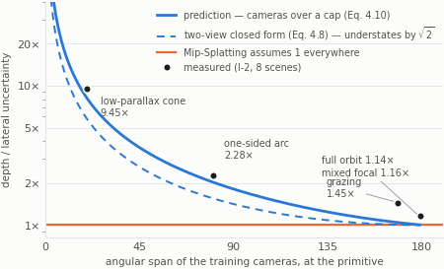
THE THEORY, AND ITS CORRECTION
A protocol is a distribution, not two views
The two-view closed form 1/sin(θ/2) is exact — for two views. A protocol is ten or a hundred cameras spread over a window, and for a cap its λ₃/λ₁ is asymptotically half the two-view value, so the two-view form understates the depth anisotropy by √2.
Direction matters. Measuring more anisotropy than the two-view form predicts is the model working. Reported against the wrong form, a confirmation would have read as a discrepancy.
Against the cap form at each protocol's own measured span, the five measurements agree to 10–15%. They were low by 60% against the two-view form.

Slide 5
DUE DILIGENCE
What the literature already had, and what is left
what it does
why this work survives it
AAA-Gaussians (2025)
already makes the 3D filter a full 3×3
anisotropy from the CURRENT VIEW RAY, per frame
PUP 3D-GS (CVPR 2025)
already builds this per-primitive matrix
collapses it to a SCALAR and prunes; spectrum discarded
FisherRF (ECCV 2024)
Fisher information in 3DGS
scores cameras to ACQUIRE; changes the dataset, not the primitive
So the contribution was narrowed, before the decisive experiment was run:
Not an anisotropic 3D filter. Not a per-primitive information matrix. What is new is the source of the anisotropy — the conditioning of the capture that happened, fixed once per primitive — and the retention of its spectrum.
A primitive seen from a narrow baseline is under-determined along depth whichever view renders it. A render-time filter cannot see that.

Slide 6
EXPERIMENTAL DESIGN
Frozen before any run
Two arms, one codebase
Six capture protocols
Arm A is Mip-Splatting. Arm B is 3DGS's band-limit semantics — filter_3D identically zero, kernel_size 0.3 — exact by Proposition 2 and verified on the saved point clouds, not argued from source.
Both arms share the dataloader, the metrics, the LPIPS backbone and the densification, so the gap between them is the method and not the plumbing.
protocol
span
σ_D/σ_L
above floor
full orbit
179°
1.14×
0%
grazing
168°
1.42×
0%
mixed focal
179°
1.16×
0%
one-sided arc
94°
2.10×
0%
low-parallax cone
51°
4.01×
100%
narrow pencil
20°
9.42×
100%
Acceptance levels and decision gates were declared in advance, so a disappointing number could not be rationalised into a success. Where a gate failed it is reported as failed.

Slide 7
RESULT 1 · THE CONTROL
Both baselines reproduced on free compute
test scale
Mip-Splatting, ours
published
Δ
full
33.44
33.36
+0.08
1/2
34.01
34.00
+0.01
1/4
31.78
31.85
−0.07
1/8
28.58
28.67
−0.09
Mip-Splatting reproduces to within ±0.20 dB at all four test scales. By the criterion declared before any run, this is L1 — numerical reproduction.
184 measured rows, 8 Blender scenes × 2 protocols × 2 arms × 4 test scales, plus 8 real scenes from Mip-NeRF 360, Tanks & Temples and Deep Blending. Every row carries both commits, the LPIPS backbone, peak VRAM, primitive count and the claimed acceptance level.

Slide 8
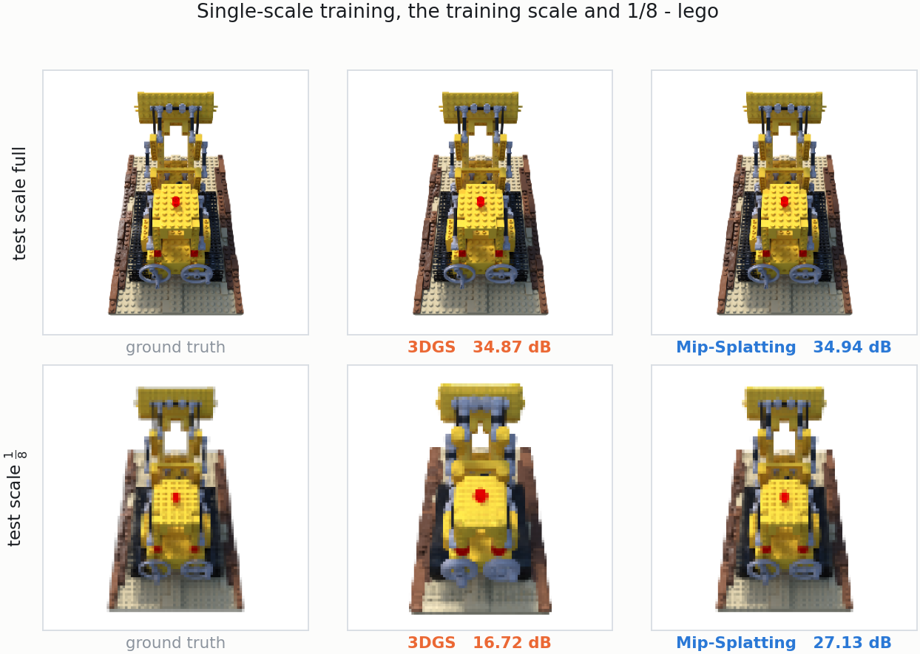
RESULT 1 · THE CONTROL, VISIBLY
What 10 dB of PSNR actually looks like
One view of lego, trained once at full resolution and tested at four scales. Left is ground truth, middle 3DGS, right Mip-Splatting.
At the training scale the two are indistinguishable — they agree to 0.07 dB. One octave down they have separated by 7 dB, and the 3DGS reconstruction visibly thickens: treads merge, the gap between the shovel arms closes, the yellow spreads past the studs that bound it.
A primitive smaller than a pixel is not removed by being unresolvable — it is splatted at full opacity into the pixel that contains it, and many such primitives sum. The band-limit is what stops that.
The pixels the PSNR column was computed from, not a re-render made for the slide. Nearest-neighbour magnification, so no resampler hides the aliasing.

Slide 9
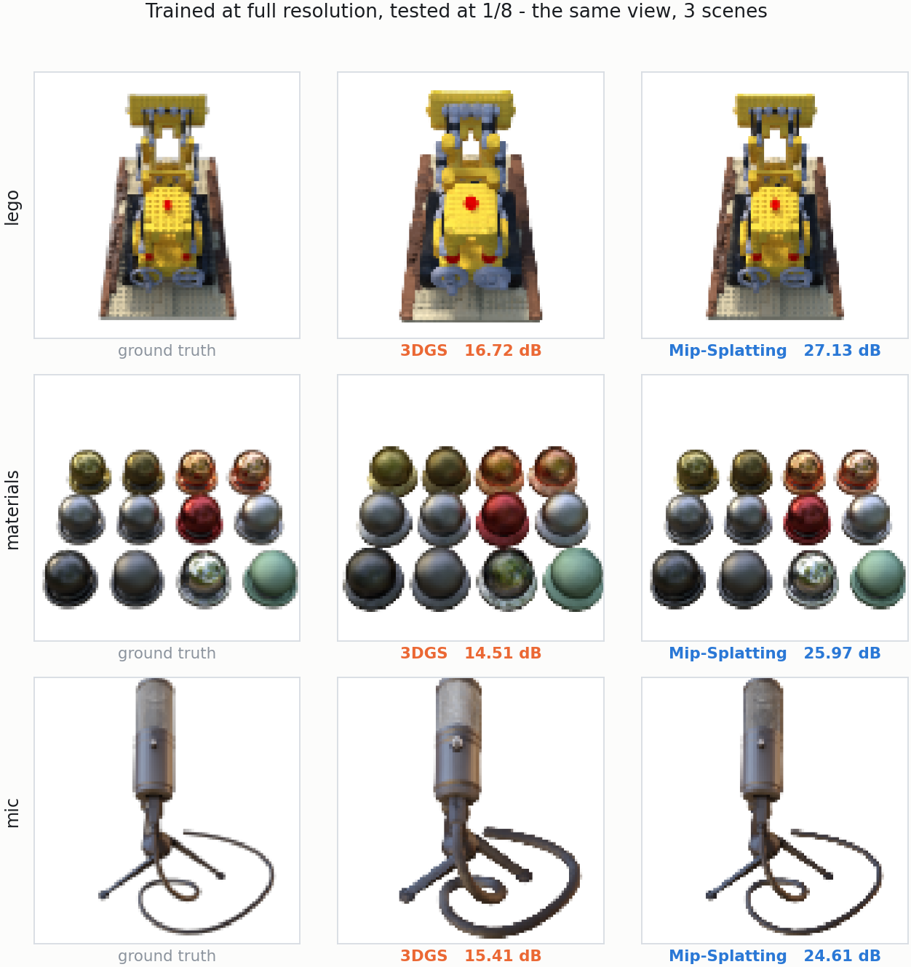
RESULT 1 · THE CONTROL, VISIBLY
The same signature on every scene
The 1/8 row, three of the eight scenes.
materials is the clearest case: the spheres lose their specular highlights to bloom and the dark ones lift towards grey. The image gains energy it should not have.
These three are shown because they are visually distinct from one another. Every scene measured under both arms shows the same thing, and all eight are stored as per-scene contact sheets in results/qualitative/ so the selection can be audited.

Slide 10
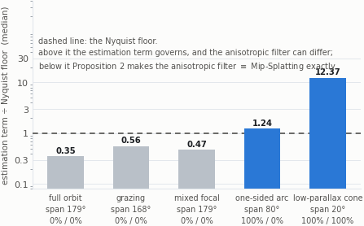
RESULT 2 · THE MECHANISM
The method can only act where the floor stops binding
This is the cheapest falsification the project had, and it did not fire.
On the standard benchmark the Nyquist floor dominates the estimation term by a factor of three, on 100% of primitives, in every direction. Proposition 2 then makes the anisotropic filter and Mip-Splatting the same filter there — no gain is available on the standard benchmark, and one would be a bug.
Degrade the capture and the balance moves exactly as predicted. Only the arc and the cone cross the line. That regime structure is the claim.

Slide 11
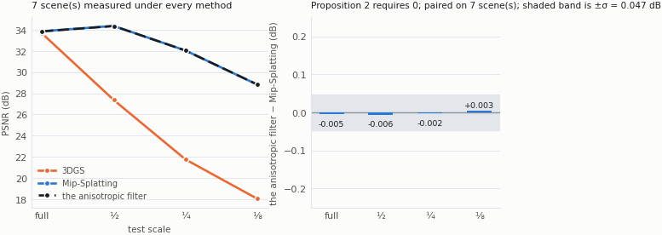
RESULT 3 · PARITY
Proposition 2, as a measurement
the anisotropic filter's curve is drawn dashed on top of Mip-Splatting's and is invisible beneath it, because that is what the proposition requires. The difference the band-limit makes is several decibels; the difference between which band-limit is hundredths of one.

Slide 12
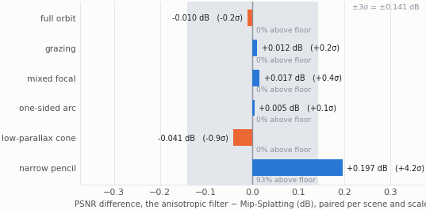
RESULT 4 · THE DECISIVE EXPERIMENT
Where the claim lives: degraded capture
Both methods train on the same protocol subset, in the same session, with the same seed, so the difference is paired per scene and test scale.
The shaded band is ±3σ of the harness's own run-to-run spread. A bar inside it is not a result.
The prediction, recorded before the runs: no change on the full orbit — Proposition 2 forbids it — and a gain ordered cone > arc > full ≈ 0.

Slide 13
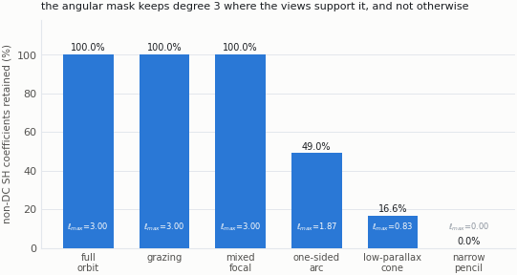
RESULT 5 · THE ANGULAR MASK
The same argument in the angular domain
Spherical-harmonic coefficients are 76% of the model. A primitive seen from a narrow cone cannot support degree 3, and the angular mask does not give it one.
Measurement amended the criterion. An absolute λ_min threshold has no value that responds gradually across regimes — it keeps everything on a full orbit and nothing on a cone. The scale-free condition number does, and is now the default. That is a change to the method only measurement could have produced.

Slide 14
RESULT 6 · COST
Rendering is unchanged, and it is measured
method
primitives
fps (render call only)
vs. Mip-Splatting
Mip-Splatting
292,946
112.7
1.000×
B1 — Fisher band-limit
291,214
111.6
0.990×
Λ is recomputed on the filter's own training schedule — about 290 times in 30,000 iterations — and never inside the render loop. So rendering cannot be slower, and the measurement confirms it.
What is NOT quoted here: the render_fps column logged by every rung. That is wall time over a whole render.py invocation — process start, scene load, PLY parse, PNG encode, disk write — which is why it reads 8–10 against a published 180–300. Quoting it as a rendering result would be a serious misreading of this project's own data.

Slide 15
WHAT RAN AGAINST EXPECTATION
Reported, not restated
The scale-collapse gate failed, and was diagnosed
The 3DGS arm did not collapse as far as the published numbers do. The cause was found in the rasteriser, not rationalised: the arm kept the 2D Mip filter's opacity compensation, which vanilla 3DGS does not apply. The arm was rebuilt and re-measured.
The mixed-focal protocol did not stress what it was built to stress
It moves the magnitude of the floor by 35% and its isotropy not at all. Either the protocol needs a wider focal spread than 2–4× or the defect is real but small; this measurement does not distinguish those, and is not reported as though it did.
Three bugs the parity requirement caught
A clamp at 1e-12 silently switched off the opacity compensation for most of the model — no error, plausible numbers, the wrong shape. What exposed it was requiring parity to hold approximately.
The two-view prediction was the wrong model for a protocol
Every measured anisotropy sat above it, by a consistent factor. That was one error, not five measurements disagreeing: a capture is a distribution of cameras, and the cap form is what it obeys.

Slide 16
STATUS
What is established, and what is next
Established
Next
— Both baselines reproduced end to end on free compute; Mip-Splatting to L1 at all four test scales.
— Variable-length SH storage, so the angular mask memory saving lands on disk — masking to zero leaves a fixed-width PLY the same size.
— Both proposed methods implemented, and both reduce to their baseline exactly where the theory requires — verified to 1.4×10⁻²¹ in the unit test.
— Pose-noise sensitivity: Λ inherits 3DGS's complete trust in SfM poses, and aggregation over views should degrade gracefully. That is a prediction, not a result.
— The regime structure the method depends on is measured, not assumed, across six capture protocols and eight scenes.
— Sampling-aware densification — the same information used to decide where primitives go, not only how large they may be.
— Every table and figure in the thesis and in this deck regenerates from one CSV by one command.
— Composition with AAA-Gaussians: a capture-side floor and a view-side clamp answer different questions and should coexist.

