Slide 1

Swiggy Analysis
RIDA SHAHWAR

Slide 2
overview
Introduction
Key factors
Dashboard design
Dashboard analysis

Slide 3


Introduction
The online food ordering market includes foods prepared by restaurants, prepared by independent people, and groceries being ordered online and then picked up or delivered. The first online food ordering service, World Wide Waiter (now known as Waiter.com), was founded in 1995. Online food ordering is the process of ordering food from a website or other application. The product can be either ready-to-eat food or food that has not been specially prepared for direct consumption.

Slide 4
KEY FACTORS
Finding the cuisines
Finding Best Restaurants
Finding Location-wise analysis

Slide 5
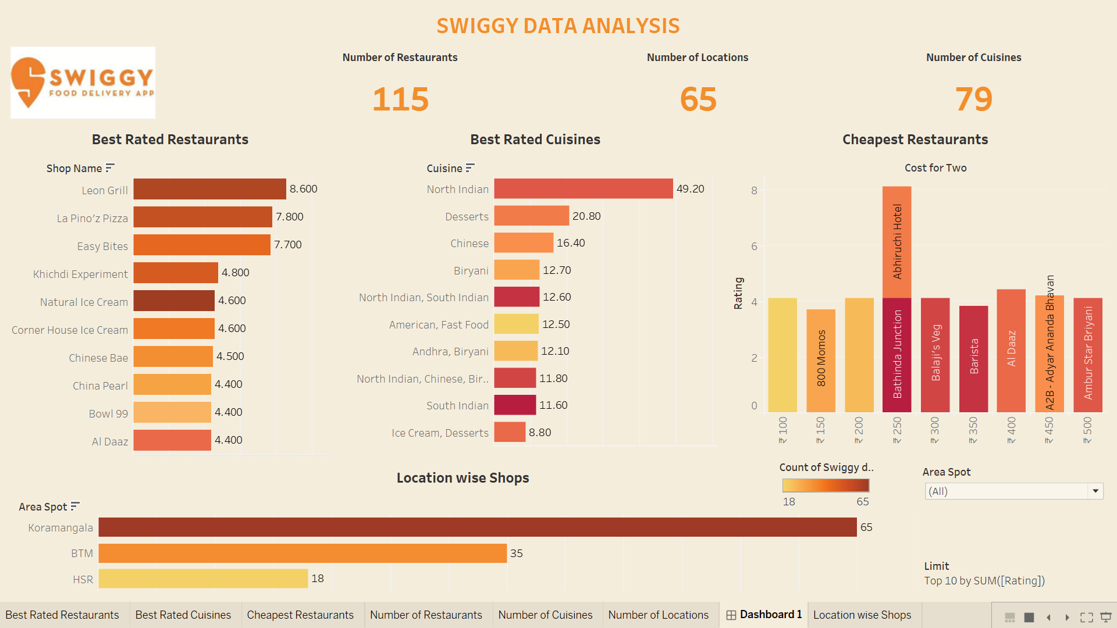
DASHBOARD DESIGN

Slide 6
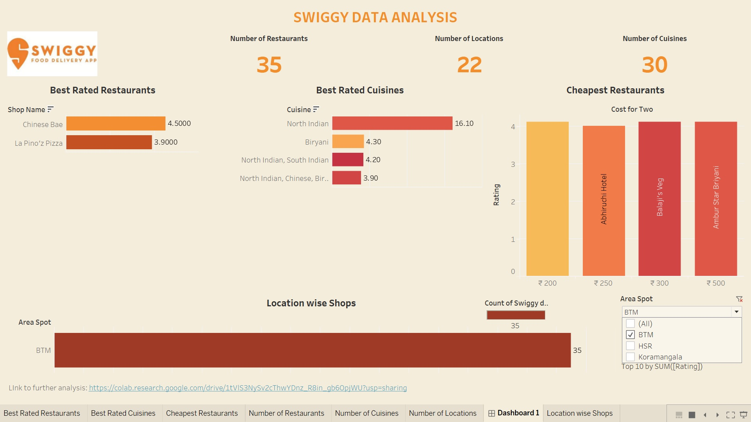
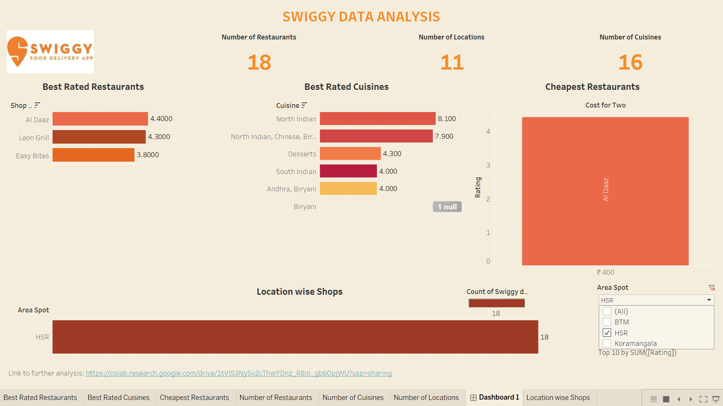
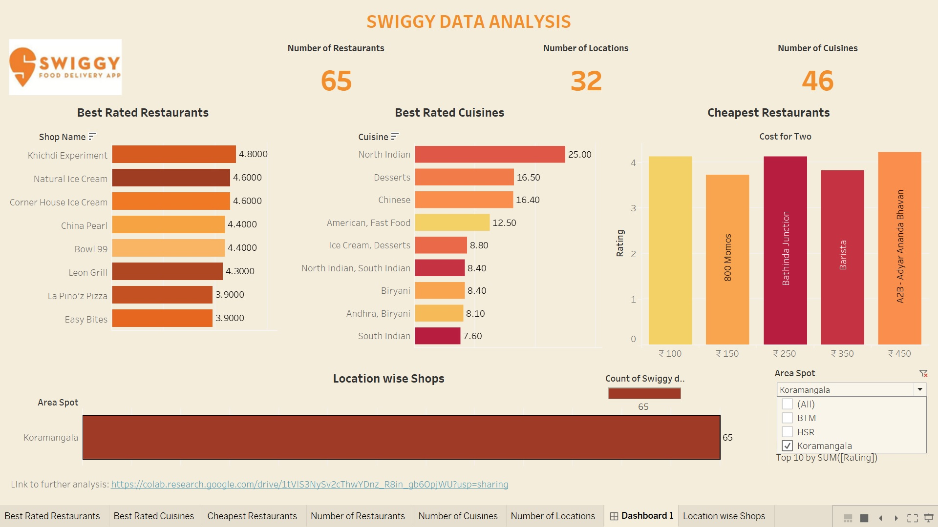
ANALYSIS BASED ON LOCATION

Slide 7
The way to get started is to quit talking and begin doing.
Walt Disney

Slide 8
ANALYSIS
Number of restaurants
Number of locations
Number of cuisines
Best-rated restaurants
Best-rated cuisines
Cheapest restaurants

Slide 9
LINKS TO THE PROJECTS
PYTHON
https://colab.research.google.com/drive/1tVlS3NySv2cThwYDnz_R8in_gb6OpjWU?usp=sharing
TABLEAU DASHBOARD
Swiggy Data Analysis | Tableau Public

Slide 10

Thank you
RIDA SHAHWAR

