Slide 1

FAKE NEWS DETECTION USING MACHINE LEARNING
Team Members:
Ananya Deep — E23CSEU0435
Akansha Attri — E23CSEU0445
Riddhi Chopra — E23CSEU0477
Misha Alam — E23CSEU0480

Slide 2

Dataset Overview
Fake.csv + True.csv combined
Labeled as 0 (fake) and 1 (true)
Used ~5000 samples for training/testing
Balanced dataset for better accuracy
NLP & Preprocessing
Lowercasing & regex-based cleaning
Removing punctuation, HTML tags, URLs
Tokenization using NLTK
Lemmatization using WordNet
Stopword removal
Output → Cleaned text for vectorization

Slide 3

Machine Learning Models
Model Training & Saving
Used TF-IDF features for training
Models experimented:
Performed train-test split (80-20)
SVC
KNN
Trained stacking ensemble
Logistic Regression
Saved final files:
Stacking Classifier chosen for best performance
nlp_model.pkl
transform.pkl

Slide 4
Flask Backend
Created routes: / and /predict
Loaded model + TF-IDF vectorizer
Implemented preprocessing inside backend
Connected HTML input to Python logic
Prediction Workflow
01
02
03
User enters news text
Text is cleaned → tokenized → lemmatized
Vectorized via TF-IDF
04
05
Model predicts Fake (0) / Real (1)
Result displayed on UI

Slide 5

Frontend UI
Result Page
Styled newspaper-themed background
Displays:
TRUE NEWS in red
Centered input box
FAKE NEWS in blue
Added "Predict" button
Simple and easy-to-read layout
Clean, minimal interface
Integrated with Flask output

Slide 6
Technologies Used
Python
NLTK
tokenization, lemmatization
TF-IDF Vectorizer
Scikit-Learn
ML models
MLXtend
Flask
HTML/CSS
stacking classifier
deployment
UI

Slide 7
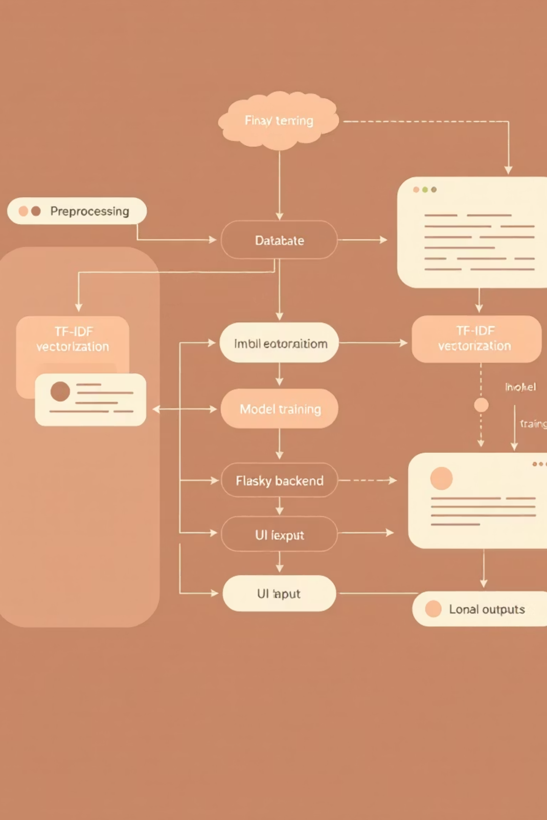
System Architecture
Dataset → Preprocessing → TF-IDF → Model Training → Flask → UI → Output
Backend & UI fully integrated

