Slide 1
Maze and Path-Finding Optimization System
BFS · DFS · Dijkstra’s Algorithm · A*
Course: Design and Analysis of Algorithms · 5th Semester [ IT-B ]
Group No.: [ 4 ]
Patel Nihira (12402080601094)
Patel Niyati (12402080601097)
Patel Riddhi (12402080601115)
Rana Riyancee (12402080601119)
Faculty: Yamini Dubey

Slide 2
Problem Statement
Find the best route through a maze from a source to a destination, and compare how different algorithms do it.
Input
Output
Constraints
Objective
Grid of R × C cells
Walls and mud cells
Source and destination
Path (list of cells)
Path length and cost
Cells explored, time
4-direction moves
Normal cell costs 1, mud costs 5
Walls cannot be crossed
Minimum-cost path
Compare BFS, DFS, Dijkstra, A* on length, time and explored nodes
Maze and Path-Finding Optimization System · DAA
2

Slide 3
Motivation and Real-World Applications
Why it matters
Where it is used
Who benefits
Shortest-path search is a core graph problem
Choice of algorithm changes speed and memory
Wrong choice gives long or costly routes
GPS and map navigation
Game AI and NPC movement
Robot and drone planning
Network packet routing
Students learning DAA
Developers picking a path-finder
Robotics and game teams that need fast, optimal routes
Maze and Path-Finding Optimization System · DAA
3

Slide 4
Objectives
1
Implement BFS, DFS, Dijkstra and A* from scratch on a grid
2
Build an interactive maze editor with walls, mud, start and end
3
Visualize each algorithm’s exploration step by step
4
Measure path length, cost, explored cells, run time and frontier size
5
Test on grids of 10, 50, 100 and 500 per side and compare results
6
Verify optimality and explain the results with complexity analysis
Maze and Path-Finding Optimization System · DAA
4

Slide 5
Existing Approach and Limitations
Existing / basic approach
Limitations
Plain DFS or BFS used alone
Fixed algorithm, no comparison
Manual trial and error on small mazes
DFS can return very long paths
BFS ignores cell weights
Dijkstra explores in all directions
No view of time vs explored cells
Need: one system that runs all four algorithms on the same maze and measures them fairly.
Maze and Path-Finding Optimization System · DAA
5

Slide 6
Proposed Approach
1 Problem
2 Input
3 Algorithm choice
4 Pseudocode
Shortest path in a weighted grid
Draw or generate the maze
BFS, DFS, Dijkstra, A*
Queue, stack, min-heap
8 Conclusion
7 Comparison
6 Testing
5 Implementation
Pick best per situation
Time, cells, cost, space
Sizes 10 to 500, 5 layouts
JavaScript, canvas
Maze and Path-Finding Optimization System · DAA
6

Slide 7
Algorithms Used
Algorithm | Basic idea | Why selected | Data structure
BFS | Expands level by level | Shortest path when costs are equal | Queue
DFS | Goes deep, then backtracks | Low memory baseline; shows non-optimality | Stack
Dijkstra | Always expands lowest total cost | Optimal with weights (mud) | Min-heap
A* | Dijkstra + Manhattan estimate to goal | Optimal with fewer explored cells | Min-heap
Maze and Path-Finding Optimization System · DAA
7

Slide 8
Algorithm / Pseudocode
BFS(s, t):
Q ← queue{s}; seen[s] ← true
while Q not empty:
u ← dequeue(Q)
if u = t: return path
for v in neighbours(u):
if not seen[v]:
seen[v] ← true; parent[v] ← u
enqueue(Q, v)
return NO PATH
Dijkstra / A*(s, t):
dist[s] ← 0; PQ ← {(0, s)}
while PQ not empty:
u ← extract-min(PQ)
if u = t: return path
for v in neighbours(u):
nd ← dist[u] + w(v)
if nd < dist[v]:
dist[v] ← nd; parent[v] ← u
push(PQ, nd [+ h(v) for A*])
BFS O(V+E) · O(V)
DFS O(V+E) · O(V)
Dijkstra O((V+E) log V) · O(V)
A* O(E) to O(b^d) · O(V)
DFS uses a stack instead of a queue; A* uses h(n) = |Δrow| + |Δcol|.
Maze and Path-Finding Optimization System · DAA
8

Slide 9
System Design / Architecture
User
Maze Module
Algorithm Engine
Metrics
Output
Draw walls, mud; pick algorithm and speed
Generate, edit, store grid g[R][C]
BFS · DFS · Dijkstra · A*
Path, cost, cells, time, frontier
Animation, table, bar charts
Data flow
Click or drag edits the grid state, then Run calls solve(alg)
solve returns {path, order, cost, time, frontier}; draw() animates the order, then the path
“Compare all 4” runs every algorithm on the same grid and fills the table and charts
Maze and Path-Finding Optimization System · DAA
9

Slide 10
Implementation
Tools
Modules
Data structures
HTML, CSS, JavaScript
Canvas for the grid
No external libraries
performance.now() for timing
Maze generator (recursive backtracking)
Editor (pointer events)
solve(alg) engine
Animator and renderer
Comparison dashboard
2D array: -1 wall, 1 normal, 5 mud
Queue (array + head index)
Stack (array)
Binary min-heap
Arrays: dist, parent, seen
Maze and Path-Finding Optimization System · DAA
10

Slide 11
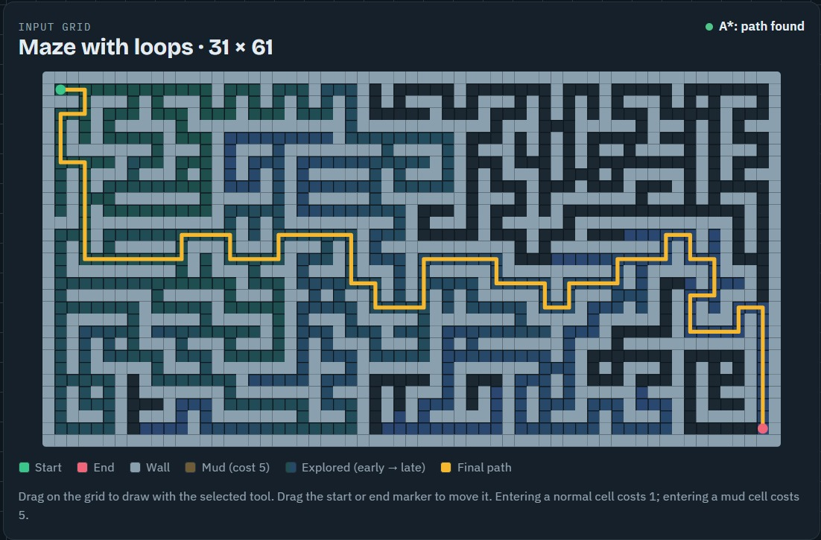
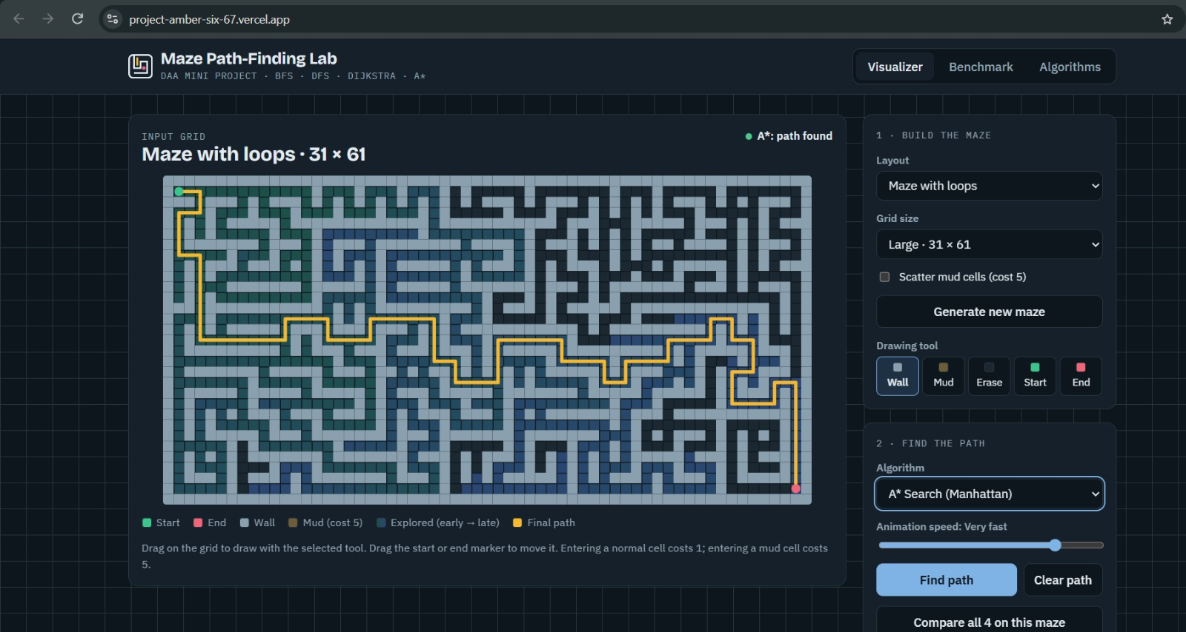
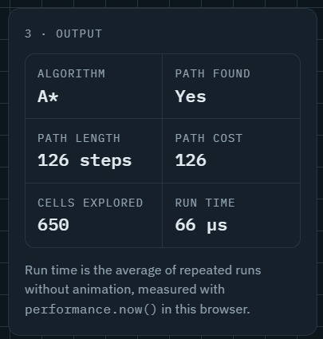
Project Screenshots
Input: layout, grid size, drawing tool and algorithm controls
Result / performance
A*: 126 steps, cost 126, 650 cells explored, 66 µs
Processing and output: A* on a 31×61 maze with loops. Explored cells are shaded, final path is orange.
Maze and Path-Finding Optimization System · DAA
11

Slide 12
Results: Input Size vs Execution Time
Grid (20% walls) | BFS | DFS | Dijkstra | A*
10×10 | 0.202 | 0.079 | 0.181 | 0.106
50×50 | 0.981 | 0.288 | 0.889 | 0.279
100×100 | 1.86 | 0.197 | 2.72 | 1.02
500×500 | 62.4 | 12.2 | 103.6 | 28.6
Time in ms (average of repeated runs)
500×500 cells explored: BFS and Dijkstra 199,321, A* 40,840, DFS 30,124
Optimal cost 998; DFS path cost 3380
Maze and Path-Finding Optimization System · DAA
12

Slide 13
Complexity Analysis
Algorithm | Best case | Average case | Worst case | Space
BFS | O(1) goal found early | O(V+E) | O(V+E) | O(V)
DFS | O(1) | O(V+E) | O(V+E) | O(V)
Dijkstra | O(1) | O((V+E) log V) | O((V+E) log V) | O(V)
A* | O(d) with a perfect heuristic | Depends on h(n) | O(b^d) | O(V)
Theory vs practice
Dijkstra and BFS explore the same 199,321 cells at 500×500, but Dijkstra takes 103.6 ms vs 62.4 ms because of heap work (log V)
A* explores 4.9× fewer cells than Dijkstra and runs 3.6× faster
DFS is fastest on some runs but returns a path 3.4× costlier than optimal
Maze and Path-Finding Optimization System · DAA
13

Slide 14
Advantages, Limitations and Future Scope
Advantages
Limitations
Future scope
All four algorithms on one maze
Live animation and metrics
Handles weighted cells
Runs in any browser, no install
4-direction moves only
Timing varies by device
Browser memory limits very large grids
Heuristic fixed to Manhattan
Diagonal moves and Euclidean heuristic
Bidirectional search, Jump Point Search
Dynamic obstacles
Export results as CSV
Maze and Path-Finding Optimization System · DAA
14

Slide 15
Conclusion and References
All four algorithms were implemented and tested on grids up to 500×500
BFS = Dijkstra on equal costs; only Dijkstra and A* stay optimal with mud
A* gave optimal paths with the fewest explored cells among optimal methods
DFS is cheap but not optimal
References
Cormen, Leiserson, Rivest, Stein, Introduction to Algorithms, MIT Press
Dijkstra, “A note on two problems in connexion with graphs”, Numerische Mathematik, 1959
Hart, Nilsson, Raphael, “A formal basis for the heuristic determination of minimum cost paths”, IEEE Trans. SSC, 1968
Russell and Norvig, Artificial Intelligence: A Modern Approach
MDN Web Docs: Canvas API, Performance.now()
Maze and Path-Finding Optimization System · DAA
15

