Slide 1
RESTAURANT DATABASE MANAGEMENT
BY :- HITESHREE PANCHAL 27
RIDDHI PANDYA 28
NEHA PAREPALLI 30
ANUJA PATEL 31

Slide 2
DESCRIPTION
This restaurant management system is for a small-scale restaurant with only one location.
The restaurant has the record of each employee working in the restaurant:
The employees have different role such as manager, waiter, chef and employee. Employee’s hire-date is also mentioned.
The database must keep track of the menu used by the restaurant:
Each item has an item-no. , name, price of the items ,The amount of quantity ordered by each customer.
The restaurant to keep a record of its customers:
Every customer has an ID, Name, Address, phone number. We keep track of the customer’s order.
The restaurant has an inventory which oversees the all requirement raw materials:
We keep track of the ID, name and quantity-left and last-date-of-entry of each raw materials available in the inventory.
The restaurant needs to keep a record of all the bills: Every customer must pay bills after his/her meal. Each customer is given an option to pay the bill with different methods.

Slide 3
Entity
employee (emp-id , name ,phone-no ,role, hire-date)
bill (bill-no , amount , method-of-payment)
customer (customer-id , name , phn-no , address)
menu (item-no, name , price,quantity )
inventory (inv-no , quantity-left , inv-item-name , last-date-of-entry)

Slide 4
Relations :
manages :- 1:N manger with employee ; both partial
service :- 1:N customer with employee; customer total, employee partial
payment :- 1:1 customer with bill ; bill total ,customer partial
orders :- M:N menu with customer ;menu partial, customer total
supply :- M:N menu with inventory ;both partial

Slide 5
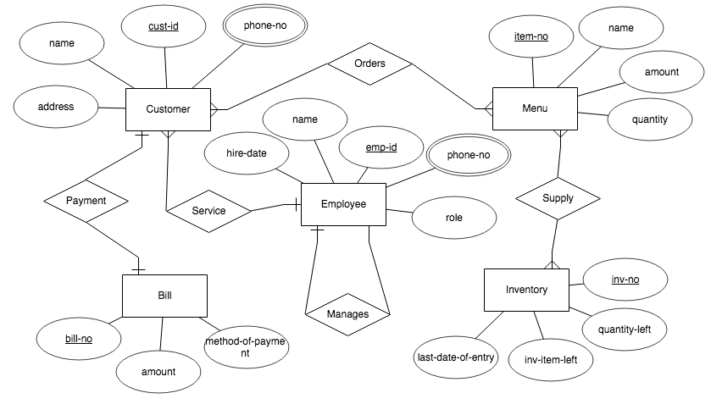
ER Diagram

Slide 6
Relational Model
employee (emp-id , name ,phone-no ,role, hire- date,manager-id*)
bill (bill-no , amount , method-of-payment , customer-id*)
customer (customer-id , name , phn-no , address , emp-id*)
menu (item-no, name , amount ,quantity )
inventory (inv-no , quantity-left , inv-item-name , last-date-of-entry)
orders ( item-no* , cust-id*)
supply ( item-no* , inv-no*)

Slide 7
Code DDL
drop table employee; drop table bill; drop table customer; drop table menu; drop table inventory; drop table orders; drop table supply; | create table employee( emp_id numeric(20) primary key, emp_name varchar(50) not null, phn_no numeric(20), hire_date date not null, role varchar(50) not null, manager_id nvarchar(20), index(emp_id), constraint fk_man_id foreign key(emp_id) references employee(emp_id)); | create table bill( bill_no numeric(20) primary key, amount numeric(50), method_of_payment varchar(30) not null, customer_id numeric(20), index(customer_id), constraint fk_custom_id foreign key(customer_id) references customer(customer_id));

Slide 8
create table customer( customer_id numeric(20) primary key, customer_name varchar(50) not null, phn_no numeric(20), address varchar(80) not null, emp_id numeric(20), index(emp_id), constraint fk_employ_id foreign key(emp_id) references employee(emp_id)); create table menu( item_no numeric(30) primary key, item_name varchar(50) not null, amount numeric(50,2) not null, quantity numeric(50)); | create table inventory( inv_no numeric(50) primary key, quantity_left numeric(50) not null, inv_item_name varchar(50) not null, last_date_of_entry date); create table orders( item_no numeric(30), customer_id numeric(20), index(item_no), index(customer_id), constraint pk_orders primary key(item_no,customer_id), constraint fk_iteeem_no foreign key(item_no) references menu(item_no) on delete cascade, constraint fk_cusmer_id foreign key(customer_id) references customer(customer_id)); | create table supply( item_no numeric(30), inv_no numeric(50), index(item_no), index(inv_no), constraint pk_supply primary key(item_no,inv_no), constraint fk_itemmm_no foreign key(item_no) references menu(item_no) on delete cascade, constraint fk_inv_no foreign key(inv_no) references inventory(inv_no));

Slide 9
Code DML
insert into bill values (5, 929, 'google_pay', 6160390); insert into bill values (2, 941, 'debit', 6734826); insert into bill values (7, 681, 'google_pay', 7238390); insert into bill values (4, 387, 'google_pay', 6003358); insert into bill values (3, 216, 'cash', 5816967); insert into bill values (10, 638, 'credit', 5989537); insert into bill values (8, 369, 'paytm', 6615632); insert into bill values (9, 762, 'debit', 6500977); | insert into bill values (1, 269, 'cash', 6645127); insert into bill values (6, 185, 'credit', 6310256); insert into customer values (6160390, 'Eve', 9902055540, 'E-20_Swami_Road_Virar', 5980172); insert into customer values (6734826, 'Avijit', 9903028079, 'E-65_Bhatia_Road_Dahisar', 7156878); insert into customer values (7238390, 'Santosh', 9949380158, 'F-328_Vajira_Andheri', 6704120); insert into customer values (6003358, 'Gautam', 9938208823, 'E-65_Bhatia_Road_Dahisar', 5762513); | insert into customer values (5816967, 'Shubham', 9941434328, 'A-32_Yam_Road_Dadar', 5846757); insert into customer values (5989537, 'Deepak', 9940917415, 'F-328_Vajira_Andheri', 6404075); insert into customer values (6615632, 'Jill', 9950235956, 'A-520_Balaji_road_Bandra', 7150565); insert into customer values (6500977, 'Rakesh', 9920769189, 'A-57_Ambadi_road_Vasai', 6474086); insert into customer values (6645127, 'Jack', 9893392469, 'B-43_Navghar_Road_Parle', 5683223); insert into customer values (6310256, 'Eve', 9950906733, 'A-32_Yam_Road_Dadar', 6604861);

Slide 10
insert into employee values (5980172, 'Rachit', 5453372364, '2019/10/20', 'cashier', 'null'); insert into employee values (7156878, 'Anuja', 6345414720, '2020/03/01', 'manager', 7156878); insert into employee values (6704120, 'Neha', 2011340305, '2019/06/25', 'waiter', 'null'); insert into employee values (5762513, 'Rishi', 6273820597, '2019/12/23', 'employee', 'null'); insert into employee values (5846757, 'Vikrant', 2449117256, '2019/04/05', 'chef', 'null'); insert into employee values (6404075, 'Riddhi', 8559449516, '2019/10/18', 'cashier', 'null'); insert into employee values (7150565, 'Atharva', 3996501490, '2019/04/02', 'manager', 7150565); | insert into employee values (6474086, 'Dhairya', 4464939775, '2019/08/29', 'waiter', 'null'); insert into employee values (5683223, 'Hiteshree', 2233514132, '2019/08/08', 'employee', 'null'); insert into employee values (6604861, 'Diksha', 5849987454, '2020/02/20', 'chef', 'null'); insert into inventory values (4, 35, 'Potato', '2020/03/08'); insert into inventory values (26, 17, 'Bread', '2020/02/06'); insert into inventory values (5, 6, 'Onion', '2020/02/11'); insert into inventory values (10, 7, 'Spinach', '2020/03/06'); insert into inventory values (27, 4, 'Tomato', '2020/02/15'); | insert into inventory values (60, 34, 'Cheese', '2020/02/29'); insert into inventory values (11, 24, 'Butter', '2020/01/15'); insert into inventory values (17, 20, 'Baby_Corn', '2020/03/14'); insert into inventory values (14, 15, 'Carrot', '2020/03/18'); insert into inventory values (30, 40, 'Capsicum', '2020/03/18'); insert into menu values (8, 'Dum_Aloo', 809.49, 2); insert into menu values (19, 'Pizza', 160.95, 5); insert into menu values (34, 'Pasta', 415.9, 8); insert into menu values (36, 'Sandwich', 240.27, 1);

Slide 11
insert into menu values (15, 'Sizzler', 542.79, 4); insert into menu values (3, 'Manchurian', 863.21, 3); insert into menu values (9, 'Fried_Rice', 848.65, 4); insert into menu values (40, 'Shahi_Paneer', 343.28, 2); insert into menu values (17, 'Burger', 490.06, 3); insert into menu values (20, 'French_Fries', 844.09, 9); insert into orders values (8, 6160390); insert into orders values (19, 6734826); insert into orders values (34, 7238390); insert into orders values (36, 6003358); | insert into orders values (15, 5816967); insert into orders values (3, 5989537); insert into orders values (9, 6615632); insert into orders values (40, 6500977); insert into orders values (17, 6645127); insert into orders values (20, 6310256); | insert into supply values (8, 4); insert into supply values (19, 26); insert into supply values (34, 5); insert into supply values (36, 10); insert into supply values (15, 27); insert into supply values (3, 60); insert into supply values (9, 11); insert into supply values (40, 17); insert into supply values (17, 14); insert into supply values (20, 30); commit;

Slide 12
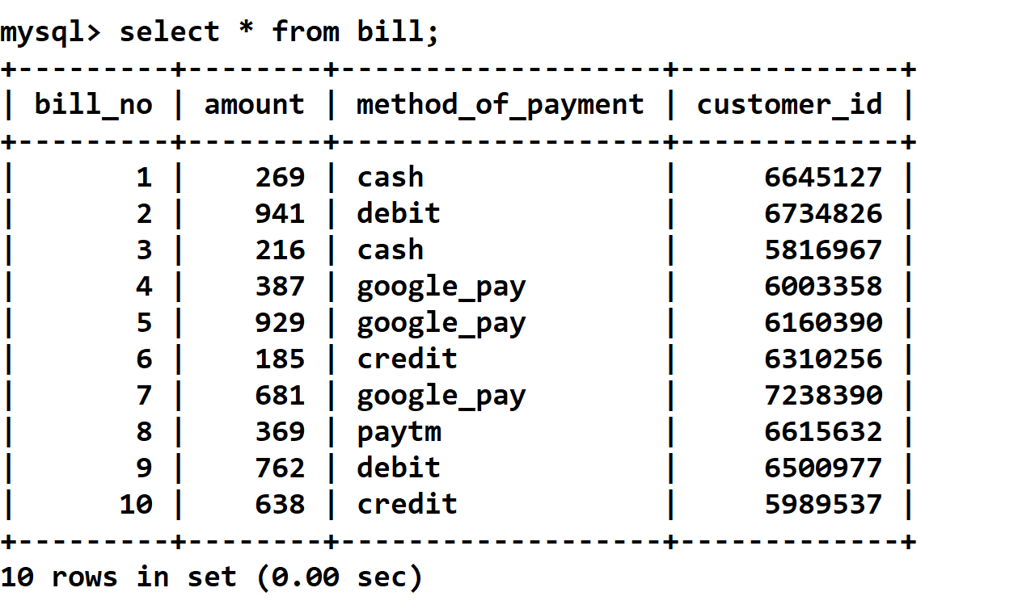
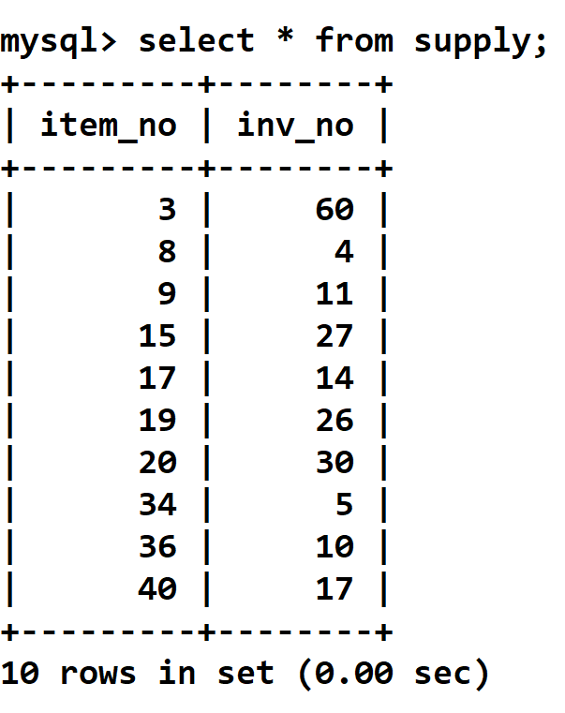
Tables

Slide 13
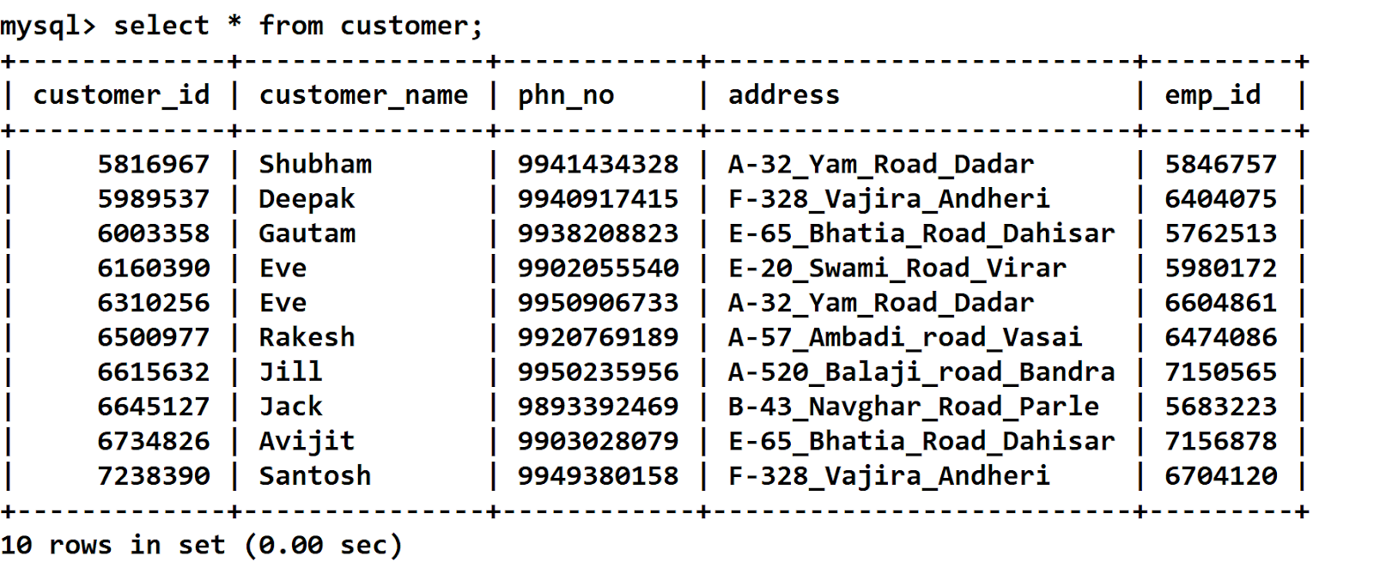
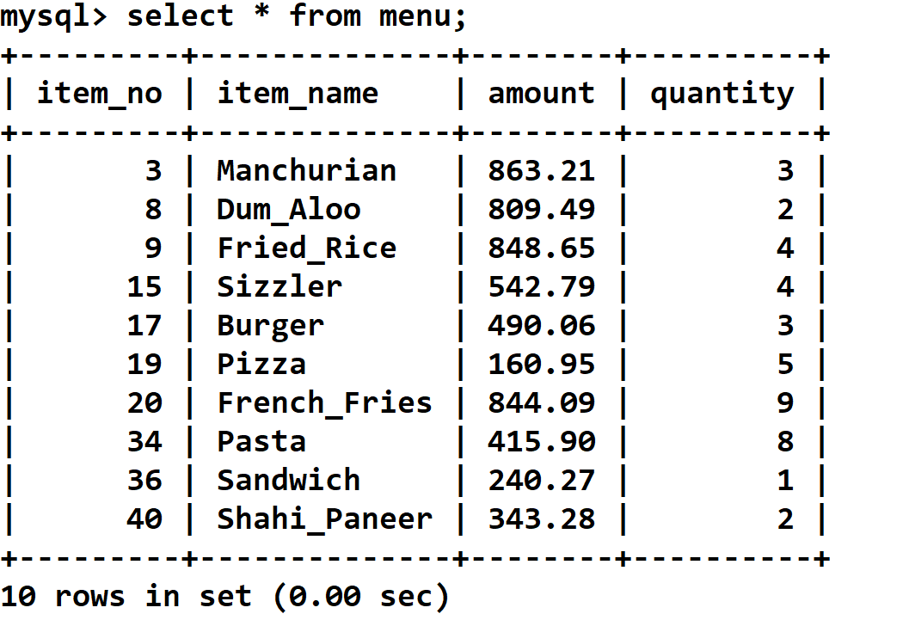

Slide 14
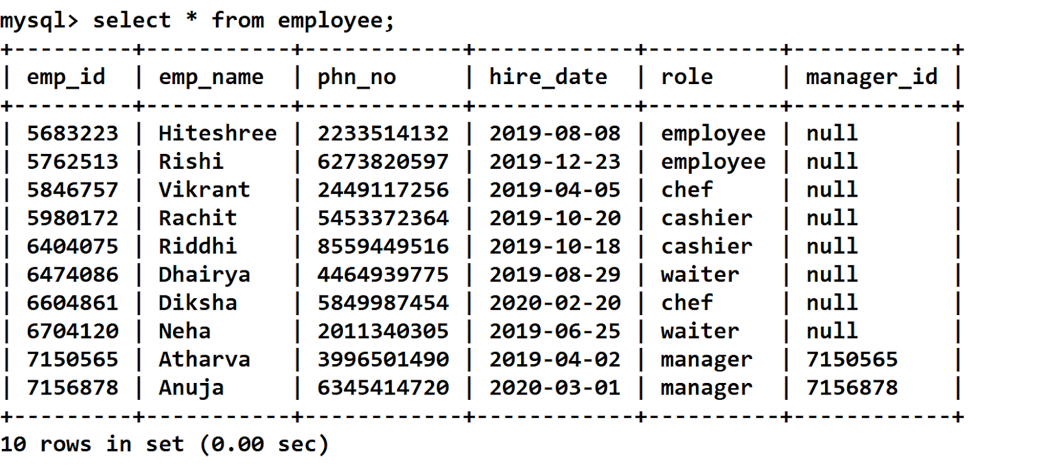
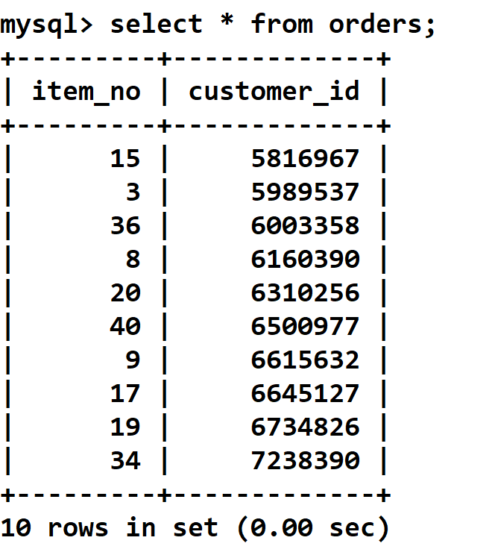

Slide 15
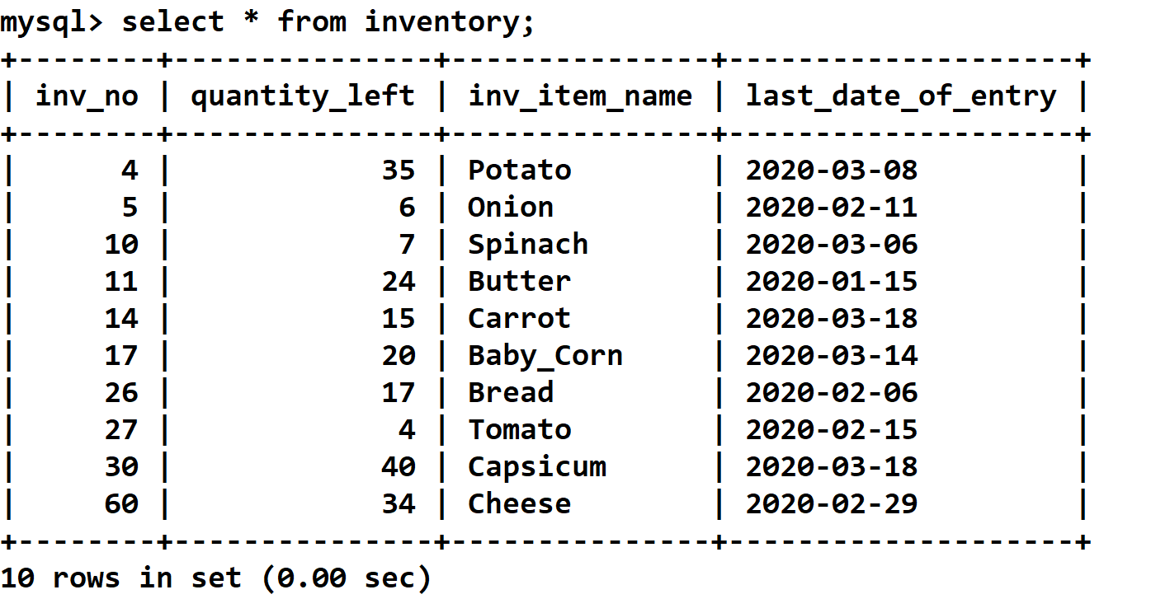

Slide 16
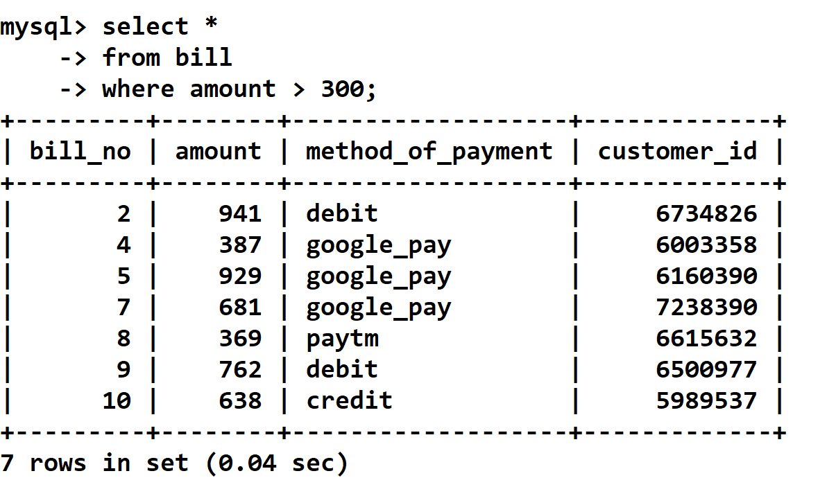
SQL Queries
1) Show the bill details of the customers who has their amount greater than Rs.300

Slide 17
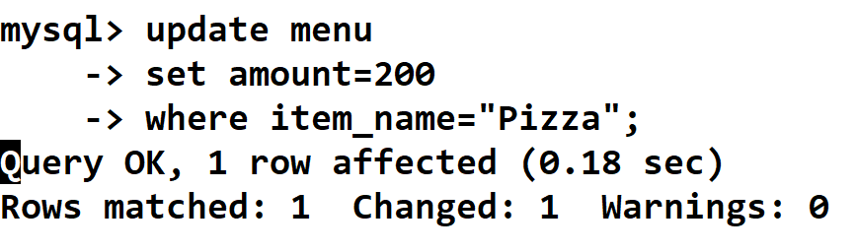
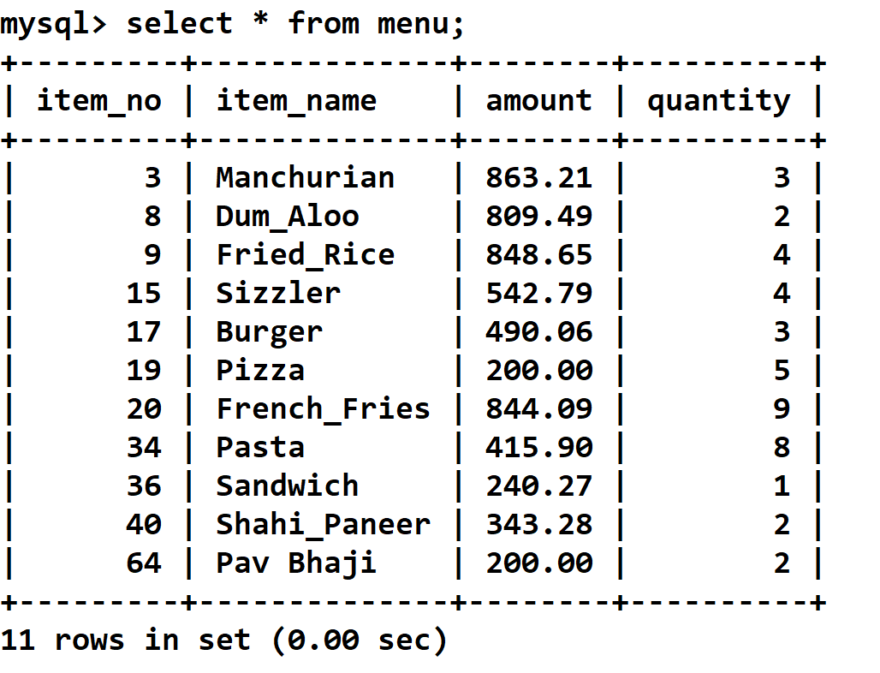
2) Change the price of Pizza to Rs 200.
AFTER
BEFORE
BEFORE

Slide 18
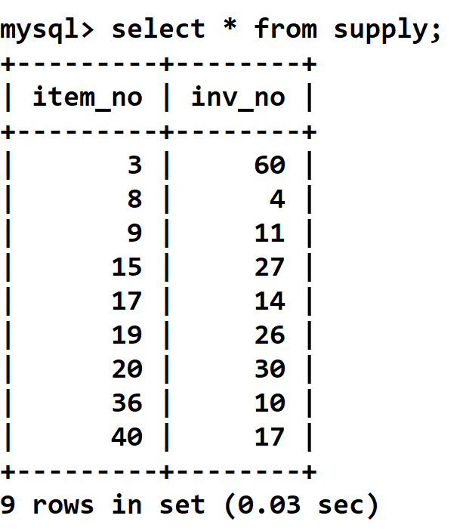
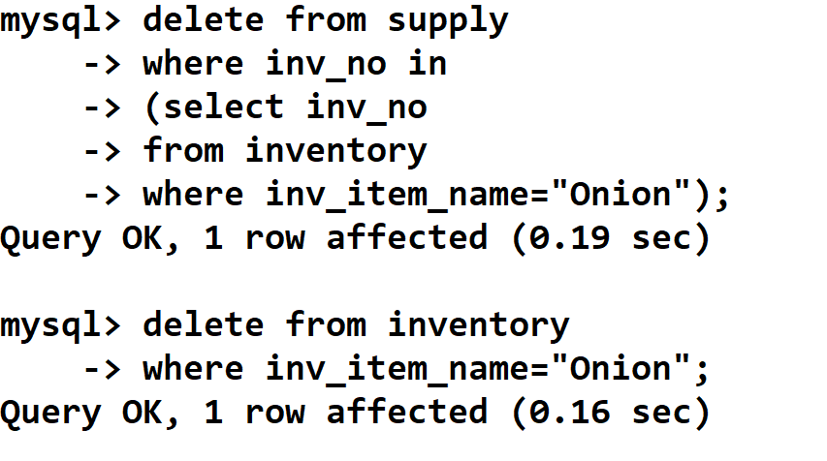
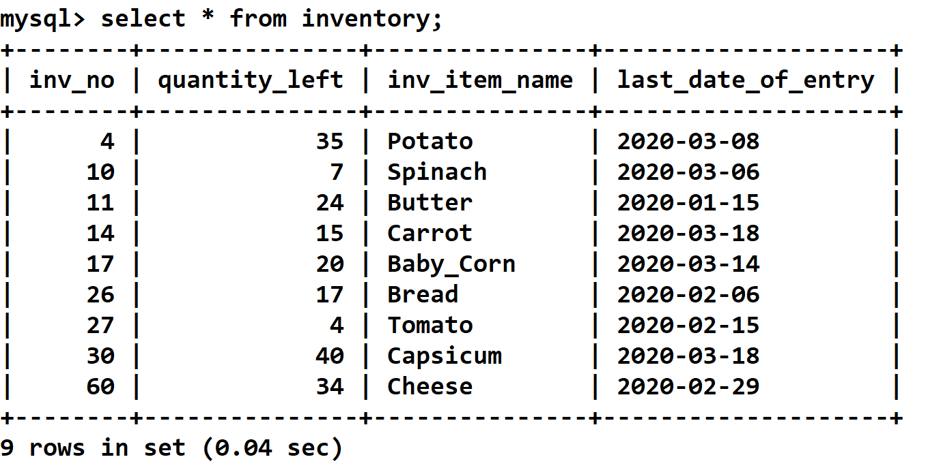
3) Delete the records of Onion from restaurant.

Slide 19
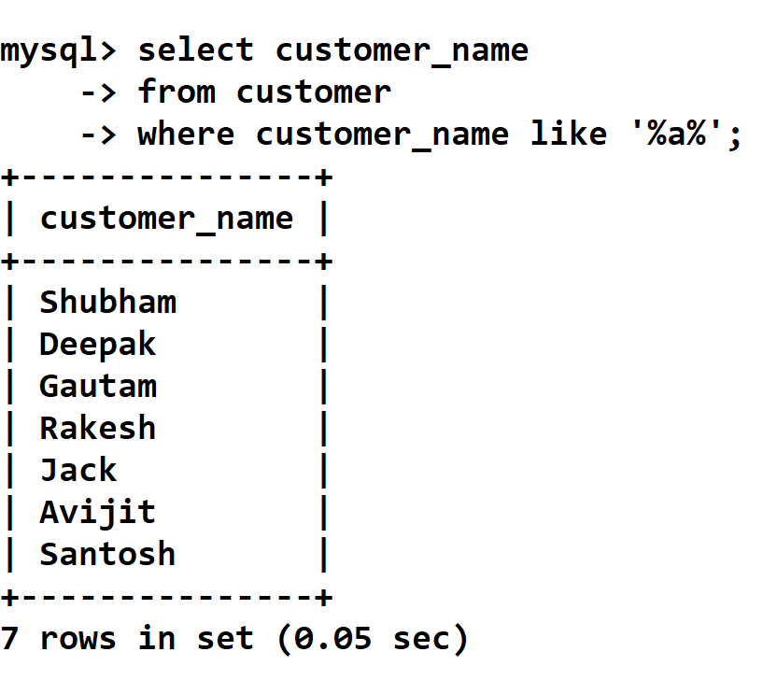
4) Show all the customers names who has “a” letter in their name.

Slide 20
attainments
DBMS provides insulation between programs and data abstraction.
It supports multi-user environment that allows users to access and manipulate data in parallel.
It can be used in various sectors such as banking, airlines, universities, telecommunication,etc.
It uses various powerful functions to store and retrieve data efficiently.

Slide 21
References
https://www.guru99.com/what-is-dbms.html
https://www.geeksforgeeks.org/introduction-of-dbms-database-management-system-set-1/
https://www.w3schools.com/sql/sql_intro.asp
https://www.tutorialspoint.com/dbms/index.html

