Slide 1
London Bike Share
Demand Forecasting & Surge Detection
Transport for London — Santander Cycles | August 2023 | 769,000 Trips
769K
800+
4
0.826
Trips Analysed
Stations
Station Clusters
Surge AUC

Slide 2
Project Overview
Business Problem: TfL operates 800+ Santander Cycles stations across London. Predicting demand surges enables proactive bike rebalancing — reducing empty stations and improving customer experience.
📅
📍
🔮
🚨
When is demand highest?
Which stations matter most?
Can we predict demand?
Can we detect surges?
Hour of day & day of week patterns
Clustering 800 stations into 4 types
3 ML models compared per cluster
XGBoost classifier, AUC = 0.826
Dataset: TfL Open Data — 769,000 trips, August 2023. Enriched with hourly weather (Open-Meteo API) and UK public holidays.

Slide 3
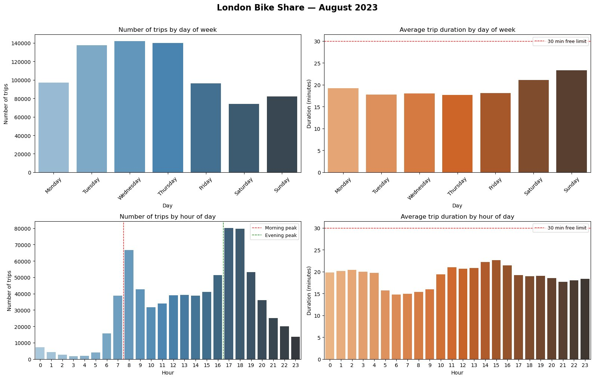
Demand Patterns
🕗 Double peak at 8am & 5–6pm confirms commuter-driven usage
📅 Tue–Thu generate ~40% more trips than weekends
⏱️ 97% of trips stay within the 30-min free usage window
🌞 Weekend trips are 4–5 mins longer — leisure cycling
August 2023 — peak tourist month. Commuter patterns partially suppressed by school holidays.

Slide 4
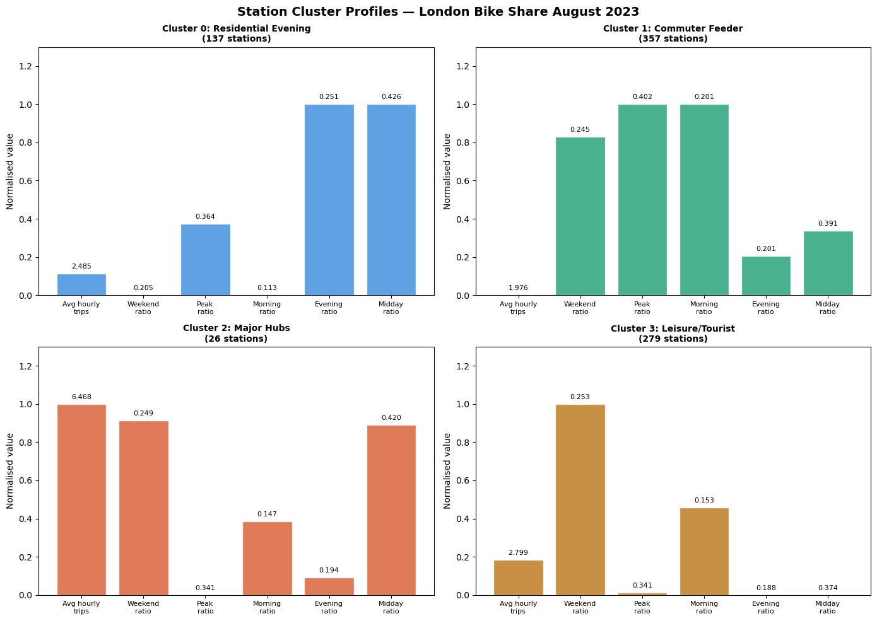
Station Clustering
KMeans (k=4, silhouette=0.29) identified 4 behavioural station types
Office District
137 stations
Mixed Use
357 stations
High Volume
26 stations
Neighbourhood
279 stations

Slide 5
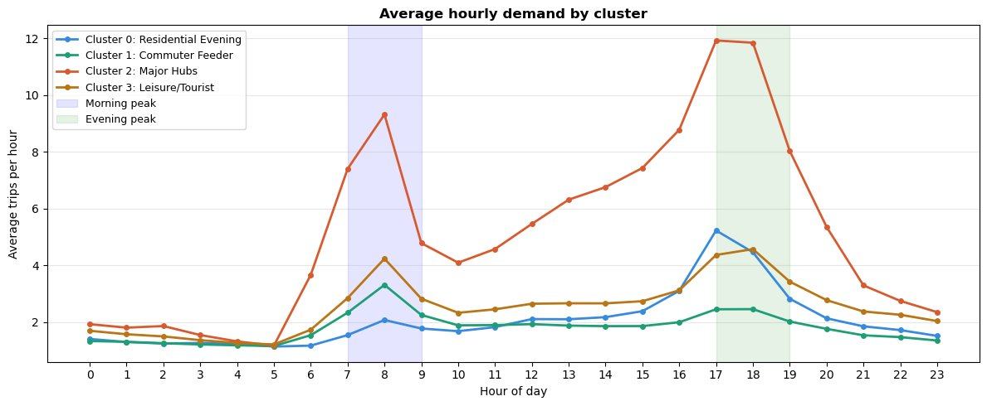
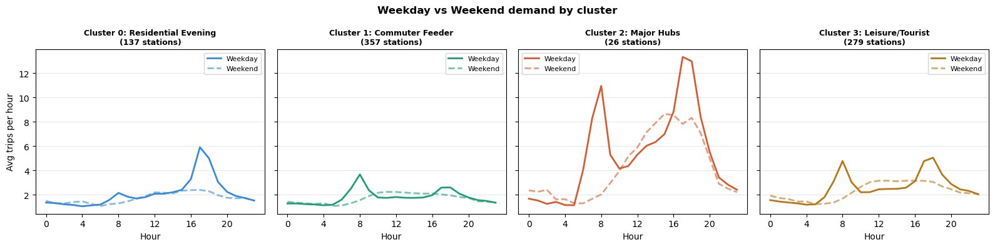
Cluster Behaviour — Weekday vs Weekend

Slide 6
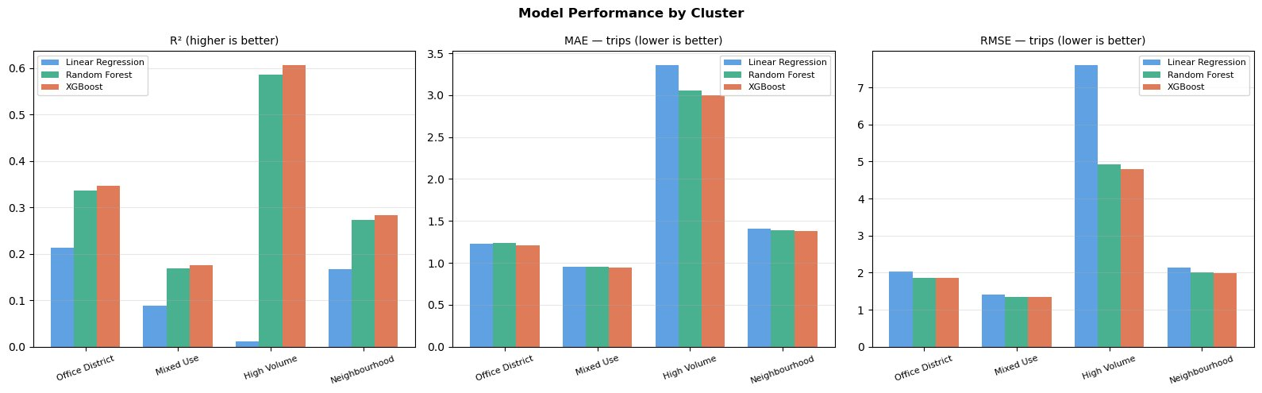
Demand Forecasting — Model Comparison
Cluster | Best R² | MAE
Office District | 0.346 | 1.21
Mixed Use | 0.176 | 0.95
High Volume | 0.606 | 3.00
Neighbourhood | 0.283 | 1.38
XGBoost wins across all clusters.
Linear regression fails on
High Volume (R²=0.012) —
non-linear surge dynamics
require tree-based models.
All models trained on 80% of data (time-based split, no shuffle) and evaluated on last 20%.

Slide 7
What Drives Demand — by Cluster Type
🏢
Office District
hour_sin/cos dominates — rigid commute schedules. Demand is predictable given the time.
Clock-driven
🏘️
Mixed Use
rolling_mean_24h most important — yesterday's pattern predicts today. Regular commuters create consistent routines.
Habit-driven
🚉
High Volume
demand_lag_1h dominates at 0.42 importance. Once busy, stays busy — surge dynamics.
Momentum-driven
🌳
Neighbourhood
Both momentum and time matter. Temperature notable — leisure cyclists are more weather-sensitive.
Complex & weather-sensitive
demand_lag_24h underperforms across all clusters — only 31 days of data limits same-hour-yesterday learning. A full year would make this the dominant feature.

Slide 8
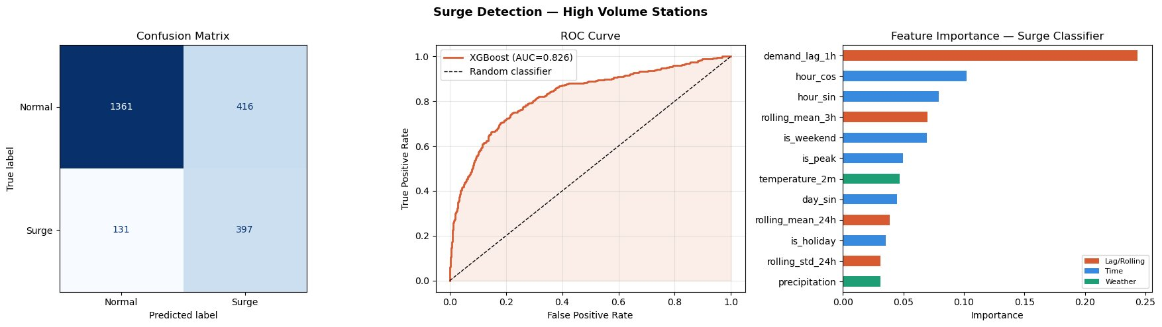
Surge Detection — High Volume Stations
Binary classifier: surge defined as >8 trips/hour (75th percentile). XGBoost with recall-optimised threshold.
0.826
90.2%
52
1,029
ROC-AUC
Surge Recall
Missed Surges
False Alarms

Slide 9
Threshold Optimisation — Business Reasoning
Asymmetric Cost Structure
Impact of Lowering Threshold 0.5 → 0.3
❌ Missed Surge (FN)
HIGH COST
Metric | Default (0.5) | Optimised (0.3)
Surges caught | 397 | 476 ✅
Missed surges | 131 | 52 ✅
False alarms | 416 | 1,029
Surge recall | 75.2% | 90.2% ✅
Surge precision | 48.8% | 31.6%
ROC-AUC | 0.826 | 0.826
Station runs empty
Cyclists can't rent
Customer dissatisfaction
Potential churn
Reputational damage to TfL
⚠️ False Alarm (FP)
LOW COST
Van dispatched unnecessarily
Wasted fuel + driver time
No customer impact
Operationally inefficient
Decision: threshold lowered to 0.3 — catching 78 more surges at the cost of 613 additional false alarms. Operationally justified.

Slide 10
Business Recommendations
01
Prioritise High Volume for automated rebalancing
26 stations (3.3% of network) drive disproportionate demand. Deploy surge model here first — AUC=0.826 justifies operational use.
02
Differentiate strategy by cluster type
Office District: pre-position before 5pm weekdays. High Volume: real-time monitoring. Neighbourhood: weekend morning pre-positioning.
03
Investigate the 52 missed surge events
Missed surges likely share common characteristics. Manual review could reveal simple rule-based overrides to improve recall further.
04
Build anomaly detection for service failures
Flag High Volume stations performing significantly below predicted demand — likely indicates strikes, closures or maintenance issues.
05
Expand dataset for production deployment
Minimum 12 months for seasonal patterns. Integrate NAB feed, event data (concerts, strikes) and retrain quarterly.

Slide 11
Limitations & Next Steps
⚠️ Known Limitations
🚀 Next Steps
One month only — August is atypical — peak tourism, school holidays. Seasonal patterns not captured.
Acquire 12+ months of TfL data for seasonal modelling
1
No NAB data — Cannot distinguish genuine low demand from supply-constrained demand.
Integrate NAB (bikes available) as a real-time feature
2
Sparse stations — Some stations have as few as 13 observations — insufficient for reliable learning.
Add event data via Eventbrite & TfL disruption API
3
No event data — Concerts, strikes drive unpredictable surges the model cannot capture.
Implement station-level model with train-period frequency encoding
4
Data leakage risk — Station frequency encoding excluded to prevent leakage from test period.
Deploy surge detection as live TfL operations dashboard with 1-hour lookahead
5

Slide 12
Thank You
London Bike Share Demand Analysis
TfL Santander Cycles — August 2023
769K
4
0.606
0.826
90.2%
Trips
Clusters
Best R²
Surge AUC
Recall
github.com/riddhi997/london-bike-share-analysis

