Slide 1
StOCKER
By Team Brightbox:
Niravra Kar
Ranadeep Guha
Riddhi Kakadiya
Komal Suthar

Slide 2
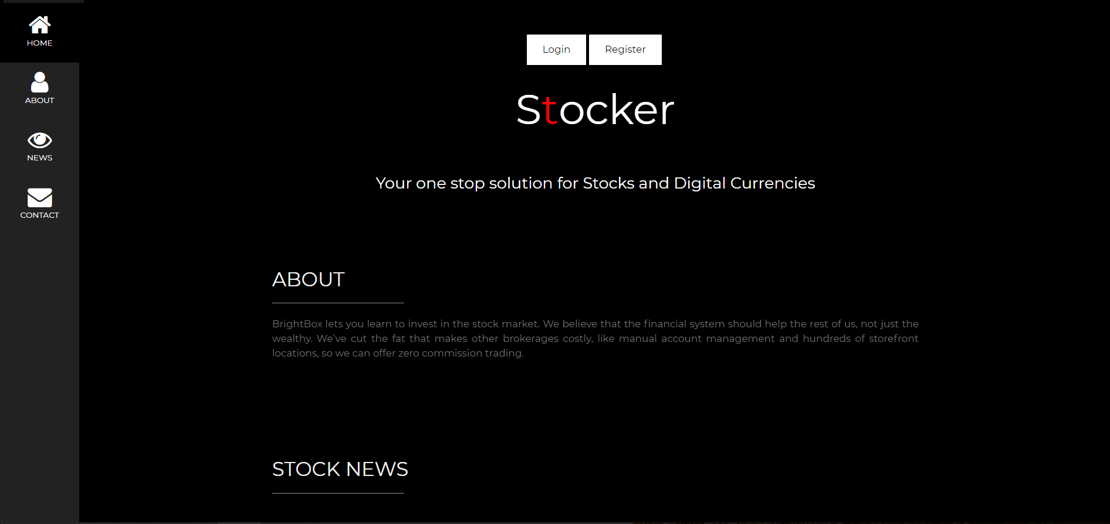
What is Stocker?
A solution for hassle-free investing in stocks and digital currencies

Slide 3
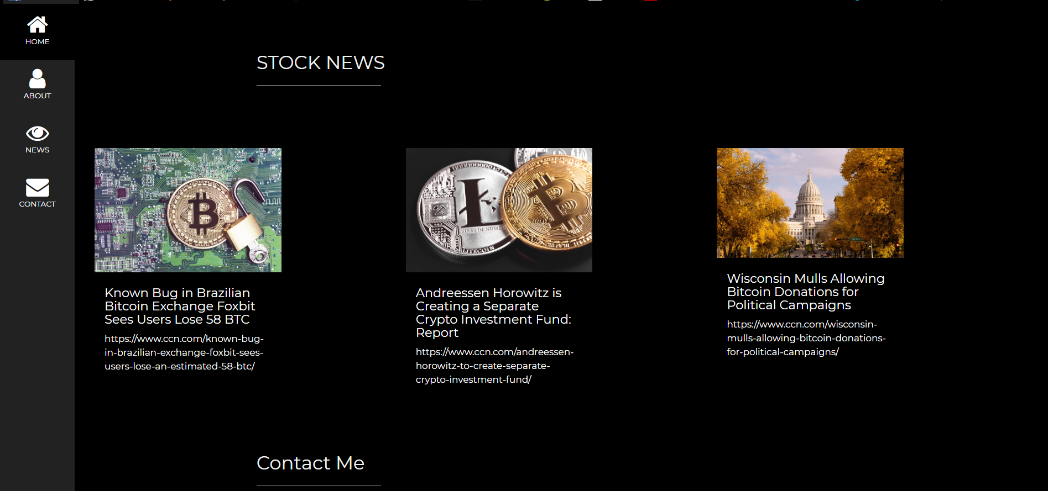
Features
Live Stock News

Slide 4
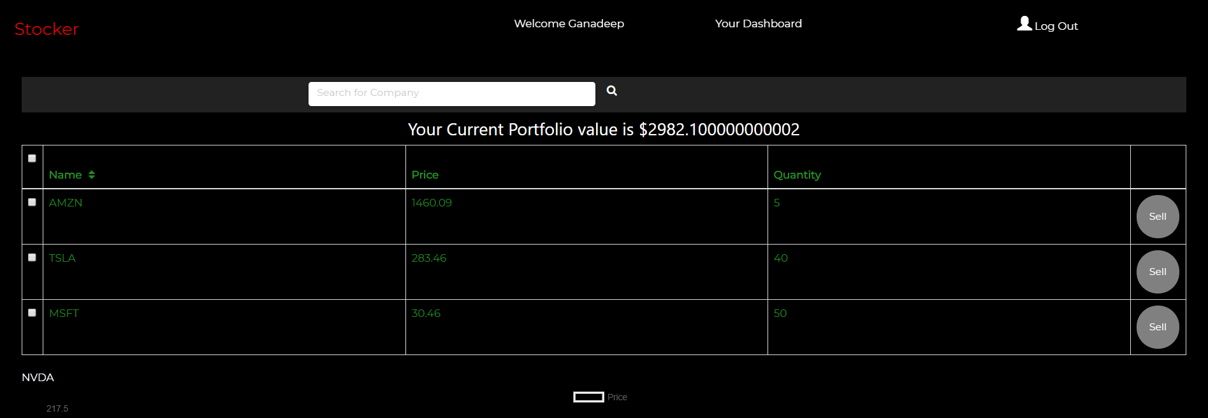
Features
User Dashboard for searching and selling stocks and cryptocurrencies with ease

Slide 5
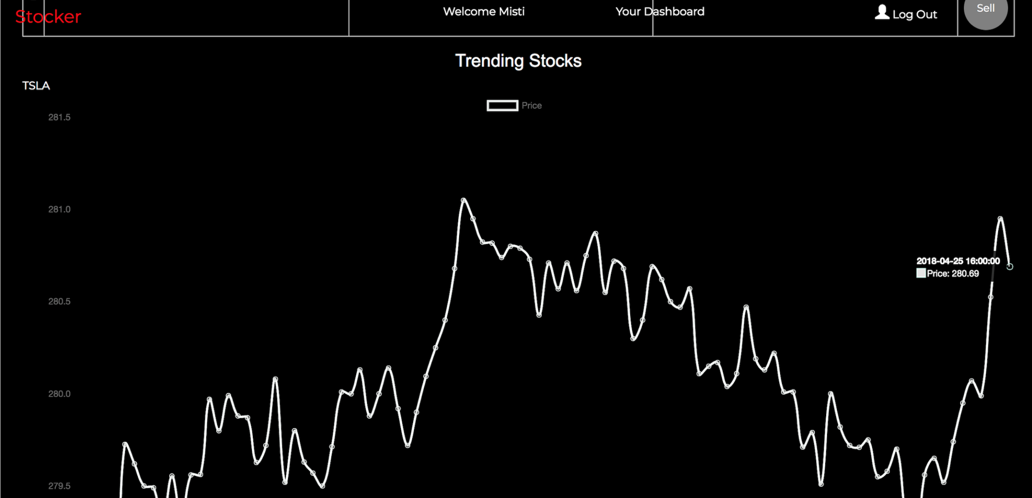
Features
Trending Stocks

Slide 6
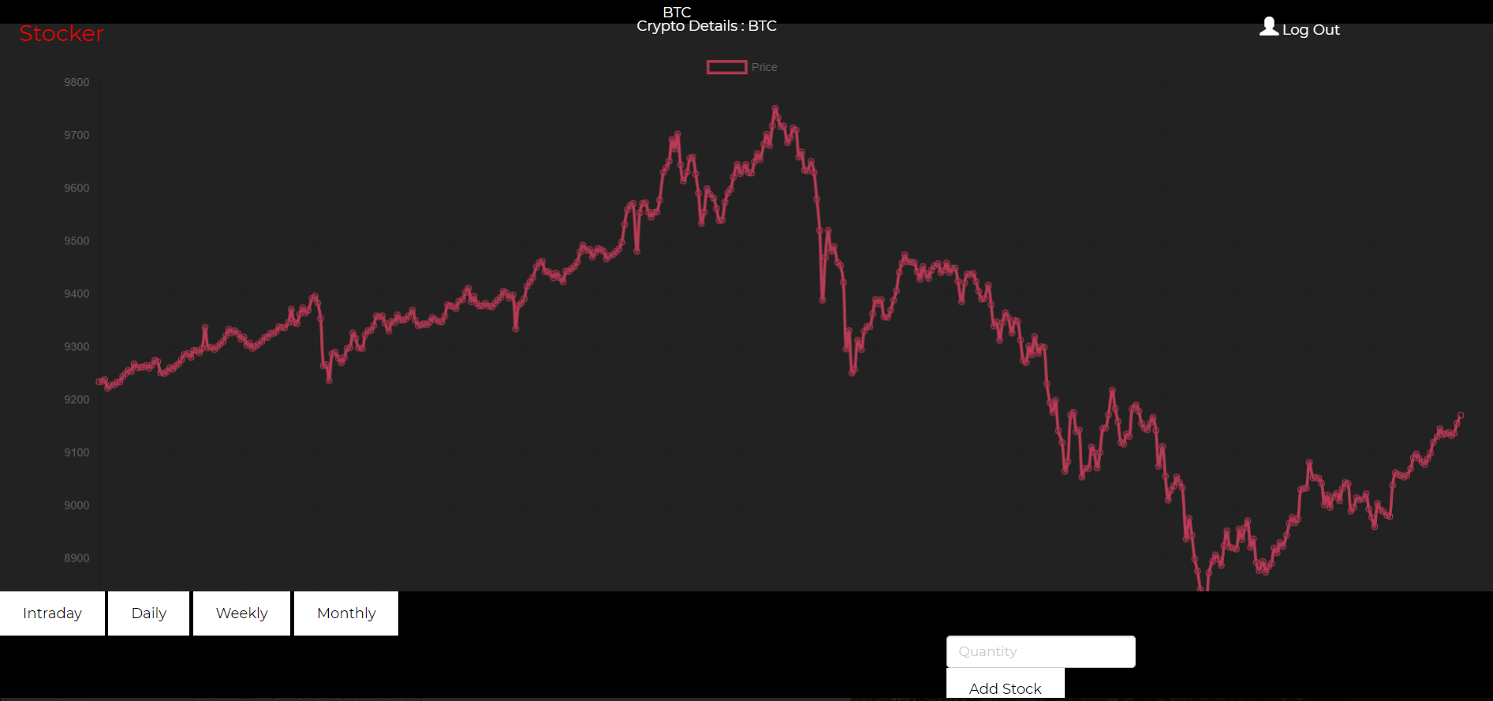
Features
Stock Detail Page with Live Graph
Check Daily, Monthly, Weekly or Intraday values

Slide 7
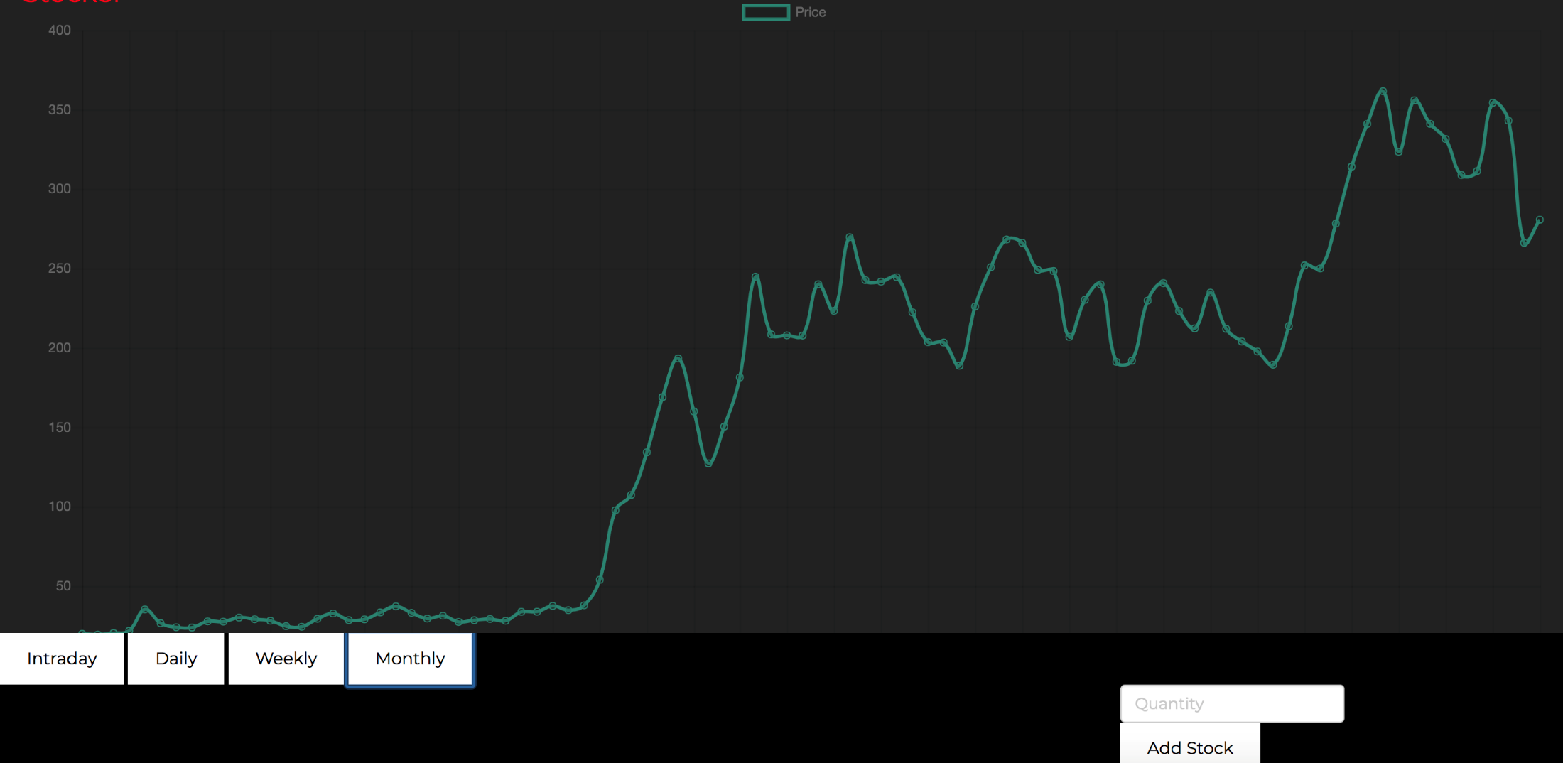
Features
Graphical Insights: Green signifies rise and Red signifies fall

Slide 8
What did we use?
Alphavantage API for retrieving raw stock data and parsing them
Set data structure to validate search strings on the front-end
Material CSS and Bootstrap for UI Design
Bcrypt/cryptr for encrypting data
Chart.js and Timer Observables for Real time Charts
News API for fetching latest news
Rest API design with services, backend server and app server with Publisher Subscriber Model

Slide 9
Thank you !

