Slide 1
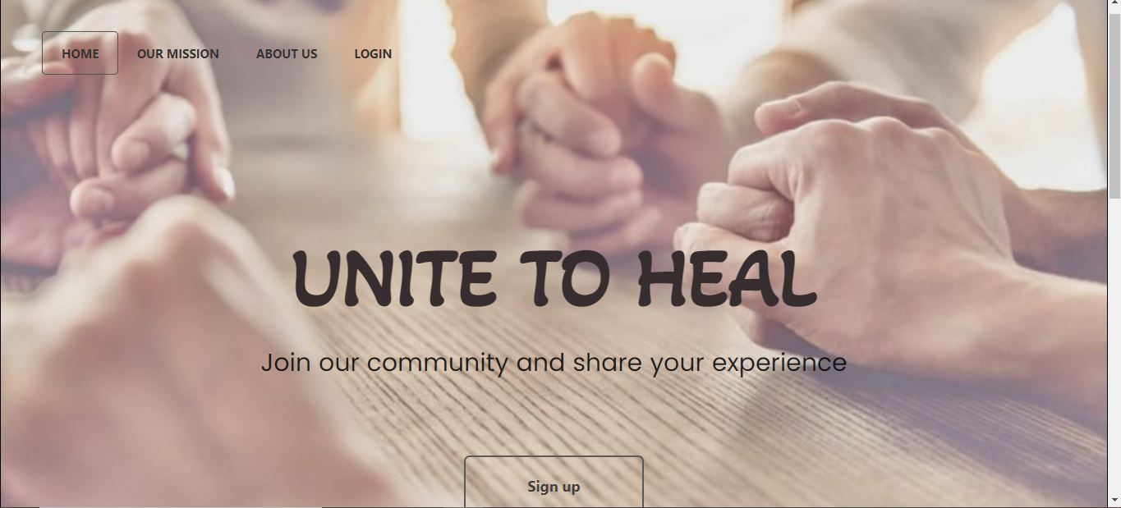
Team Name:
Byte For Bait

Slide 2


Slide 3
Our target audience
People across the globe who are suffering from different medical problems but are not being able to find someone to share their emotions and problems with.

Slide 4
Problem Statement
1) Our idea is to fill gap between medical treatment and the need for emotional support. A person's relationship with a doctor or other medical personnel may not provide adequate emotional support, and a person's family and friends may not understand the impact of a disease or treatment. So this website where people can share their respective experiences may function as a bridge between medical and emotional needs.

Slide 5
Problem Statement
2)We as a community would be able to discuss problems, find solutions, motivate each other and most importantly cheer each other up, resulting in a happy community.

Slide 6
Problem Statement
3. We also provide a blogging section where various professionals can add blogs and articles and help them stay updated of different happenings in field of medicine, and talk about different practices which they should follow for their own betterment.

Slide 7
Problem statement
4.Other benefits include that the acquaintances of the patient can also communicate with acquaintances of the patient with similar problem and can share their experiences and do’s and don’ts that would make the person/patient more comfortable and at ease.

Slide 8
Problem statement
5)Doctors too can share among themselves their experiences in the field of medicine, about what all mistakes they made in solving any case, so that other doctors don’t.Also in the times like covid where people can’t go out for a meet in support group, this website really solves majority of problems. This provides a more widespread reach as people aren’t just restricted to connect with the people only living near them.

Slide 9
Problem statement
Often people with certain limit themselves and do not reach their full potential due to societal pressure and fear of being alone. They shy away and feel that they would not be able to compete with everyone or other people might make fun of them. So the main objective behind our project is to let these people realise that they are not alone and help them find their own community. This would help them gain confidence and love themselves the way they are

Slide 10
Tech stacks used:
1.HTML
2.CSS

Slide 11
Future scope
Currently, we have mainly worked on the front-end of the website. But in the future, we shall try to make our website more functional. We will work on Back-end to enable the complete functioning of the website.

